Slide 1

Ace Consulting Services
We Help You Lead the Deck
FoxMeyer Corp. - ERP Implementation Business Proposal
Sucheth Renuka Prasad

Slide 2
Who are We ?
Founded in 1989, we are one of the world’s leading organizations specializing in management consulting, technology and outsourcing services
Ace Consulting Services
A US$ 30 billion Fortune Global 500 company, we operate in more than 200 cities in 56 countries
With a strong work force of 319,000, our current clients include 79 Fortune Global 100 and around three-quarters of the Fortune Global 500

Slide 3
How much ACS knows about you
5th largest wholesaler in US healthcare services
Annual sales : USD 5.5 billion
Customers : Pharmaceutical retailers , independent pharmacies & dispensaries
Daily shipments : approx. 420,000
25 nation wide distribution centers
17 self-warehousing facilities
IT infrastructure in process : Legacy

Slide 4
Project Timeline
SRS Review and Finalize
completion of User Acceptance Testing /Project Hand-Off
Feb 16
completion of Development and implemtation
May 27
Project start date
Staffing requirements completion
BPR completion
post implemantation audit
Feb 1
Feb 23
Mar 17
Apr 29
Jun 12
2015
Day 1
12
23
34
45
56
67
78
89
100
111
122
2015
15 days
Feb 2
Today
Analyze and review SRS
Feb 16
36 days
Feb 10
BPR
Mar 17
22 days
Feb 2
staff allocation
Feb 23
79 days
Feb 10
Design and Implement
Apr 29
94 days
Feb 23
End user training
May 27
29 days
Apr 29
User Acceptance Testing
May 27
23 days
May 21
Roll-out and support
Jun 12

Slide 5
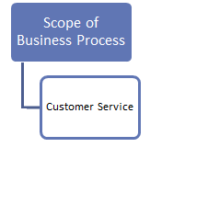
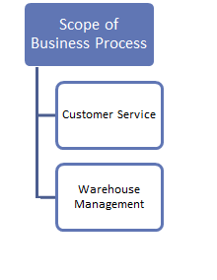
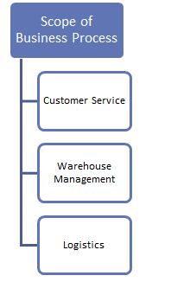
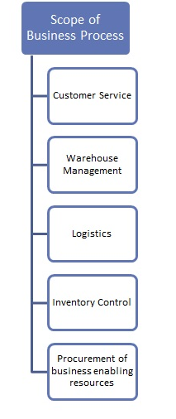
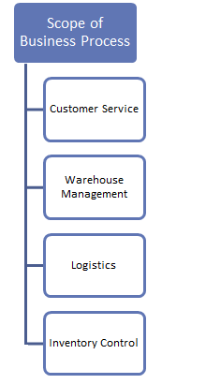
Proposed Solution Approach Scope
FoxMeyer Business Process
Customer fills out electronic order
Orders sent to the appropriate distribution center
Order filled manually and packed
Package shipment to customer via national distributor centers
Tracking Inventory

Slide 6
ERP Evaluation – Why SAP ?
Largest ERP vendor market share. Hence much larger pool of SAP developers & consultants
405,520,080 fully business processed order line item transactions per day
5000 + concurrently active users
SAP ERP HR/HCM can process payroll calculation for 500,000 employees and retirees in 4 hours
Multi-lingual user interface
Platform independent
Superior integration among all its modules
Supports ‘hooking up’ to other systems for specific solutions
Allows customization in reserved spots (user exits, customer functions, etc.)
FoxMeyer corp. with 4097 employees, is appropriate for SAP implementation
SAP has the highest executive and employee satisfaction rating among all ERP vendors

Slide 7
Microsoft’s SAP ERP implementation
Examples of ERP Implementation
SAP improved integration of Microsoft Business, Suppliers and Customer unit
Savings of $18 million per year
Reduction of planning cycle (95%)
Reduction of delivery times (10-40 %)
Lower stock levels (20-25 %)
Reduction of late deliveries (25-30%)
Increase in Productivity (2-5%)
SAP ERP at California Department of Corrections and Rehabilitation
Cuts purchasing process lifecycle by half
Savings of $1 million by retiring a single legacy system
Reduction in time required to access data (>99 %)
Reduction in time to create backup reports of procurement activities
Saved $1 million in system access and maintenance costs

Slide 8

Proposed Solution Approach – Functional Scoping
Scope of Business Process
Customer Service
Warehouse Management
Inventory Control
Logistics
Procurement of business enabling resources
Scope of Business Process
Customer Service
Warehouse Management
Inventory Control
Logistics
Procurement of business enabling resources
Scope of Business Process
Customer Service
Warehouse Management
Inventory Control
Logistics
Procurement of business enabling resources
Scope of Business Process
Customer Service
Warehouse Management
Inventory Control
Logistics
Procurement of business enabling resources
Scope of Business Process
Customer Service
Warehouse Management
Inventory Control
Logistics
Procurement of business enabling resources
Scope of Business Process
Customer Service
Warehouse Management
Inventory Control
Logistics
Procurement of business enabling resources
SAP Sales & Distribution (SD) –
Receiving and managing orders
Billing to customers for products sold
Schedule, handling transportation and delivery
SAP Customer Service (CS) –
Information on customers,
Employees (responsible for customer relationships, service engineers, etc.) ,
Materials (e.g. equipment, spare parts, services)
Warranty data (conditions, dates, coverage).
Information Systems Infrastructure –
Data center servers and disk storage systems
Network gears ( routers, network switches and security firewalls
Tape backup units
SAP Human Resources –
Enable the organization to process employee related data according to business requirements in an effective structure
SAP Material Management (MM) –
Integrated with Warehouse Management module
Manage stock in the warehouse
Suggest placement of stock in specific storage areas in the warehouse
Goods purchasing, receiving and material storage
Consumption-based planning and inventory
SAP Logistics Execution (LE) –
Helps in supporting overall logistics processes including but not limited to warehousing, shipping, and transportation.
SAP Material Management (MM) –
Supports procurement and inventory functions
Goods purchasing, receiving and material storage
Consumption-based planning and inventory
Reduction in dependency on safety stock

Slide 9
Projected Outcome Matrix
Streamlined organization resulting higher executive and employee satisfaction
Worker retention resulting increased job satisfaction and reinforced commitment
USD 40m annual savings
Physical warehouse automation, increased efficiency and quality assurance
Capability to compete market competition and tackle increased bargain power of retailers

Slide 10
Project Schedule & Resource Estimation
Proposed Project Resources | Estimation
Client/server systems from Hewlett Packard | USD 640,300
SAP software
No. of employees | 400
No. of users | 100
Estimated Timelines | Duration (weeks)
Business Process Re-engineering | 3
Code design, development and unit testing | 12
UAT | 4

Slide 11
Phased Implementation
Pre-implementation Phase
Business Process Re-engineering
Participation of end user in analysis and design process
Requirements sign-off
Implementation Phase
Adequate time for UAT
Knowledge transfer sessions
Post Implementation Phase
Post Implementation Audit
Support for error handling

Slide 12
Business Process Re-engineering
Understanding Existing Business Process
Creating Vision for BPR
Redesign Business Process
Evaluate & Implement Redesigned Process
Evaluating Results and making Improvements
Implementing Final proposed Solution
Modification of Business Process Management according to the implementation needs of ERP
Avoid the “Silo Effect” – e.g Hershey Food Inc.**
No complete management dependency on the project
**source: Based on article David F. Carr, “Hershey’s Sweet Victory”, December 16,2002, issue is of Baseline Magazine

Slide 13
Human Resource Management
20 SAP consultants from ACS
Train existing warehouse workers
400 Employees
100 Users

Slide 14
Service Terms & Conditions
The amount is exclusive of taxes. Taxes as and when applicable will be charged extra. Currently the service tax rate is 10.3%.
Payment terms:
60% of the contract amount to be paid in advance along with the contract.
Balance 40% to be paid on successful delivery of Product and services as defined in the contract.
Any change in scope due to additional request will call for re-negotiations on the timelines and hence the project fees.
The acceptance of any deliverables has to be within one week of submission. After the one week period the deliverables are deemed accepted.
This proposal is valid for 30 days from the date of submission.
The payment shall be due and payable within fifteen (15) days of the invoice date

