Slide 1

Cloud Solution Architect - Assignment
Landing zone & Migration Plan

Slide 2
NordBank AB Internal App Cloud Landing Zone

Slide 3
Assumptions
Below are the few assumptions that were made while designing the landing zone and architecture:
As this is an internal application it was assumed that application will not be exposed to the internet for public access (Cloud Landscape for App Deployment - Figure 1). Access is through VPN from the Datacenter only. An alternate landing zone or architecture has been also provided as part of Cloud Landscape for App Deployment - Figure 1 which makes provision for public access from the open internet, if required.
It is assumed that the application in discussion is a Web App hosted on Linux and will be accessed from a browser.
Datacenter has stable and high speed internet connection with devices supporting failover for stable S2S connectivity.
IAM and SNS services were not explicitly included in Figure 1 and Figure 2, it should be assumed that they will be used for Access Control and sending Notification (SNS) for various events by default.
All AWS native services were used. Although there are cheaper alternative solutions available in marketplace especially for security and observability, they were not considered for this assignment.
Automated build and deployment of the application along with Infrastructure as Code was not taken into consideration for this assignment.
DNS is managed from the Datacenter or a separate DNS manager and existing SSL certificate will be used. Route53 not taken into consideration.

Slide 4
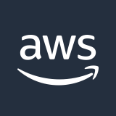
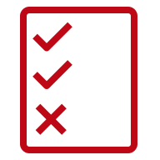


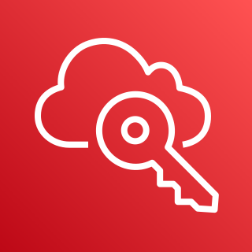
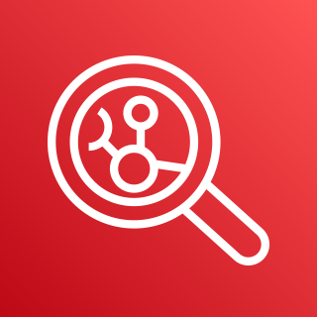

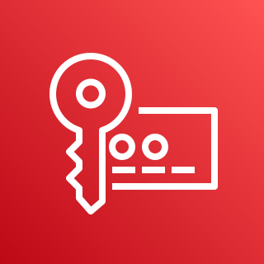
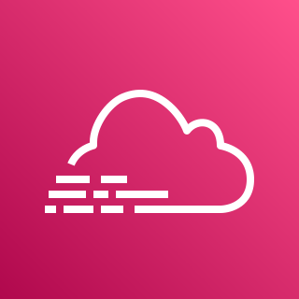

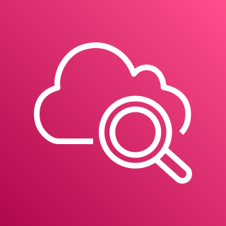

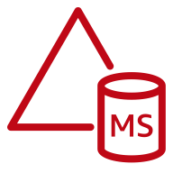
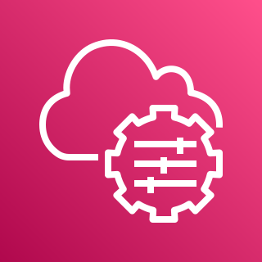



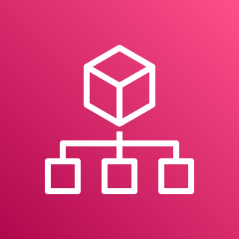


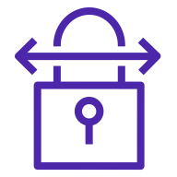

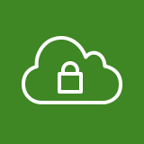

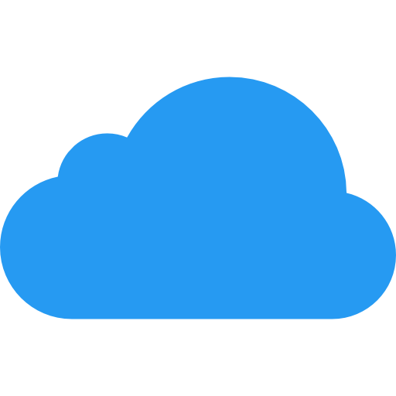
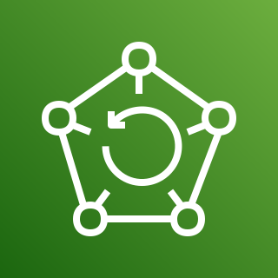

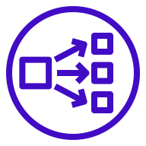

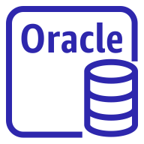
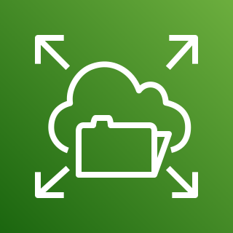

Security and Infra Services Account
Corporate
data center
Policies
Role
DBA/ Dev
AWS
SSO
Amazon Inspector
Amazon GuardDuty
KMS
AWS CloudTrail
AWS
Config Aggregator
CloudWatch
Insights
On Prem AD
Org Management Account
Customer gateway
SSM
Role
Policies
AWS
Config
Log Archive Account
AD Connector
Policies
SNS
Role
AWS Organizations
Management account
AWS
SSO
AWS CloudTrail
From CloudTrail
Central Logs
Flow logs
AWS
SSO
Amazon GuardDuty
AWS CloudTrail
Access Logs
Application Logs
S2S VPN connection
AWS Managed Microsoft AD
SSM
App Services Account
Region - Stockholm
AWS Organization Structure
VPC
Policies
Role
AWS CloudTrail
AWS Config
CloudWatch
KMS/ Endpoint
GuardDuty
AWS Transit Gateway
AWS
SSO
Index
Public Internet
AWS Backup
Cross Account
Roles
WAF
ALB
EC2
Oracle RDS
EFS
Flow logs

Slide 5




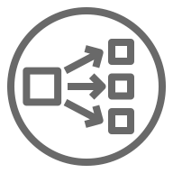
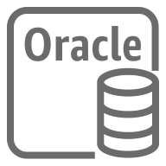

App Service Account
Corporate
data center
Region - Stockholm
Availability Zone
Availability Zone
VPC
Public subnet-1
Public subnet-2
DBA/ Dev
AWS WAF
On Prem AD
NAT gateway
NAT gateway
Customer gateway
AWS CloudTrail
AWS Config
Private subnet -1
Private subnet -2
Multi AZ Deployment
Amazon GuardDuty
ALB Node [Multi AZ]
ALB Node [Multi AZ]
Amazon Inspector
agent
EC2 Security Group
S2S VPN connection
AWS Transit Gateway
M6i.xlarge instance
M6i.xlarge instance
M6i.xlarge instance
M6i.xlarge instance
KMS/ endpoint
DB Security Group
App Services Account
Figure 1
AWS Backup
SSM Agent
Multi AZ Replication
Mount Target
Oracle RDS
instance
Oracle RDS
instance
Mount Target
Flow logs
Amazon EFS
Region – Stockholm [eu-north-1]
AZ - eu-north-1a, eu-north-1b
Amazon CloudWatch

Slide 6

App Service Account
Public Internet
Region - Stockholm
Availability Zone
Availability Zone
Corporate
data center
VPC
Public subnet-1
Public subnet-2
AWS WAF
DBA/ Dev
Internet gateway
NAT gateway
Internet gateway
NAT gateway
On Prem AD
AWS CloudTrail
AWS Config
Customer gateway
Multi AZ Deployment
Amazon GuardDuty
ALB Node [Multi AZ]
ALB Node [Multi AZ]
Amazon Inspector
agent
Private subnet -1
Private subnet -2
EC2 Security Group
S2S VPN connection
AWS Transit Gateway
M6i.xlarge instance
M6i.xlarge instance
M6i.xlarge instance
M6i.xlarge instance
KMS/Endpoint
App Services Account
Figure 2
AWS Backup
DB Security Group
SSM Agent
Multi AZ Replication
Flow logs
Mount Target
Oracle RDS
instance
Oracle RDS
instance
Mount Target
Amazon EFS
Region – Stockholm [eu-north-1]
AZ - eu-north-1a, eu-north-1b
Amazon CloudWatch

Slide 7
Account Details
Organization Management Account
This is the root account which will be used to manage other member accounts centrally along with centralized governance and compliance management. Service Control Policies will be implemented from this account.
Security & Infra Services Account
This account will be used to deploy security services and toolchain for the purpose of security management, vulnerability reporting and mitigation and compliance enforcement.
Log Archive Account
Application logs and AWS services related audit logs will be shipped to this account from App Services account and will be stored here in a S3 bucket. Log analytics tools can be deployed in this account or services in Security Services Account and consume these logs for alerting and monitoring.
App Services Account
This account will be used to deploy the NordBank AB application. This account will also host security services relevant to local infra security.
Organization Management Account
Security and Infra Services Account
Log Archive Account
App Services Account

Slide 8
Infrastructure Details
AWS SSO – This service is used to allow admins and developers to connect to multiple AWS Org accounts without having to manage multiple credentials.
AWS Organization – It will allow us to enable consolidated billing and also allow us to govern multiple accounts from a single management account. AWS Organizations is integrated with other AWS services so you can define central configurations, security mechanisms, audit requirements, and resource sharing across accounts in NordBank AB with additional discount through consolidated billing. Also application of service control policies (SCPs) in the Org Management account ensures that member AWS accounts stay within your account governance strategy and access control guidelines. SCPs do not grant any permissions. Instead, SCPs deployed in the Org Management account specify the maximum permissions for this AWS organization allowing seamless governance and compliance.
Region – Stockholm or eu-north-1 will be used for this deployment as to stay in compliance with GDPR and for better network performance when accessed from within Sweden.
Availability Zones – Multi AZ deployment is chosen for redundancy and resiliency. Availability zones chosen are eu-north-1a and eu-north-1b within Stockholm region for this purpose.
Network – S2S VPN connectivity is preferred here because of cost implications. Direct connect is preferred but as this is only one single application is being migrated we chose VPN. VPN tunneling will encrypt traffic and will also provide semi stable connectivity but will depend on the internet connectivity speed. It will not provide the security and stability of a dedicated connection like Direct Connect. We suggest to upgrade to Direct Connect once more applications are being migrated to AWS cloud.

Slide 9
Infrastructure Details
NAT Gateway – This is used to ensure App servers can connect to the internet for Operating System Service Pack upgrades and patching for vulnerability remediation. This will be only used for outbound access to internet.
Internet Gateway – This is only used in Figure 2 for inbound access to application from the open internet in case application needs to be accessible from other all locations.
Compute Instances – Instance type M6i.xlarge is being used as it meets the requirement of 4 CPU and 16 Gb of RAM. We chose to use RDS, as it is a managed and DB instance type db.m5.4xlarge is chosen as it meets the requirement of 64 GB memory.
Elastic File System – To meet the requirement of 4 TB of shared storage, we will leverage EFS as that gives us scalability and can store data up to 47.9 TiB approx. and is only charged for the amount of data stored.
Backup and Restore – AWS Backup provides an RTO of 24 hours or less, which meets the required RTO of 1 day.
Monitoring and Observability – CloudWatch will be used for monitoring VM resources, custom metrics can be used for monitoring memory usage if required. All application, server and access logs will be forwarded to CloudWatch using SSM Agent for centralized alerting and visibility. CloudWatch Insights allows for log analysis and single pane visibility.
Encryption – Data at rest will be encrypted using KMS. All volumes will be encrypted. Data in transit will be encrypted with SSL certificate.
Configuration Management – Quick Setup is an automation feature of AWS Systems Manager. It enables the Org Management account to easily define configurations for Systems Manager to engage on your behalf across accounts in your AWS organization. You can enable Quick Setup across your entire AWS organization or choose specific OUs. Among other things, Quick Setup can schedule AWS Systems Manager Agent (SSM Agent) to run biweekly updates on your EC2 instances and can set up a daily scan of those instances to identify missing patches.

Slide 10
Infrastructure Details
Security – Compliance and policies will be enforced with AWS Config rules, which will trigger scan whenever there is any changes made to the infrastructure and will auto remediate and compliance drift.
AWS WAF will be used specifically for mitigating OWASP Top 10 for web applications and to prevent DOS/ DDOS attacks.
GuardDuty and IAM will be used for Cloud Account Security, to prevent malicious activity, for observability and notification against workload.
VPC Flow Logs and Cloudtrail will be used for auditing and will be integrated with GuardDuty for continuous monitoring and analysis.
Amazon inspector is configured in this project for vulnerability scanning and reporting. This will assist system admins with remediation of internal vulnerabilities related to OS and any misconfiguration at the server level. Agents will be installed on all VMs.
Apart from all the above mentioned services, all traffic (except the allowed traffic) to and from the instances, RDS and EFS will be restricted with Security Groups. To add another layer of security, administrative access like RDP or SSH will be allowed only from the IP associated with the Customer Gateway, i.e. from the datacenter (relevant for Figure 2 and for Figure 1 it can be allowed from specific IP ranges). Administrative access to RDS DB will be also allowed only from the internal network that is from the Datacenter only.
S3 Bucket – S2 bucket will be used in Log Archive account to gather all the logs and then process those through Log Analytics applications or Amazon Detective.
SNS/ EventBridge – Will be used for sending realtime notification or alert for any incident related to security and compliance. Also, SNS will be used for alerting against Cloudwatch related metrics when there is a breach in threshold. This can be integrated with Service Now.

Slide 11
Application Migration

Slide 12
Using Server Migration Service
Downtime
Get downtime and schedule migration or start immediately as per outage schedule
Upload Image
Take snapshot
Convert to EBS
Create EBS snapshot from uploaded VMDK
Export VM as OVF
Copy VMDK file to S3 bucket
Create AMI
Create AMI and launch EC2

Slide 13
Using AWS App Migration Service
Analyze Datacenter environment and identify VMs/ physical servers
Install replication agent on source servers
Continuous Replication to AWS without any downtime
Perform sanity test on migrated app running on low cost cutover instances. At this stage RDS connectivity should be also tested.
Decommission source servers and finalize cutover by swapping DNS and configuring services like ELBs, EFS along with SSM agent installations.

Slide 14
Oracle DB Migration to AWS
1. Create Oracle DB instance in RDS
2. Create replication instance in AWS Data Migration Service
3. Register endpoint for replication task in AWS DMS
4. Create replication task in DMS
5. Once migration is complete, clean up all DMS resources post data validation.

