Slide 1
Analysis of the Distribution of Financial Institutes in Brooklyn boroughs in NY
Background
Bronx, Brooklyn, Manhattan, Queens and Staten Island are the five boroughs in NY city
Brooklyn which is the most populated borough with the third highest Gross Domestic Product (GDP)
Objective
To analyze the distribution of banks in Brooklyn borough predict the best neighborhood to open a new branch for CHASE bank services

Slide 2
Data Requirement and manipulation
Geogcraphical data can be found at https://geo.nyu.edu/catalog/nyu_2451_34572
Preliminary data wrangling showed that there were 70 neighborhoods in the Brooklyn borough
Out of these 70 only 57 had banks accessible and there are 87 different banking systems (294 banks in total) are distributed in these 57 neighborhoods.
Foursquare API was used to request information on banks in each individual neighborhood.
radius is defined for each neighborhood as 500 m² for each neighborhood and the number of banks were summed up for each.

Slide 3
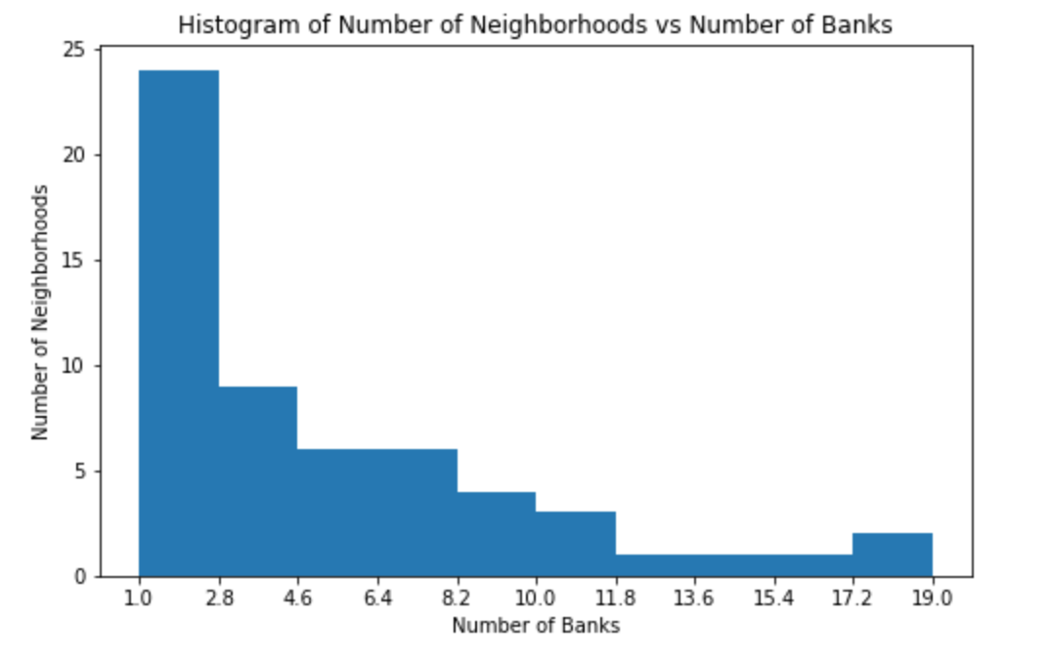
Results
Shows the distribution of the number of banks accessible vs. the number of neighborhoods.
There are less than 5 neighborhoods with more than 15 banks and only seven with more than 10.

Slide 4
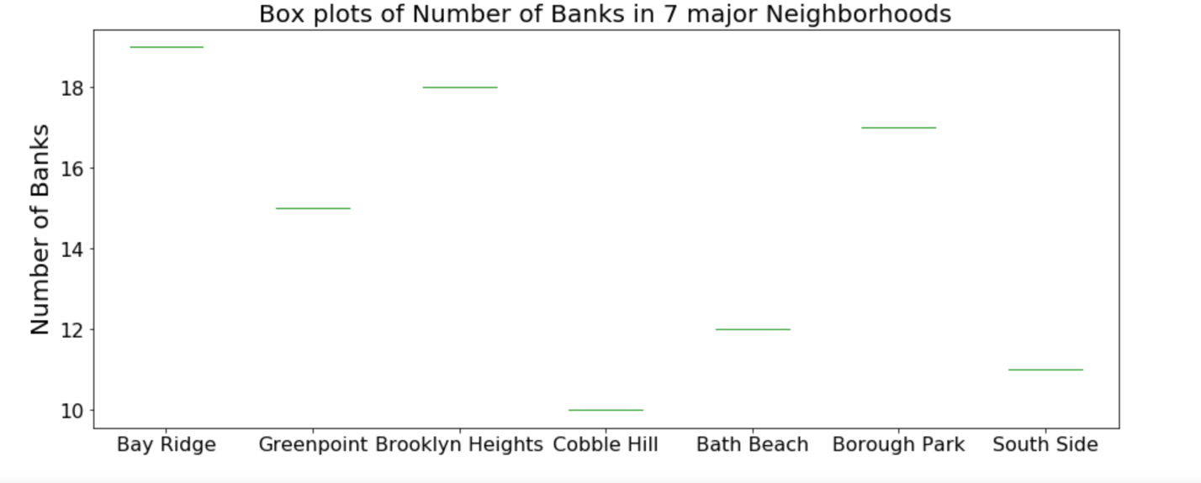
Bay Ridge, Greenpoint, Brooklyn Heights, Cobble Hill, Bath Beach, Borough Park and South Side are the seven neighborhoods more than 10 accessible banks
Out of those seven the Bay Ridge has the highest number (19)
The two successive neighborhoods are Brooklyn Heights and Borough Park

Slide 5
Conclusions
Bay Ridge, Greenpoint, Brooklyn Heights, Cobble Hill, Bath Beach, Borough Park and South Side are the seven neighborhoods more than 10 accessible banks
Analyzied the CHASE banks in the three neighborhoods with highest number of banks
Bay Ridge showed the least with more competitive banking systems
The best neighborhood to start the new brach would be Bay Ridge

