Slide 1


CAR PRICE PREDICTOR
MODEL USING
MACHINE LEARNING
Name – Suchika Raturi
Uni. R.No. – 2021478
Section – E
Roll No. – 70

Slide 2

CONTENT
01
INTRODUCTION
02
CODE IMPLEMENTATION
03
RESULT
04
FUTURE WORK

Slide 3
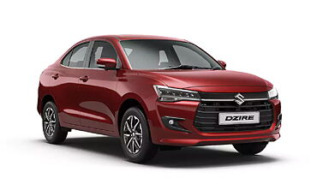

INTRODUCTION
The goal of this project is to create a simple and accurate tool to predict car prices using Linear Regression. It uses important car details like age, mileage, and fuel type to estimate the price. This tool is designed to help people like car
buyers, sellers, and businesses easily find
the right price for a car.

Slide 4
CODE IMPLEMENTATION
·The following libraries are used in the implementation of the
car price prediction model:-
Pandas (pandas)- For data loading and pre- processing.
Scikit-learn (sklearn)- For machine learning model training, testing and evaluation.
NumPy (numpy)- For handling numerical data.
Matplotlib- For line plots, scatter plots, etc.
Seaborn – For creating graphs.

Slide 5
CODE IMPLEMENTATION
Data Preprocessing: The dataset is cleaned and prepared (e.g., calculating car age and encoding categorical features).
Feature Selection: Key features like price, mileage, and fuel type are selected for training .
Train-Test Split: Data is split into training and testing sets to evaluate the model.
Model Training: Linear Regression is trained on the data
Evaluation: Metrics like R² Score and RMSE measure performance.
Prediction: The trained model predicts the price of a new car based on its features.

Slide 6
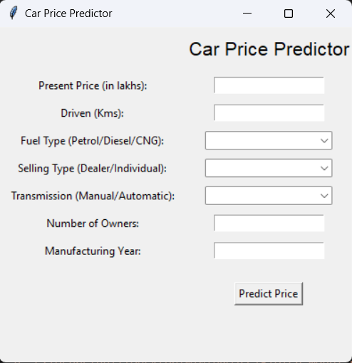
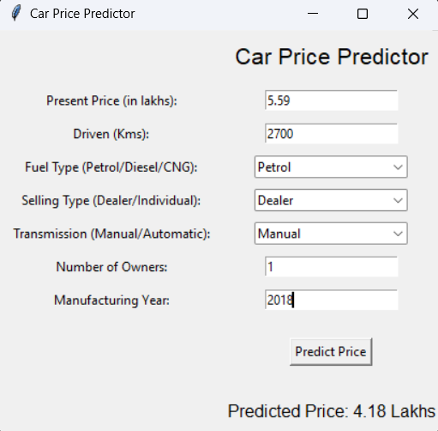
CODE IMPLEMENTATION
Build a Tkinter based GUI for predicting car prices using a pre trained ML model.
Features include- Input fields, dropdowns, a predict button, and a result display label.
Firstly, inputs are processed and matched to the model format.
The pre-trained model predicts the price.
Displays the predicted price.
For execution , we run the GUI in a loop using root.mainloop() for user interaction

Slide 7
RESULT
A scatter plot was created comparing the predicted car prices to the actual car prices. A straight diagonal line represents perfect predictions, and the closer the points are to this line, the better the model's performance.
To assess the effectiveness of the Linear Regression model, the following performance metrics were calculated on the testing dataset:
Mean Absolute Error (MAE)
Mean Squared Error (MSE)
Root Mean Squared Error (RMSE)
R-Squared (R²)

Slide 8
FUTURE WORK
Experiment with advanced ML algorithms (e.g., Random Forest, Gradient Boosting) to improve accuracy and compare with Linear Regression.
Develop a web application for a user-friendly interface.
Deploy the model on cloud platforms for scalability and accessibility.
Create an API for real-time predictions and integration with e-commerce platforms.
Perform feature importance analysis to identify key factors influencing car prices.

Slide 9

THANKYOU

