Slide 1

CORPORATE AND BUSINESS STRATEGY
By Suchitra Subramani

Slide 2

Business Objective is to recommend strategies that minimize cost and maximize revenue.
Lariat 2018 Business Summary
50 different locations
Fleet of 4000 vehicles
60.4 million in Revenue*
27.3 million in Profits*
*Expected Profits derived from data for 10.5 months extrapolated to 12 months for FY 2018

Slide 3
AGENDA
Discussion of three strategies to grow revenue, reduce costs and maximize profit.
Combination of all three strategies to meet the business objective.
In conclusion to predict revenue and profits expected in FY 2019.
Recommendations to implement the strategy.

Slide 4
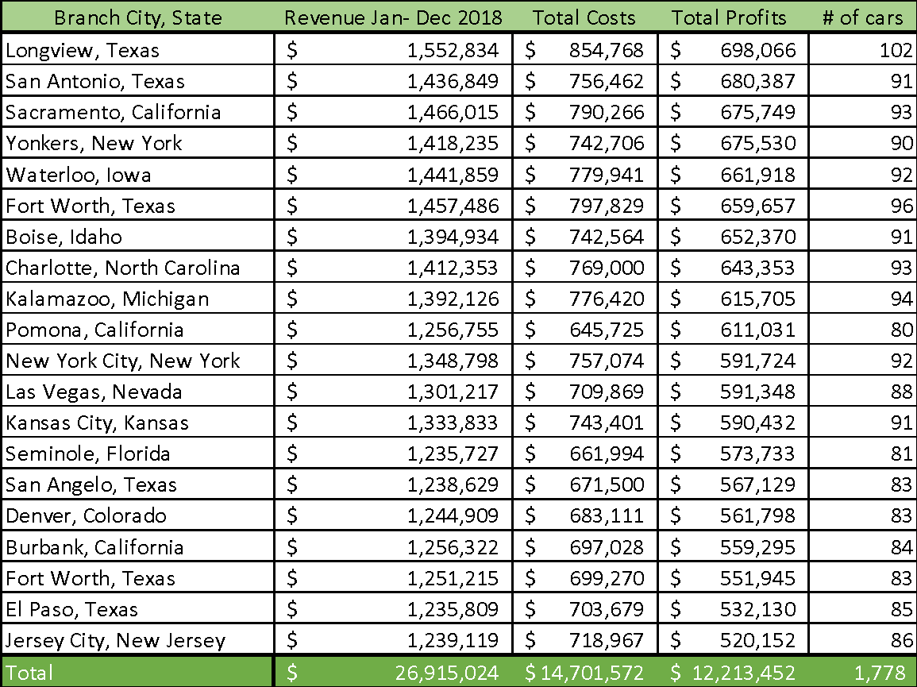
Strategy 1 Increase the Fleet size in the Top 20 performing locations from 44% to 65%.
Identify the top 20 profit making branches
Top 20 branches based on profits made from Jan 2018 to Dec 2018, has just over 44% of the fleet of vehicles.
Top 20 of profit-making branches should have at least 65% of the fleet ready at its disposal.

Slide 5
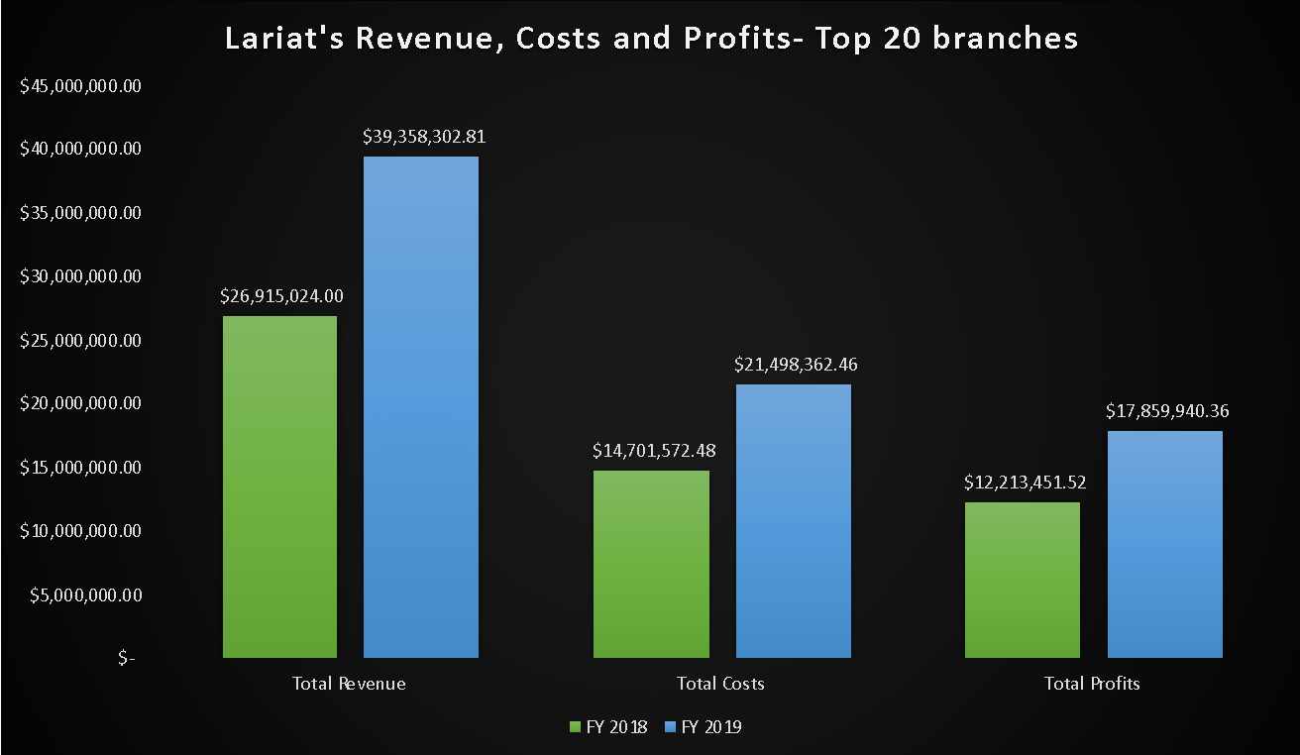
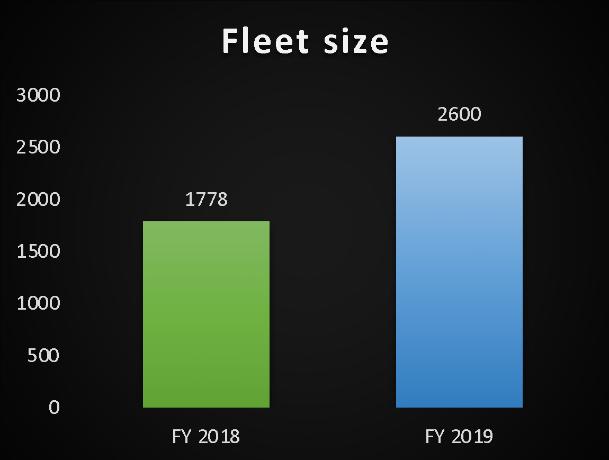
Strategy 1 Increasing fleet size from 44% to 65%, leads to 45% increase in profits. The revenue and costs increase by 45% as well.

Slide 6
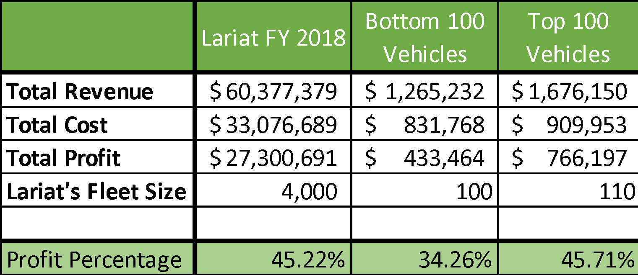
Strategy 2 Replacing/ Phasing out bottom 100 cars and replacing it with 100 of Top 5 profit-making cars
Lariat’s fleet has four vehicles that have a higher cost in maintenance than the revenue they bring in.
In the Bottom 100 of the least profit-making cars, most cars have been used for under 2 months and some under 3 months through the entire year of 2018.
The Bottom 100 of Lariat’s Fleet have significantly lower profit percentage when compared to the entire fleet.

Slide 7
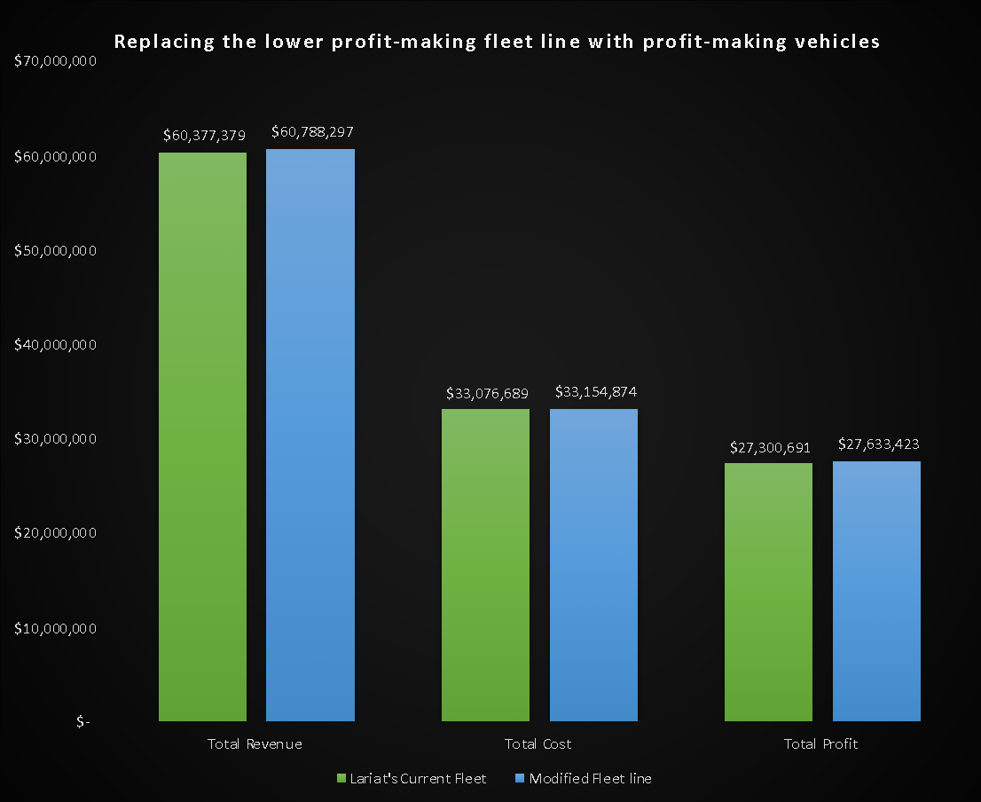
Strategy 2
By replacing/ phasing out about 100 of the bottom profit-making cars with 110 of the top five cars, increase the profit percentage by 0.24% or $332,733.
There is no significant change in the profits or revenue when the 100 low-profit making cars are replaced by a similar number of top profit-making cars.

Slide 8
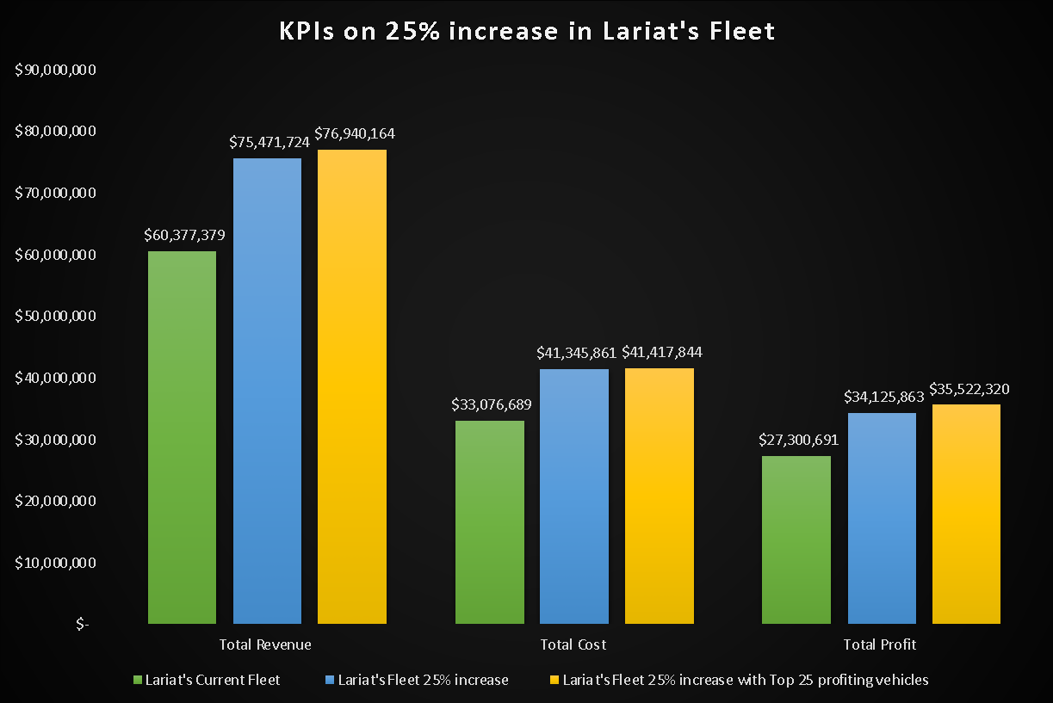
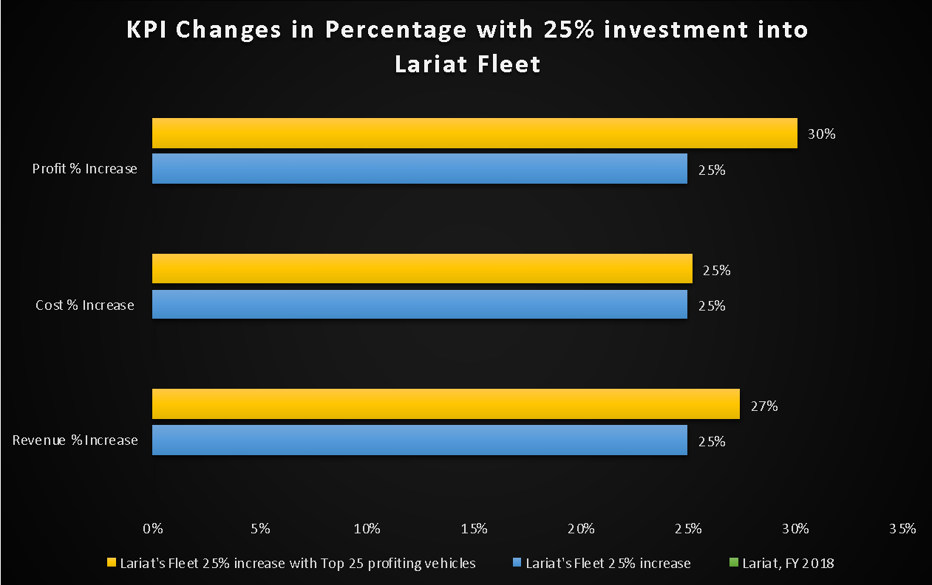
Strategy 3 Investing in 25% increase in fleet size with top 25 profit-generating vehicles
Key KPIs on investing in expanding the fleet line by 25%.
By investing with the Top 25 profit-generating vehicles, a higher percentage of returns.

Slide 9
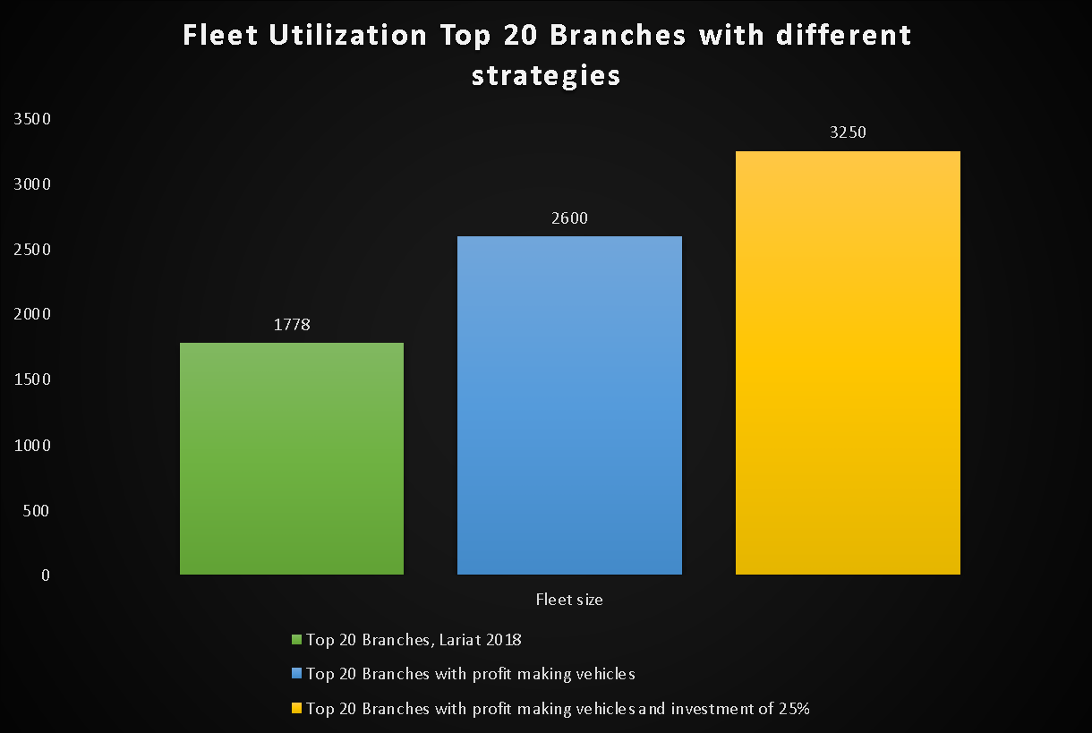
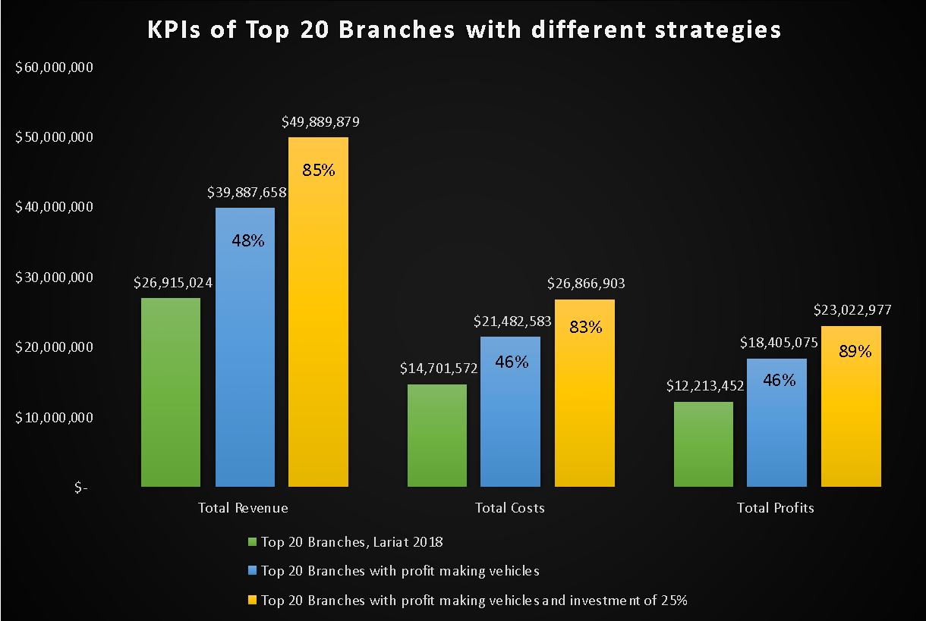
Combined Strategy Identify the Top 20 profit-generating Branches, eliminating its under performing fleet and adding 25% to its fleet line with 25 Top performing cars.
By moving top performing cars to Top 20 locations, 65% of the cars are available for utilization, the profits and revenue go up to 46%.
By investing in Lariat further with the identified top performing cars, there is a remarkable increase in revenue and the profits as well.

Slide 10
Summary
Focus on the top 20 branches that are making the most profit.
Eliminate/ move the low performing vehicles from these branches.
Identify the most popular vehicles in Lariat’s fleet in these branches.
Invest in the fleet by adding most popular and top performing vehicles in these locations so Lariat’s 65% of the fleet is available for rental in these branches. This rearrangement enables Lariat’s revenue and profits to increase
By further investing in fleet line, as we saw in the model today by adding 25% to the roster, we have seen a remarkable increase in revenue and profits.

Slide 11
Recommendations, a call to action!
Lariat can meet its corporate business goal to maximize its revenue and profits and minimize its costs by
Focusing on the top performing branches and providing these branch locations with a bigger roster for higher fleet utilization that will convert to higher profits and revenue.
In the future, Lariat can continue to assess branch locations and invest in adding more rental branches based on the demand, revenue and profits generated in these locations.

Slide 12
THANK YOU!
Questions?

