Slide 1

Lead Scoring Case Study
Suchindran varadaraj
Umang Malhotra
Vikash KR. tripathi

Slide 2
Problem Statement

Slide 3
Problem Statement
Background:
X Education company sells online courses and gets its initial leads from various modes of online marketing.
The company wishes to identify Hot Leads, who have high chances of conversion.
It would help sales team focus on nurturing hot leads rather than all available ones.
Their present lead conversion rate is 30% and their target is 80%.
Goal:
An ML model to assign lead score from 0 to 100 to each lead.
Higher the lead score, higher are the chances of lead conversion.

Slide 4
Analysis Approach

Slide 5
Data Analysis
Data Cleaning:
Drop features with >40% null values (including ‘Select’)
Impute remaining categorical null values with ‘Not Provided’ string
Imputing with mode would impact data distribution in such columns
Impute remaining numerical null values with respective median
Exploratory Data Analysis:
Univariate Analysis: Histograms, Boxplots and Bar plots to see distribution and remove outliers and single category variables
Bivariate/Multivariate Analysis: Boxplots, Heatmap and Stacked Bar plots to visualize correlation of various features with lead conversion.

Slide 6
ML Modeling
Feature Engineering:
Dummy variables creation for categorical features
This gives higher number of attributes to model on compared to Label Encoding.
Model Building:
Min-Max Scaling to bring all numerical values in similar range (sklearn).
Scaling make numerical data better fit and helps improve model accuracy.
Feature selection using RFE on Logistic Regression (sklearn).
Statistical summary based on the recommended features from RFE (statsmodels).
Feature elimination based on p-values and VIF scores of different features.

Slide 7
Model Evaluation
Training Dataset:
Evaluation of model on training data with various metrics (sklearn)
Accuracy Score: 81.57% & ROC-AUC Score: 88.97%
Precision: 79% accurate on conversion
Recall: 71% accurate on conversion
Area under ROC curve: 89%
Test Dataset:
Evaluation of model on test data with various metrics (sklearn)
Accuracy Score: 81.85%
Precision: 80% accurate on conversion
Recall: 71% accurate on conversion
Confusion Matrix: TP: 762, TN: 1507

Slide 8
Lead Scores & Key Points
Generating Scores:
Based on test data probability information, scores fall between 0 to 100.
Scores beyond 80 can be considered the leads with highest chances of conversion.
Score between 50 to 80 can be considered the leads with moderate chances.
Score below 50 can be considered the leads with lowest chances of conversion.
Key Points:
Identified a few (among others) top predictors contributing in lead conversion.
Welingak Website as Lead Source
Total Time Spent on Website
Working Professionals
Lead Add Form as Lead Origin
Phone Conversation as Last Notable Activity

Slide 9
Important Visualizations

Slide 10
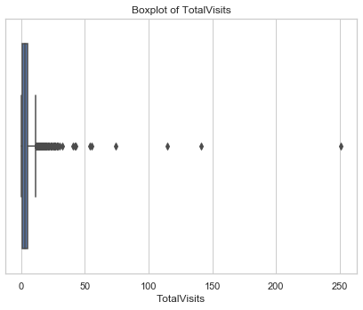
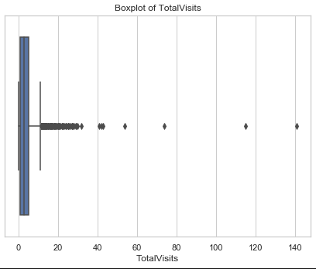
Univariate Analysis – Outlier: ‘TotalVisits’
‘TotalVisits’ feature indicated presence of outliers, which got treated well by limiting the values within 150.

Slide 11
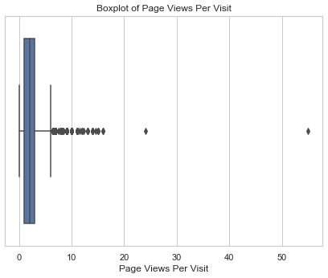
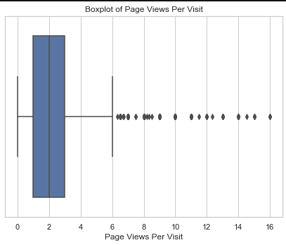
Univariate Analysis – Outlier: 'Page Views Per Visit'
'Page Views Per Visit' feature has some outliers too, which were treated by keeping the values within 20.

Slide 12
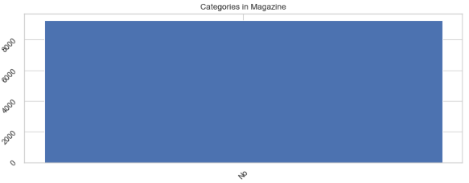
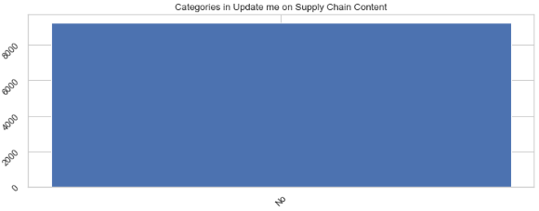
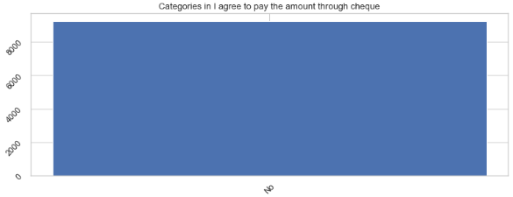
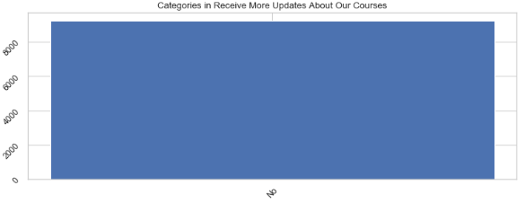
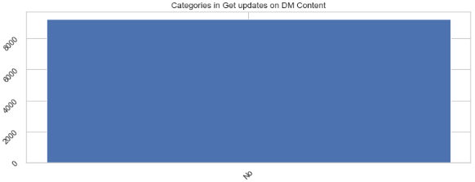
Univariate Analysis – Single Category Features
Some categorical features had only one categorical value. These would not make sense for the ML modeling, so dropped.
‘Magazine’,
‘Receive More Updates About Our Courses’,
‘Update m on Supply Chain Content’,
‘Get updates on DM Content’,
‘I agree to pay the amount through cheque’

Slide 13
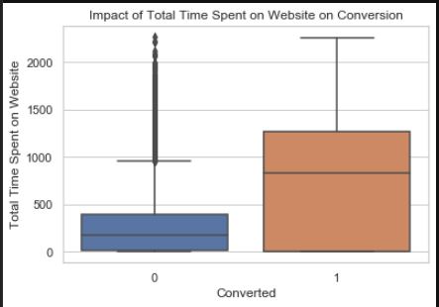
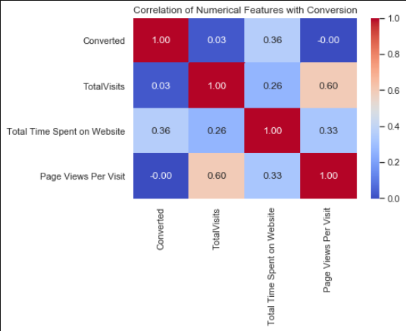
Bivariate Analysis – ‘Total Time Spent on Website’
‘Total Time Spent on Website' feature is seen having a good correlation with the target ‘Converted’.

Slide 14
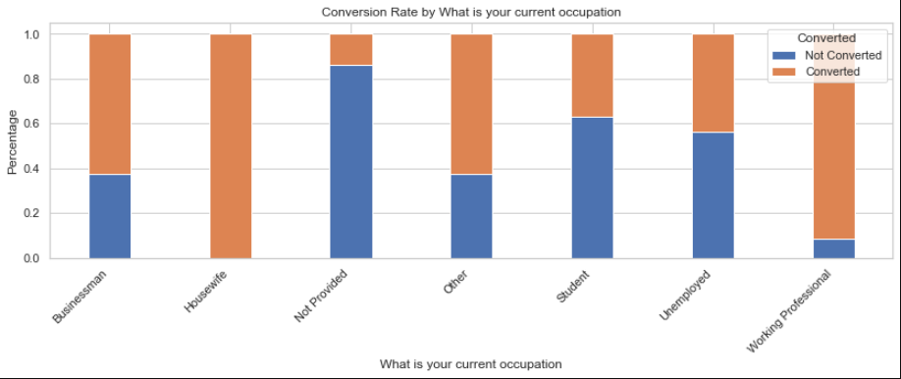
Bivariate Analysis – ‘Occupation’
‘Working Professionals’ are observed to have quite high chances of lead conversion.
Housewife and Businessman also indicate a good correlation with target ‘Converted’.

Slide 15
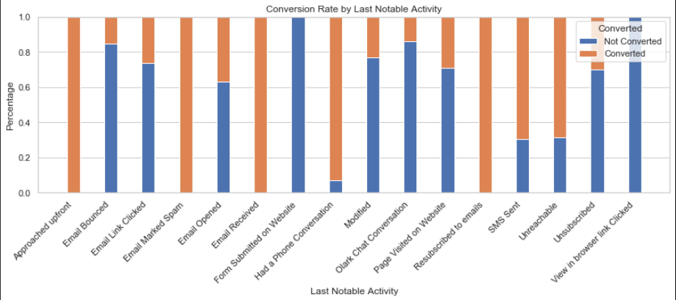
Bivariate Analysis – ‘Last Notable Activity’
‘Leads who had a phone conversation lately’ have quite fair chances of lead conversion.
Among others, ‘SMS Sent’ & ‘Resubscribed to emails’ also indicate a good correlation with ‘Converted’.

Slide 16
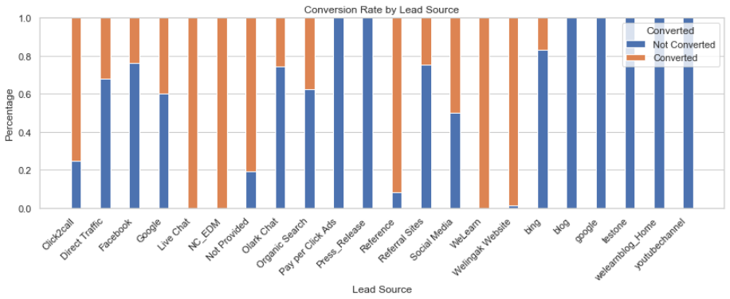
Bivariate Analysis – ‘Lead Source’
Leads who approached from Welingak website, WeLearn or References show a good chance of lead conversion.
Leads who were found on ‘Live chat’ or ‘Click2call’ options, also indicate good correlation with ‘Converted’.

Slide 17
Results in Business Terms

Slide 18
Business Insights
Key Findings:
The most influencing factors behind a lead conversion are total visits to and time spent on website.
Leads visiting Welingak website have high chances of getting converted.
Direct traffic on X Education website and platforms such as google or facebook have negative influence on the lead conversion.
Working professionals among occupation categories are the highest potential leads to buy a course with X Education.
Student and Unemployed leads have fairly good influence on lead conversion.
Leads whose recent engagement has been a phone call have high chances of conversion.
Leads with recent interaction in form of SMS have fairly good chance of conversion.
Leads who didn’t opt for email, are very less likely to get converted.
Leads contacting through Olark chat platform have negative impact on the lead conversion.

Slide 19
Business Recommendations
Key Actions:
Enhance website content and user experience to encourage longer visits and more interactions.
Prioritize marketing efforts for leads visiting the Welingak website.
Shift marketing budget away from direct traffic sources (Google/Facebook) to more productive channels.
Develop targeted campaigns for working professionals as they show the highest conversion potential.
Prioritize working professionals and students/unemployed leads for proactive outreach.
Use automated engagement for leads with lower likelihoods.
Prioritize phone calls for recent interactions as they have the highest conversion likelihood.
Increase SMS engagement strategies for nurturing leads.
Encourage leads to opt-in for emails through incentives.
Personalize email campaigns to improve conversion rates.
Reassess the effectiveness of Olark chat and explore alternative communication tools.
Identify reasons behind the negative impact and refine chat engagement strategies.

Slide 20
Thank You

