Slide 1

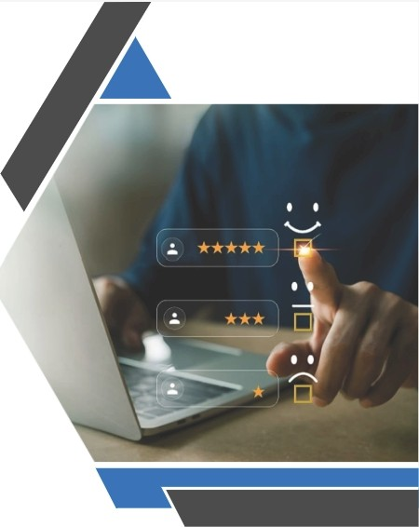
OTT CONSUMER SEGMENTATION
USING PYTHON
Presented To:
Prof. Sunil Gouda
Submitted By:
Guruvendra Singh (22052384)
•••••

Slide 2

Contents
1. Introduction to OTT Consumer Segmentation
3. Objective
2. Problem Statement
4. Python Packages Used
6. Conclusion
5. Results

Slide 3

0
INTRODUCTION

Slide 4


·1 Definition and Importance
What Is OTT consumption?
OTT (Over- the- Top) consumption refers to accessing media content directly via the internet without traditional telecommunication or broadcast methods, revolutionizing how audiencesengage with entertainment.
Significance of consumer segmentation
Consumer segmentation in OTT services allows for targeted marketing and personalized experiences, enhancing viewer satisfaction and loyalty by understanding diverse audience preferences and behaviors.

Slide 5
Algorithms Used
•
RANDOM FOREST
A powerful ensemble learning method that improves classification accuracy by combining multiple decision trees.
SUPPORT VECTOR MACHINE
A robust classification technique that
finds an optimal hyperplane to separate different consumer groups.
K-NEAREST NEIGHBOURS
A simple yet effective algorithm that classifiesusers based on their similarity to
existing data points.

Slide 6

PROBLEM STATEMENT
0

Slide 7
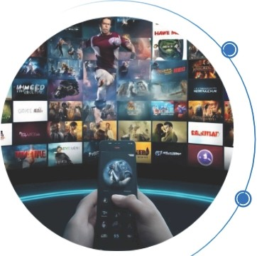
Problem Statements
•
Challenges of unsegmented user Data
OTT platforms collect extensiveuser data, but without proper segmentation, it remains underutilized, leading to ineffective content recommendations, reduced engagement,and lower customer satisfactation. Additionally, inefficient marketing strategies result in poorly targeted promotional campaigns and ad placements.
Solution Through Machine Learning
Implementing consumer segmentation using machine learning helps categorize users based on viewing behavior, enabling personalized content recommendations,precise advertising, and improved user experience.This enhances customer retention, boostsengagement, and drives revenue growth in the competitive streaming industry.

Slide 8

OBJECTIVE
0

Slide 9


·1 Key Objectives
Develop a consumer segmentation Model
Provide Insights for Personallzatlon
This project implements a machine learning-based segmentation model using KNN,SVM,and Random Forest to categorize users based on
viewing behavior for personalized OTT
experiences.
Segmented user data enables personalized content,targeted advertising, and optimized subscriptions, enhancing engagement, reducing churn, and improving ad conversion rates for OTT platforms.

Slide 10

Python Packages Used
0

Slide 11
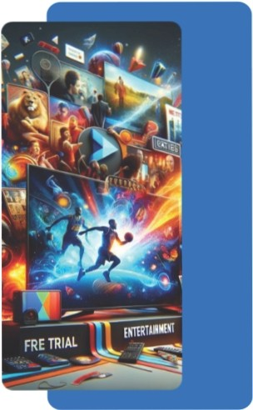
LIBRAR IES USED
pandas
numpy
matplotllb.pyplot
seaborn
scikit-learn

Slide 12

RESULTS
0

Slide 13

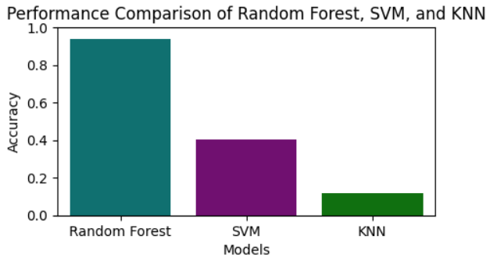
Summary of Findings
•
The OTT consumer segmentation model was evaluated using Random Forest, SVM, and KNN,with performance assessed through accuracy,precision, recall, and F1-score. Random Forest outperformed the others due to its ensemble learning approach, effectively handling complex consumer behavior and reducing overfitting.SVM showed moderate performance but struggled with overlapping segments,while KNN performed the worst due to its inefficiency in high­ dimensional data and computational complexity.

Slide 14
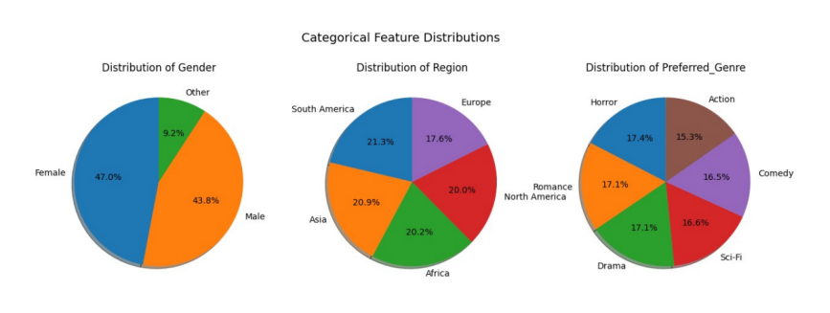

·1 Visualizing the Results
The pie charts represent categorical feature distributions, including Gender, Region, and Preferred Genre. These charts help in segmenting users based on demographic and content preferences, enabling targeted recommendations and marketing strategies. For example, the gender distribution indicates diverse audience representation, while regional segmentation highlights the geographical variations in OTT usage. The genre preference distribution assists in curating personalized content, ensuring higher user engagement and satisfaction.

Slide 15
CONCLUSION
0
0

Slide 16

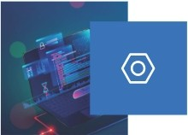
·1 Conclusion and Future Scope
Concluslon
This project implemented an OTT consumer segmentation model using Random Forest.SVM.and KNN, where Random Forest demonstrated the highest accuracy due to its ensemble learning approach.Data
preprocessing, feature selection and standardization ensured optimal model performance and evaluation metrics like accuracy, precision, recall.and Fl­ score provided a comprehensive assessment of effectiveness.
Future scope
Future work can focus on integrating deep learning models to improve segmentation accuracy and real-time data processing for dynamic content recommendations. Hybrid machine learning approaches can enhance
classification efficiency, while cross-platform behavior analysis will help
create a unified user experience. Additionally, optimizing models for large­ scale data will ensure scalability and better personalization.

Slide 17
Thank you
•••••

