Slide 1

A Project on
BANK APPLICATION

Slide 2
Error Knights Bank Corporation
Team members:
BV Damodar
Muskan Karnani
Piyush Deep
Priya Gupta
Shubhi Rajput
Suchit Y
Supriya Singh

Slide 3
Objective of project
The project is an online banking application for customers of a bank to open an account, view and edit the account information and execute basic operations.
It ensures secure login and integrity among all the modules of the application.
The main objective of the system is to manage the details of Accounts, Internet Banking, Transaction. It manages all the information about Accounts and Customers.

Slide 4
Features
Home Page: The page has links for Employee Login, Customer Login and Customer Registration
Employee Login provides access to open account option for both new/existing customers.
Customer Login screen with options for Customers View and Edit Details page and Transfer Funds
Feature to open an account with various business rules
Transfer Funds feature with various business rules
Security: Unauthorized users should not have to access the system
The application is object oriented and easily extensible to add new features like new type of accounts and other use cases
Employee information is stored in an XML file
The web application is based on MVC design pattern

Slide 5
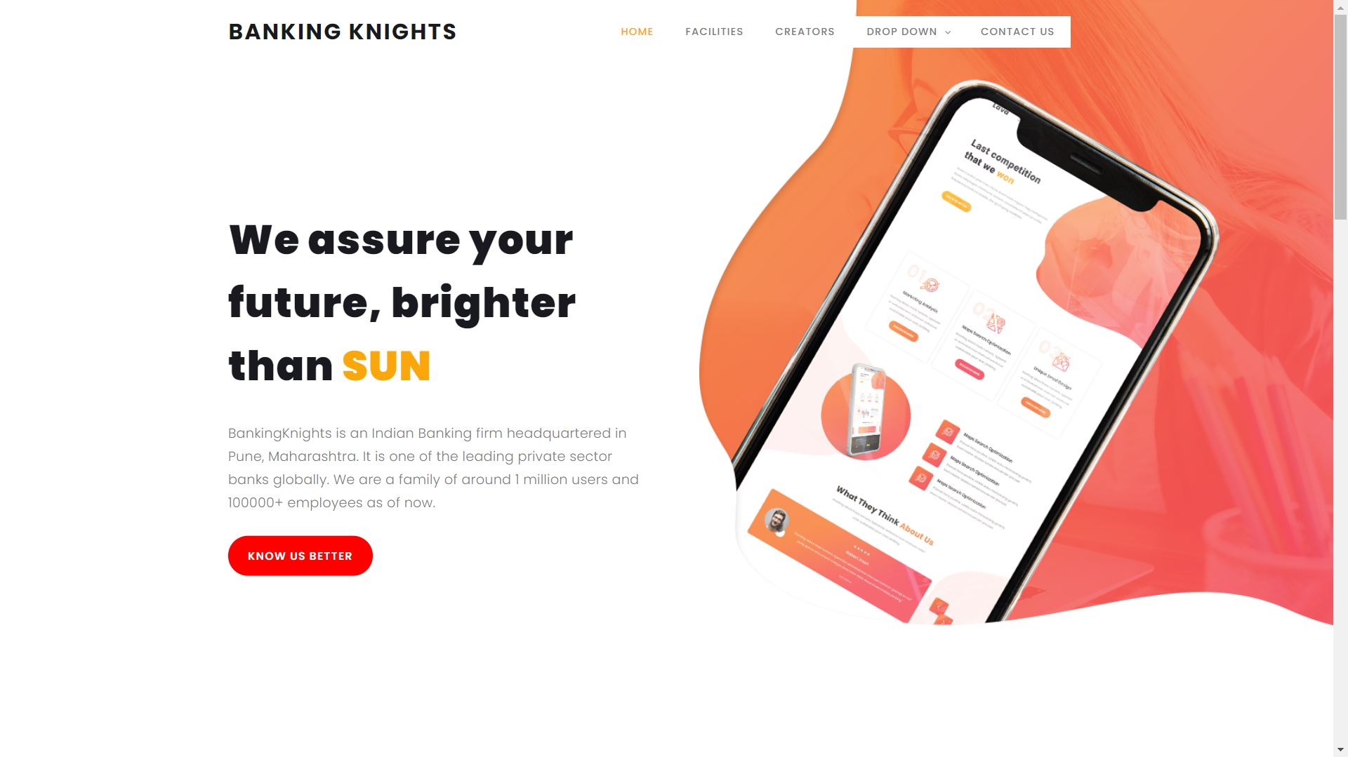
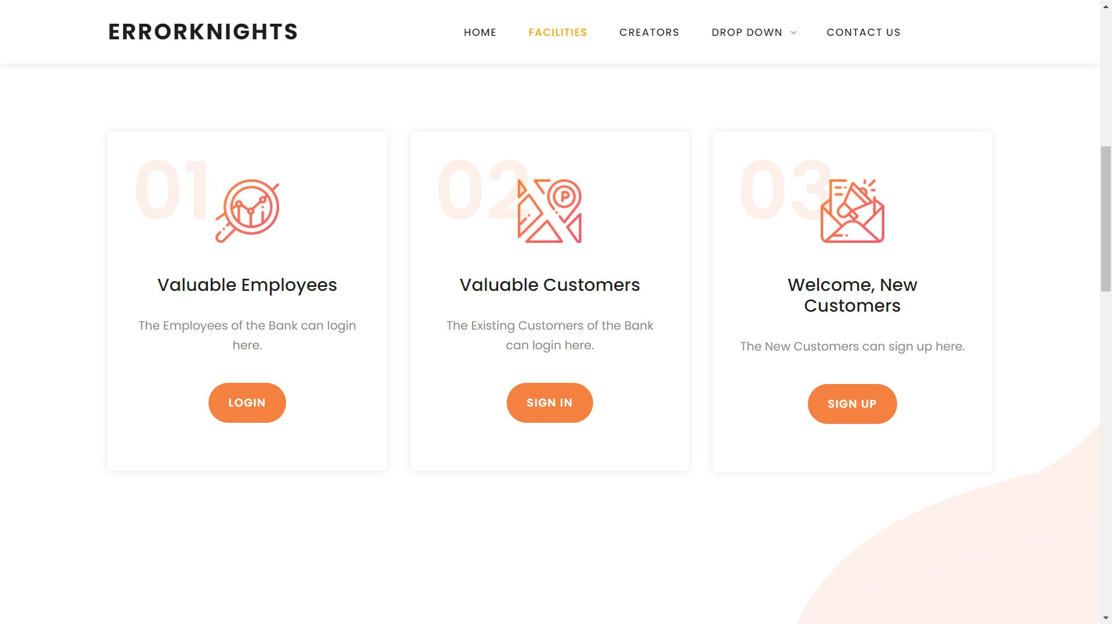
Screen Shots

Slide 6
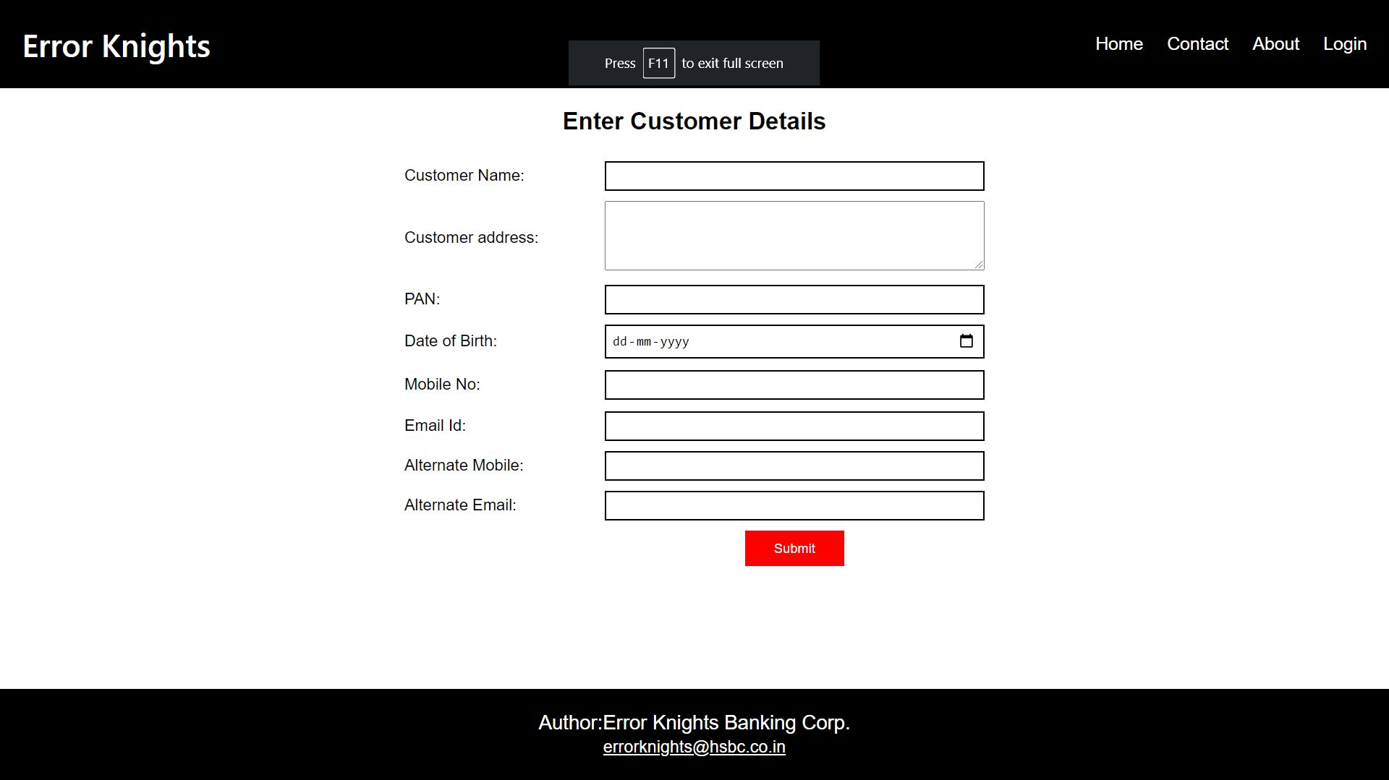
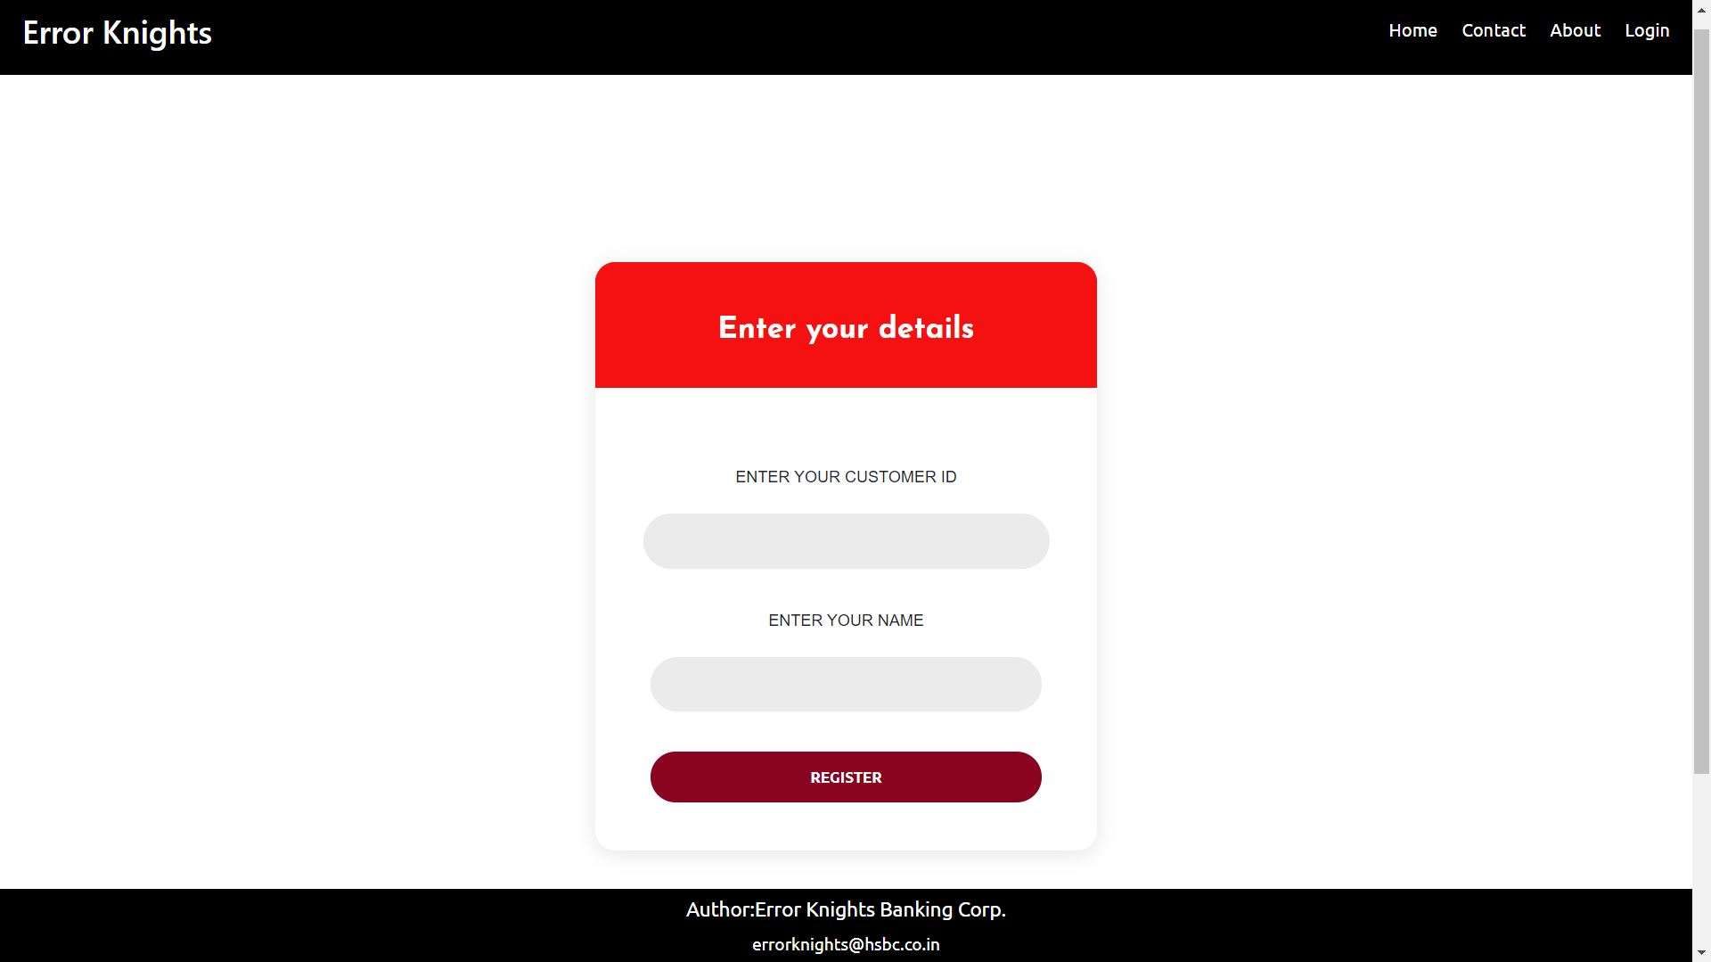
Screen Shots

Slide 7
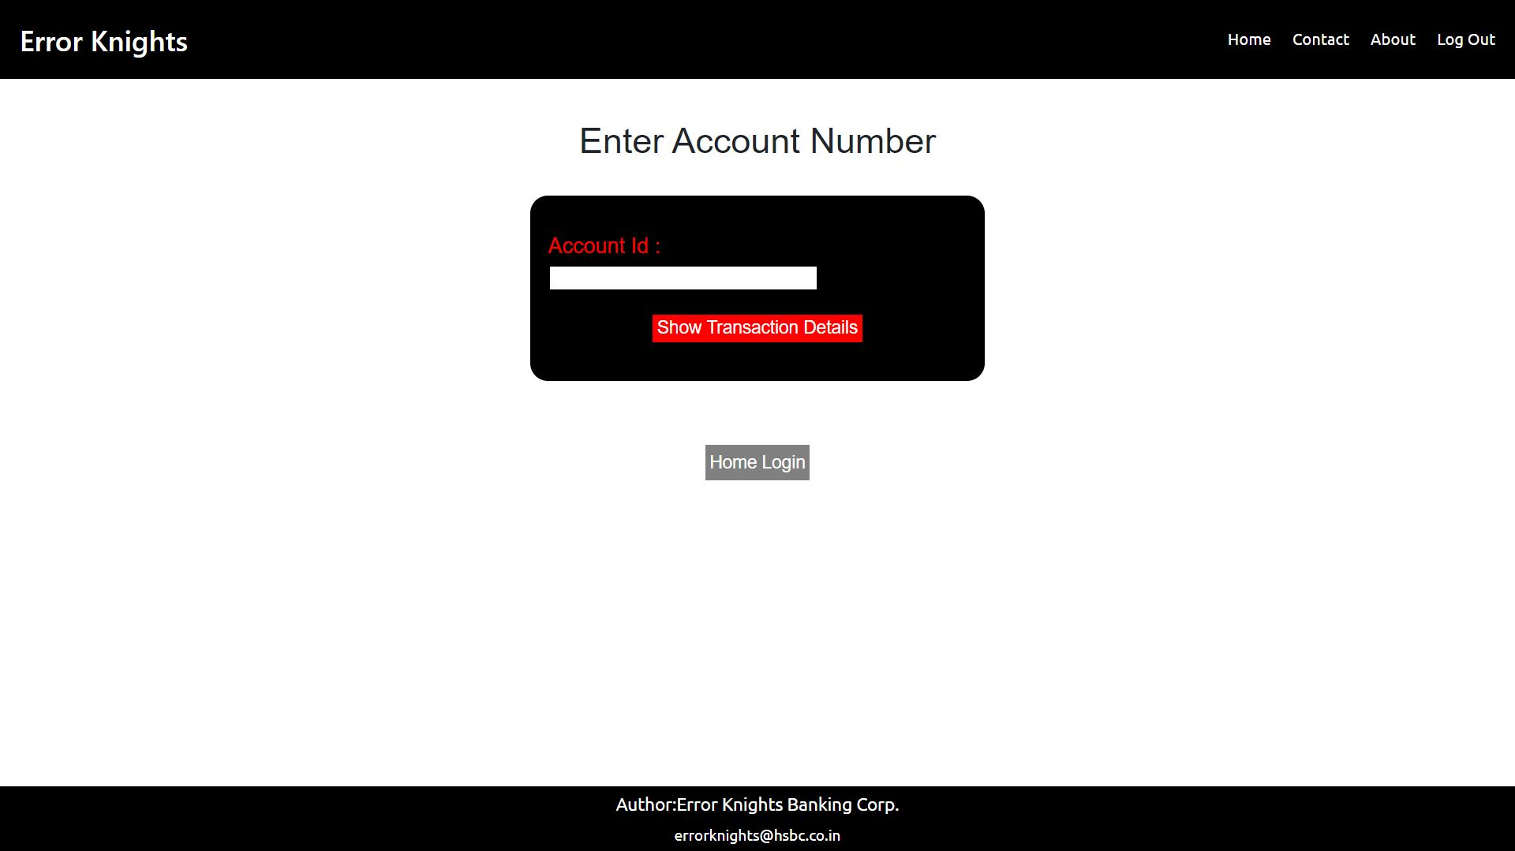
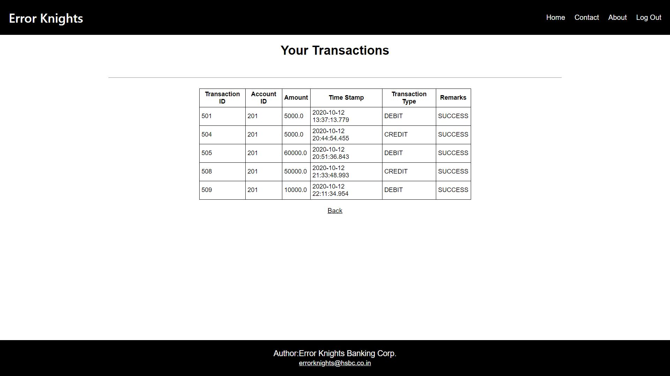
Screen Shots

