Slide 1


CropConnect
Nuturing Local Food Networks

Slide 2


Our fresh produce promise
Local
Fresh
delicious

Slide 3

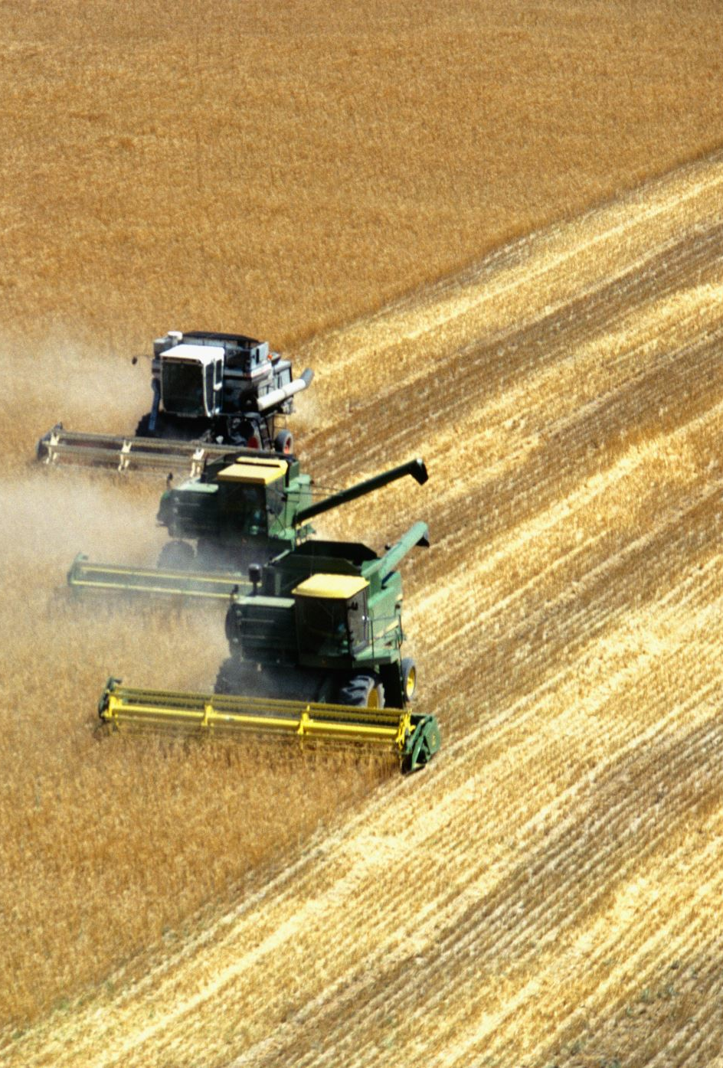
Constrain Elaboration
Agriculture stands as a pivotal economic sector in every nation. However, the current market scenario presents challenges for farmers, particularly concerning the escalating costs of supplies and equipment. This surge in expenses poses a significant hurdle for farmers, impacting their ability to cultivate efficiently due to soaring overhead costs.
Primarily, the existing cost structure makes it challenging for farmers to secure favorable profit margins for their agricultural produce. The presence of middlemen and an extended retail chain further exacerbates this issue, limiting the returns that farmers can derive from their hard work.
Moreover, for those situated in remote regions, the procurement of supplies becomes a formidable challenge. The geographical distance and a lack of awareness about prevailing costs make it difficult for them to source materials from different suppliers efficiently.
In essence, a comprehensive system is essential to facilitate the procurement of supplies and the sale of produce for farmers to achieve success and sustainability. The current landscape poses a multifaceted challenge, making it strenuous for farmers to engage in cultivation practices that lead to prosperity and accomplishment.
Given the complexity of these issues, it becomes increasingly challenging for farmers to navigate the agricultural landscape and achieve success in their endeavors.

Slide 4
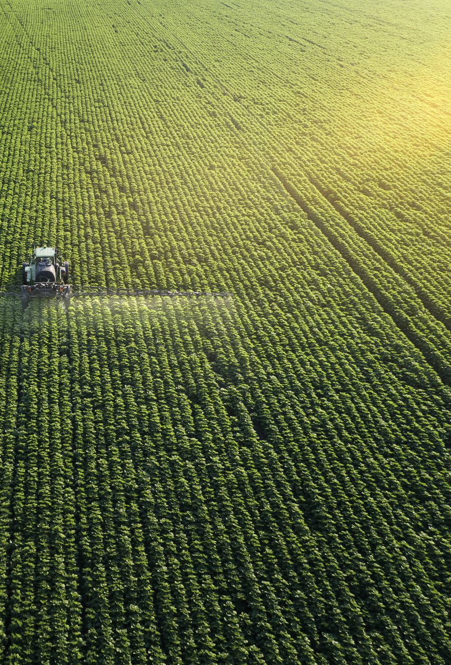
Solution
Centralize all interconnected systems into a unified platform, providing farmers with a comprehensive application.
Through this application, farmers gain the convenience of ordering essential farming supplies at affordable prices, all within the same platform.
Additionally, the application facilitates the process of applying for bank loans for large-scale productions, streamlining the traditionally intricate procedures.
For small-scale productions and immediate financial assistance, farmers can easily apply for microfinance through a simplified and hassle-free process embedded in the application.
In times of various crises, the application serves as a gateway for farmers to apply for government subsidies. The process considers both expected and actual yields, supported by the necessary documentation for a smoother application experience.

Slide 5

APPROACH
We employed an ecosystem model comprising various enterprises and organizations.
Among the entities involved are:
Agricultural Enterprise
Financial Institution
Microfinance Organization
Governmental Body
Supply Chain Partner

Slide 6
Use cases
System Manager
View/Add/Delete Network
View/Add/Delete Enterprise
View/Add/Delete Enterprise Admin
Farmer Enterprise Admin
View/Add/Delete Farmer Organization
View/Add/Delete Farmer
Bank Enterprise Admin
View/Add/Delete Bank Manager Organization/Bank background check Organization
View/Add/Delete Bank Manager/Bank background check officer
Micro-Finance Enterprise Admin
View/Add/Delete Micro-Finance Manager Organization/Micro-Finance background check Organization
View/Add/Delete Micro-Finance Manager/Micro-Finance background check officer
Government Enterprise Admin
View/Add/Delete Subsidy Manager Organization/Subsidy background check Organization
View/Add/Delete Subsidy Manager/Subsidy background check officer
Supplier Admin
View/Add/Delete Seed Supplier Organization/Fertilizer Supplier Organization/Equipment Supplier Organization
View/Add/Delete Seed Supplier Employee/Fertilizer Supplier Employee/Equipment Supplier Employee

Slide 7
Use cases
Farmer
View Loan/Micro-loan/Orders
Apply Loan/Micro-loan/Order Supplies
Bank Manager
View Loan Application
Refer application for background check
Approve/Reject loan application
Background check officer
View Loan Application
Approve/Reject loan application
Micro Finance Manager
View Loan Application
Refer application for background check
Approve/Reject loan application
Micro Finance Background check officer
View Loan Application
Approve/Reject loan application

Slide 8
Use cases
Subsidy Manager
View Subsidy Application
Refer application for background check
Approve/Reject loan application
Subsidy
Background check officer
View Subsidy Application
Approve/Reject loan application
Seed Supply employee
View Order
Ship/Reject order
Fertilizer Supply employee
View Order
Ship/Reject order
Equipment Supply employee
View Order
Ship/Reject order

Slide 9

Use cases
Local Restaurants
Order Supplies
Request Bank Loan
Request Micro Loan
View Loan Requests
View Micro Loan Requests
View Order Requests
View Subsidy Requests
Restaurants WorkArea

Slide 10



Our process
Farmer -> Bank Manager -> Bank Background check Officer -> Farmer
Farmer -> Micro Finance Manager -> Micro Finance Background check Officer -> Farmer
Farmer -> Subsidy Manager -> Subsidy Background check Officer -> Farmer
Farmer -> Seed Supplier -> Farmer
Farmer -> Fertilizer Supplier -> Farmer
Farmer -> Equipment Supplier -> Farmer

Slide 11
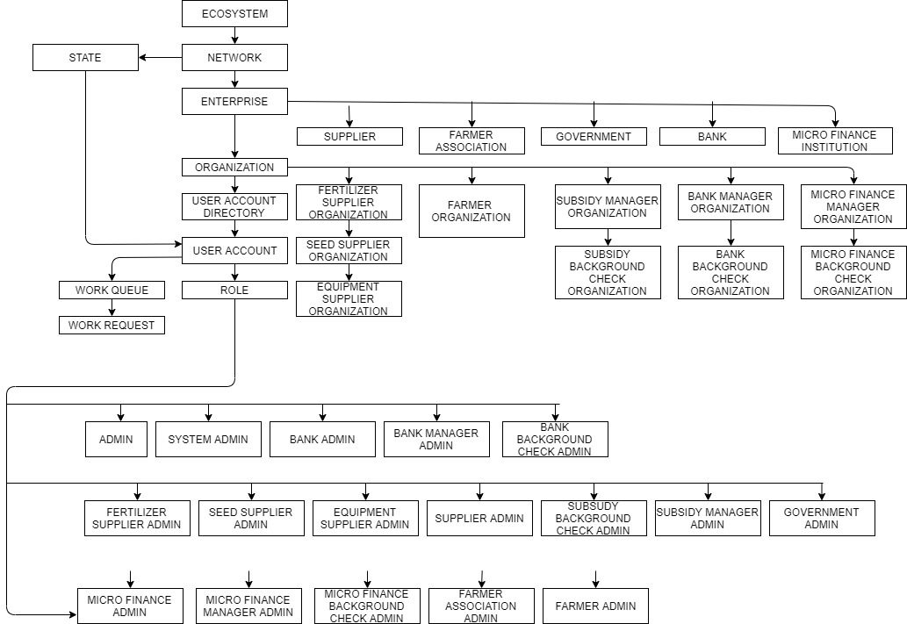
architecture Diagram

Slide 12
Thank you

