Slide 1
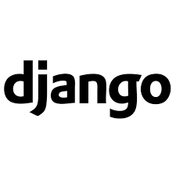

“Journey from Beginner to Expert”
with
django
By
Brijesh Mishra
Sr. Manager (IT)

Slide 2
My Experience
12 years experience in Software Development and Database Administration.
Programming Languages :- C, C++, Java, C#, VB, Assembly, Python.
Web Technologies :- HTML5, CSS3, Java Script, Jquery, JSP, PHP, ASP.Net.
Database Applications :- Oracle Enterprise Edition & Oracle Developer 2K
Platforms :- Windows , Linux, Android
Business Domains :- Finance , Retail ,Mobile Applications , ERP, Telecom.
Embedded System, PLC Programming with SCADA for Industry Automation
Frameworks :- Struts ,Hibernate and Spring for Java.
MVC 5.2 for ASP.Net.
Django for Python.

Slide 3
Agenda
Programming Language, Software Technology and
Framework (A discussion)
Why django framework?
What is django?
Architecture : MVC – MVT pattern.
Hands on : Get Started with django
Building blocks of django
Project : A web application

Slide 4
Programming Language:-
Raw materials providing basic features for application
development.
Defines the syntaxes (rules),semantics (structure) of
programming by supplying compilers, interpeters.
Base to create technologies, frameworks,DB s/ws,Tools,
Operating systems and etc..

Slide 5
Software Technology:-
It is software specification providing rules and guidelines to
develop software by using one or another programming
language.
Technology is not installable, but technology s/w is installable
or arrangable.
eg: Jdbc technology gives rules and guidlines to develop jdbc
s/ws using java language.

Slide 6
Types of Software Technology:-
a) Open Technologies
Here rules and guidelines of technology are open to multiple
software companies to create softwares.
eg: All Java technologies like JDBC,Servlet,Jsp , Python CGI etc..
b) Propritierary Technologies
Here the vendor who has created Technology, is only allowed
to create Tehchnology based softwares.
eg: All MicroSoft technologies like asp.net etc..

Slide 7
Framework:-
It is a installable software that is built on the top of one or more
technologies having ability to generate the common logics of the
application dynamically.
It is a special installable software that provides abstraction layer
on one or more technologies to simplify the application
development process.
While working with technologies we need to develop both
common and uncommon logics.
While working with frameworks we just need to develop
application specific logics.

Slide 8
Why django framework?
django is Python web framework.
A framework provides a structure and common methods to
make the life of a web application developer muck easier for
building flexible, scalable and maintainable web application.
Python web framework is a code library that provide tools
and libraries to simplify common web development framework

Slide 9
What is django?
Django is a high level and has a MVC – MVT styled architecture.
Django web framework is written on quick and powerful python language.
Django has a open source collection of libraries for building fully functioning web application.

Slide 10
Features of django?
Fast
Fully Loaded
Secure
Scalable

Slide 11
Django MVC – MVT pattern
MVC is slightly different from MVT as django itself take
care of the controller part.
It leaves the template which is a HTML file mixed with
django template language (DTL).
The developer provides the model, the view and the
template then just maps it to a url and django does the
magic to serve it to the user.

Slide 12
Django MVC – MVT pattern
Request
View
Controller
View
Model
Template
Model
MVT
MVC

Slide 13
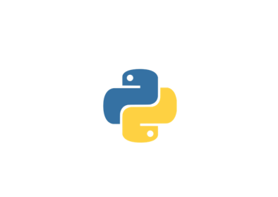
Let’s start with Django

