Slide 1

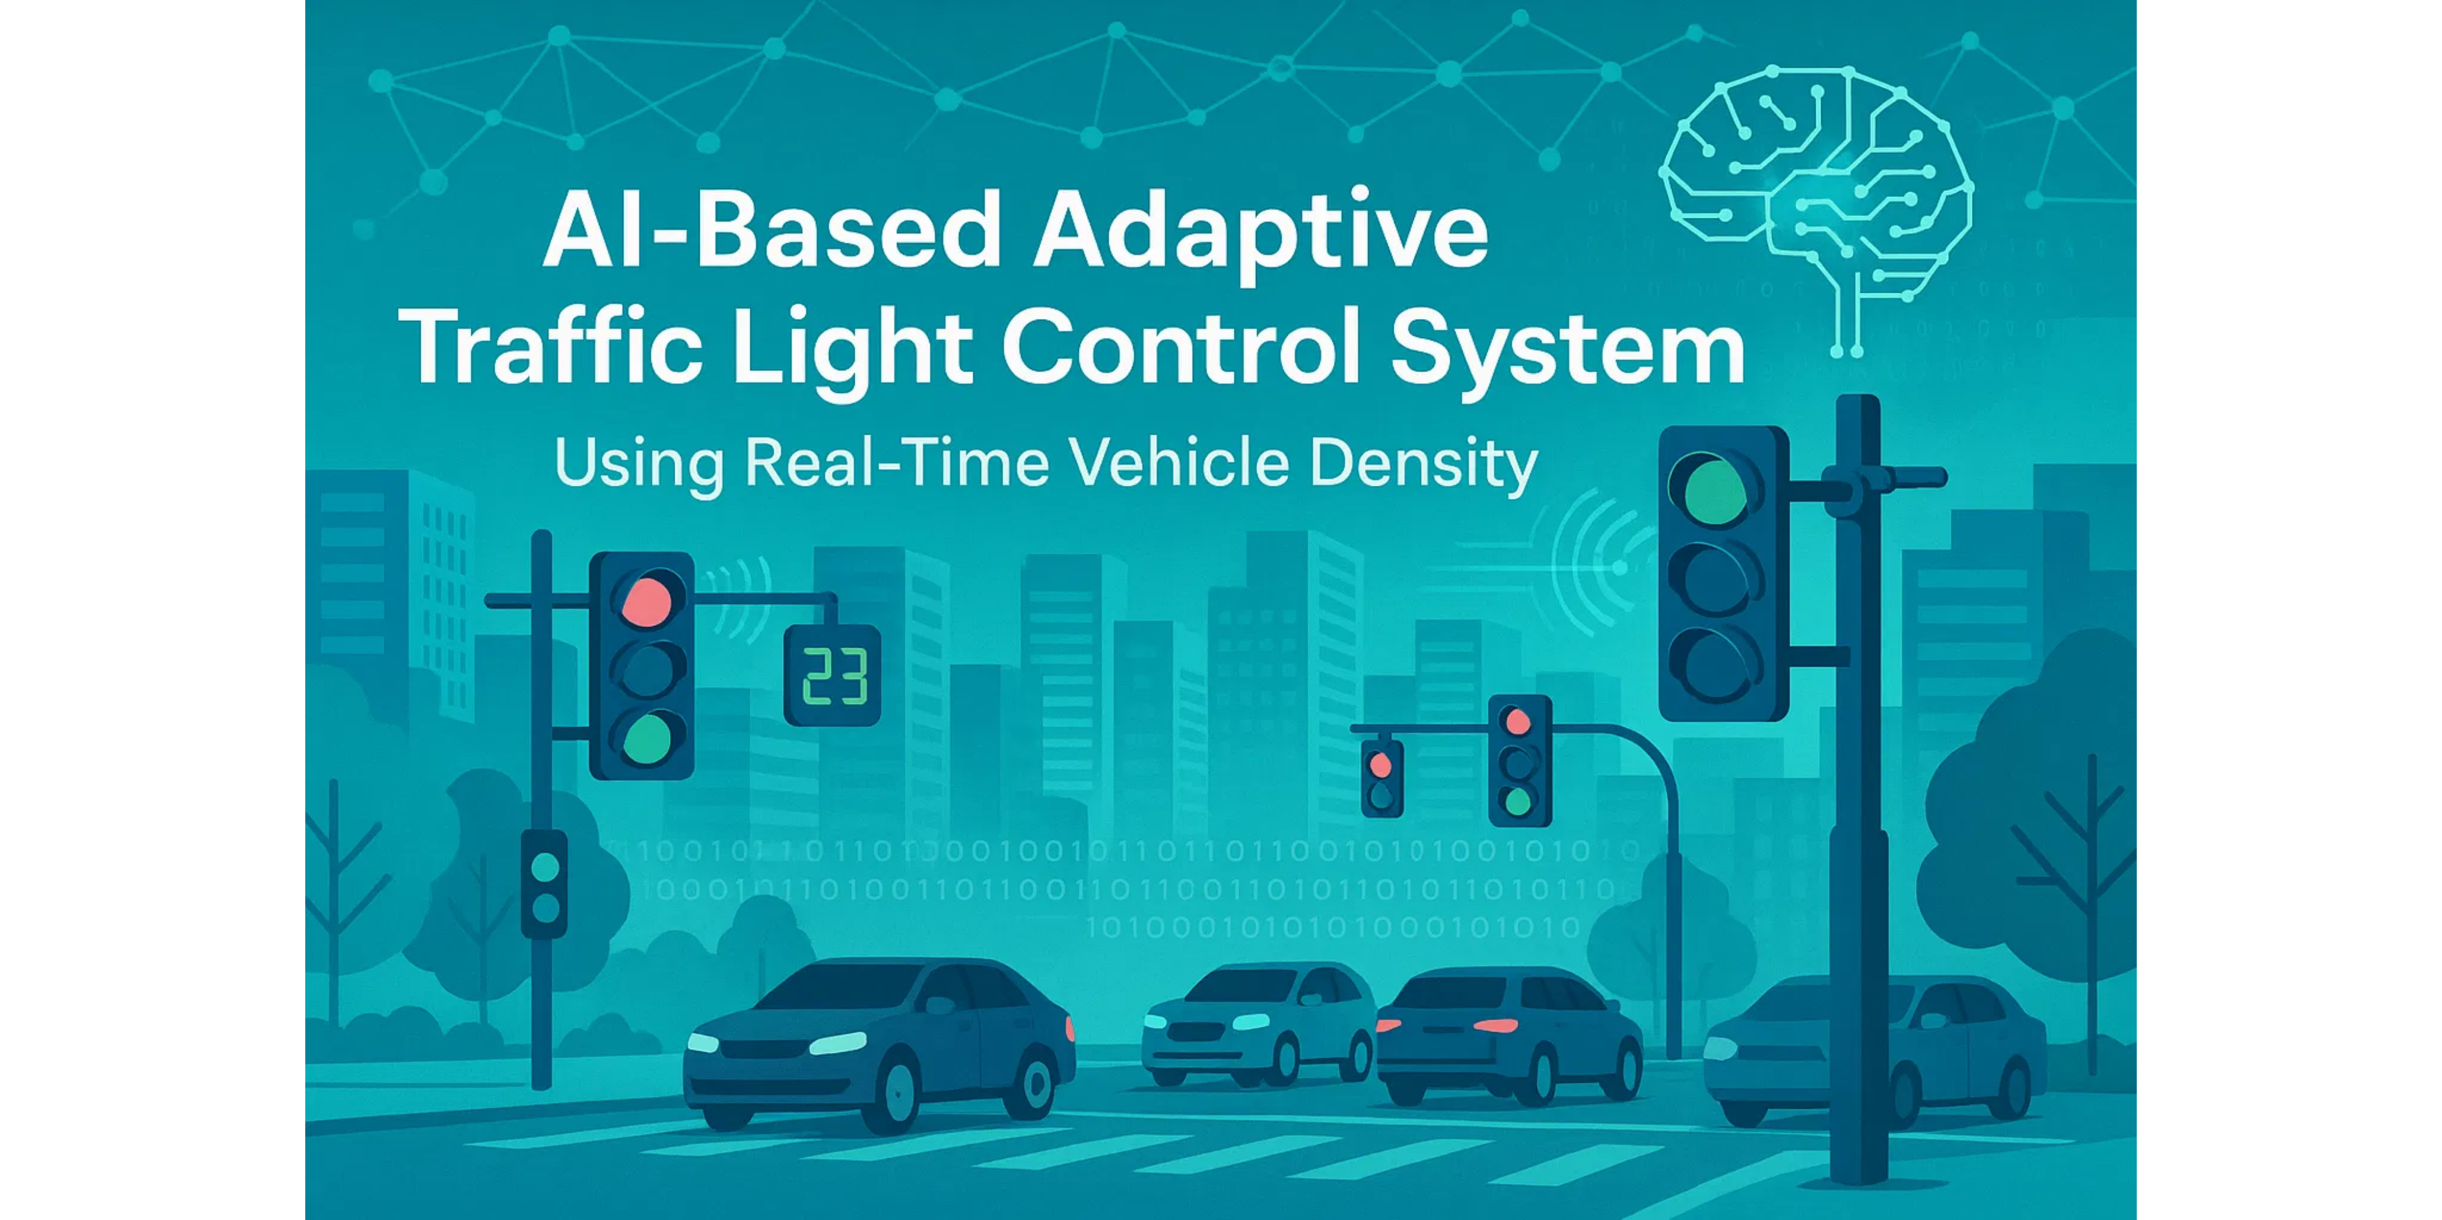
J.DIANA SUCHITA - 323129512019
AI-Based Adaptive Traffic Light Control System
Using Real-Time Vehicle Density

Slide 2

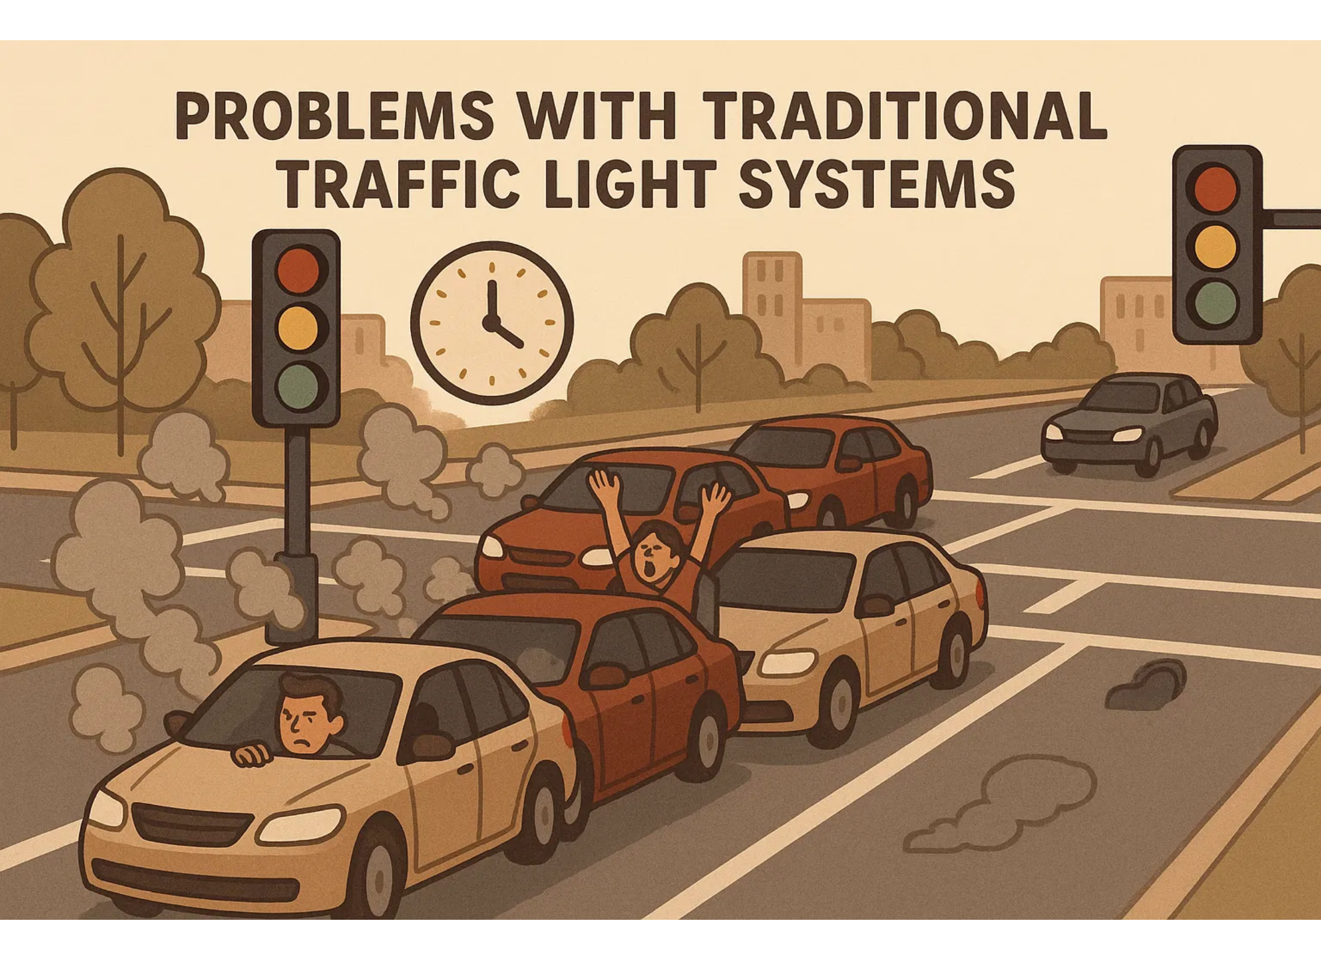





Problem Statement
Fixed timers lead to inefficient traffic management
Unnecessary congestion during peak hours
Excessive waiting at red lights with no cross-traffic
Increased fuel consumption due to idling vehicles
Higher air pollution in urban areas
Delays for emergency vehicles

Slide 3
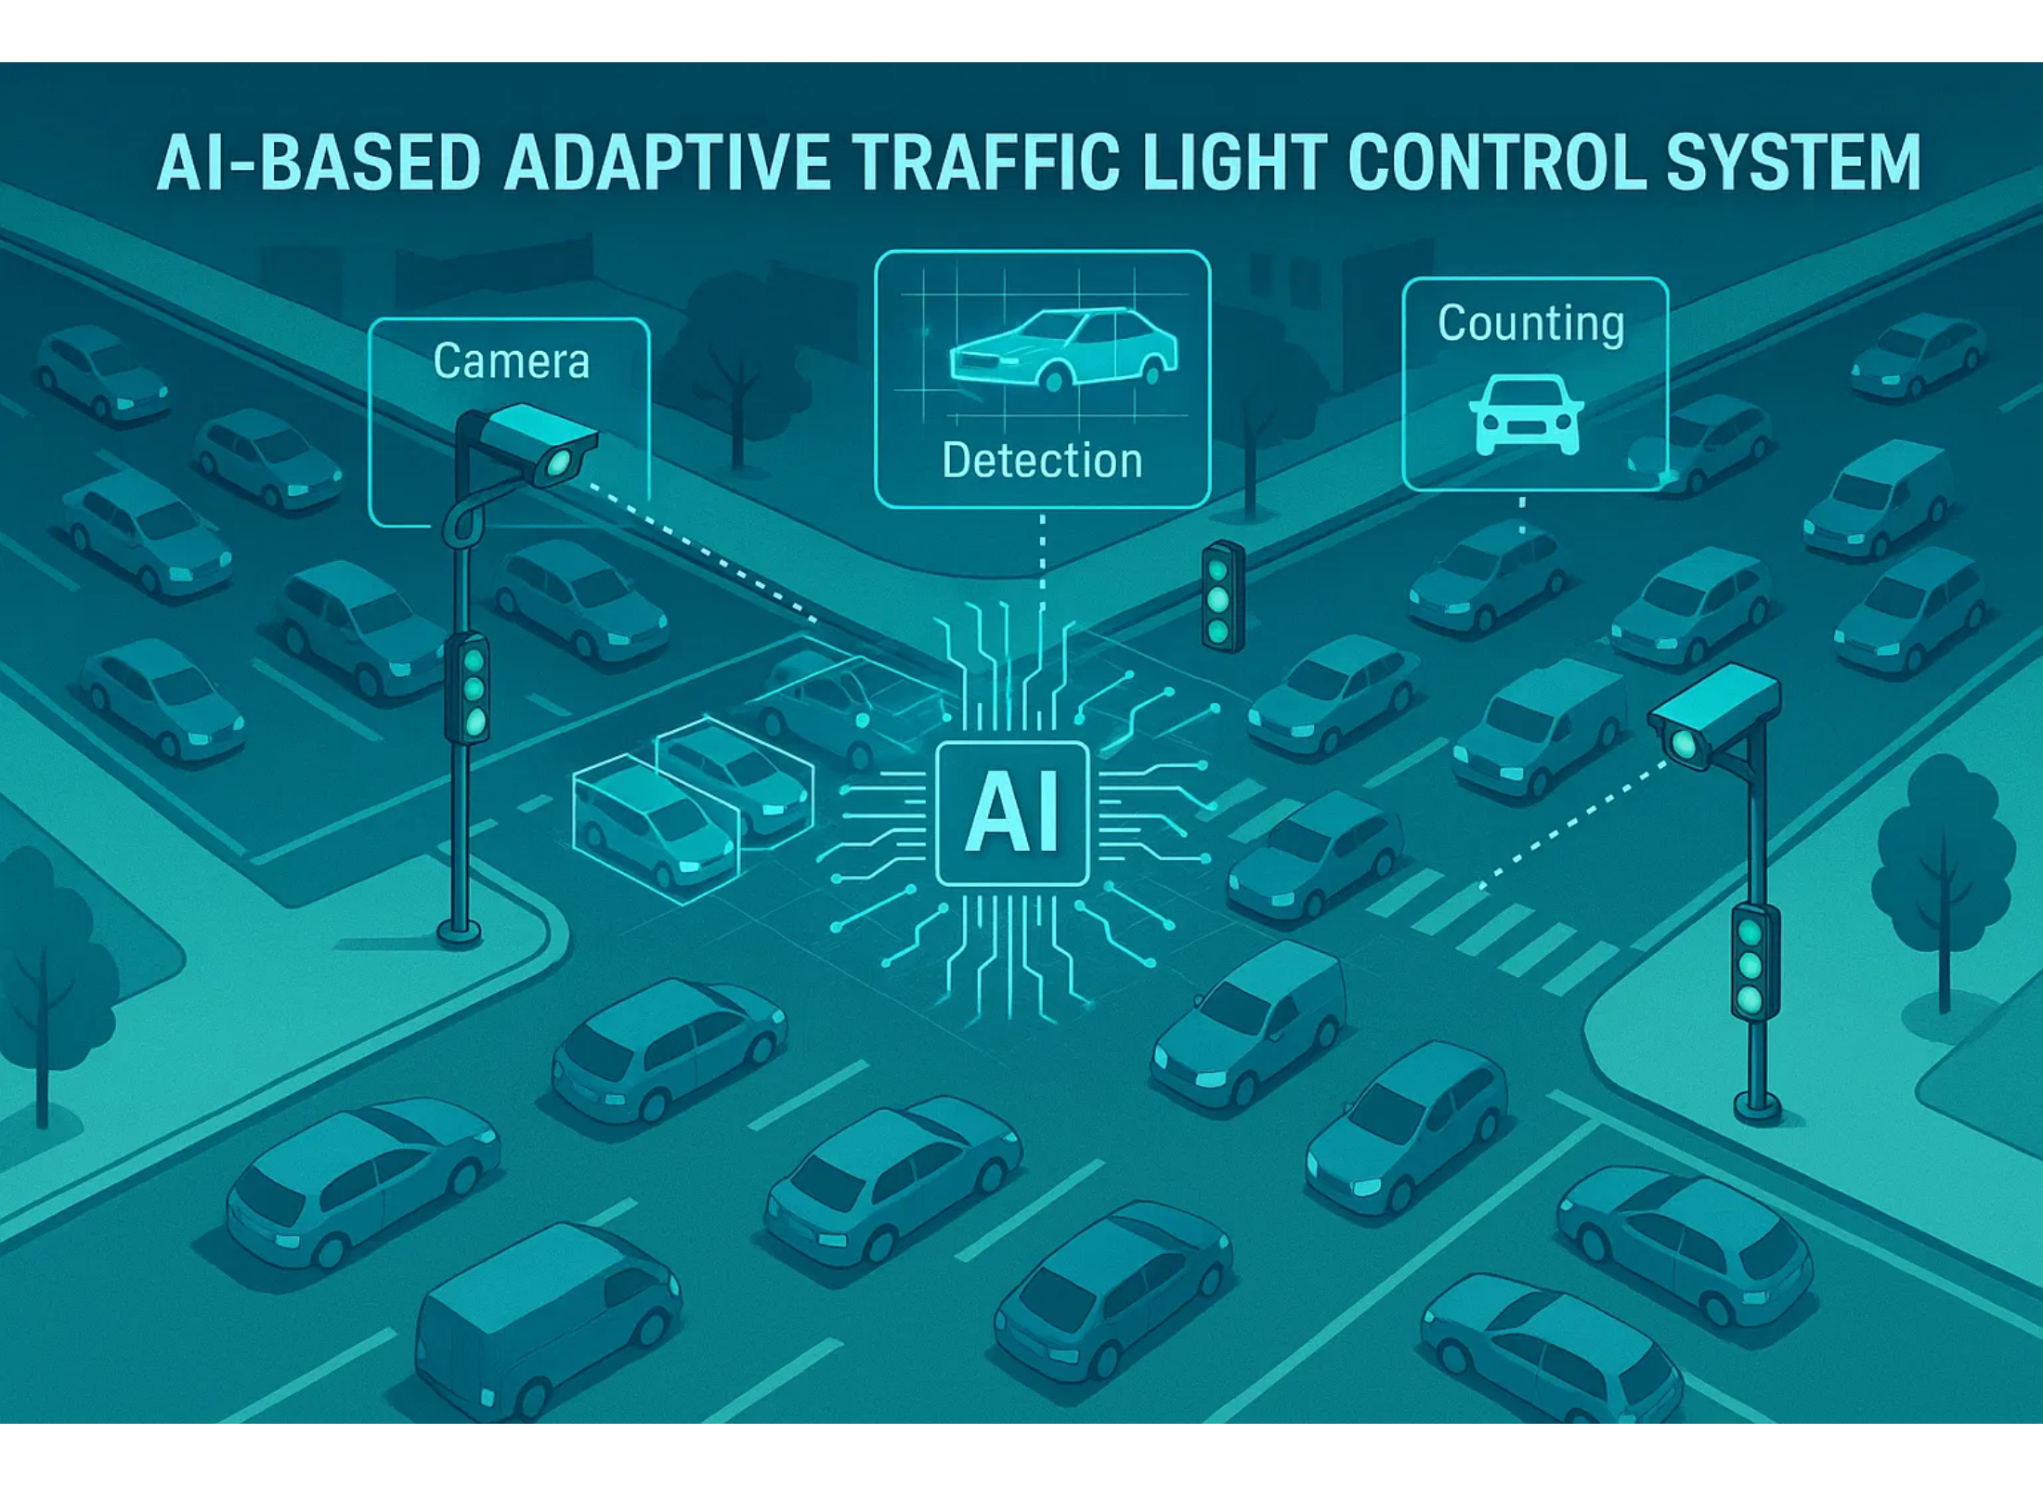






Proposed Solution
Real-time vehicle detection using cameras and sensors
AI-powered traffic density analysis
Dynamic adjustment of green light duration
Machine learning for optimized traffic flow
Priority passage for emergency vehicles
Reduced emissions and fuel consumption

Slide 4
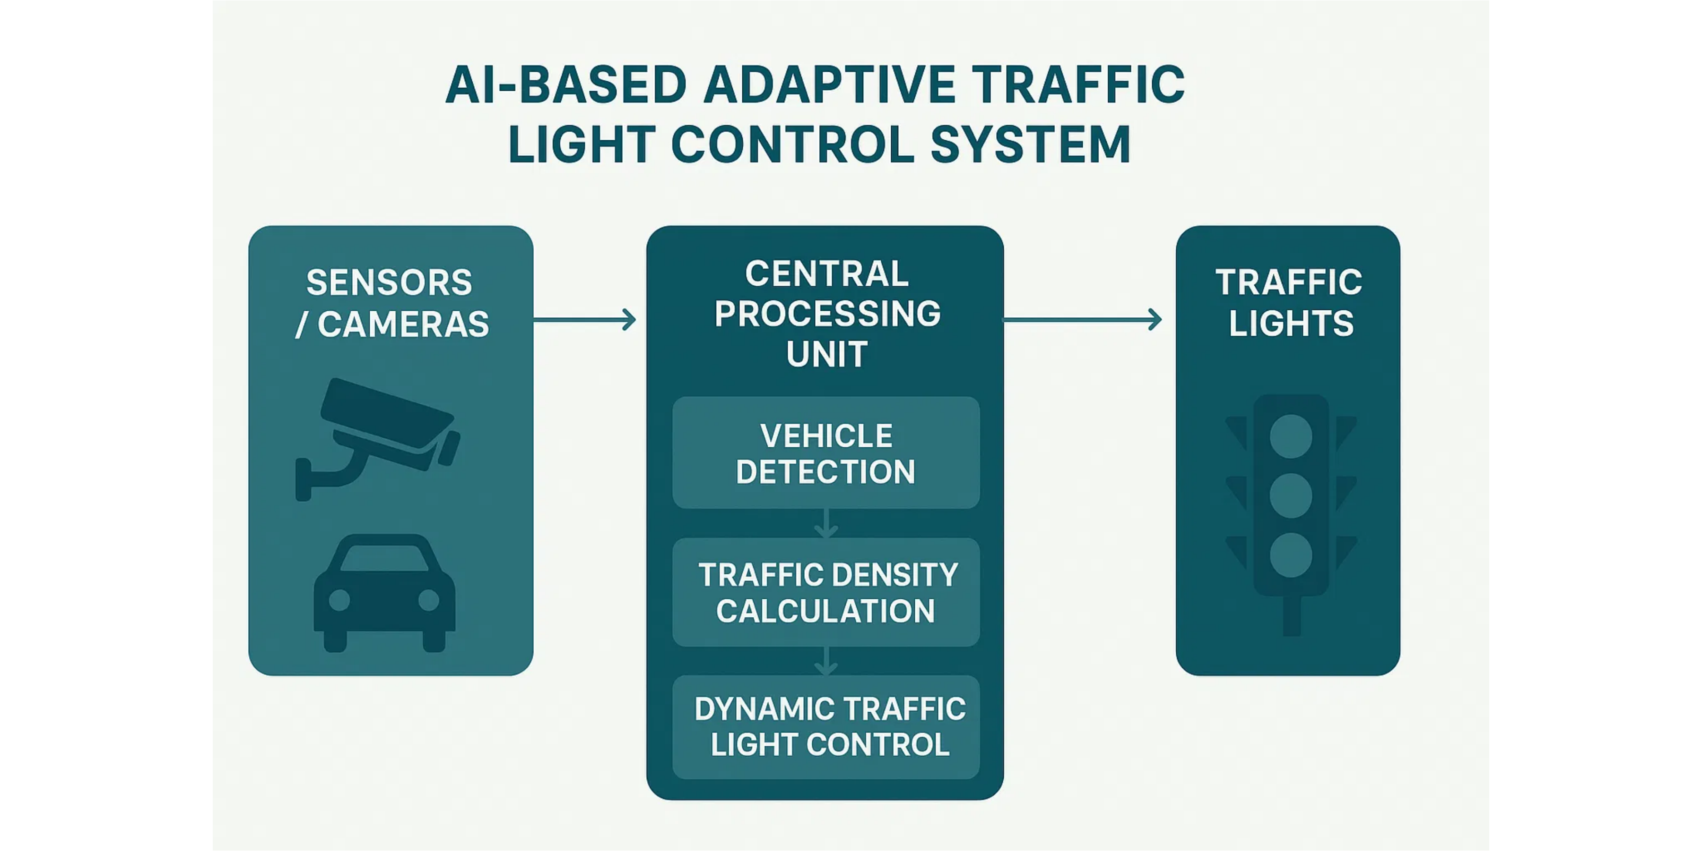
System Architecture
Our system uses
sensors and cameras
to collect real-time data, which is
processed by the
central processing unit
to dynamically control
traffic lights
based on vehicle density.

Slide 5

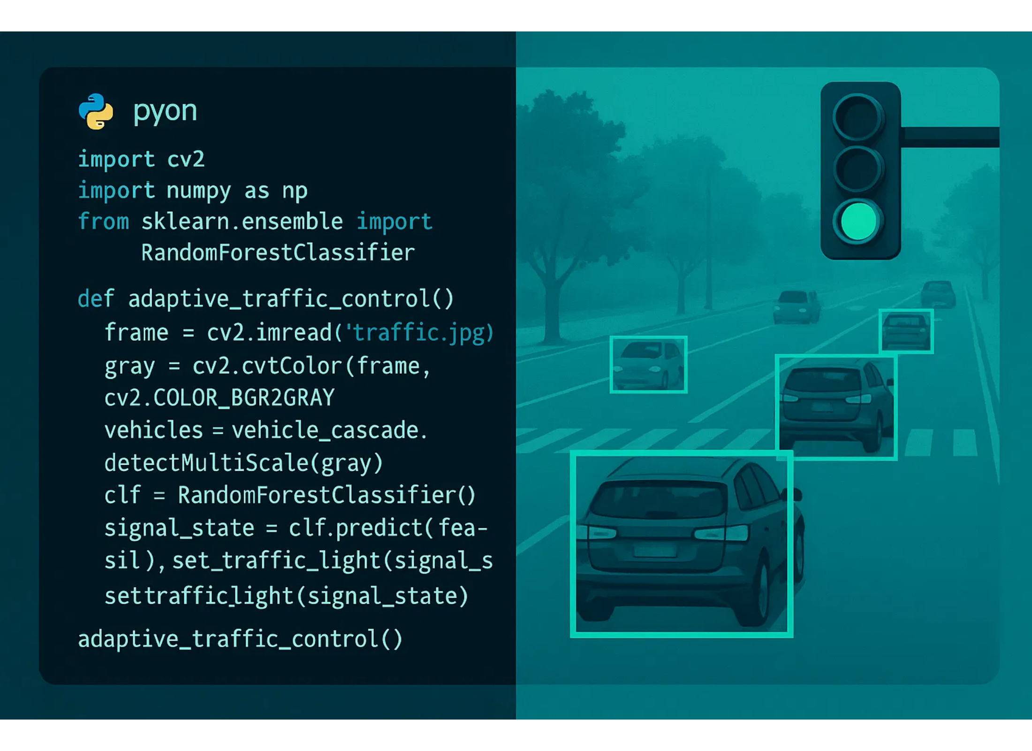



Implementation
Python:
Primary programming language
OpenCV:
Computer vision for vehicle detection
Scikit-learn:
Machine learning for traffic
prediction
NumPy & Pandas:
Data processing and
analysis
Matplotlib:
Data visualization and reporting
SQLite:
Lightweight database for traffic data

Slide 6
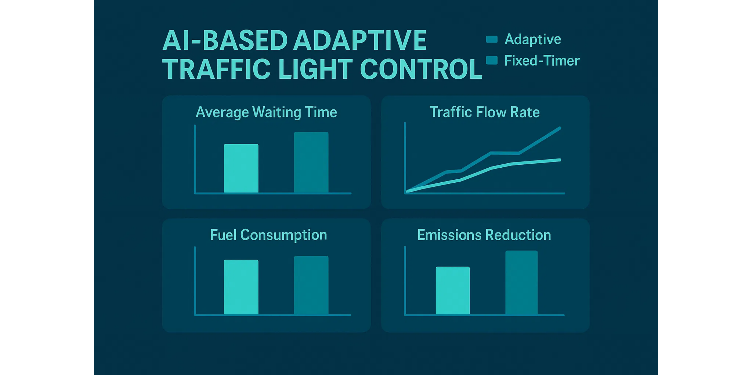
Results and Performance
Our AI-based system showed significant improvements over traditional fixed-
timer systems:
reduced waiting times
,
increased traffic flow
,
lower fuel
consumption
, and
reduced emissions
.

Slide 7
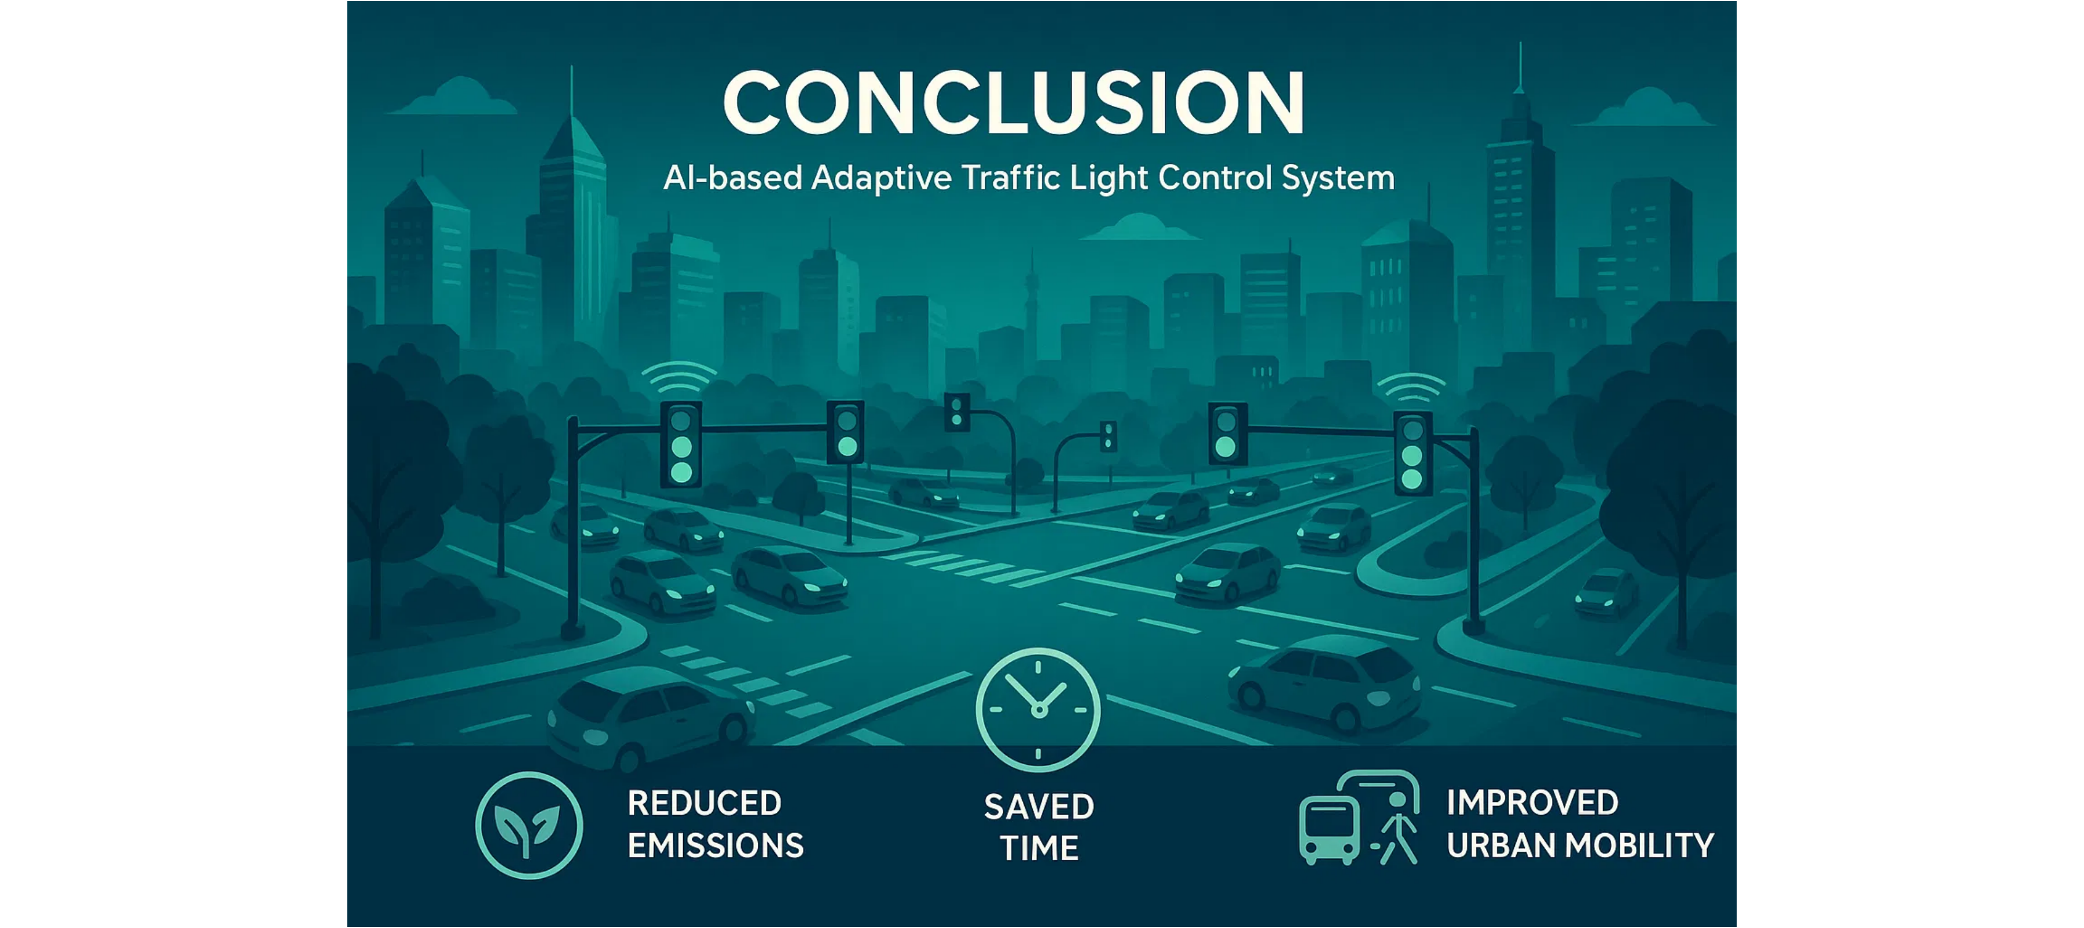



Conclusion
The AI-based adaptive traffic light control system successfully addresses the
limitations of traditional fixed-timer systems by
dynamically adjusting
to real-
time traffic conditions, resulting in
optimized traffic flow
and
reduced
congestion
.
Reduced Emissions
Saved Time
Improved Urban Mobility

