Slide 1

Let’s start with a story…

Slide 2

Imagine you’re in a good mood, in the car, on the way to the gym. You have your airpods in and you’re listening to some lyrical ballads

Slide 3

You get to the gym, and begin your workout and as your heart rate rises, the music switches over to pop

Slide 4

As you continue your workout, rhythmic, high-energy songs start playing

Slide 5
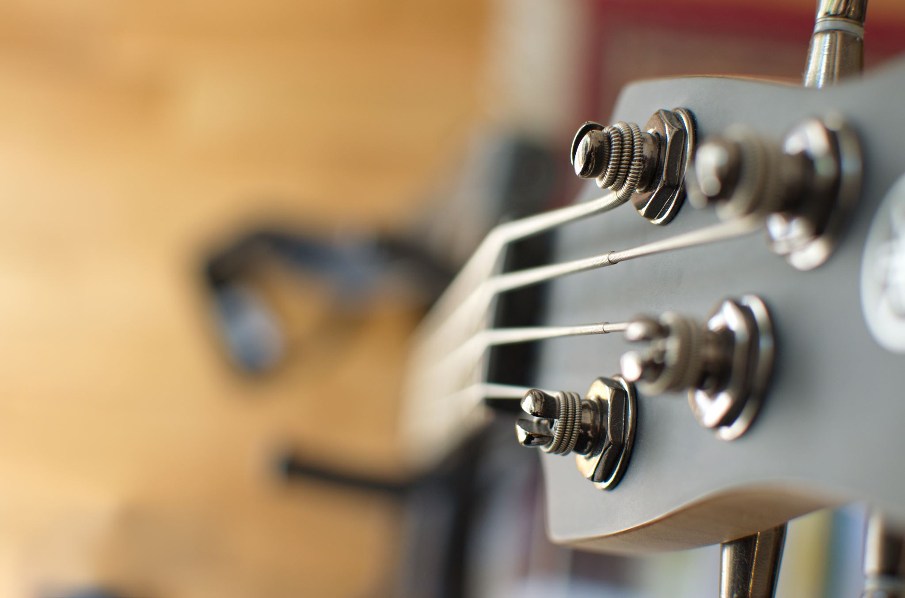
Once, you’re finished with your workout, the music winds down to some country beats

Slide 6
All of this happens, without you switching from your car playlist, to your workout playlist, to your cooldown playlist

Slide 7
eat rew

Slide 8
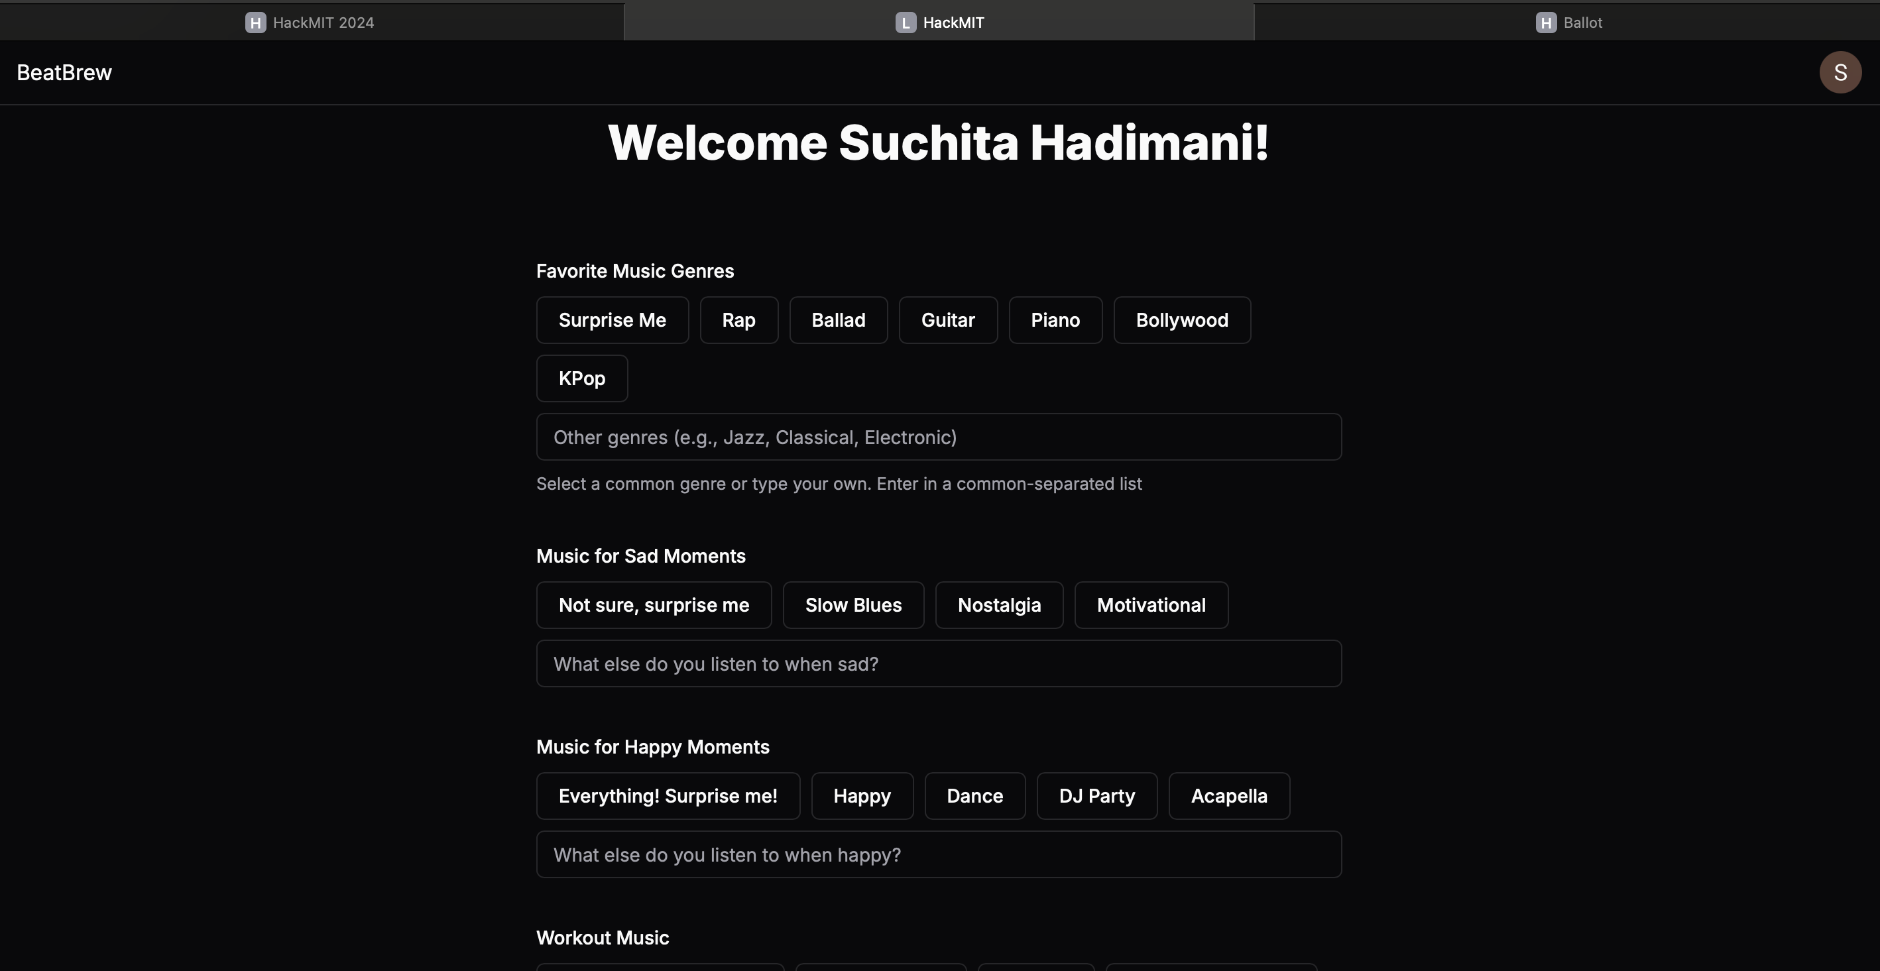

Slide 9
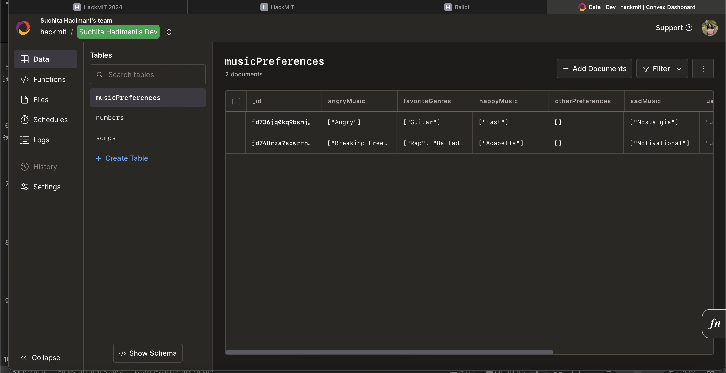

Slide 10
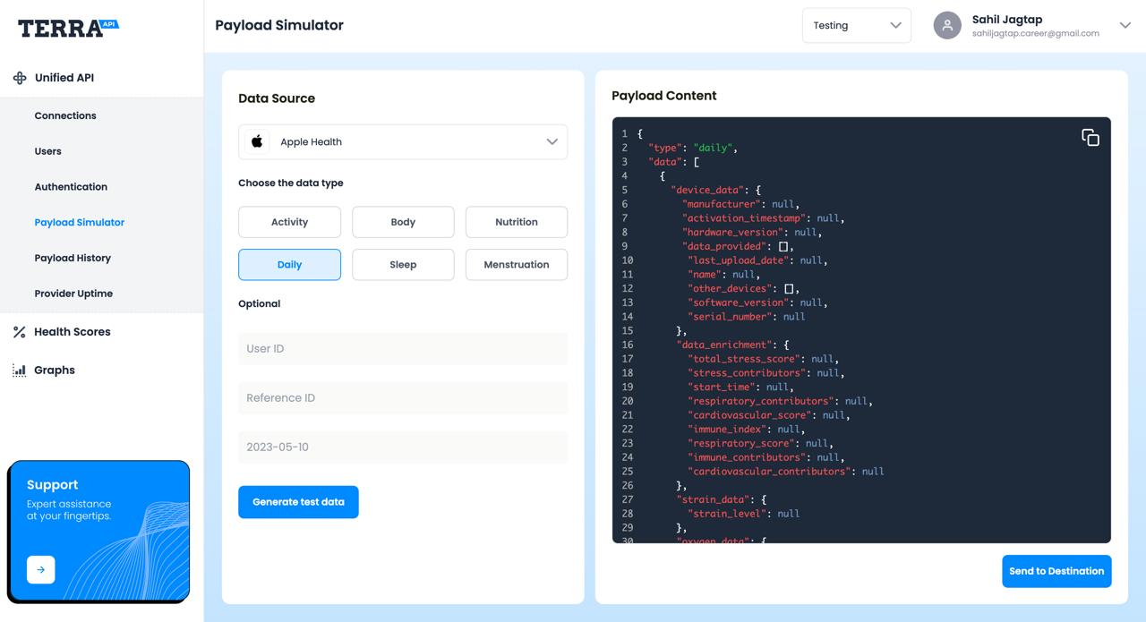

Slide 11
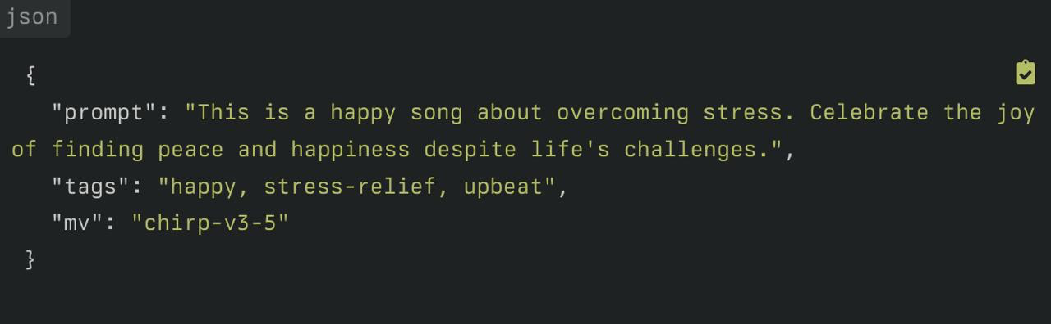
LLM – Prompt Generation

Slide 12
suno

Slide 13
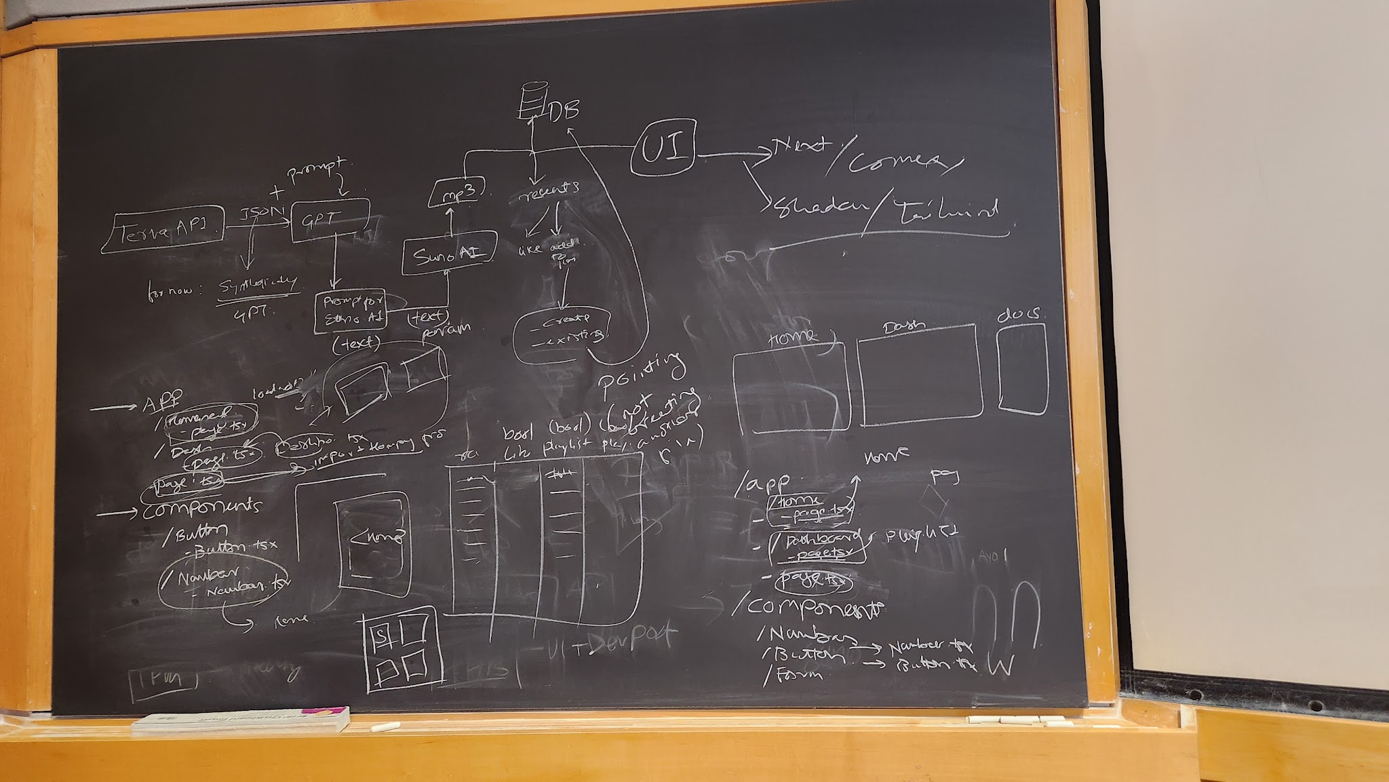

Slide 14
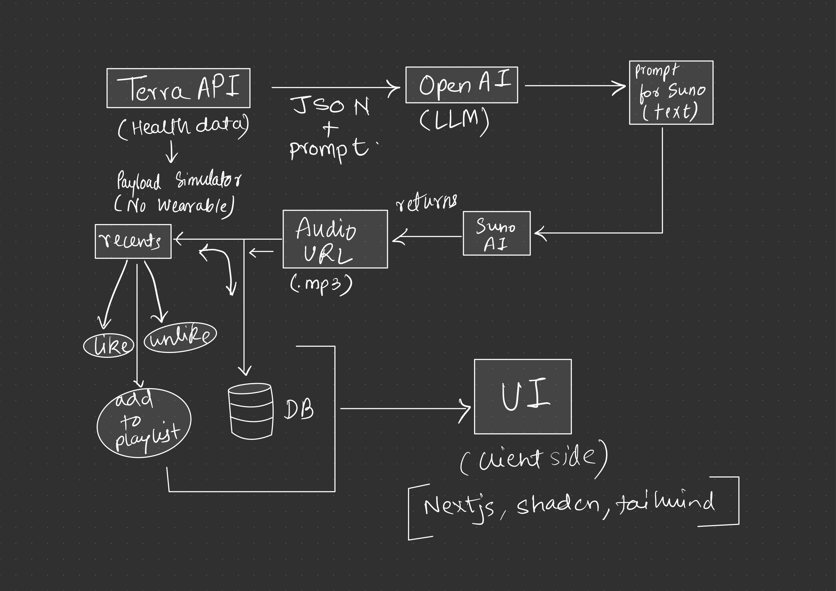

Slide 15
Thank you

