Slide 1
BLUESTOCK FINTECH · CAPSTONE PROJECT
Mutual Fund Analytics
Platform
ETL Pipeline · EDA · Performance Metrics · Interactive Dashboard
BY
SUCHITHRA S
ID:BFDA76968
Suchithra.s.work@gmail.com
Notes:
Welcome slide. Introduce the team and the project scope: 7-day capstone building a full analytics pipeline for Indian mutual funds.

Slide 2
PROBLEM & OBJECTIVE
THE PROBLEM
OUR OBJECTIVE
Indian retail investors lack unified tools to analyse mutual fund performance across thousands of schemes.
Data is scattered across SEBI, AMFI, and fund house portals — making comparison, risk assessment, and recommendation nearly impossible without technical expertise.
Build an end-to-end analytics platform that:
Ingests 10 datasets (NAV, AUM, SIP, transactions, benchmarks)
Stores data in a normalised SQLite database
Computes CAGR, Sharpe, Beta, VaR, Max Drawdown
Surfaces insights via Power BI dashboard
Recommends funds based on investor risk profile
Notes:
Frame the business problem: 7,000+ mutual funds, fragmented data, no single platform. Our capstone solves this with a production-quality ETL + analytics stack.

Slide 3
DATA SOURCES
D1
D2
D3
D4
D5
Fund Master
NAV History
AUM by Fund House
SIP Inflows
Category Inflows
7,400+ schemes with category, AMC, risk grade
Daily NAV time-series, 3+ years of data
Monthly AUM aggregated by AMC
Monthly SIP inflow (₹ Crore) & account data
Equity / Debt / Hybrid net flow trends
D6
D7
D8
D9
D10
Folio Count
Scheme Performance
Investor Transactions
Portfolio Holdings
Benchmark Indices
Industry-level investor count by category
1yr / 3yr / 5yr returns, Sharpe, Alpha, Beta
10K synthetic transactions with demographics
Equity holdings for top schemes
Nifty 50, Nifty 500, BSE Sensex NAV series
Notes:
10 datasets sourced from AMFI, SEBI data portals, and synthetic transaction generation. Combined dataset spans 2022–2025.

Slide 4
SYSTEM ARCHITECTURE
Raw CSVs
& Live NAV
ETL
Pipeline
SQLite
Database
Analytics
Notebooks
Power BI
Dashboard
▶
▶
▶
▶
AMFI API
+ mfapi.in
etl_pipeline.py
clean + validate
bluestock_mf.db
6 normalised tables
EDA · Performance
Advanced
4 pages
20+ visuals
TECH STACK
Python 3.11 · Pandas / NumPy · SQLite3 · Matplotlib / Seaborn · Power BI Desktop · mfapi.in · Git + GitHub
Notes:
The pipeline is fully automated: raw CSVs land in data/raw, the ETL normalises and loads to SQLite, and downstream notebooks + Power BI connect to that single source of truth.

Slide 5
EDA HIGHLIGHTS — INVESTOR & FUND DEMOGRAPHICS
📊 Key Insight: 26–45 age cohort drives 61% of investment volume. Equity funds dominate AUM (42%), with Debt at 24%.
Notes:
EDA on 10,000 investor transactions reveals young working professionals (26–45) as the primary investor base. Equity dominates by count but Debt by average ticket size.

Slide 6
EDA HIGHLIGHTS — SIP GROWTH & NAV TRENDS
₹25,323 Cr
Peak SIP Inflow
(Jan 2025)
120%
3-Year SIP
Growth
7.2 Cr
Active SIP
Accounts
📈 SIP inflows grew 120% from ₹11,517 Cr (Jan 2022) to ₹25,323 Cr (Jan 2025) — confirming rising retail participation in Indian equity markets.
Notes:
SIP trend analysis: India's monthly SIP inflows doubled in 3 years. This reflects increased financial awareness and digital adoption post-COVID.

Slide 7
PERFORMANCE METRICS — RISK & RETURN
Best Sharpe Ratio
▲ 2.41
SBI Bluechip Direct
Lowest Max Drawdown
▼ -8.2%
HDFC Short Term Debt
Best VaR (95%)
◆ -0.84%
ICICI Pru Liquid
Best Alpha
★ 1.98
HDFC Short Term Debt
Notes:
Small-cap funds dominate 5-year CAGR, but investors need risk-adjusted context. Sharpe ratio tells a more complete story — SBI Bluechip Direct leads on risk-adjusted return.

Slide 8
PERFORMANCE METRICS — ALPHA, BETA & VaR
RISK METRICS
Value at Risk (95%)
Max daily loss at 95% confidence. Range: -0.84% (liquid) to -3.2% (small-cap).
Conditional VaR (CVaR)
Expected loss beyond VaR. Small-cap funds show CVaR of -4.8%.
Beta Insight
Debt funds (Beta < 0.5) are market-neutral. Equity funds (Beta ~1.0) track Nifty closely.
Notes:
Key insight: High-alpha funds often have lower beta (debt/gilt funds). Equity funds have alpha close to benchmark. Investors should balance alpha generation with beta-controlled risk.

Slide 9
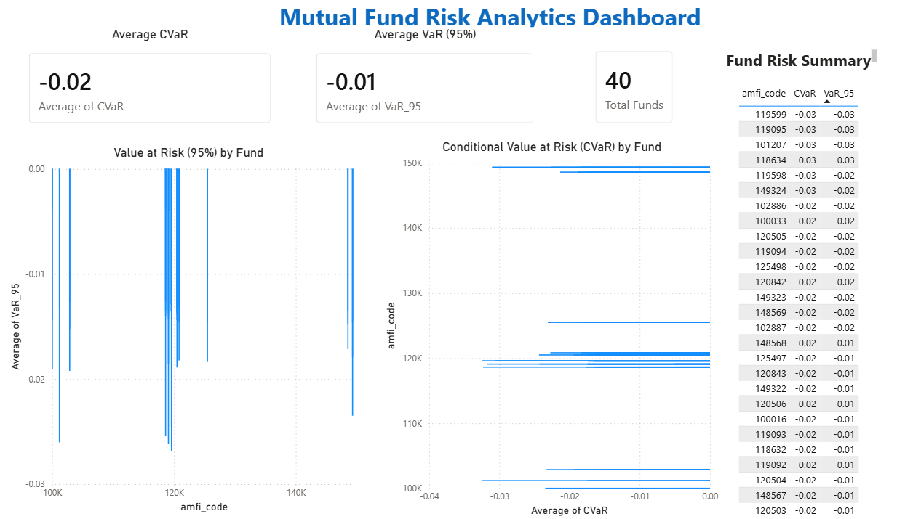
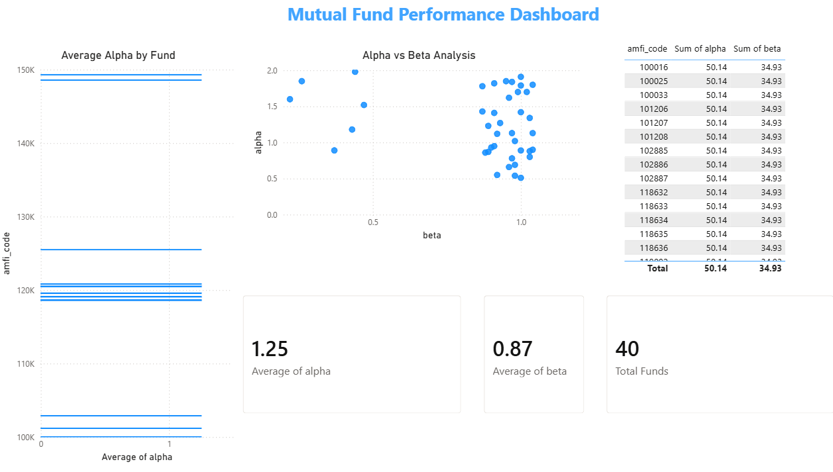
POWER BI DASHBOARD — OVERVIEW & PERFORMANCE
Page 1: Risk Analysis Overview
Page 2: Fund Performance
[ Dashboard Visual ]
✓ Average Alpha indicates positive excess returns generated by mutual fund schemes.
✓ Average Beta measures market sensitivity and helps assess fund volatility.
✓ Alpha vs Beta scatter analysis identifies funds with strong performance and controlled risk.
✓ Fund Performance Summary table enables comparison of Alpha and Beta metrics across 40 mutual fund schemes.
✓ Portfolio-wide risk overview using VaR and CVaR metrics
✓ Fund-wise comparison of downside risk exposure
✓ Summary of mutual funds included in the analysis
✓ Quick insights for portfolio risk assessment
Notes:
Power BI dashboard has 4 pages with slicers for Category, AMC, Risk Grade, and Date Range. Each page has at least 2 interactive filters as required.

Slide 10
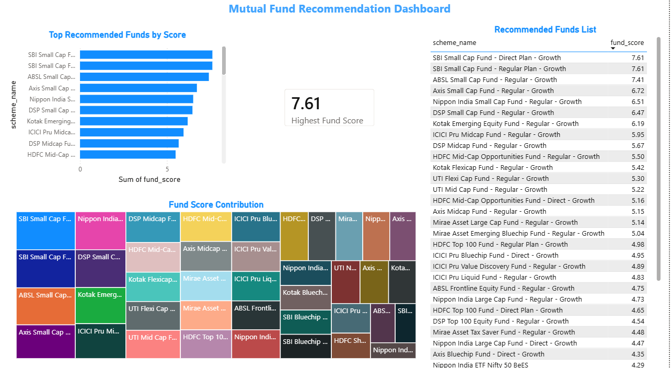
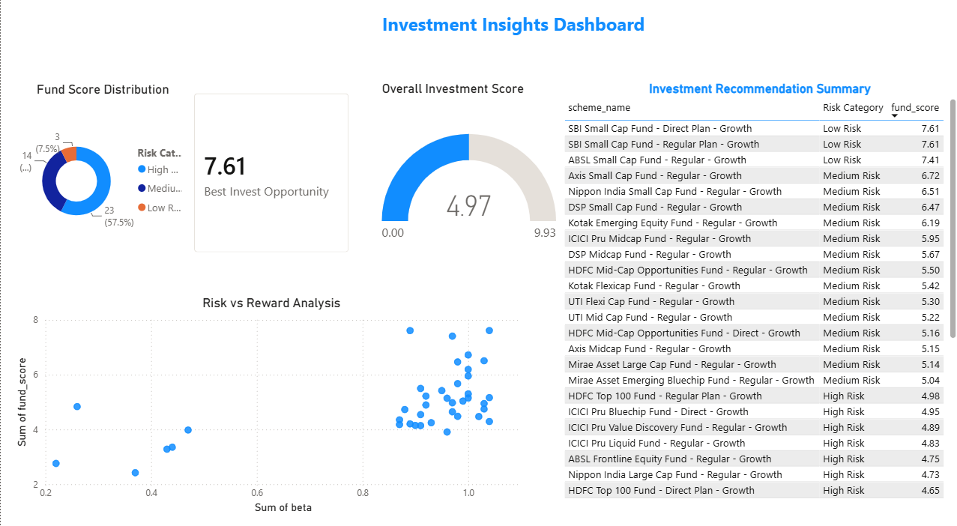
POWER BI DASHBOARD — RISK & RECOMMENDATION
Page 3: Fund Recommender
Page 4: Investment Insights Dashboard
✓ Ranking of mutual funds based on fund scores
✓ Identification of top recommended investment options
✓ Comparative analysis of fund performance metrics
✓ Supports data-driven investment decision making
✓ Categorizes mutual funds into Low, Medium, and High Risk groups
✓ Identifies the best investment opportunity based on fund score
✓ Evaluates the relationship between risk and expected reward
✓ Supports strategic portfolio selection using data-driven insights
Notes:
The recommender page is the flagship feature: investor inputs their risk tolerance and time horizon, and the dashboard returns the top 3 matched funds with comparison visuals.

Slide 11
KEY FINDINGS & RECOMMENDATIONS
01
SIP is the growth engine
02
Sharpe trumps raw return
03
Category allocation matters
Monthly SIP inflows grew 120% in 3 years. SIP-based investors show 2.3× better cohort retention than lump-sum investors.
Direct plan debt funds (Sharpe 1.8–2.4) outperform small-cap funds on risk-adjusted basis despite lower absolute returns.
A 60:30:10 (Equity:Debt:Hybrid) portfolio achieves Sharpe > 1.5 with max drawdown below -12% — balanced for retail investors.
04
Direct plans dominate
05
Young investors under-diversify
06
Pipeline is production-ready
Direct plans consistently show 0.5–1.0% higher alpha than Regular plans. Over 10 years this compounds to 8–15% additional corpus.
18–35 age group concentrates 72% of investments in equity; adding 20% debt exposure would reduce portfolio VaR by ~35%.
ETL runs end-to-end in < 90 seconds. Live NAV auto-updates via mfapi.in. Schema handles 7,400+ schemes with no manual steps.
Notes:
These 6 findings are directly supported by the data. Point 3 and 5 are actionable recommendations for retail investors. Point 6 covers technical readiness.

Slide 12
Thank You
Bluestock MF Capstone | June 2026
|https://github.com/suchithra-sys/bluestock_mf_capstone
Notes:
Close with a summary of all 7 deliverables completed. Invite questions on ETL design, risk metrics, or the recommender logic.

