Slide 1
Case Study 3
TEAM 12
MADE BY::
GUANXIONG LIU
JIANKUN BI
NAVEEN POTHAYATH
ABHISHEK EASWARAN
SUCHITHRA BALAKRISHNAN

Slide 2

Data
2000 samples are used.
1000 Positive reviews
1000 Negative review
Split into training and testing data.
Training data-75%
Test data=25%

Slide 3
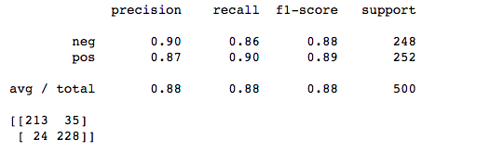
Sklearn Tutorial Problem

Slide 4
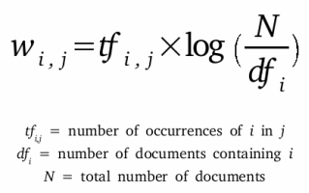
TFIDVECTORIZER
In information retrieval, tf–idf, short for term frequency–inverse document frequency, is a numerical statistic that is intended to reflect how important a word is to a document in a collection or corpus.^{[1]:8} It is often used as a weighting factor in information retrieval and text mining. The tf-idf value increases proportionally to the number of times a word appears in the document, but is offset by the frequency of the word in the corpus, which helps to adjust for the fact that some words appear more frequently in general.

Slide 5
Impact of min_df, max_df and ngram upper bound on the number of extracted features

Slide 6
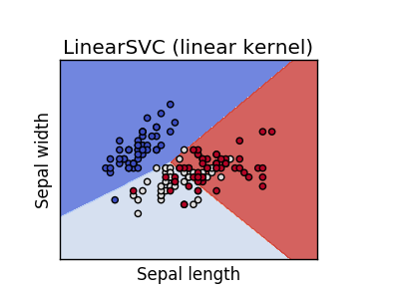
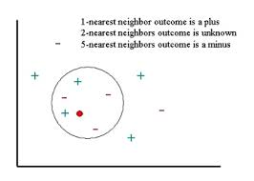
In machine learning, support vector machines (SVMs, also support vector networks[1]) are supervised learning models with associated learning algorithms that analyze data used for classification and regression analysis.
In pattern recognition, the k-Nearest Neighbors algorithm (or k-NN for short) is a non-parametric method used for classification and regression.[1] In both cases, the input consists of the k closest training examples in the feature space.

Slide 7
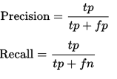
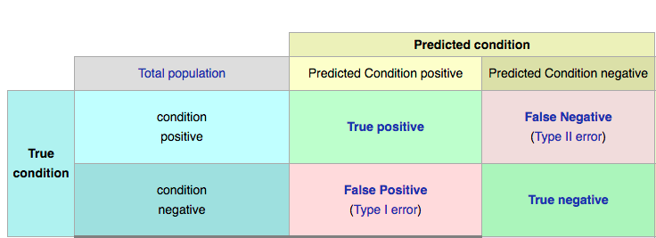
Evaluation Metrics

Slide 8
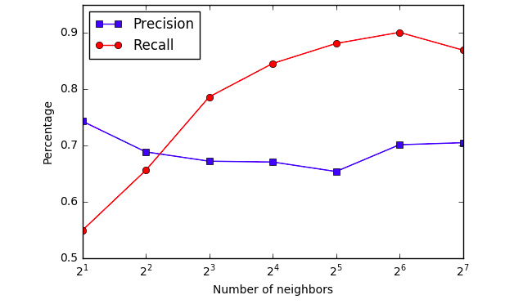
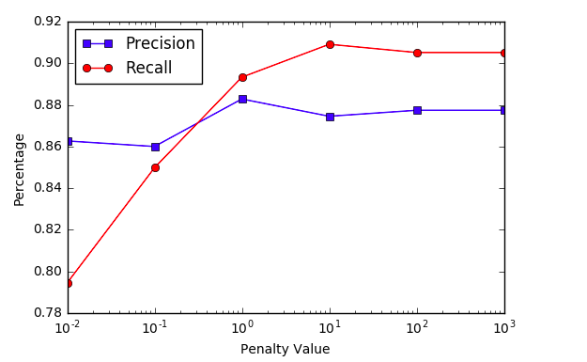
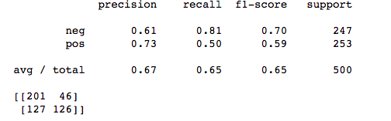
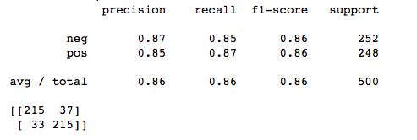
KNN
Linear SVC

Slide 9
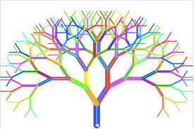
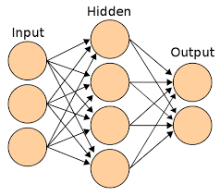
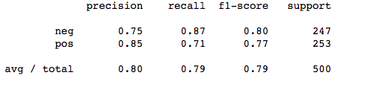
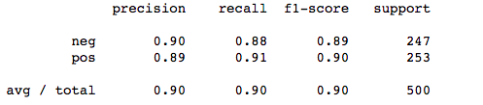
Random forests or random decision forests^{[1][2]} are an ensemble learning method for classification, regression and other tasks, that operate by constructing a multitude of decision trees at training time and outputting the class that is the mode of the classes (classification) or mean prediction (regression) of the individual trees.
A multilayer perceptron (MLP) is a feedforward artificial neural network model that maps sets of input data onto a set of appropriate outputs. An MLP consists of multiple layers of nodes in a directed graph, with each layer fully connected to the next one.

Slide 10
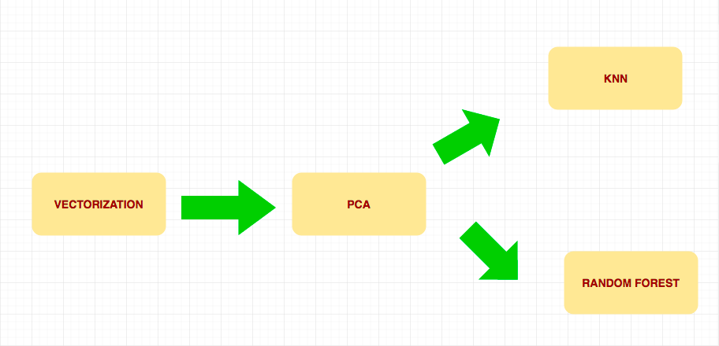
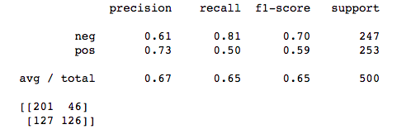
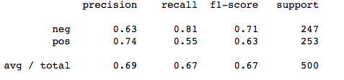
SYSTEM DIAGRAM FOR RANDOM FOREST/KNN WITH PCA
CONFUSION MATRIX FOR
KNN AFTER PCA
CONFUSION MATRIX FOR
RANDOM FOREST AFTER PCA

Slide 11
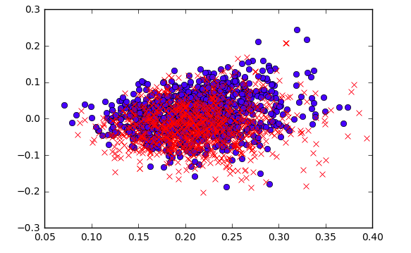
The Classification Problem
LSA
Latent semantic analysis (LSA) is a technique in natural language processing, in particular distributional semantics, of analyzing relationships between a set of documents and the terms they contain by producing a set of concepts related to the documents and terms.

Slide 12
Visualization of top 100 principal components
Too many features
Less correlation between features
Less information contained in top principal components

Slide 13
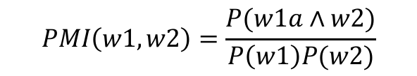
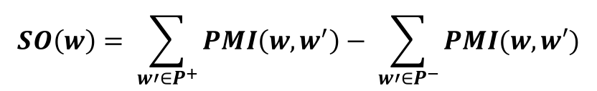
PMI
(Pointwise Mutual Information)
How “close” two words could be
Semantic Orientation
What’s the “Orientation” of each word

Slide 14
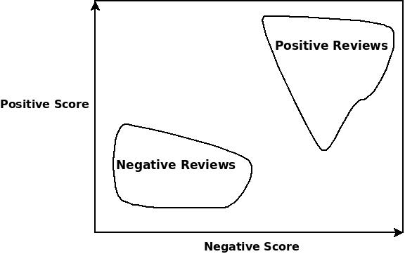
Semantic Orientation Analysis

Slide 15
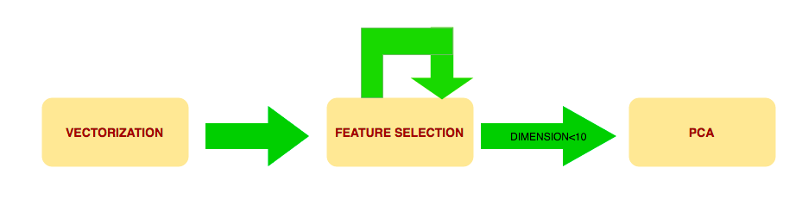
SYSTEM DIAGRAM FOR COMBINING FEATURE SELECTION AND PCA
Visualization of principal
components

Slide 16
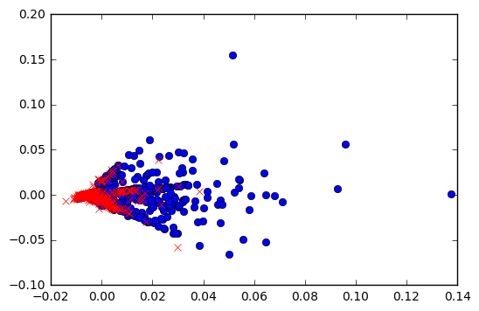
Final visualization

Slide 17

End
Q&A

