Slide 1
Power BI Student Performance Dashboard

Slide 2
About Power BI
Power BI is a Business Intelligence tool by Microsoft
Used to analyze data and create interactive dashboards
Helps in data-driven decision making

Slide 3
Power BI Components
Power BI Desktop – Report creation
Power BI Service – Cloud publishing & sharing
Power BI Mobile – Dashboard access on mobile

Slide 4
Student Performance Dashboard Overview
Total Students: 20,000
Average Study Hours: 4.01
Average Attendance: 70.02%
Average Exam Score: 62.51

Slide 5
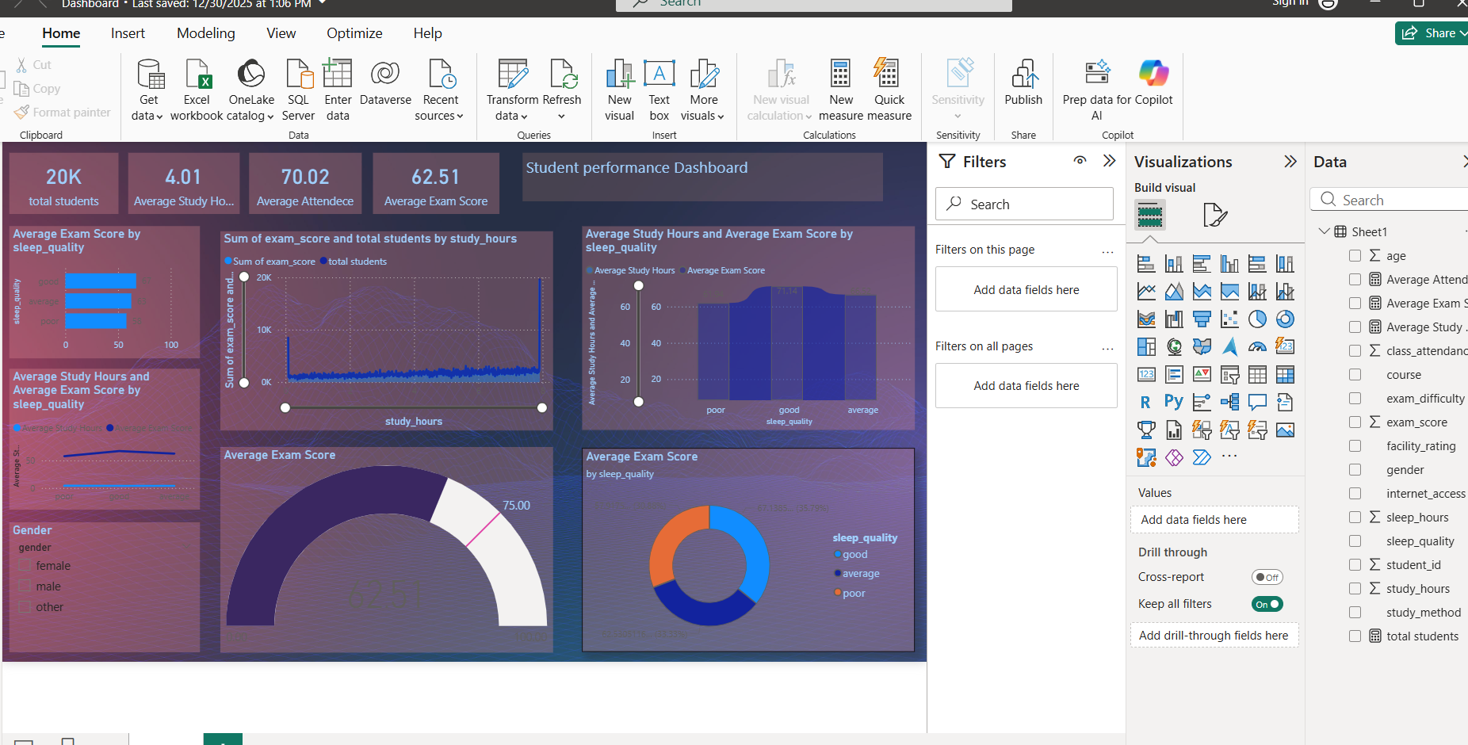
Student Performance Dashboard (Power BI)

Slide 6
Key Insights from Dashboard
Good sleep quality leads to higher exam scores
Students with more study hours perform better
Poor sleep quality negatively impacts performance

Slide 7
Power BI Visualizations Used
Cards – Key metrics like total students and averages
Bar & Column charts – Sleep quality vs scores
Line charts – Study hours vs exam scores
Donut & Gauge charts – Performance distribution

Slide 8
Benefits of Power BI for Analysis
Interactive and dynamic dashboards
Easy data filtering and slicing
Clear visualization of trends and patterns

Slide 9
Conclusion
Power BI simplifies complex data analysis
Dashboard highlights factors affecting student performance
Useful for academic and institutional decision-making

