Slide 1


CMR TECHNICAL CAMPUS
UGC AUTONOMOUS
Accredited by NBA & NAAC with A Grade
Approved by AICTE, New Delhi and Affiliated to JNTU, Hyderabad
Department of CSE(Cyber Security)
MAJOR PROJECT (REVIEW-2)
Eye Movement Controlled Cursor Using OpenCV A Hands-Free Mouse Solution
Under the guidance
of
G.V. Ashritha
(Assistant Professor)
Group Members:
SUCHITHRA RAVULA 227R1A6249
SWETHA THADEM 227R1A6258
MURALI KRISHNA VANGA 227R1A6261
FARHAN ABASSI 227R1A6232

Slide 2

TABLE OF CONTENTS
1. Abstract
2. Problem Definition
3. Literature Review
4. Objectives
5. Proposed Methodology
6.Analysis
7.Implementation
8. Design/Modeling
9. References

Slide 3
ABSTRACT
This project presents a hands-free solution for computer interaction using eye movement tracking via OpenCV. Aimed primarily at individuals with motor disabilities, the system uses real-time video input to detect and track the user's eye movement, translating these movements into cursor control commands. By eliminating the need for traditional mouse hardware, this solution promotes accessibility and hands-free computing using only a webcam and intelligent software.

Slide 4
PROBLEM DEFINITION
Physically challenged users often face difficulties in interacting with computers due to reliance on hardware-based input methods. There is a need for a low-cost, software-based, hands-free interface that enables effective and intuitive cursor control using only eye movements.
Most computer systems rely on physical input devices (mouse, keyboard, touchpad).
People with motor disabilities face difficulties in using traditional devices.
Existing eye-tracking hardware is costly and requires specialized equipment.
Lack of affordable, real-time, and software-based accessibility solutions.
Need for a low-cost, hands-free cursor control system using webcams and computer vision

Slide 5
OBJECTIVES
Objective | Description
Hands-Free Computer Control | Enable users to operate the mouse cursor using only eye movements, eliminating the need for physical devices like a mouse or touchpad.
Accessibility for Disabled Users | Provide an alternative input method for people with motor impairments, improving digital accessibility and inclusivity.
Real-Time Eye Tracking | Implement OpenCV and MediaPipe for real-time detection and tracking of eye movements with high accuracy and minimal latency.
Cursor Movement Based on Eye Gaze | Map eye gaze positions to cursor movement, ensuring smooth and precise control of on-screen navigation.
Click and Selection Simulation | Replace mouse clicks with eye-based gestures such as blinking or prolonged gaze, allowing complete mouse functionality.
Cost-Effective HCI Solution | Develop a low-cost, software-based approach using a standard webcam without requiring specialized hardware.
Robustness to Lighting & Head Movements | Ensure reliable performance under varying lighting conditions and small head shifts, making the system practical in real-world environments.
User-Friendly Interface | Create an intuitive and easy-to-use interface that requires minimal training, improving user adoption.
Application in Assistive Technologies | Support assistive systems such as virtual keyboards, online learning tools, and remote communication for disabled users.
Future Scalability | Allow integration with advanced AI models for enhanced accuracy, gesture expansion, and potential VR/AR applications.

Slide 6
LITERATURE REVIEW
Study | Year | Focus | Methodology | Key Contributions | Relevance to Eye-Movement Controlled Cursor
Hand Gesture Recognition Based Virtual Mouse Events (Ranawat et al.) | 2021 | Vision-based mouse using hand gestures | OpenCV + PyAutoGUI for hand tracking and gesture mapping | Eliminates external hardware; tested under lighting and skin variations | Demonstrates feasibility of low-cost vision-based HCI systems
Virtual Mouse Control Using Coloured Fingertips (Reddy et al.) | 2022 | Fingertip recognition for cursor control | Coloured caps + contour & convex hull tracking | Supports multiple mouse operations (click, scroll); real-world tests | Shows contour-based approach but dependent on skin tone & coloured caps
Mouse on a Ring (Zhao) | 2022 | Portable IMU-based virtual mouse | Smart ring with IMU sensors + multi-level decision algorithm | High accuracy (>96%), portable, no 2D surface needed | Highlights hardware-based alternative, emphasizes portability

Slide 7
Wireless Gyro-Mouse (Pogoreanu & Bozomitu) | 2022 | Text input via virtual keyboard using IMU mouse | Gyroscope + accelerometer, dwell-time selection | Achieved ~4.1 WPM typing; user-friendly, easy to learn | Provides insights into IMU-based assistive text entry
Gesture Recognition Virtual Mouse & Keyboard (Unspecified) | ~2020s | Combined virtual mouse & keyboard using vision | Hand gestures mapped to cursor and keyboard inputs | Extends gesture recognition to both mouse & keyboard | Illustrates broad potential of vision-based HCI
Real-time Eye Gaze Classification (George & Routray) | 2016 | Eye gaze direction for HCI | CNN-based eye gaze classification + facial landmarks | Real-time, useful for attention tracking & cognitive cues | Directly relevant: gaze + CNN supports eye-controlled cursor systems

Slide 8

EXISTING SYSTEM
Traditional human-computer interaction methods, such as keyboards and mice, present accessibility challenges for individuals with motor impairments. This project introduces an innovative, hands-free cursor control system using eyeball movement detection, leveraging Raspberry Pi, OpenCV, and dlib's facial landmark detection. The proposed system tracks eye movements in real time and translates them into cursor movements, enabling seamless control of a computer without physical input devices
Current input systems largely depend on physical interfaces such as a mouse, keyboard, or touchpad. Assistive technologies such as head trackers or eye-tracking hardware exist, but they are often expensive, require specialized equipment, and lack open-source adaptability.
Most conventional systems do not leverage computer vision for accessible input in an affordable way

Slide 9
PROPOSED METHODOLOGY
This project proposes a low-cost, camera-based solution using OpenCV for real-time eye detection and tracking. The key steps include:
1. Capturing real-time video through a webcam.
2. Detecting facial and eye landmarks using computer vision techniques.
3. Mapping eye movements to cursor actions on the screen.
4. Implementing blink detection as a click event (left/right click).
The system is fully software-driven, leveraging Python and OpenCV to deliver a functional, accessible, and responsive hands-free mouse interface

Slide 10
Analysis
Feasibility Analysis
Technical: Uses Python with OpenCV, Dlib, and PyAutoGUI; works with any webcam.
Economic: Fully cost-effective since all tools are open-source and require no extra hardware.
Operational: Easy to use and suitable for people with physical disabilities, providing real-time cursor control through eye movement.
Functional Analysis
Face Detection: Identifies the user’s face.
Eye Tracking: Detects and tracks eye movements.
Cursor Mapping: Converts gaze direction into cursor motion.
Blink Detection: Uses blinking to perform click actions.

Slide 11
Implementation
Phase 1: Camera Initialization and Frame Capture
The webcam is activated using OpenCV’s cv2.VideoCapture() function.
Each frame is captured in real-time and converted to grayscale to reduce processing complexity.
import cv2
cam = cv2.VideoCapture(0)
while True:
ret, frame = cam.read()
gray = cv2.cvtColor(frame, cv2.COLOR_BGR2GRAY)
cv2.imshow("Eye Tracking", gray)

Slide 12
Phase 2: Face and Eye Detection
Haar Cascade Classifiers or Dlib’s 68 Facial Landmarks are used to detect the position of eyes.
The region of interest (ROI) is extracted around the eyes for further tracking.
face_cascade = cv2.CascadeClassifier('haarcascade_frontalface_default.xml')
eye_cascade = cv2.CascadeClassifier('haarcascade_eye.xml')
faces = face_cascade.detectMultiScale(gray, 1.3, 5)
for (x, y, w, h) in faces:
roi_gray = gray[y:y+h, x:x+w]
eyes = eye_cascade.detectMultiScale(roi_gray)

Slide 13
3: Pupil Detection and Gaze Estimation
Inside the detected eye region, thresholding and contour detection are applied to locate the pupil (darkest region).
The pupil’s centroid coordinates are calculated to estimate gaze direction (Left, Right, Up, Down).
_, thresh = cv2.threshold(roi_gray, 30, 255, cv2.THRESH_BINARY_INV)
contours, _ = cv2.findContours(thresh, cv2.RETR_TREE, cv2.CHAIN_APPROX_SIMPLE)
for cnt in contours:
(cx, cy), radius = cv2.minEnclosingCircle(cnt)

Slide 14
Phase 4: Cursor Mapping
The detected gaze coordinates are mapped to the screen coordinates using the pyautogui library.
The eye movement’s direction corresponds to mouse pointer movement.
import pyautogui
screen_w, screen_h = pyautogui.size()
x = int((cx / frame.shape[1]) * screen_w)
y = int((cy / frame.shape[0]) * screen_h)
pyautogui.moveTo(x, y)

Slide 15
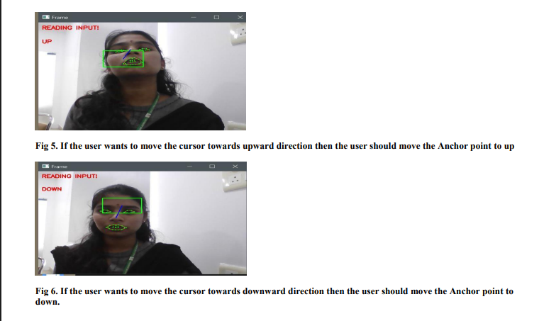
Output

Slide 16
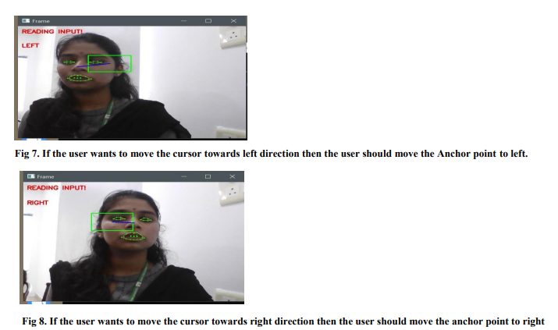

Slide 17
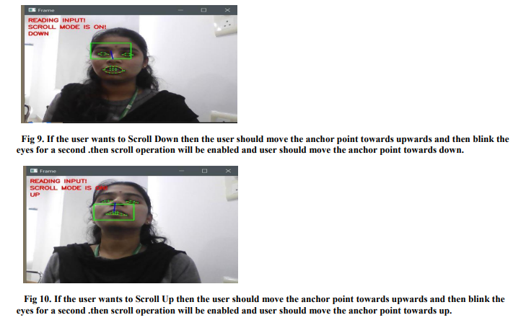

Slide 18
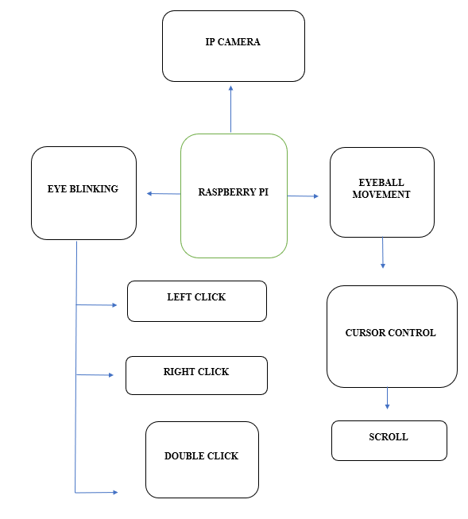
ARCHITECTURE

Slide 19
REFERENCES
Zhiwei Zhu and Qiang Ji, “Eye and gaze tracking for interactive graphic display,” Machine Vision and Applications, vol. 15, no. 3, pp. 139–148, 2004.
M. Chau and M. Betke, “Real time eye tracking and blink detection with USB cameras,” Boston University Computer Science Technical Report, 2005.
D. W. Hansen and Q. Ji, “In the eye of the beholder: A survey of models for eyes and gaze,” IEEE Transactions on Pattern Analysis and Machine Intelligence, vol. 32, no. 3, pp. 478–500, 2010.

Slide 20
Thank you!!!

