Slide 1

Grown-Ups Next-Door!
Team:
2+2=5
Avantika Karki
Chao Feng Huang
Suchi Undevia

Slide 2
Product Vision
FOR a senior person WHO wants to share their skills, learn from others while engaging with the neighbours THE Grown-Up Next-Door IS A web application THAT allows senior people within the local community to make friends, share interests, organize, and join activities and find useful local information promptly. UNLIKE other applications or platforms that are too complex to use and not focusing on senior people.

Slide 3
User Stories

Slide 4
User Story
As a person in the neighbourhood, I want to view the activities or classes I am interested in, so that I don't have to spend a long time searching through the city events.

Slide 5
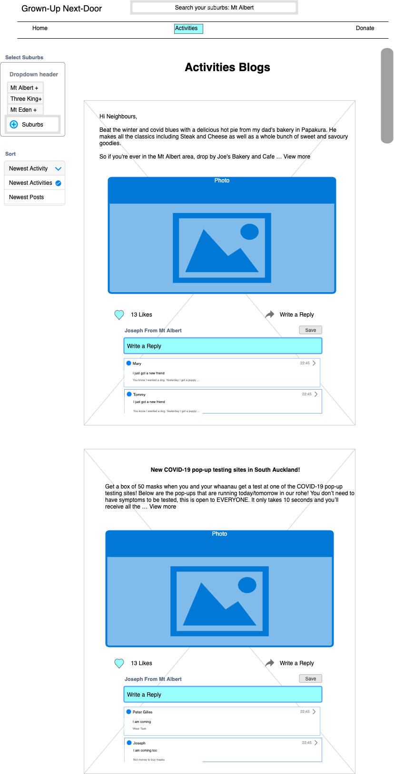
Activities List

Slide 6
User Story
As a senior person, I want to add location and contact details when arranging an activity, so that everyone attending knows where to arrive.

Slide 7
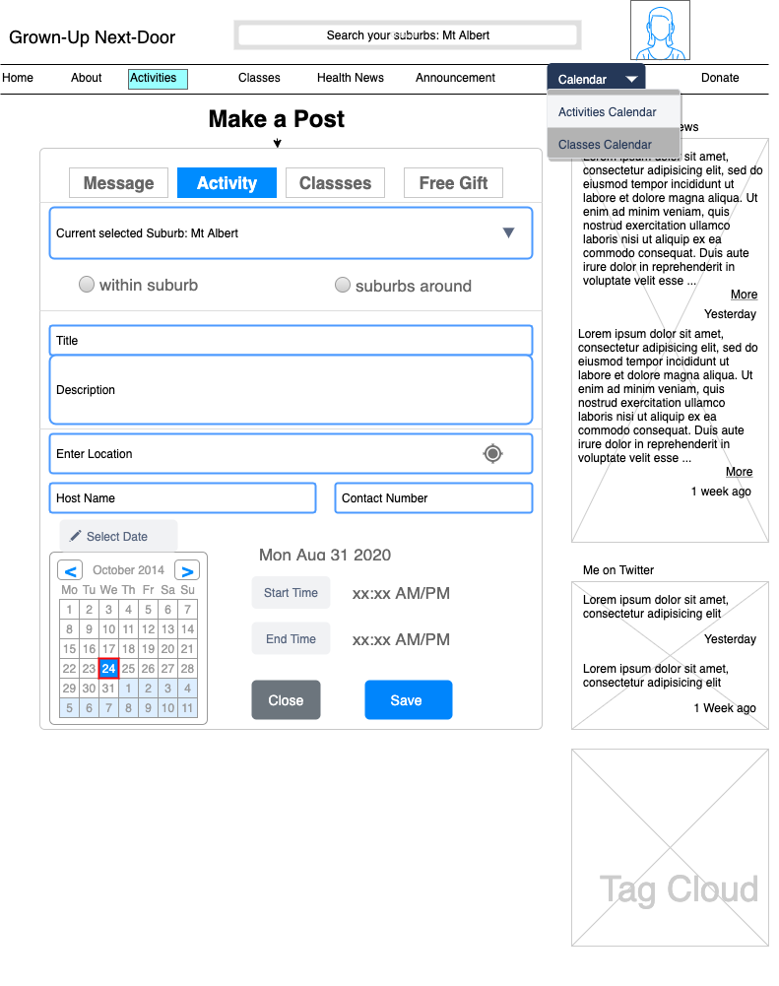
Organise Activity

Slide 8
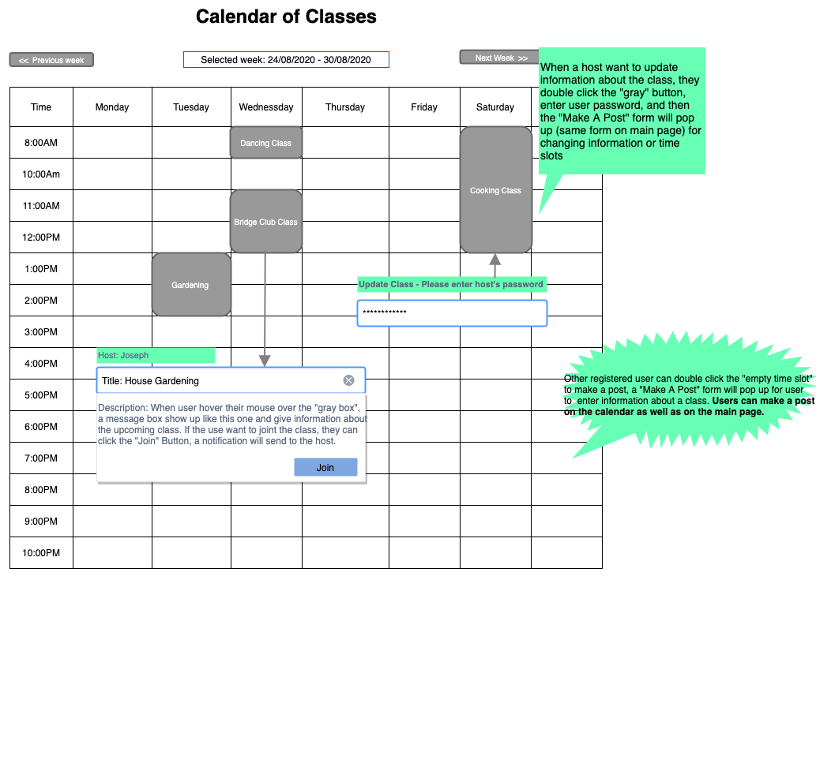
Activity Calendar

Slide 9
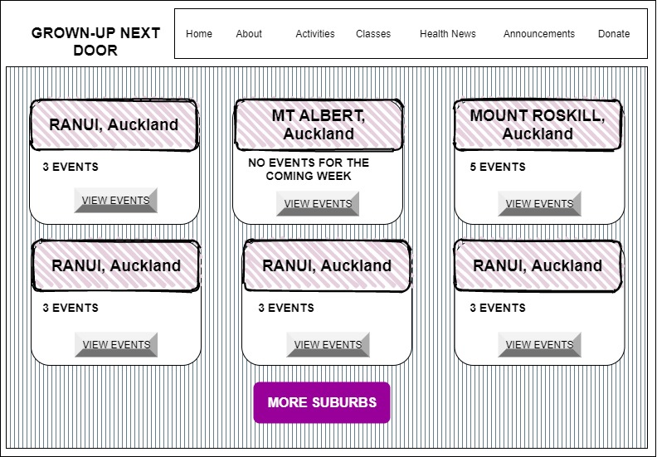
Suburb Selection

Slide 10
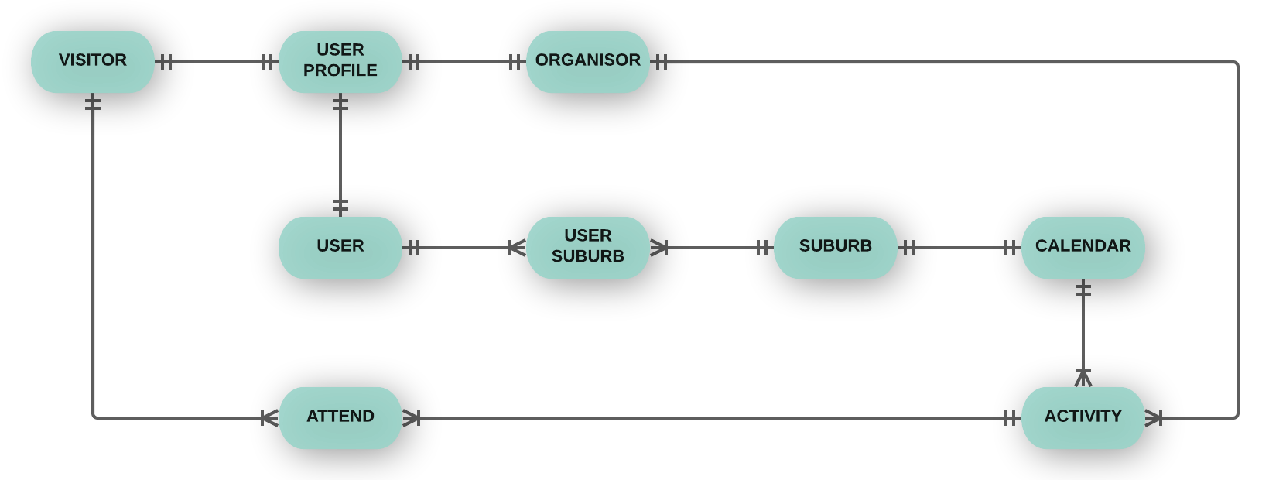
Conceptual ERD

Slide 11
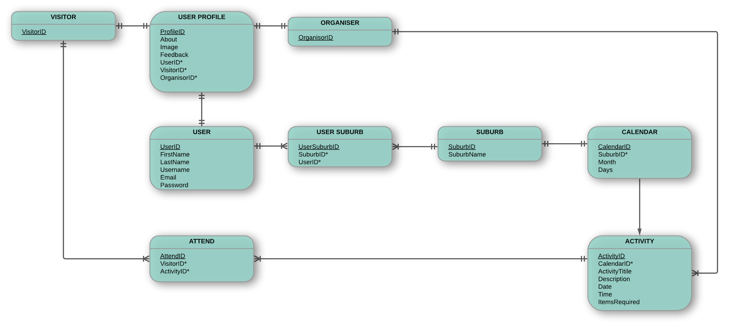
Logical ERD

Slide 12
Retrospective
More research required for implementation for web framework and deployment (to be considered during estimating story points)
We learned about a lot of different tools that can assist us execute the project.
While working on the wireframes, we realized that we may not enough time to build a complete, fully functional application. We may only achieve a MVP (a basic version).

Slide 13
Next Tasks
Refine acceptance criteria
Update YouTrack board
Update Story Point Estimates
Start Implementation

