Slide 1

Grown-Ups Next-Door!
Avantika Karki
Chao Feng Huang
Suchi Undevia

Slide 2
Product Vision
FOR a senior person WHO wants to share their skills, learn from others while engaging with the neighbours THE Grown-Up Next-Door IS A web application THAT allows senior people within the local community to make friends, share interests, organise, and join activities and find useful local information promptly. UNLIKE other applications or platforms that are too complex to use and not focusing on senior people.

Slide 3
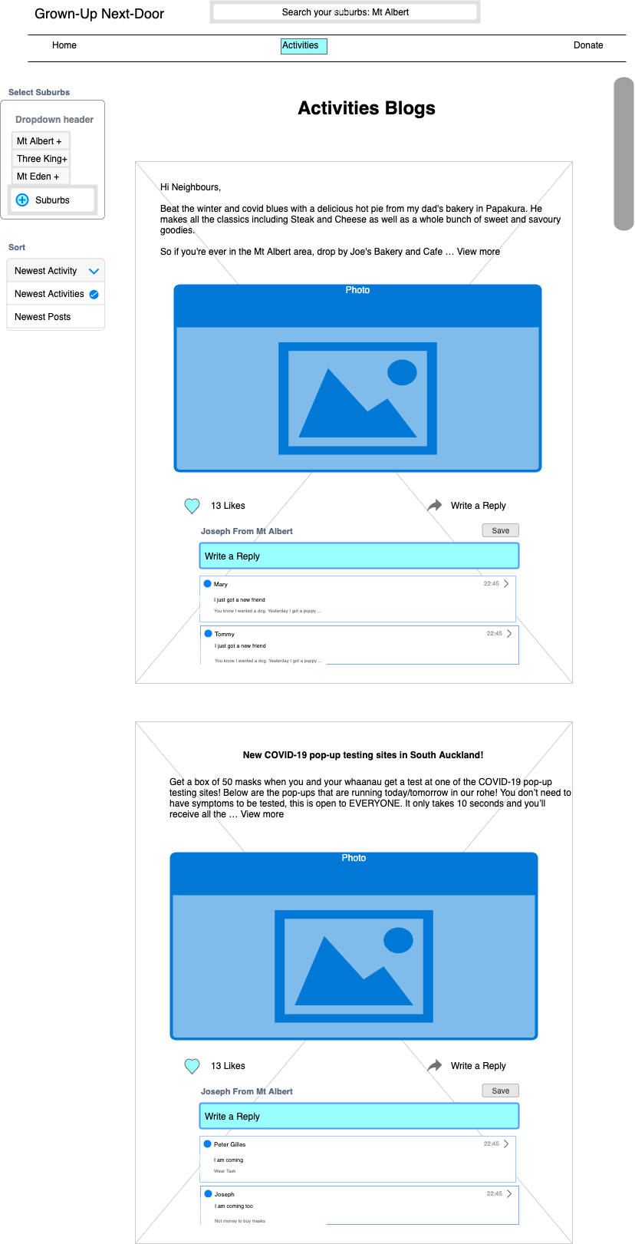
Activities List

Slide 4
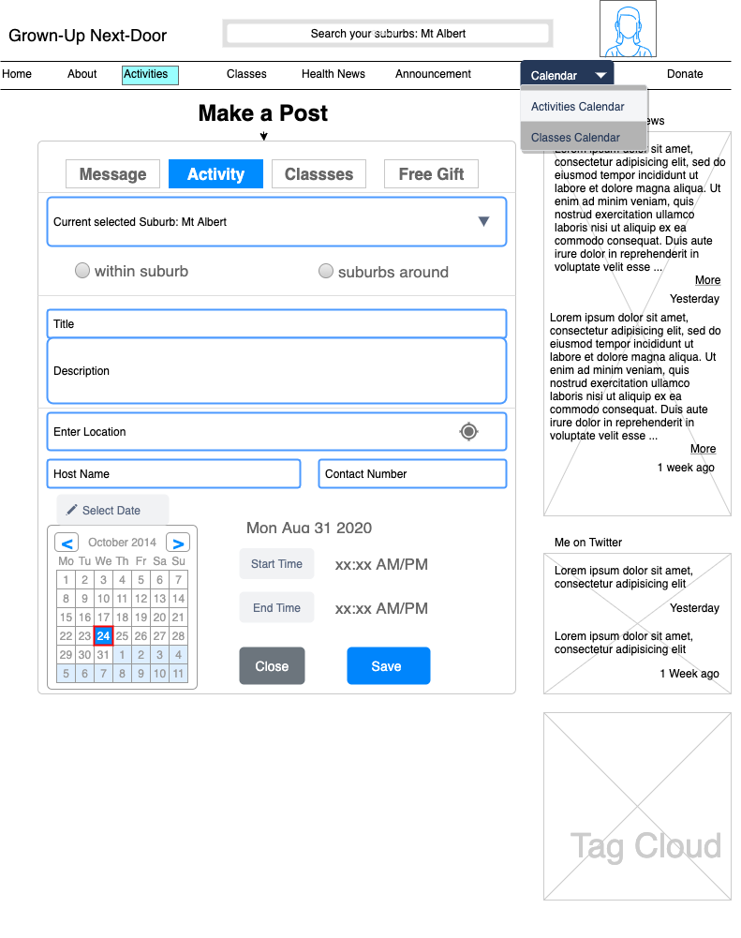
Organise Activity

Slide 5
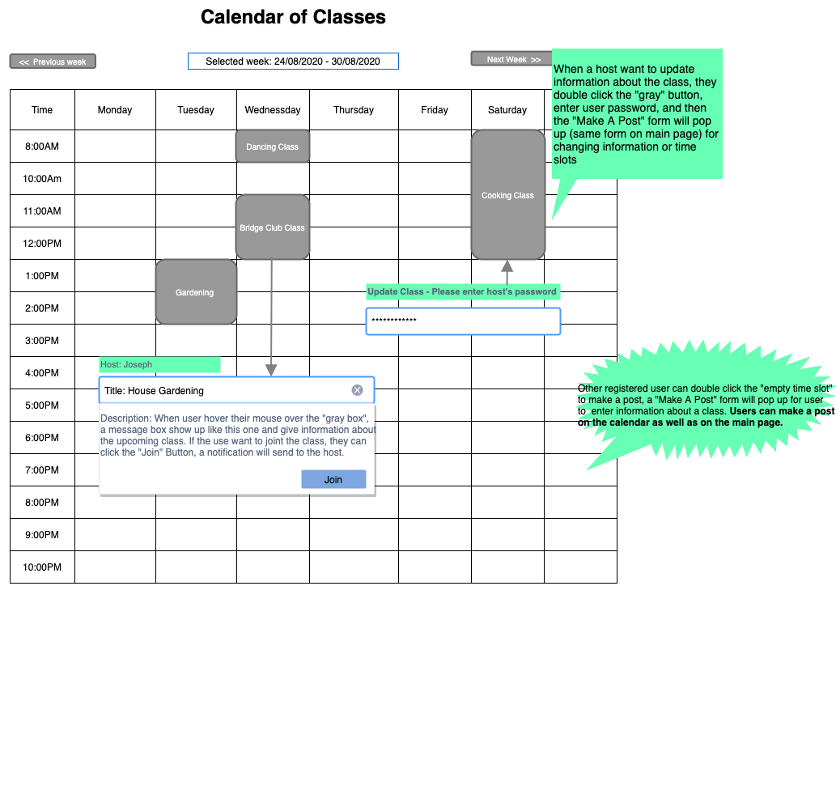
Activity Calendar

Slide 6
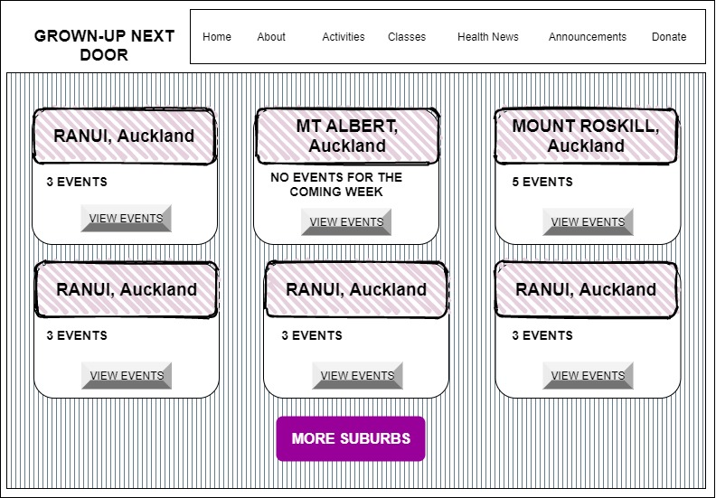
Suburb Selection

Slide 7
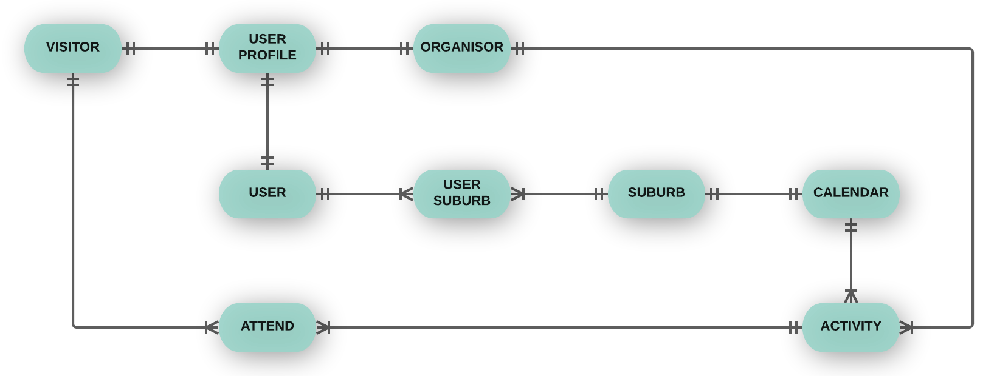
Conceptual ERD

Slide 8
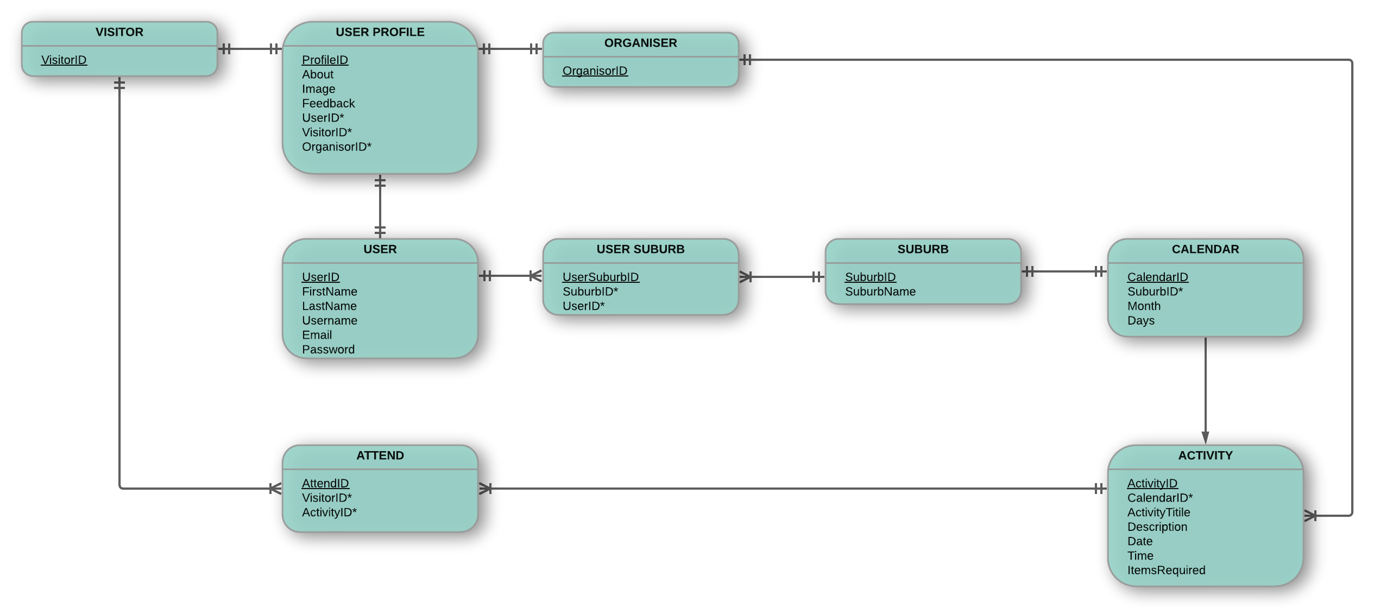
Logical ERD

Slide 9
Next Tasks
Sprint 01 User story selection
Sprint 01 Planning
Refine acceptance criteria
Update YouTrack board
Update Story Point Estimates

