Slide 1
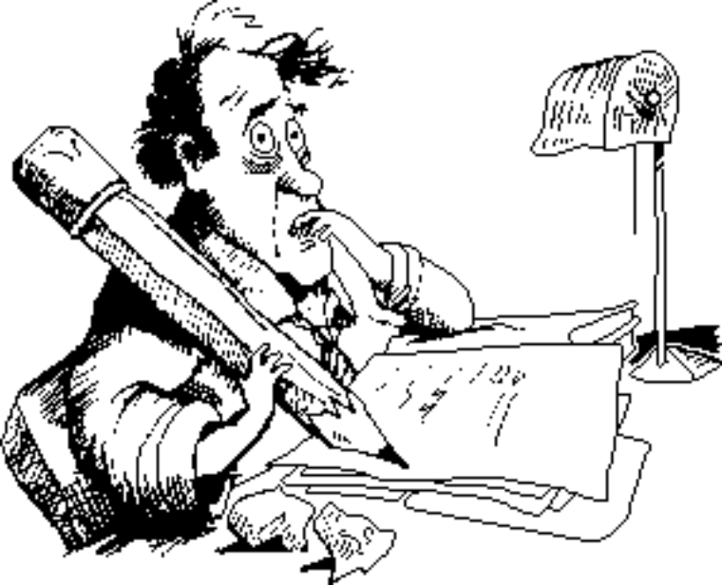
How to Write a
Research Paper and Thesis
Saul Greenberg
University of Calgary

Slide 2
How to write a research paper and thesis
The Messages:
  Write to communicate and contribute information you feel is important
  Papers and theses have typical structures and contents
  A thesis gives more room to develop arguments
  To write well: write often (with a mentor), and review papers
Outline
  Motivation
  When you should write a paper?
  Types of papers
  How referees evaluate papers
  Paper structure
  Thesis structure

Slide 3

Motivation: Why write?
Science includes the dissemination of knowledge
Purpose of a scientific paper:
  to communicate to the community
  to contribute to the advancement of knowledge

Slide 4
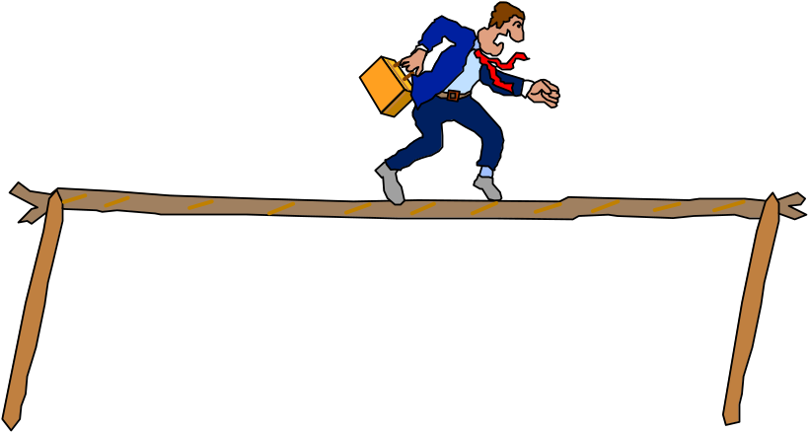
Motivation: Why write?
Writing
  the product of research
  audience:
    gives you a potentially wide audience
    reaches specialists/peers in your area
    but depends on where you publish
  archival:
    always available
    snapshot of your research work a given time
  vehicle for clarification
    for developing sound arguments, messages...
The downside:
  risky!
    months of work can be rejected

Slide 5

When you should write a paper
You should have something important enough to share with others
  new ideas
  new facts or data
  intelligent reviews of old facts and ideas
Mature results
  research milestone completed
  can articulate the research
    clear problem statement, solution, and contribution to discipline
never published

Slide 6
When you should NOT write a paper
Wrong reasons
  want or need publications
    increase publication count
    fame
    publish or perish
  peer pressure
  want to go to a conference
Bad papers/work will reflect badly on you!
  should always be proud of your paper
never published

Slide 7

Types of papers
Breakthrough
  solves an open problem that many people have worked on
  rare (one per conference, if lucky!)
Ground-breaking
  opens up a field/area that is not well explored
  places it on a firm foundation

Slide 8

Types of papers (continued)
Inventions
  clever variations/innovations that are appealing in their elegance
Progress
  solves open problems that have arisen from recent work
  typical conference/journal paper
Survey
  surveys and unifies a specialized subject
  contains added value (frameworks, taxonomies)
  brings together disparate work

Slide 9

How Referees Evaluate Papers
Purpose of Refereeing
  quality control
    eliminate bad papers
  choose best papers from a good set
    competition for space
Referees
  topic specialists
    is/has worked on similar problem
    knows literature, other work very well
    understands methodologies
    considers nuances of your work/contribution
  area specialists
    knows general area, and how your special topic fits within it
    considers contribution of your work to the general area
    evaluates comprehensibility by non-specialist
referee

Slide 10
Typical Questions on a Referee Form
Briefly summarize the paper (2-3 lines)
  can they extract a main message from your paper?
  “If you can’t, there is probably something wrong with the paper”
      --- CHI FAQ
What is new and significant in the work reported?
  New:
    has it been done before?
    is it a rehash / republication of old stuff (yours or others)?
  Significance
    in five years time, would the work have an identifiable impact? (rare)
  Would it stimulate further work in this area?
    is it a reasonable increment that keeps the research area going (frequent)?
    does it have innovations?
    is it interesting?
    is it timely to the community?

Slide 11
Questions on the referee form
How does it relate to existing work?
  bibliographies, background, important omissions...
How reliable are the methods used?
  are they adequate to support the conclusions
  is it correct?
    are there any errors (math, loopholes...)
How reasonable are the interpretations?
  good arguments
  alternative interpretations explored/left out
Can an experienced practitioner in the field duplicate the results from the paper and the references?
  unethical to publish something that can’t be reproduced

Slide 12
Questions on referee form
Is the subject relevant to the publication?
  domain
  depth of treatment
  degree of specialization
Describe the quality of the writing
  is the message clear?
  is the paper easy to follow and understand?
  is its style exciting or boring?
  good flow of logic/argumentation?
  is it well organized?
  is it grammatically correct?
  is it accessible to the audience of the publication?

Slide 13

Paper Structure
Title
  clearly describes the subject of the paper
    “Recognizing hand-written text”
      vs
    “DETENTE: Practical Support for Practical Action”
  can be catchy, but not at the cost of clarity
    “Bringing Icons to Life”
    “User Interface Design in the Trenches: Some Tips on Shooting from the Hip”
    “Virtual Reality on Five Dollars a Day”
A paper
by
Me

Slide 14
Paper Structure
Abstract
  Communicates results of paper
  Completely self-contained
    bibliographies, on-line databases...

Slide 15
Example abstract structure
  Background/setting the scene:
    Icons are used increasingly in interfaces because they are compact "universal" pictographic representations of computer functionality and processing.
  The focus and innovation:
    Animated icons can bring to life symbols representing complete applications or functions within an application, thereby clarifying their meaning, demonstrating their capabilities, and even explaining their method of use.
  The problem:
    To test this hypothesis, we carried out an iterative design of a set of animated painting icons that appear in the HyperCard tool palette.
  The method:
    The design discipline restricted the animations to 10 to 20 second sequences of 22x20 pixel bit maps. User testing was carried out on two interfaces - one with the static icons, one with the animated icons.
  The results:
    The results showed significant benefit from the animations in clarifying the purpose and functionality of the icons.

Slide 16
Paper Structure
Introductory Section (s)
  Sets the scene
  Gives background
  Motivates
  Defines general terms/concepts
  Describes problem and argues for the approach taking
  Relates to other work
  Summarizes the structure of the paper
    “The next section details the experimental methodology, which is a 2x2 Anova design. The subsequent section describes the results, the most notable being...”

Slide 17
Paper Structure (continued)
Main body
  Section organization reflects how your argument unfolds
  Each section should have a main point
  Each paragraph should have a main point
  Look at “exemplars” in your field
Summary/Conclusions
  Tell them what you’ve told them
    some people only read abstract, intro and conclusions
  Relate back to general area
  Introduce future work

Slide 18
Paper Structure (continued)
Figures and Tables
  should assist the reader
  tables:
    summarizes data
    collects main points described in text
  figures
    system snapshots
    conceptual diagrams
    should be legible, instructive, adequately labeled and titled

Slide 19
Using Figures and Tables
  should always refer to both in text
    make the reader look at it
    bad:
      “...animated icons contain movies ( Figure 1).”
    better:
      “... The several images in Figure 1 illustrates an example of an animated icon, which represents a printer. Each image is actually a key frame of a “movie” that, when played, would show the user what would happened if the icon were selected. We see a document being moved on top of the printer, and the printer putting out some paper...”
Examples and Scenarios
  excellent to clarify and to apply your ideas
  should be detailed enough to illustrate the concept, but not to the point of tedium

Slide 20
Paper Structure
Citations and References
  contains only the papers cited in your work
    use the best and most up to date literature
    make sure its relevant
    don’t overdo it
    avoid self-glorification
  must be correct and complete citation information
    can they find it from your information?
    prefer archival works to hard-to-get technical reports/obscure publications
  should conform to style of publication
    most publications are strict about this

Slide 21
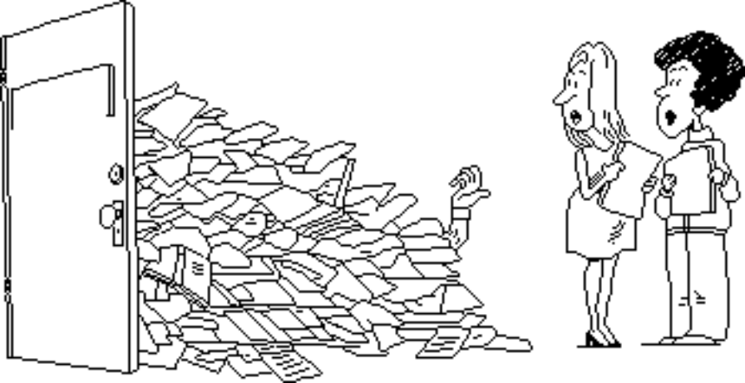
The Thesis
Format
  strictly set by Faculty of Grad Studies
    violations are grounds for rejection by the Faculty
    see “Thesis/Dissertation Guidelines” reading
  typesetting
    a “supported” LateX thesis style is available
    Microsoft Word style sheets
  do drafts in thesis format
    gives feeling for length, typographic structure
  length (MSc)
    100 pages, +/- 10 (MSc)
    balance:
      chapters should be of similar length
      (excepting intro and conclusions)
    appendices:
      could be “extra” to length
      lesser material
      excluded from microfilm record (?)
Thesis
drafts

Slide 22
The Thesis
Examiner’s Report
  thesis should usually cover/display
    use of relevant literature and techniques
    good organization
    literary competence
    good logic of inquiry in research and interpretation of results
    sound argumentation leading to conclusions
    sophistication
    originality
    contribution to the discipline
  thesis compared to other theses examined
  statement on author’s ability to do independent research
    see “Final Thesis Examination—Examiner’s Report” reading

Slide 23
The Thesis: Typical Structure
  Abstract:
    forms the steps of an argument
    each sentence outlines contents of thesis chapter
    should reflect the main thesis message
    describes:
      problem, motivation, current state of the art, what you did, results, significance, future work
  1: Introduction
    sets the scene, motivates, describes problem, chapter by chapter outline of thesis
  2: Related work
    current state of the art, synthesis of literature, frameworks for thinking about the area,
    describes parts of the problem that you will and won’t do (focus)

Slide 24
  3, 4: Heart of thesis
    develops logic of inquiry
    has clear and sound arguments
    interprets specific results
    discusses implications of results back to general area
  5 Conclusions/Further work
    summarize results and illustrate how they contribute to the discipline
    summarize original aspects of the work
    discuss future work that you or others could do
  6 References
    use standard formats, include all information
  See: The Researchers Bible, p 17-20

Slide 25
Other readings
  Knuth: Mathematical Writing
  Langley: Advice to Machine Learning Authors
  Greenberg: How to Structure Reports on Experiments in HCI
  Parberry: A Guide for New Referee in Theoretical Computer Science
  Forscher: Rules for Referees
  Exemplar papers in your area
  References to writing good English
To help you get your thesis done:
  write, write, write
  tell your supervisor you would like to review papers
  work with others
    as co-authour
    as reviewer/commenter
  have your supervisor review your writing
    begin writing now!

Slide 26
Conclusions
Write to communicate and contribute information you feel is important
Papers and theses have typical structures and contents that you should follow
A thesis gives more room to develop arguments
You should write to convince referees to accept your paper
A good way to write well is to:
  write, write, write
  review papers so you are familiar with how others will review yours
  work with an associate or mentor

