Slide 1
HOW TO MANAGE GEMS ACCOUT (PLACEMENT)
Abhishek Pandey
TPO NBNSSOE

Slide 2
ENGINEERING STUDENTS How to complete your profile for PLACEMENTS
Mozilla ( DO NOT USE IE )
Go to the URL(myecampus.info)
Login–you must know your username(your email id) and password(Default-123456)
Accept the license agreement by pressing “I Accept”.
Go to option button left hand side corner click on “Profile”.
Personal Details.
Contact Details.

Slide 3
How to complete your profile for PLACEMENTS..
7. 10thwith attached scanned copy of Mark-sheet.
8. 12thwith attached scanned copy of Mark-sheet.
Or
Diploma with attached scan copy of Mark-sheet.
9. UG (Click on View )If the student a direct second year admission case ( after Diploma )
i. Enter sem –1 and sem –2 total marks '0' ,out of '0' percentage '0'.
ii. If normal admission –enter semester wise marks.
iii. Click on upload button attach scannedcopy of Mark-sheet current Semester only.
10. Certification details if any
11. Projects undertaken if any
12. Work Experience if any
13. GAP –System automatically calculate your gap, only select gap year and enter reason.
14. Technical Skills if you want to highlight something important
15. Career Objective

Slide 4
How to complete your profile for PLACEMENTS..
16. After you do all and save –your profile MUST be approved by the TPO –Only after it is approved you will get placement notifications and will be able to register for companies. Approval means verification of the data you have entered by competent authority.
17. After approval you cannot edit your marks. For subsequent results –the TPO would unfreeze your profile. You can edit/add marks and then again your TPO needs to verify and approve your profile.
18. For Management students entering specialization is IMPORTANT as based on specialization the placement opportunities will be visible to you.
For Help either mail to helpdesk.gems@gmail.com
OR
Go To www.gems-on-line.comcreate an account and Raise a Ticket.

Slide 5
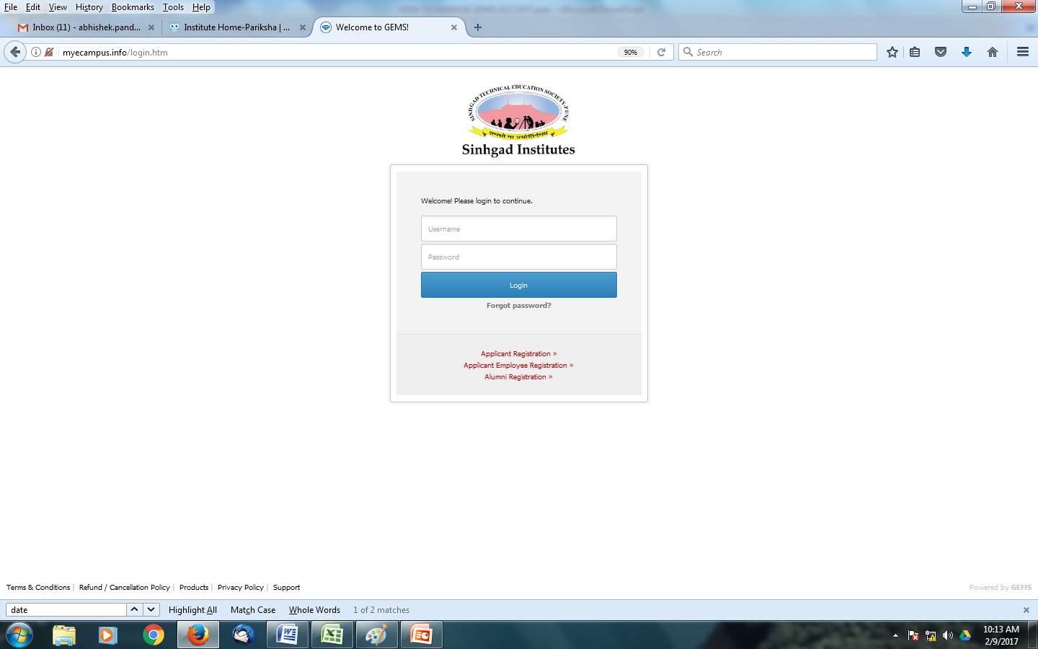
Your email id
123456 is default password, you should change it afterwards for security

Slide 6
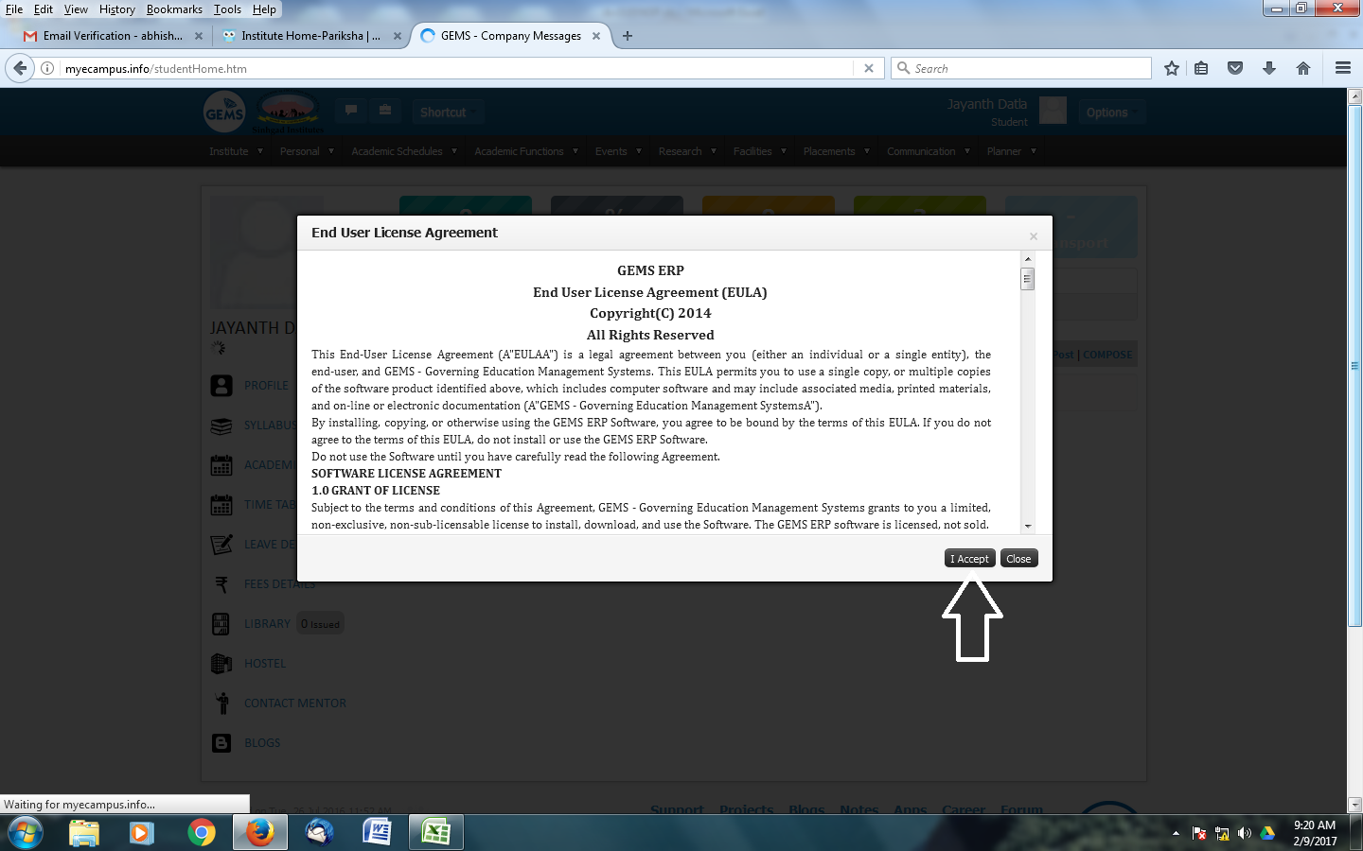
Logout and login again once you have accepted License agreement

Slide 7
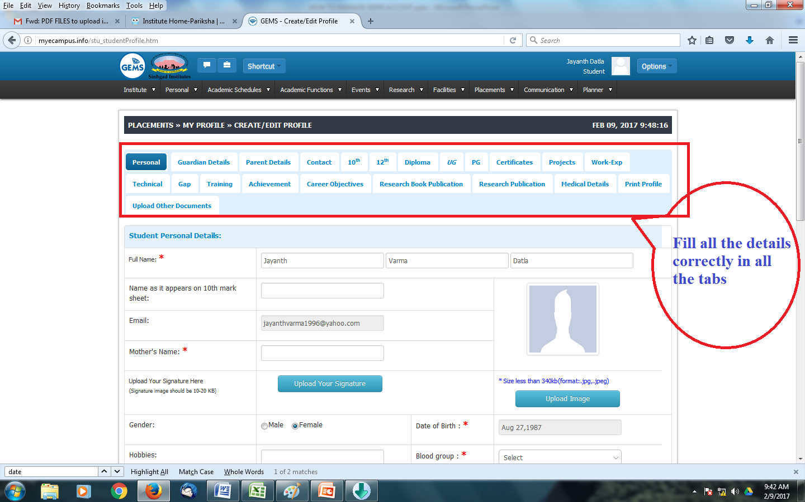

Slide 8
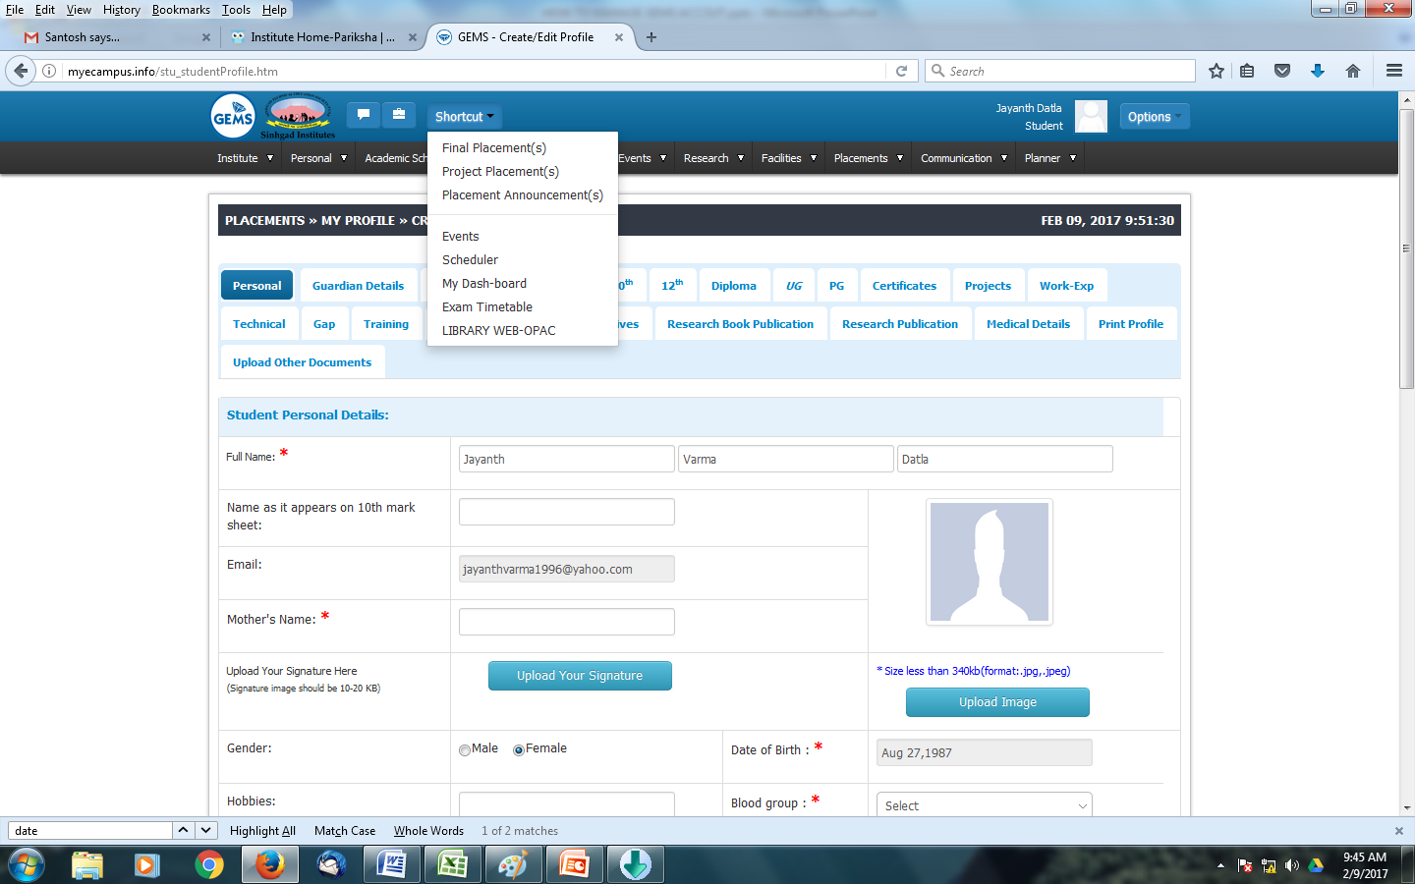

Slide 9
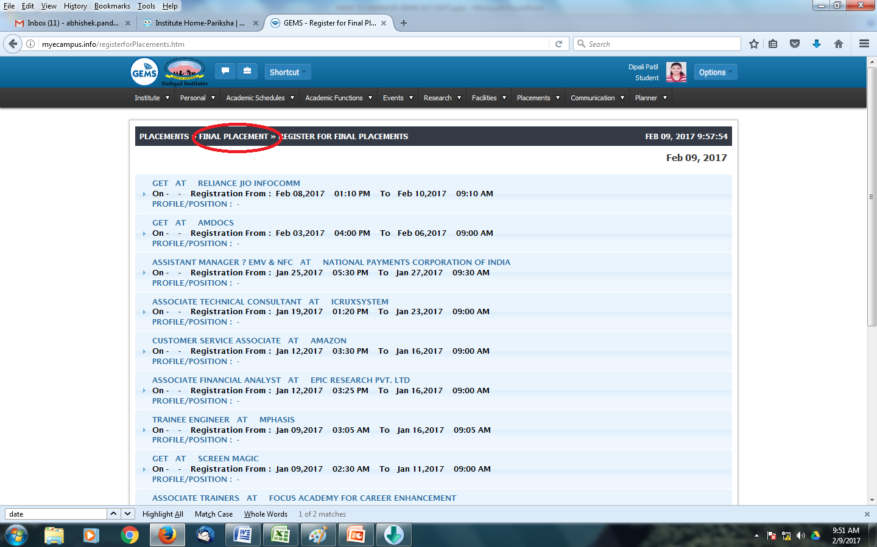

Slide 10
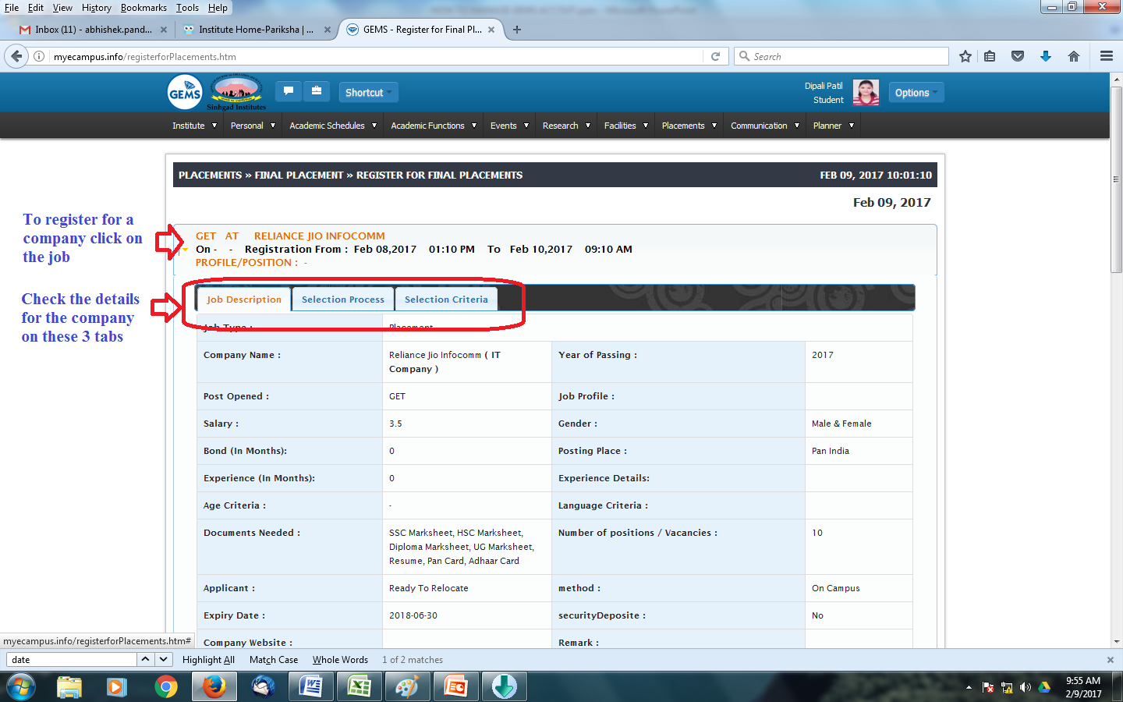

Slide 11
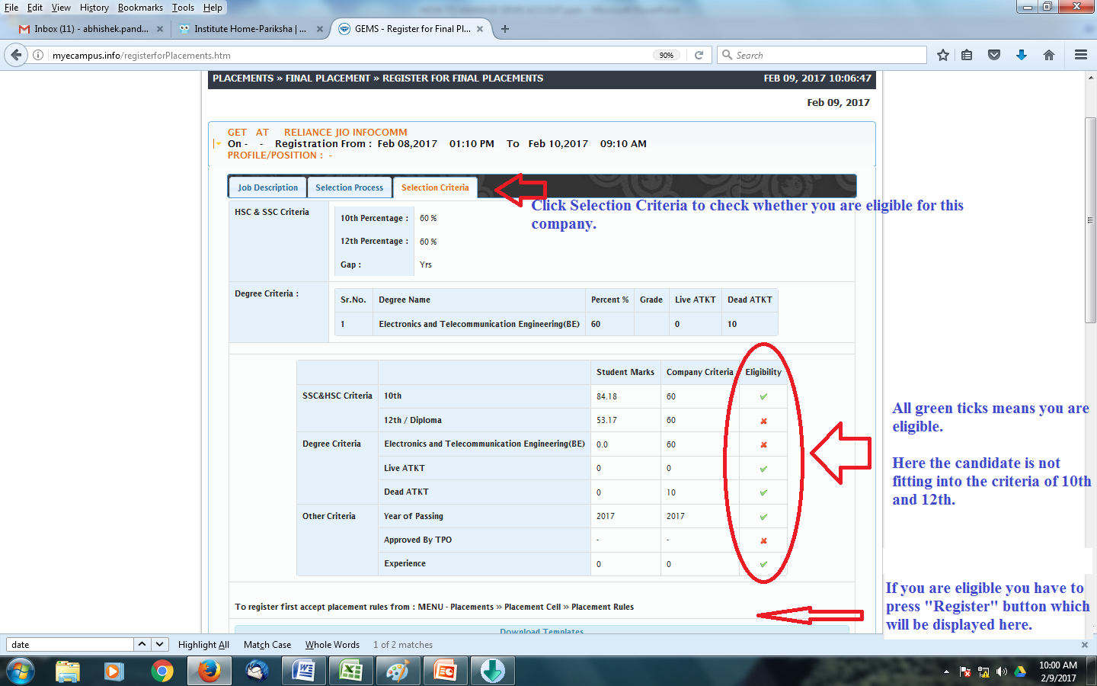

Slide 12
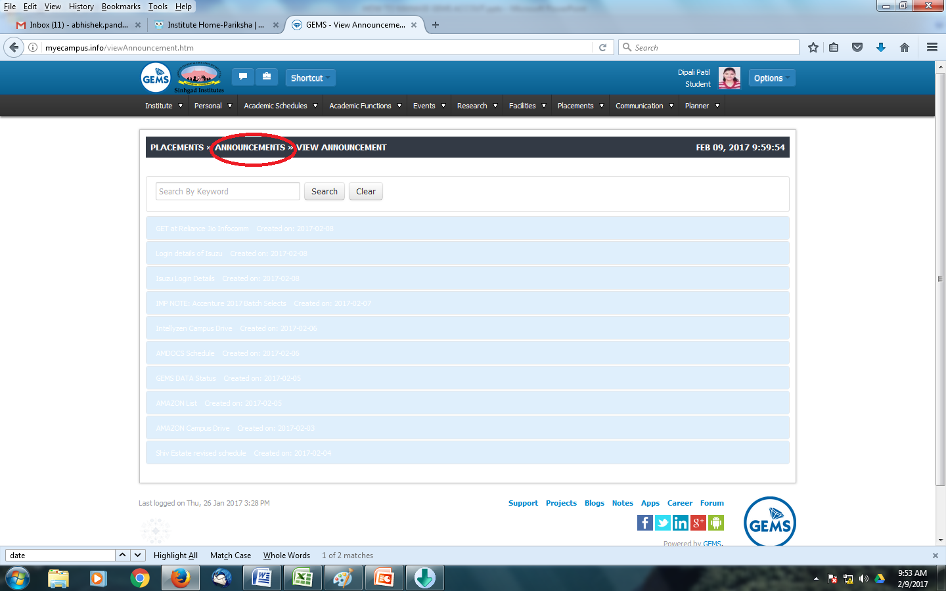
Keeps checking announcement 2-3 times a day.

