Slide 1
CUSTOMER INTERCATION COUNT PREDICTION USING ML
INCEPTEZ HACKATHON 2022
PREPARED BY SUDALAI MANI P

Slide 2
CONTENT
Problem Discussion
Data Preprocessing
Model Evaluation
Results

Slide 3
Problem Discussion
Inceptez Pvt Ltd is a new startup, which provides service on users to find good properties in least amount of time.
So they decided to develop a Machine Learning model which can predict/suggest best results to the user, to find their desired properties with their type of requirement.
We have given a Dataset.csv, Photos.tsv, Intercation.csv data files, with the help of these files we going predict /find the number of interactions by the users on a specific/individual property by data preprocessing and developing algorithm.
Lets get started and process on data.
We are to work jupyternotebook python3.7 environment.

Slide 4
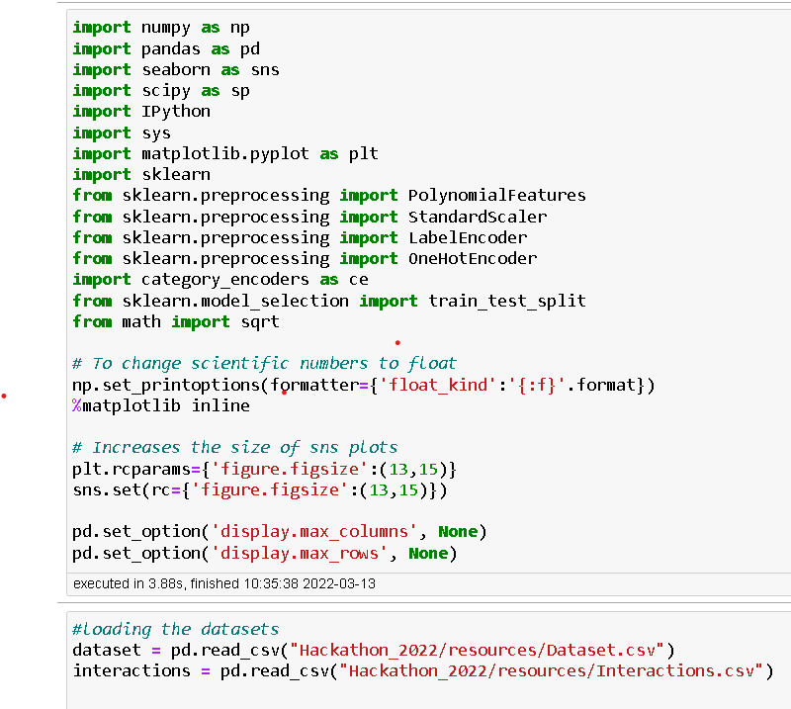
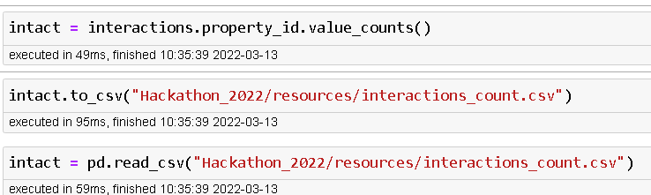
Data Preprocessing Data preprocessing is a process of preparing the raw data and making it suitable for a machine learning model.
Step 1: Importing required python libraries and datasets.
Step 2: Processing interaction dataset and we can infer that it has two features, ‘property_id’, ‘request date’, the number of interaction to specific property implies the count and consolidate it by following method and naming the feature as ‘count’

Slide 5
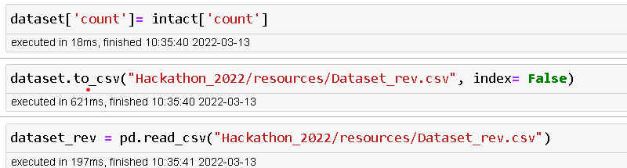
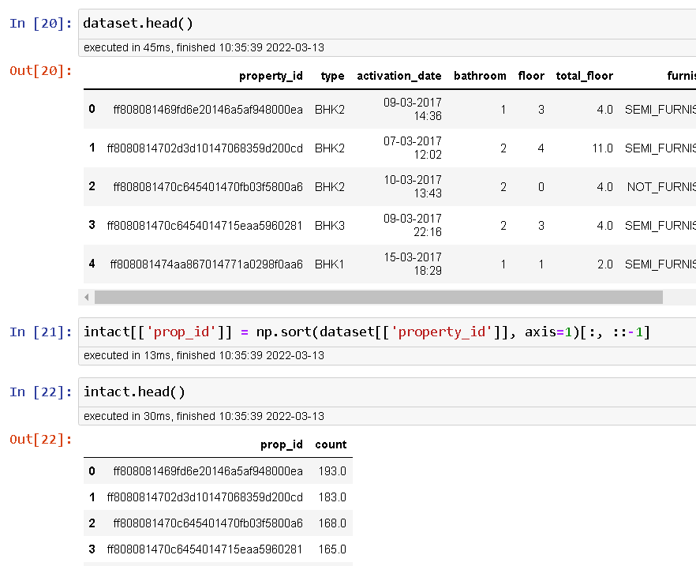
Step 3: we can also infer that, the number of rows in interaction and dataset differs by 6109. Let us consider those rows in dataset.csv as test data. Now sorting the rows as same as in both dataset and interactions.
Step 4: Inserting ‘count’ feature in dataset DF and creating a new revised dataset and .csv file.

Slide 6
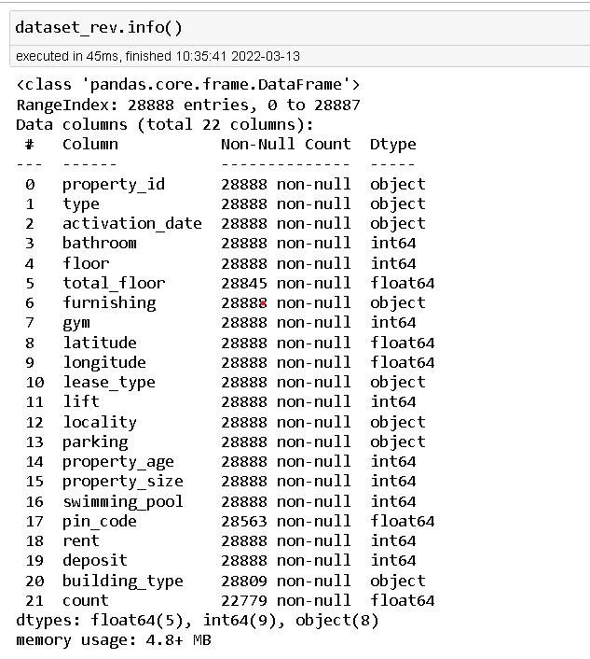
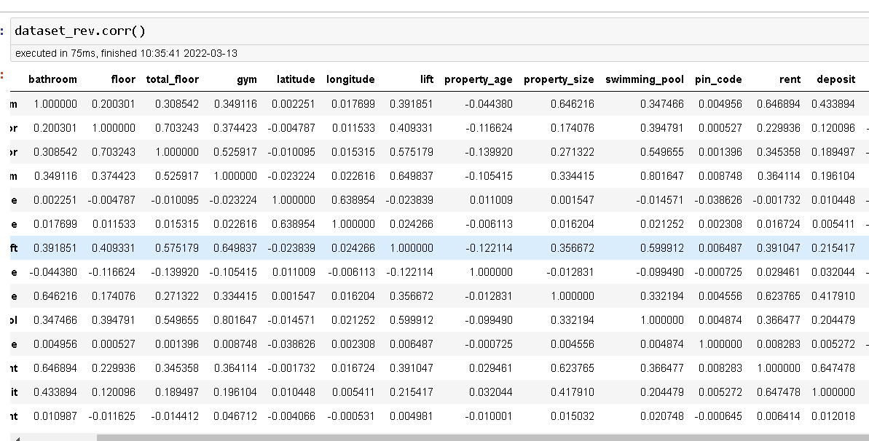
Step 5: EDA on revised dataset. We can see that it has combination of both continuous and categorical data.

Slide 7
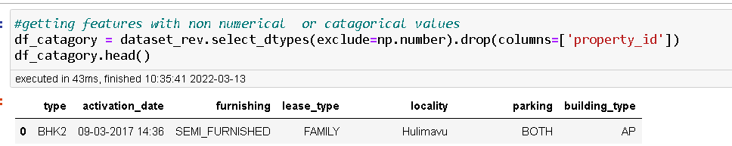
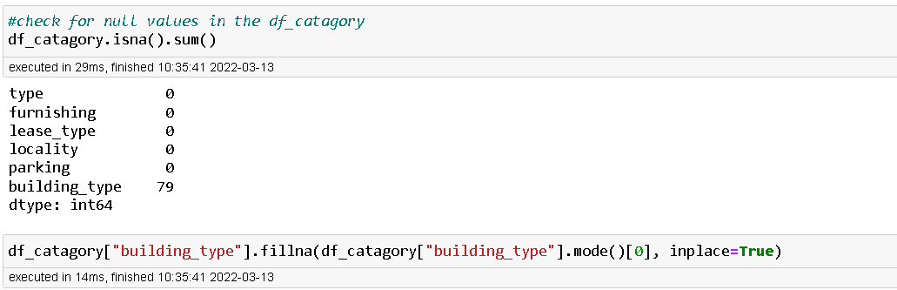
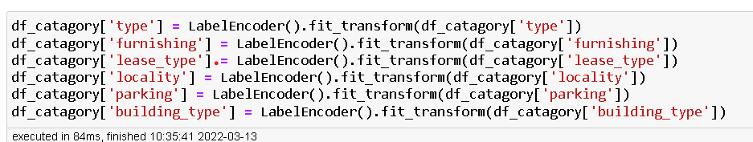
Step 6: Now let us classify the data into numerical and categorical data. Firstly we process the categorical data. Then checking for null, duplicates. Conducting Data cleaning, Data transformation.

Slide 8
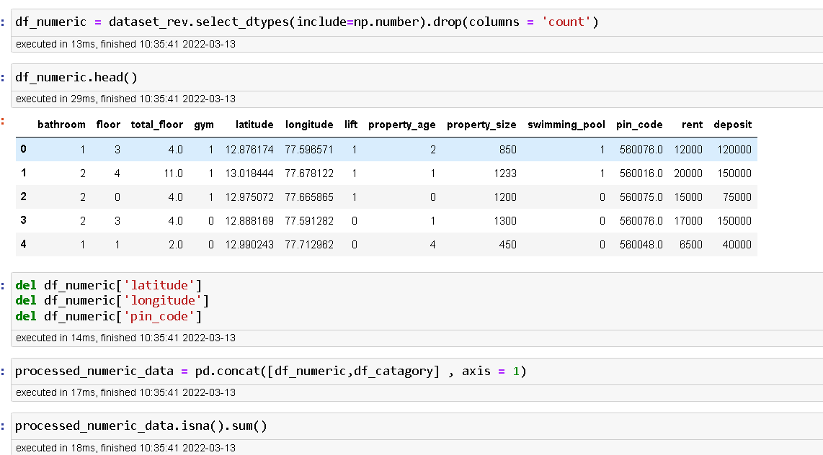
Step 7: Now processing on Numeric dataset. Forming new dataframe processed_numeric_data

Slide 9
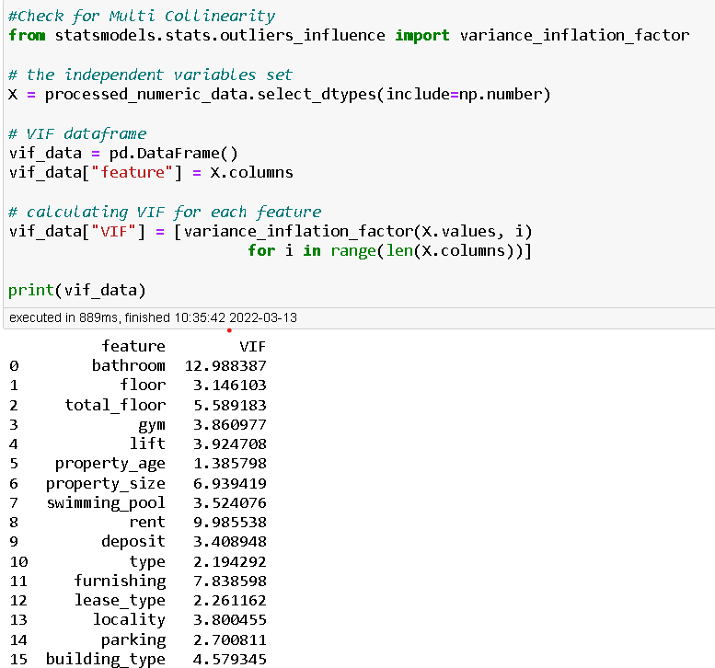
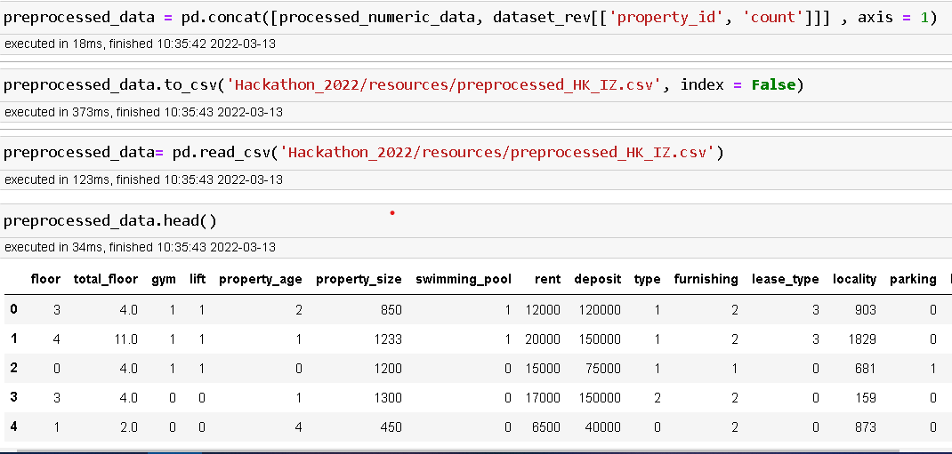
Step 8: Check for Multicollinearity
Step 9: concat all processed dataframe to final preprocessed_data

Slide 10
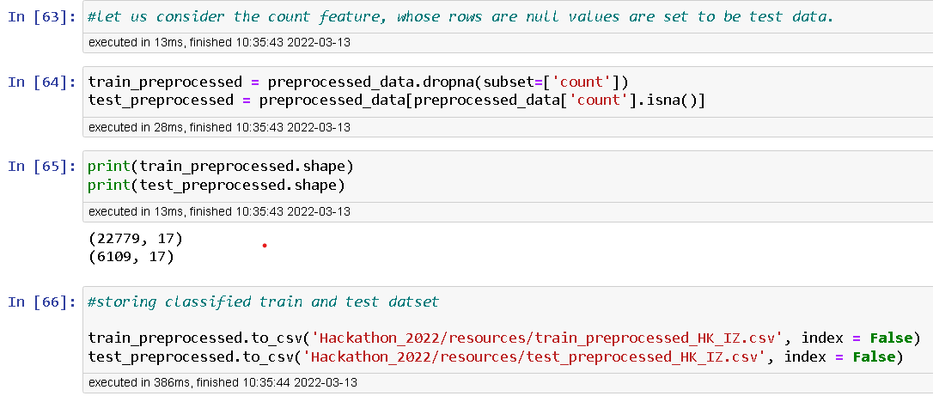
Step 10: Creating train and test dataset for model development.

Slide 11
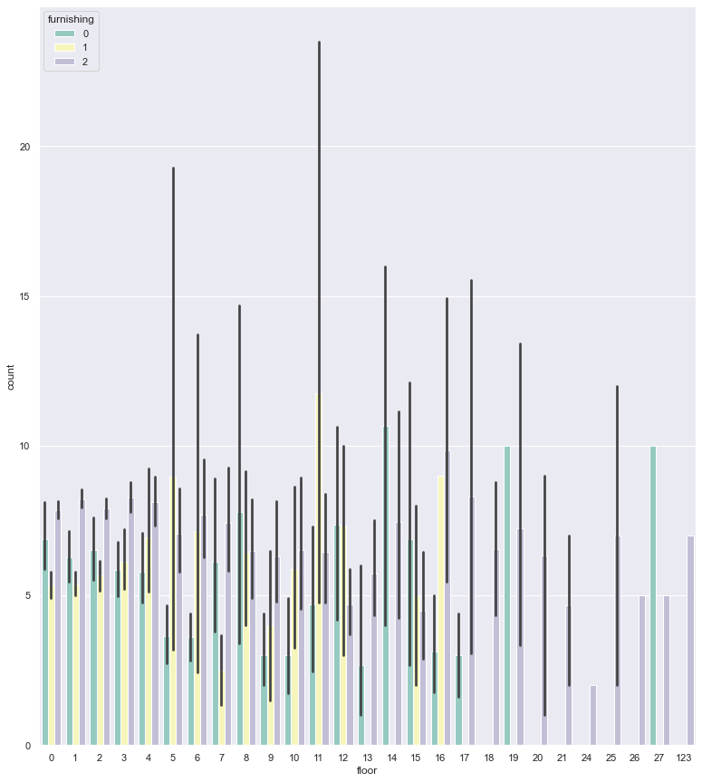
Step 11: Descriptive analysis on train data. Classified based furnishing type of property since, the count correlation is high for this feature. 0-Fully furnished, 1-Not furnished, 2-Semi furnished
'floor' - From the plot we can see that most people interacted more for semi-furnished house which are mostly apartment building type since it has many floors.

Slide 12
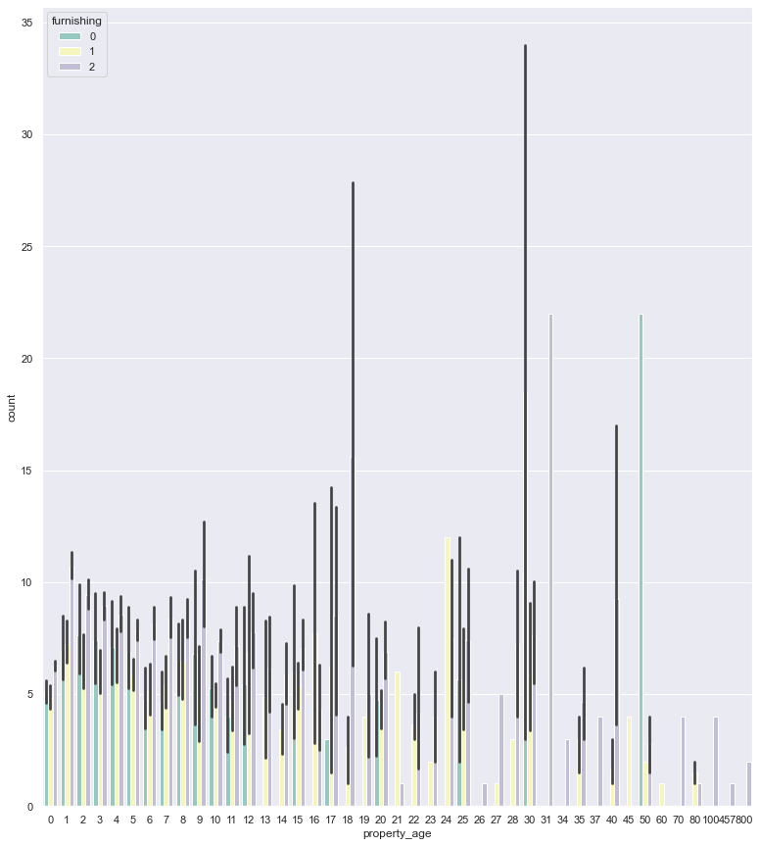
Step 11: Descriptive analysis on train data.
‘property_age’ – The interactions count also depend on age of the property, if the property is new ,the user interactioons is more.

Slide 13
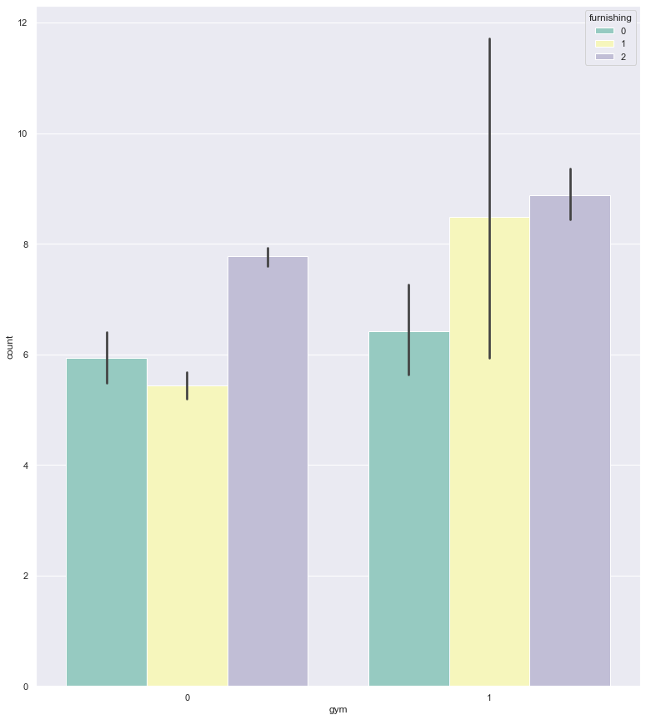
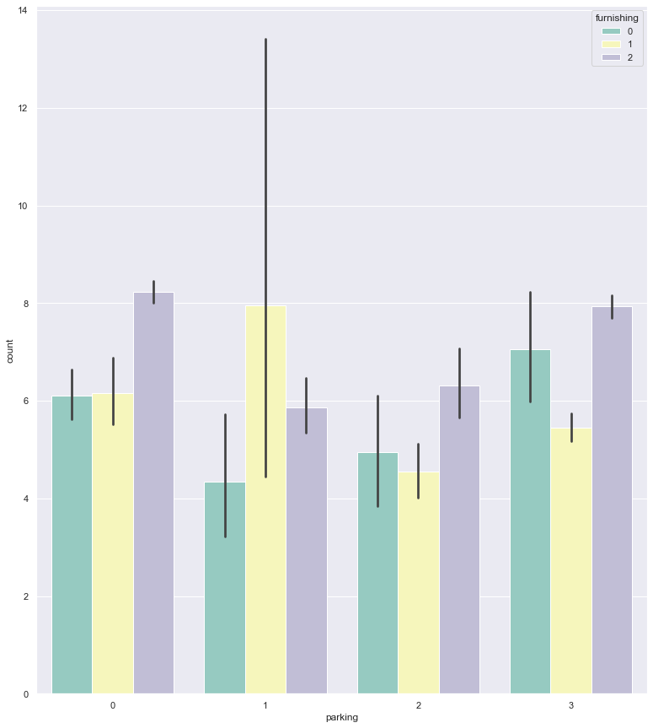
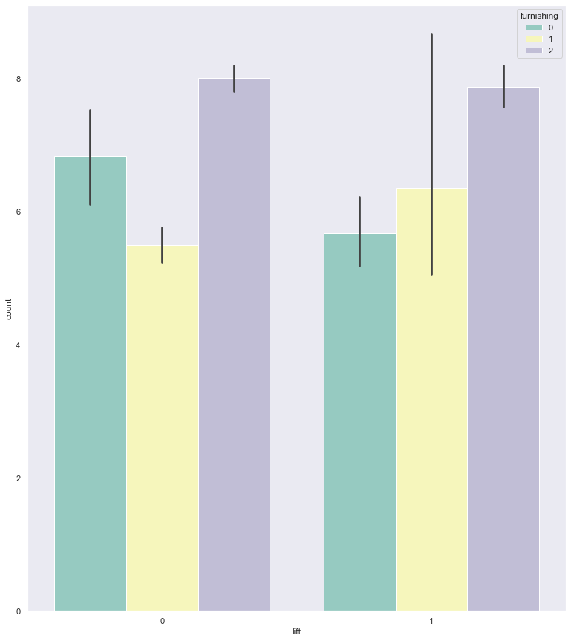
Step 11: Descriptive analysis on train data.
‘gym’, ‘parking’, ‘lift’ – from these features the interactions are high for AP(apartment type) buildings only if these three facility are available.

Slide 14
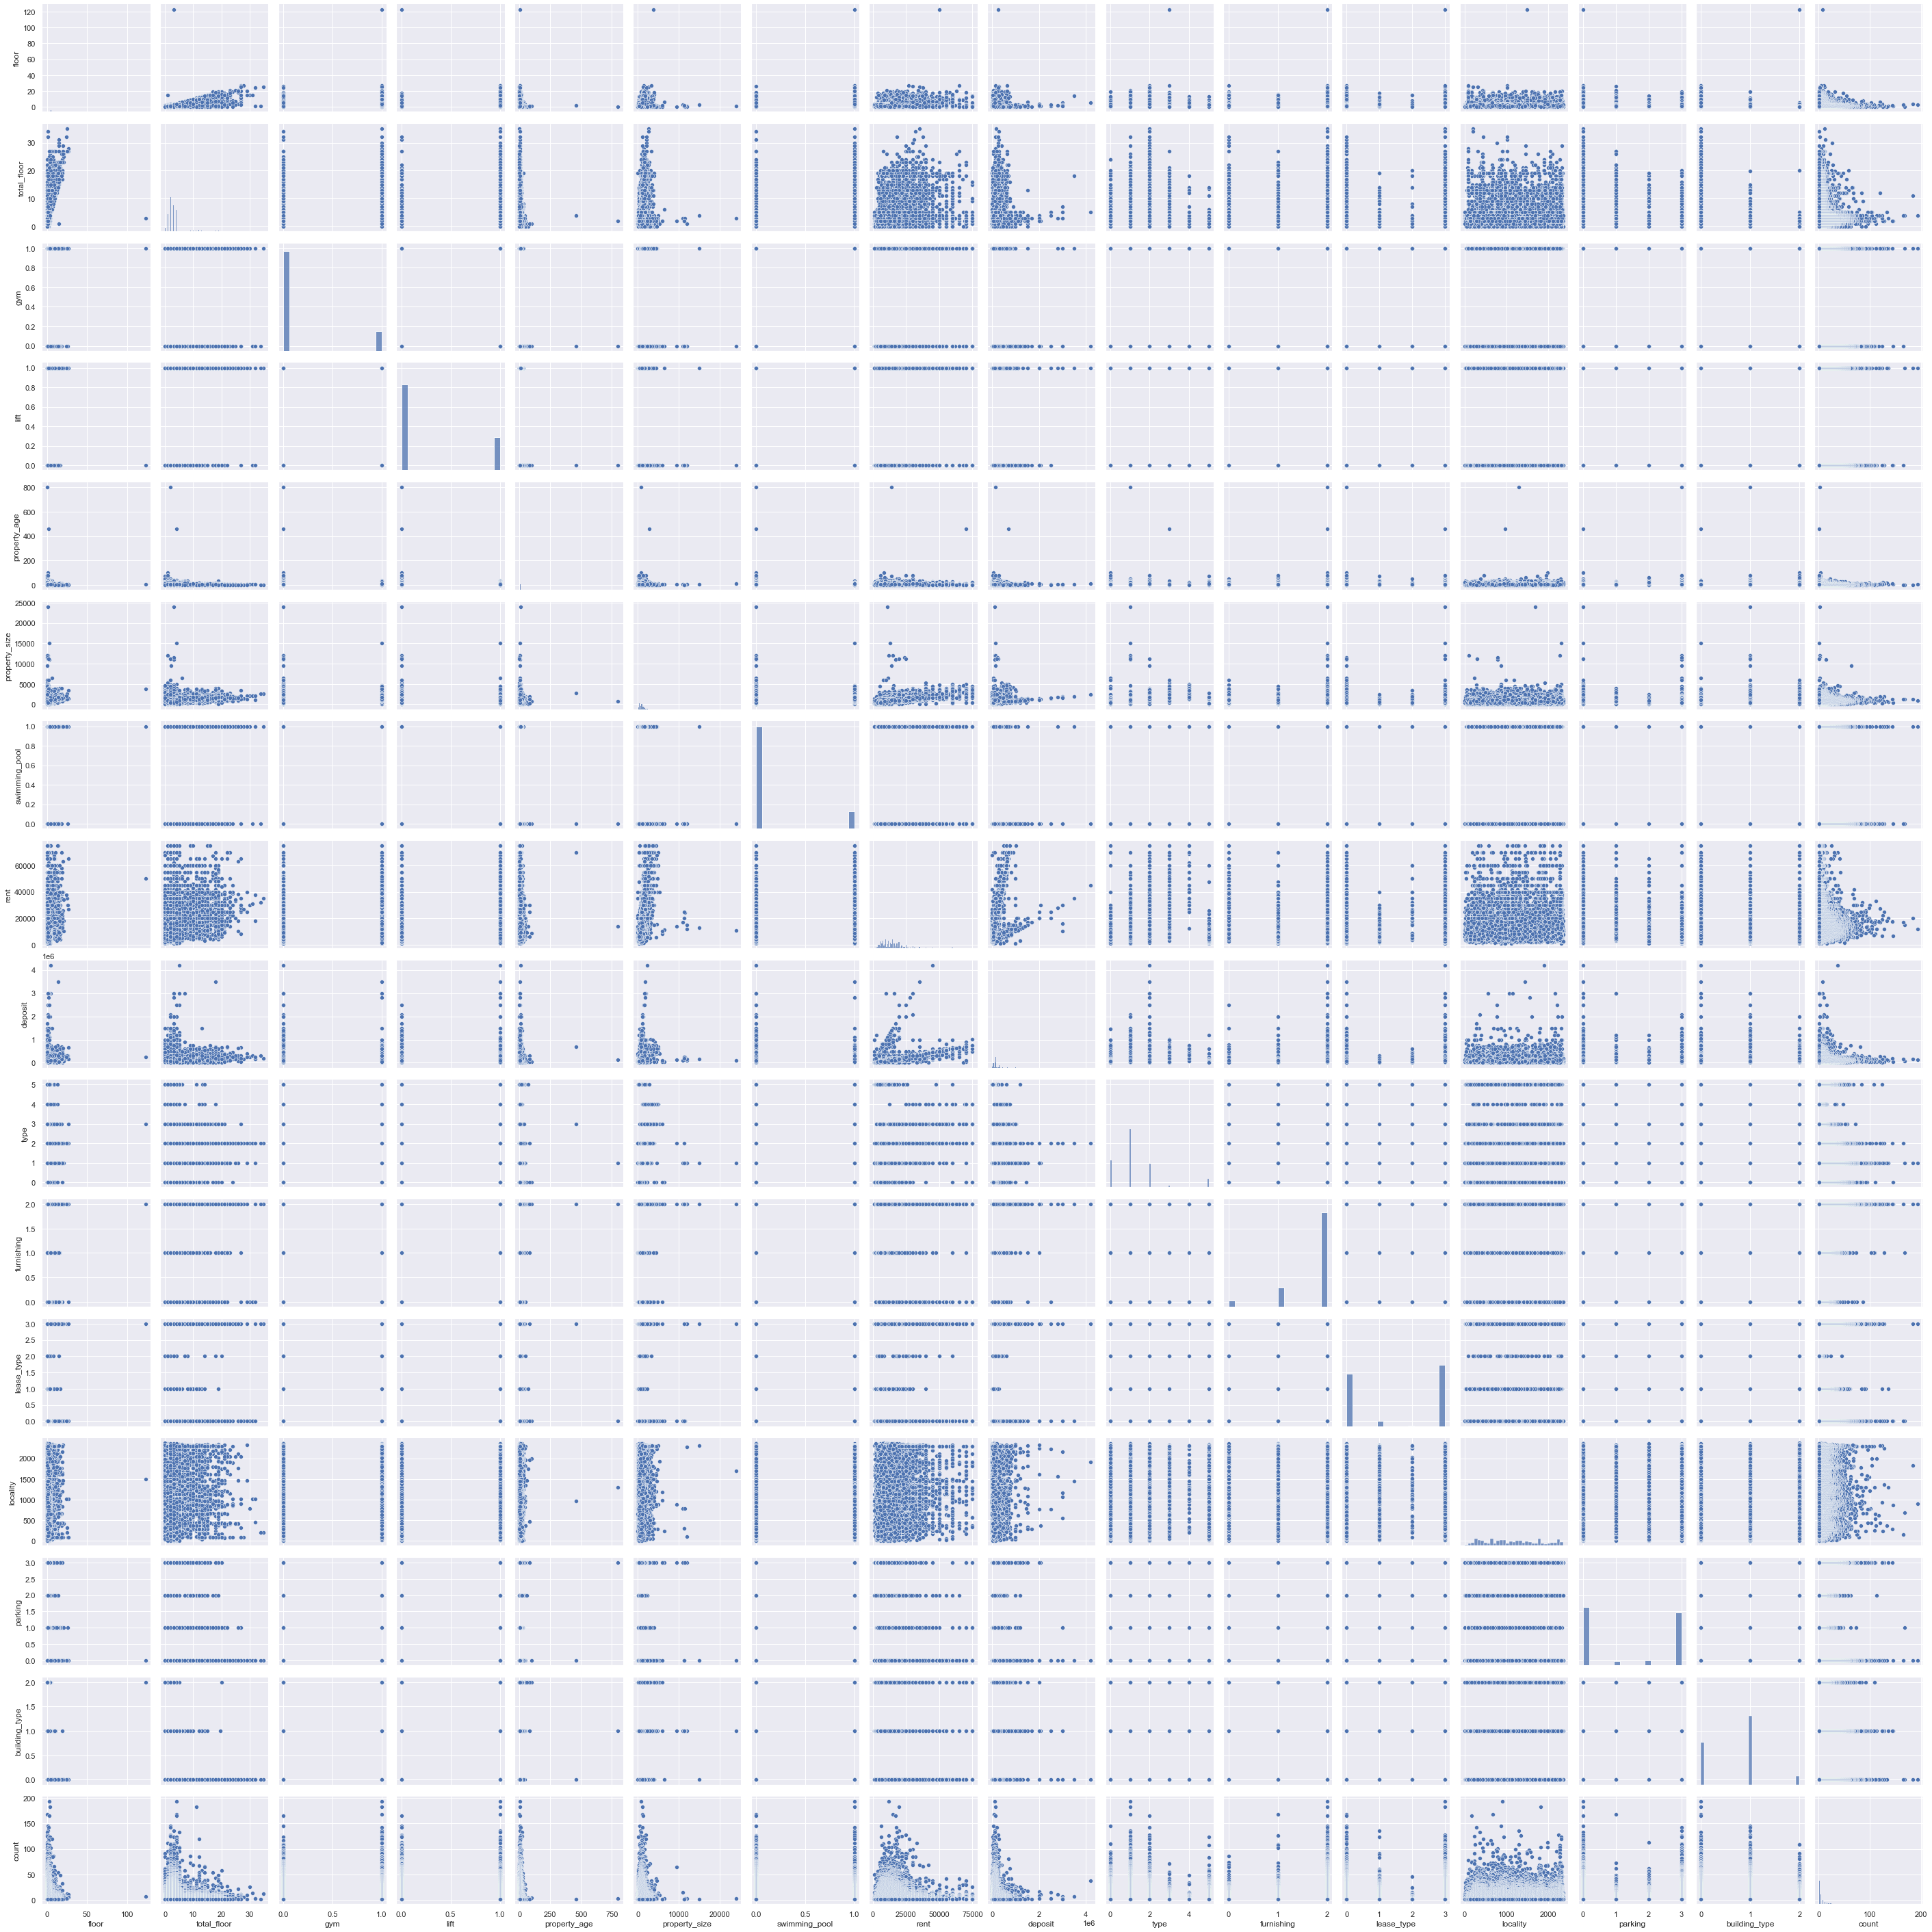
Pair plot for all features

Slide 15
Insights on train dataset features based on furnishing feature, because it highly correlated to target feature 'count
people enquire more about furnishing quality of the house 65-70%
mostly prefer Building with GYM facility 45-50%
most people prefer for rental housing type 45-50%
last but not least, the size and age of the property also enquired 5-6%
Most enquires for AP type of building with large property size, average number of floors with lift facility.

Slide 16
Business Insight on Dataset
We can use this model to predict whether a property advisement will have a best customer reach by predicting what will be the interaction count will be, so that we can improve the contents to be displayed in the ad.
This model can be sell to property dealer who wants to create to ad for his know properties.
People who prefer gym, building with lift, expecting low property age, small property size, swimming pool, good furnishing, large property size prefer going with high rent and deposit option.
Moreover all the enquires on rental with apartment type buildings, with features like gym, parking, lift.
The enquires with lease type facility mainly about IF-Individual Farm,
Increasing the parking facility, gym, lift facility, floors to be less than 10, large property, low property age, availing more rental facility in AP apartment type buildings might increase the business opportunities.
Building IF in large property, with gym, swimming pool, more parking, might increase the lease, deposit type clients.
Similarly IH type with low property age, in a moderate property size will attract deposit clients who are willing to buy individual homes.

Slide 17
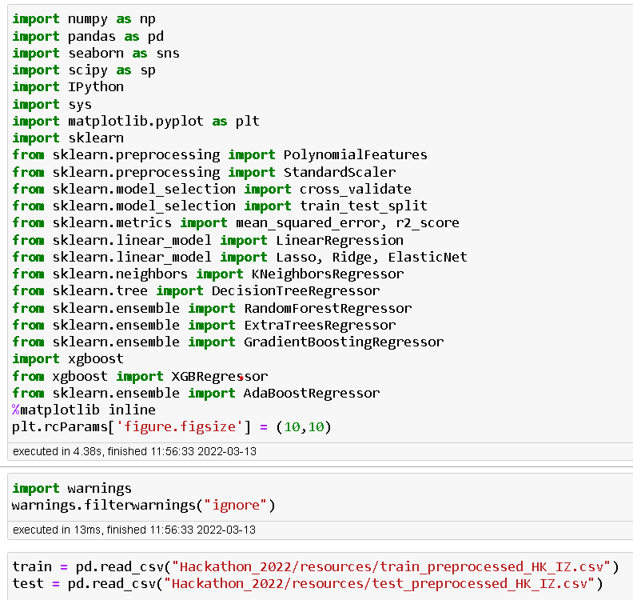
Model Evaluation
Since the preprocessing part is over, now we can create a model that will predict the user count of interactions based property details.
Importing the required python libraries and datasets.

Slide 18
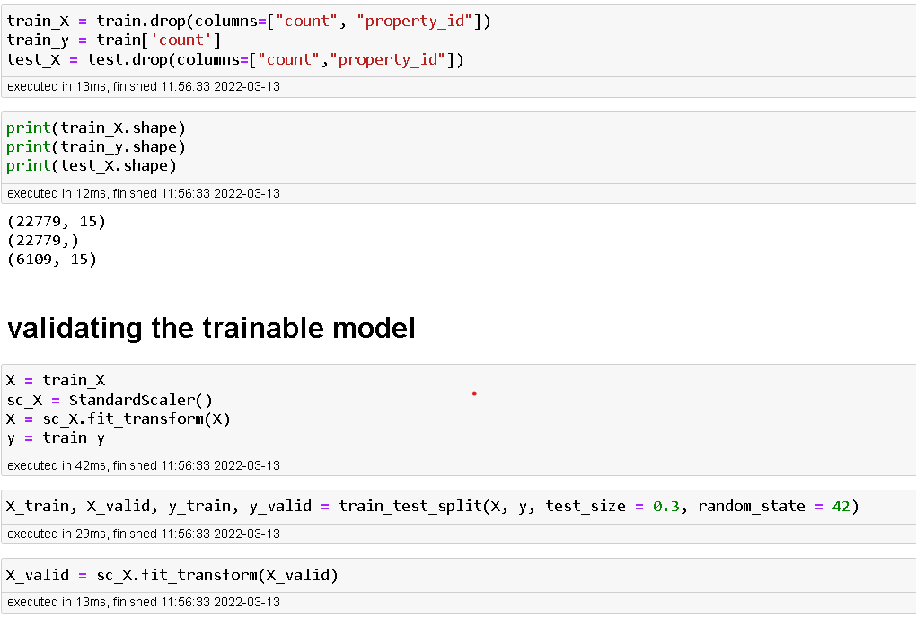
Creating trainset, testset and validationset. Also conducting Scaling operation to balance the dataset values, since ‘property_size’, ‘rent’, ‘deposit’, ‘lease’ has large data values while others are very low.

Slide 19
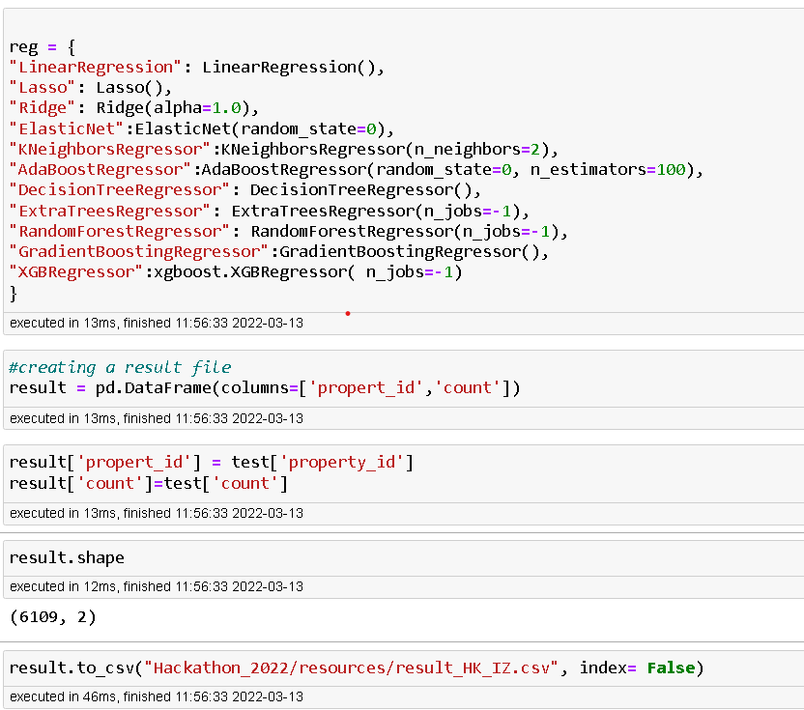
Assuming the ML models with params and creating result file.

Slide 20
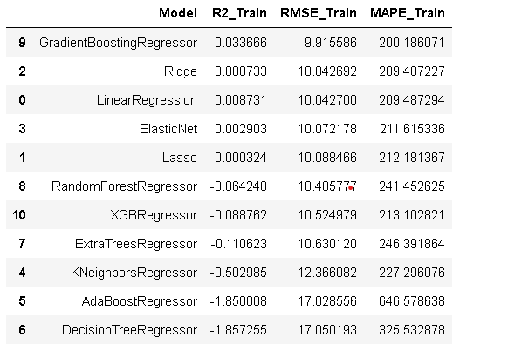
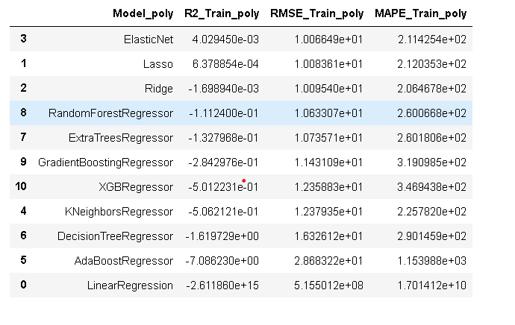
Model Evaluation Results
Comparing the model performance results, with and without implementation of polynomial features.

Slide 21
Insights on model results
By using polynomial features it seems that the R2 score is decreasing and increase in RMSE so we use the dataset without using polynomial features
Another insight we can observe that the ensembles of decision tree model like Gradient boosting regressor and XGB regressor were performing well on the dataset. so by much tuning the model parameters we may achieve good RMSE score.
From above results we can consolidate good model for final evaluations Gradient Boosting Regressor, Ridge, Linear Regression.
Lets do Hyper tuning for the model parameters and see the model performance
Even after hypertuning the results to other model the RMSE doesn’t differ much. so we can use some advanced model for predicting the data.
I used Voting Regressor with base regressors as Gradient Boosting Regressor and Ridge, Linear regression as they both gave the best predictions as described in previous cells

Slide 22
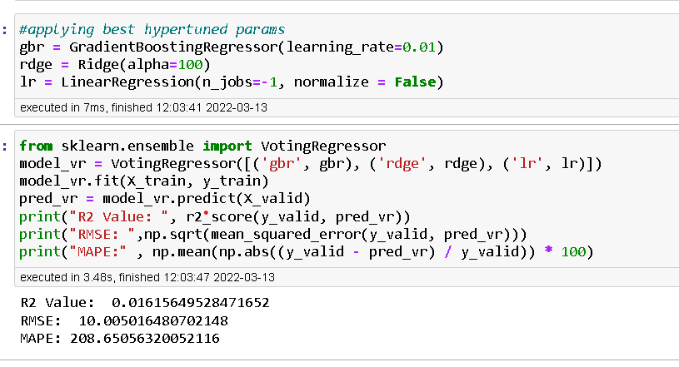
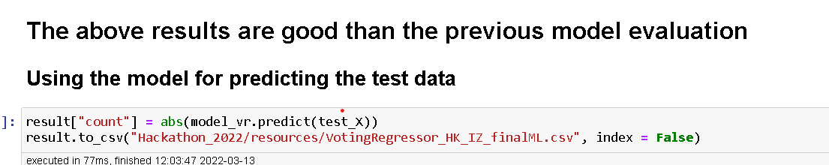
Voting regressor model results.

Slide 23
END OF THE PRESENTATION THANKYOU source code available : https://github.com/sudalaimk666/Inceptez_Hackathon_2022

