Slide 1

CS 624 Data Analytics & Big Data
Rainfall prediction using Big data pyspark
Members
Carson
Megha
Sonal
Sandeep
https://www.kaggle.com/datasets/trisha2094/weatheraus

Slide 2

Overview
Introduction
Problem
Goals
Detail Steps
Visualization results
Justification
Expected Outputs
Challenges
Future Scope
Acknowledgment

Slide 3

Introduction
The objective of this project is to develop a predictive model that accurately forecasts whether it will rain tomorrow based on historical weather data.
This involves building a machine learning pipeline that preprocesses the data, trains a classification model, and evaluates its performance.
We will focus on using Random Forest and Logistic Regression classifiers to achieve this goal.

Slide 4

Problem Statements
This is a batch problem with a large dataset, specifically utilizing historical weather data.
The dataset, weatherAUS.csv, contains over 140,000 records, which satisfies the requirement of a large dataset with more than 50,000 records.

Slide 5

Goals
The main goal of this project is to build a robust and accurate predictive model that can forecast the likelihood of rain on the next day.
This prediction can be highly valuable for various applications, including agriculture, disaster management, and daily weather forecasting for the general public.

Slide 6
1) Data Loading and Preprocessing
Load the historical weather data from the weatherAUS.csv file.
Handle missing values and drop irrelevant columns to clean the dataset.
Convert categorical variables to numerical values using StringIndexer.
Assemble the features into a single vector for machine learning models.

Slide 7
2) Model Training and Evaluation
Split the data into training and testing sets.
Train Logistic Regression and Random Forest classifiers on the training data.
Evaluate the models on the testing data using metrics such as accuracy and ROC AUC.
Visualize the results using confusion matrices and ROC curves

Slide 8
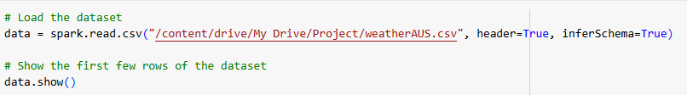
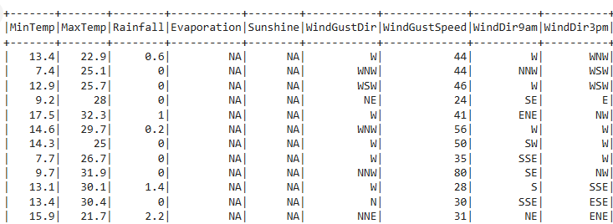
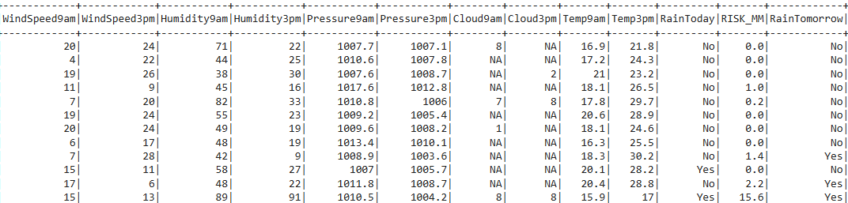
Data Loading
Data is loaded in Google drive.

Slide 9
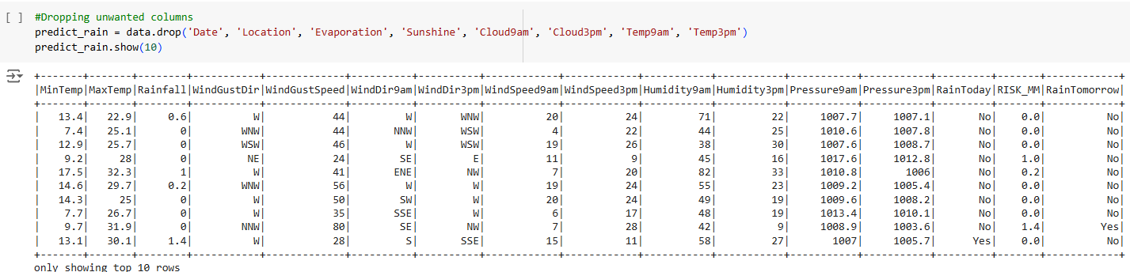
Data Cleaning

Slide 10
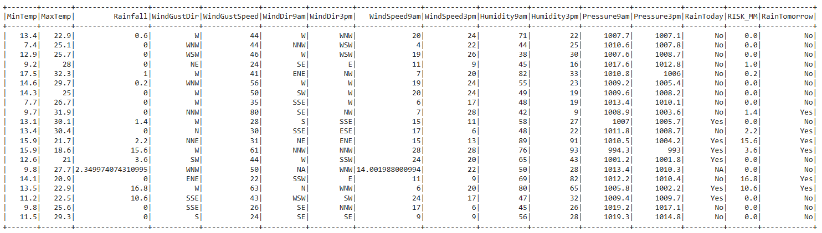
#Replace the numerical column null values with mean values of that column

Slide 11
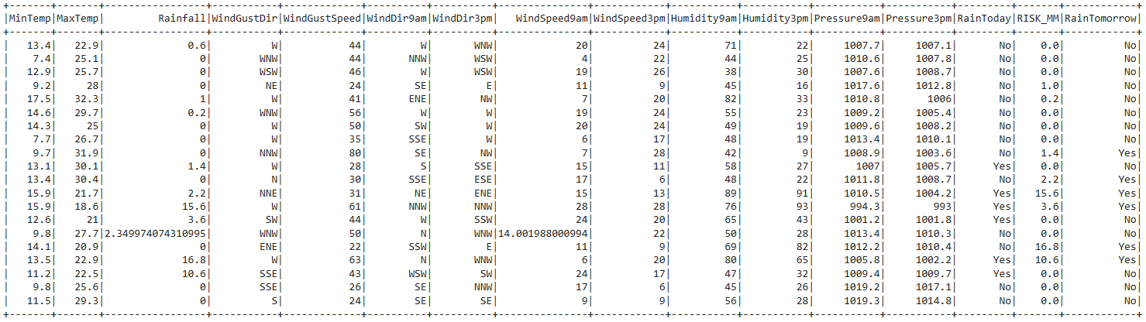
#Replace missing values in categorical column with the mode for each categorical column

Slide 12
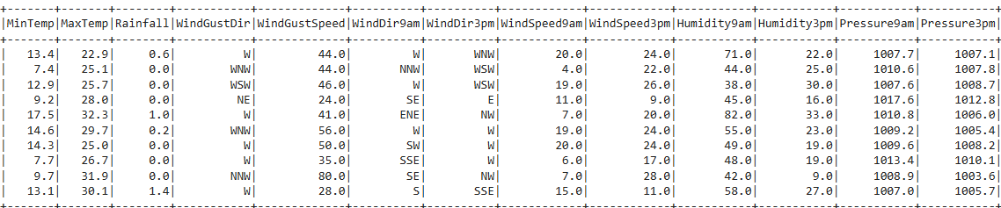
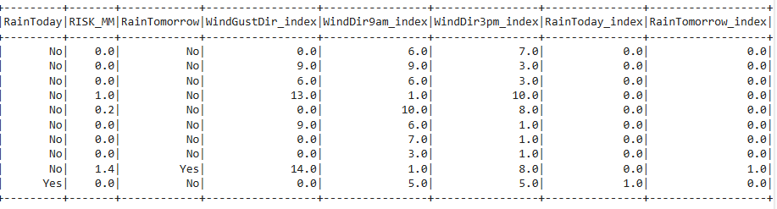
Data Preprocessing
#Create indexes for categorical columns. Fit the pipeline and transform the data

Slide 13
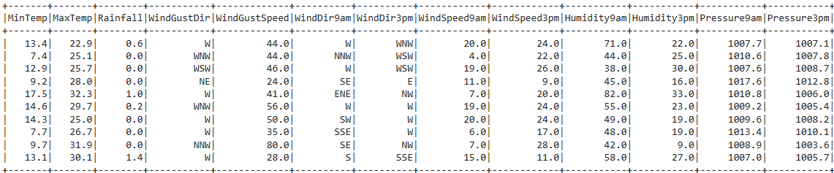
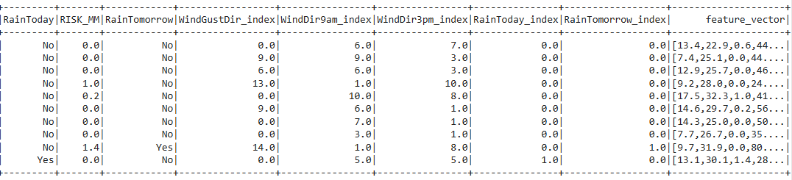
Feature Engineering
# Include only numerical and indexed categorical columns

Slide 14
3) Visualization
Use various visualizations to analyze the data and the performance of the models
Histograms
Box plots
Correlation heatmaps
Confusion matrices
ROC curves

Slide 15
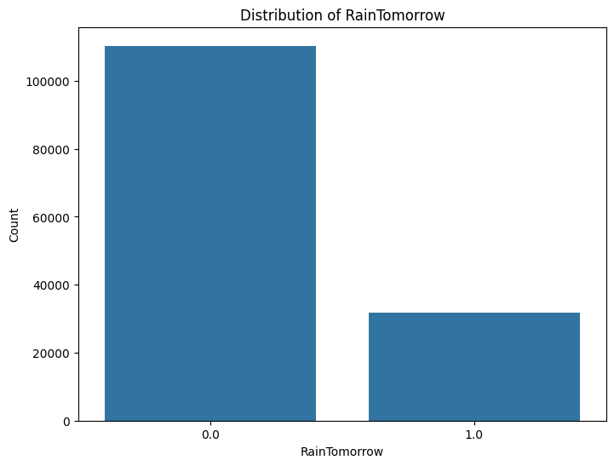

Slide 16
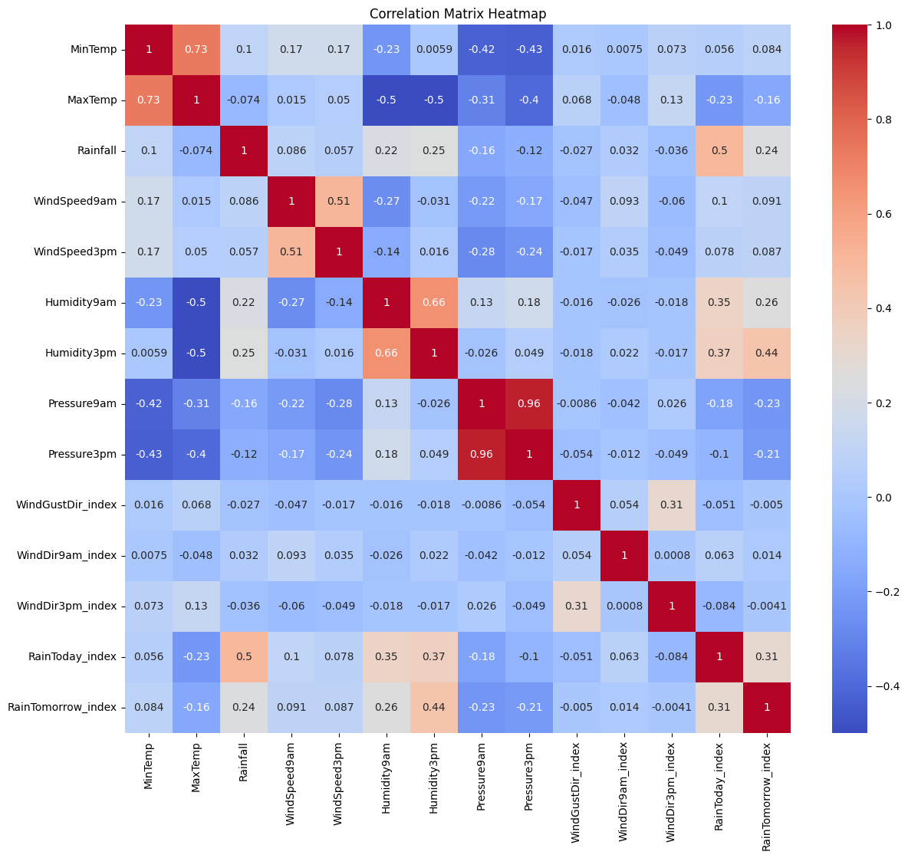
Correlation matrix heatmap

Slide 17
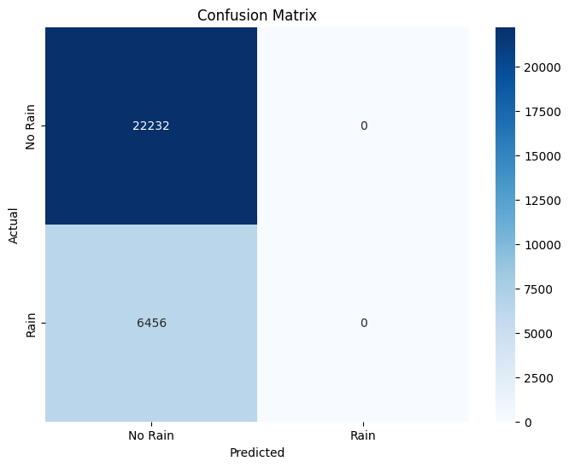
Logistic Regression

Slide 18
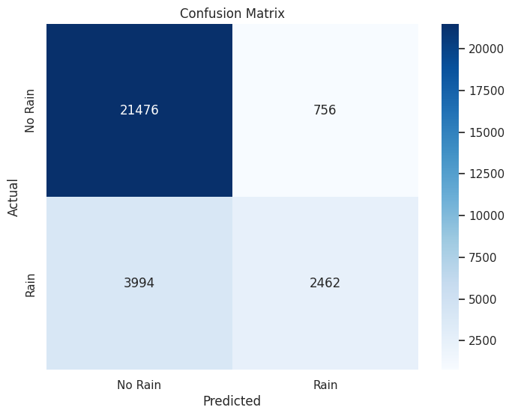
Random Forest

Slide 19
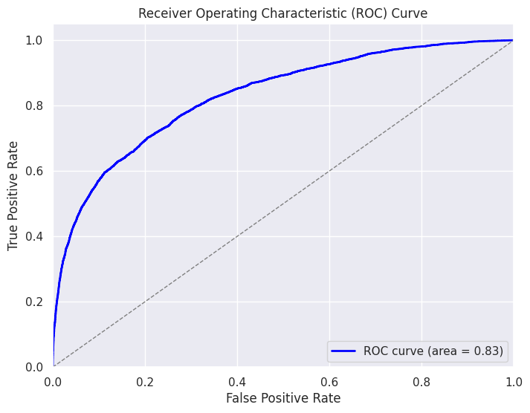
ROC Curve

Slide 20
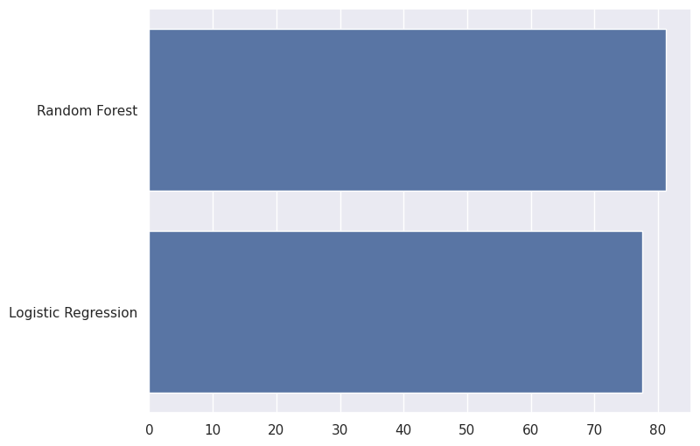
Comparison of two models

Slide 21
Justification
Choosing a batch problem with a large dataset allows us to leverage the historical weather data effectively.
The substantial number of records helps in building a more generalized model that can capture diverse weather patterns and improve the accuracy of predictions.
By focusing on tabular data, we can utilize well-established techniques in data preprocessing, feature engineering, and machine learning to achieve our predictive goals.
Expected Outcome
The expected outcome of this project is a well-performing machine learning model that can predict the probability of rain for the next day with high accuracy.
The insights gained from the model and visualizations will also help in understanding the key factors influencing rainfall predictions.
This project will demonstrate the application of machine learning techniques to real-world problems, providing a valuable tool for weather forecasting.

Slide 22
Big Data Evaluation
Performance Gains Using Apache Spark
1) Distributed Data Processing
Scalability: Apache Spark's distributed computing framework allows the dataset to be partitioned and processed across multiple nodes in a cluster.
This enables the system to handle large volumes of data efficiently, significantly reducing the processing time compared to a single-machine setup.
Speed: Spark's in-memory computation capabilities reduce the time spent on disk I/O operations, which is crucial for large datasets.
By keeping data in memory, Spark minimizes the latency associated with reading and writing data to disk.

Slide 23
2) Efficient Data Loading and Transformation
Parallel Data Loading: The dataset was loaded in parallel, which sped up the data ingestion process. This is particularly beneficial for large datasets as it allows data to be read and processed simultaneously across multiple nodes.
Optimized Transformations: Using Spark's DataFrame API, transformations like filtering, indexing, and assembling features were executed in a highly optimized manner.
The Catalyst optimizer in Spark ensures that these operations are performed efficiently, leveraging the distributed nature of the data.

Slide 24
3) Model Training and Evaluation
Parallel Model Training: Training the Logistic Regression and Random Forest models was expedited by distributing the computation across multiple nodes.
For example, the Random Forest model with 500 trees benefited from parallel tree construction, significantly reducing the training time.
Scalable Machine Learning: Spark MLlib, the machine learning library in Spark, is designed for scalability. It allows the training of models on large datasets without running into memory issues, which is a common problem with single-node machine learning frameworks.

Slide 25
4) Batch Processing
Efficient Batch Processing: Since this is a batch problem with a large dataset, Spark's ability to process large batches of data efficiently was crucial.
The entire dataset of over 140,000 records was processed in parallel, ensuring timely completion of the data pipeline from preprocessing to model evaluation.
By leveraging Apache Spark, we achieved significant performance gains in terms of scalability and speed, enabling us to handle the large dataset efficiently and perform complex machine learning tasks in a reasonable timeframe

Slide 26
Challenges
Handling Missing Values
Issue: The dataset contained a considerable amount of missing values, which required careful handling to avoid biases and inaccuracies in the model.
Solution: We employed techniques like dropping columns with excessive missing values and imputing missing values for the remaining columns.
Feature Engineering
Issue: Converting categorical variables to numerical format and assembling features into a single vector were challenging, especially with the large number of categorical variables.
Solution: Using Spark's StringIndexer and VectorAssembler simplified the process, but required careful attention to ensure all necessary transformations were applied correctly.
Model Evaluation
Issue: Evaluating models on a large dataset can be computationally intensive and time-consuming.
Solution: Spark's distributed computation framework helped in performing evaluations more efficiently, but required ensuring that the evaluation metrics were computed correctly and in a scalable manner.

Slide 27
Future
1)Hyperparameter Tuning:
Objective: Implement hyperparameter tuning for the models to improve their performance. This could involve using techniques like cross-validation and grid search to find the optimal parameters.
Approach: Utilize Spark's CrossValidator and ParamGridBuilder for efficient hyperparameter tuning in a distributed manner.
2)Feature Selection:
Objective: Perform feature selection to identify the most important features and reduce the dimensionality of the data, which can enhance model performance and interpretability.
Approach: Use techniques like feature importance from tree-based models and correlation analysis to select relevant features.

Slide 28
3) Model Deployment
Objective: Deploy the trained model in a real-world environment to make predictions on new data.
Approach: Integrate the model with a web-based interface or API, allowing users to input new data and receive predictions in real-time.
4) Streaming Data Integration
Objective: Extend the project to handle streaming data, allowing for real-time weather predictions.
Approach: Use Spark Streaming to process data in real-time, continuously updating the model with new data as it arrives.

Slide 29


