Slide 1


Team Details
  Team name: BreederNear AI
  Team leader name: Sudarsan N
  Problem Statement: Retail & Commerce: trusted, legal breeder-to-buyer pet commerce in India (BreederNear AI)

Slide 2
Brief about the idea
“The breeder is 50 metres away. The customer never finds them.”
Why we are building this
Our founder Sudarsan N spent five years as a bird breeder, pet-shop owner and broker in Coimbatore. He started with a ₹750 setup and earned over ₹4 lakh while knowing only about 100 people. Every week he watched buyers walk past a breeder on their own street into a shop, pay more for a weaker bird, or lose money to a stranger in a WhatsApp group.
Buyers lose money and trust
Can’t find the breeder next door, so they pay shop prices
Can’t tell a real seller from a scam: “full advance, courier only”, stolen photos
Don’t know which birds are protected or that dog breeders must register⁵
Alone after buying: wrong cage, wrong food, late to the vet
Breeders lose time and reach
Sell only inside their own small circle and district groups
Hours of calls every day, the same 20 questions, the same post retyped in every group
Good breeders look exactly like bad ones: no way to prove it
Animals and the law lose most
300+ of India’s ~1,200 bird species are found in illegal trade³
Munias are dyed to disguise them⁴; dyed chicks were still on sale in an unlicensed Bengaluru shop in June 2026⁶
Sick animals are sold because nobody checks before the sale
Still unsolved in 2026: OLX stopped live-animal listings², big pet platforms sell food and accessories, so India’s ~39 million-pet market¹ still buys animals through WhatsApp, Facebook and Instagram groups with no checks at all.
Founder figures are his own experience · ¹ Euromonitor 2025 · ² OLX India: items not allowed · ³ WWF-India / TRAFFIC · ⁴ Deccan Herald, Aug 2023 · ⁵ PCA (Dog Breeding and Marketing) Rules 2017 · ⁶ PETA India, 25 Jun 2026

Slide 3
From pain to product: the whole journey, end to end
Step | Today, in groups and shops | With BreederNear AI | Built and measured
Find | Walk into the nearest shop; the breeder next door is invisible | Pets near you, trusted first, a match % for your home, a fair-price bar | Match % calculated in code; 16 breeders, 36 pets
List | Breeder retypes the same post in every group | Photos + a Tamil or English message become a full listing | 17–27 s live: upload, AI fill, trust check
Trust | No checks: stolen photos, scam prices, protected birds | Every listing screened before it goes live; Verified breeder badge | 8/8 protected species blocked, 0/37 false alarms
Check | Pay a stranger on social media in full, in advance | Paste any outside post: “Is this post safe?”; share the warning back to the group; report protected animals | 5–7 s per post; nothing stored
Talk | Endless calls and the same answers | AI drafts the buyer’s first message and the breeder’s reply; scam shield on both | Scam scan on every enquiry and reply
Buy | “Courier only”, no handover | Book a visit, see the pet, pay in person, tap “I bought this pet” | No payments in the app, by design
After | New owner on their own | Starter kit sized for welfare, 14-day plan, daily log, growth, symptom urgency | Never a medicine or dose (evals E11, E19)
Grow | Breeder has no data | Dashboard: views, enquiries, visits and sales, week on week | 8-week charts and trend cards
One tool layer, two ways in: every step works by tapping or by asking seven Gemini agents in English or Tamil. Live now: 66/66 agent eval runs, 335 unit tests, 0 accessibility problems.

Slide 4
Opportunities
How is it different?
WhatsApp / Facebook groups: reach, but no checks, no records, no recourse
Classifieds (OLX): stopped live-animal listings
Pet super-apps: food, accessories and vets, not the animal
Kennel websites: one seller vouching for itself
No platform we found checks every listing for wildlife law, registration, scam prices and reused photos before it goes live, and then stays with the buyer after the sale.
How does it solve the problem?
Invisible breeders → listed in a minute from photos and a Tamil message
Scams → price, wording and reused-photo checks; outside posts checked too
Illegal birds → blocked in code from the photo alone
Unproven breeders → Verified badge: phone, facility photos, registration
Lost hours → AI drafts replies; visits booked in the app
Alone after buying → starter kit, care plan, daily log, vet urgency
USP
Trust built in, not bolted on.
Rules in code decide; Gemini reads and explains. A prompt injection still ends in CAUTION (eval E12).
Protected species blocked from the photo alone: 8/8 in testing, 0/37 false alarms.
Works where the trade already happens: Tamil and English messages, posts from groups.
Founder–market fit: designed from five years inside this exact trade.

Slide 5
List of features offered by the solution
For buyers (customer app)
Pets near me with a match % for your home, trusted first, fair-price bar
Listing page: trust checks, health notes, questions to ask
AI-drafted first message; scam warnings on replies
Book a visit; “I bought this pet” after it (paid in person)
My pets: daily log with AI feedback, growth, health calendar
Symptom checker: how urgently to see a vet (never medicines)
“Is this post safe?”, starter kit, Local Breeders directory
For sellers (seller app)
“Fill with AI”: photos + a Tamil/English message become a listing
Publish with trust check: TRUSTED, CAUTION or BLOCKED, with reasons
Dashboard charts: views, enquiries, visits, sales, funnel
Verified breeder badge: phone code, facility photos read by Gemini, dog-breeder certificate (no ID documents)
Visit requests to confirm; AI-drafted replies to enquiries
Vaccination card read into the trust check
Everywhere
Seven Gemini agents in English or Tamil use the same tools as the screens. Sign-in: password, one-time code or Google (Firebase Authentication). Safety: roles checked in the API and the AI tools, rate limits, every AI reply checked for medicine doses. Accessible: WCAG 2.2 AA, phone to desktop.

Slide 6
Process flow diagram or Use-case diagram
SELLER
Photos + message
Tamil or English, as in WhatsApp
Gemini fills the form
multimodal, JSON schema
Seller checks it
+ optional vaccination card
Trust screening
Gemini vision + rules in code
BLOCKED
never shown to buyers
TRUSTED / CAUTION
published with reasons
published listings
BUYER
Pets with match %
rules score your home
Listing + trust card
reasons, fair price
Message the breeder
AI draft, scam shield
Book a visit
seller confirms
See it, pay in person
“I bought this pet”
Post in a WhatsApp group
“Is this post safe?”
nothing is stored
CAUTION + questions
never pay before visiting
Symptom checker
urgency + vet, never doses
My pets
daily log, growth, calendar
Every step works by tapping, or by asking BreederNear AI in chat: the same tools, the same checks. Sellers also earn a Verified breeder badge.

Slide 7
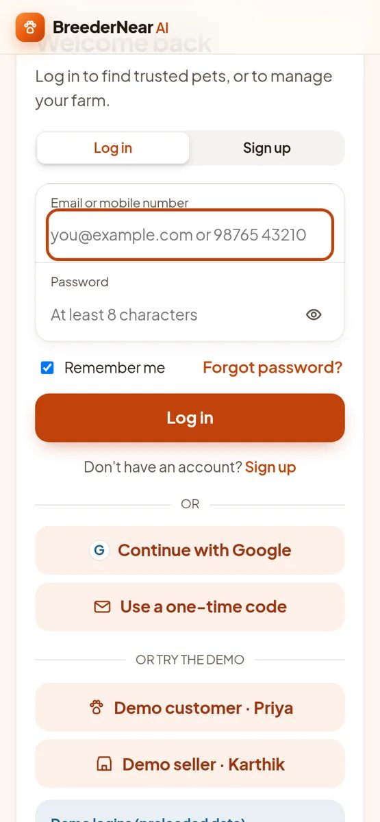
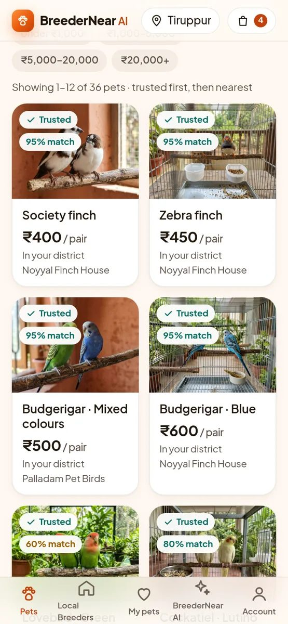
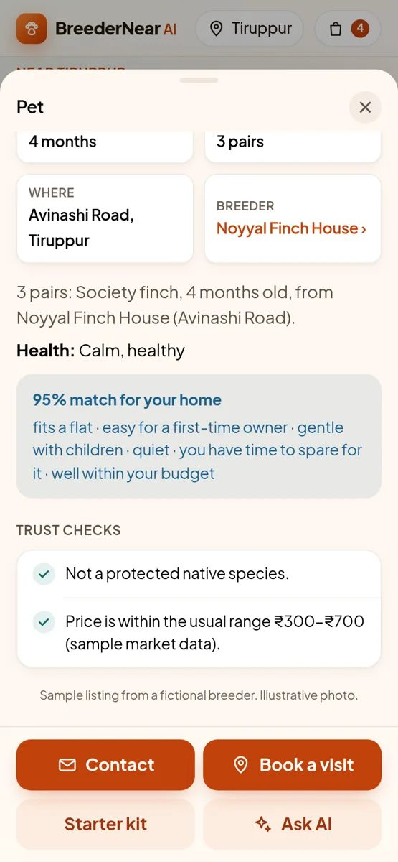
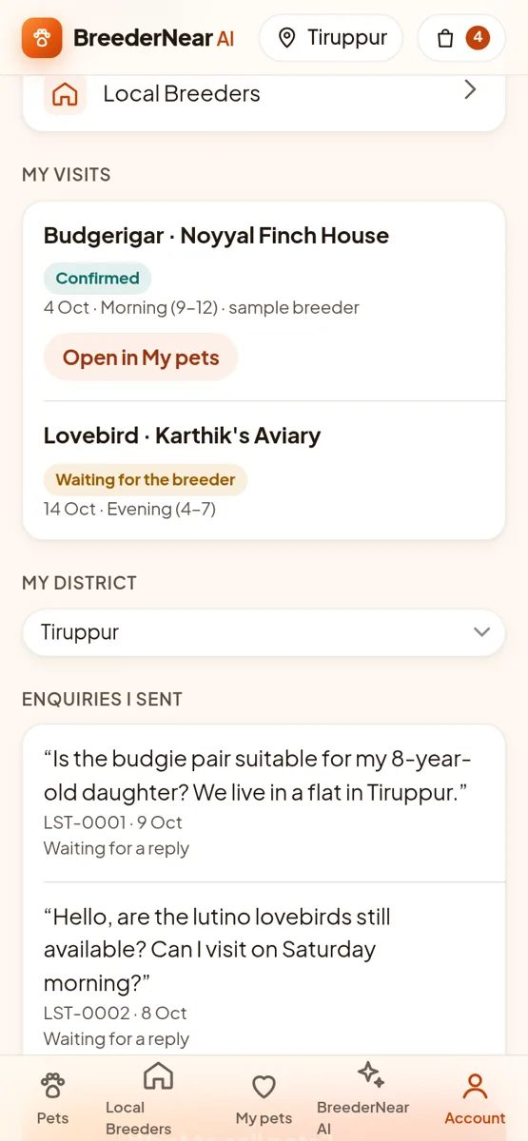
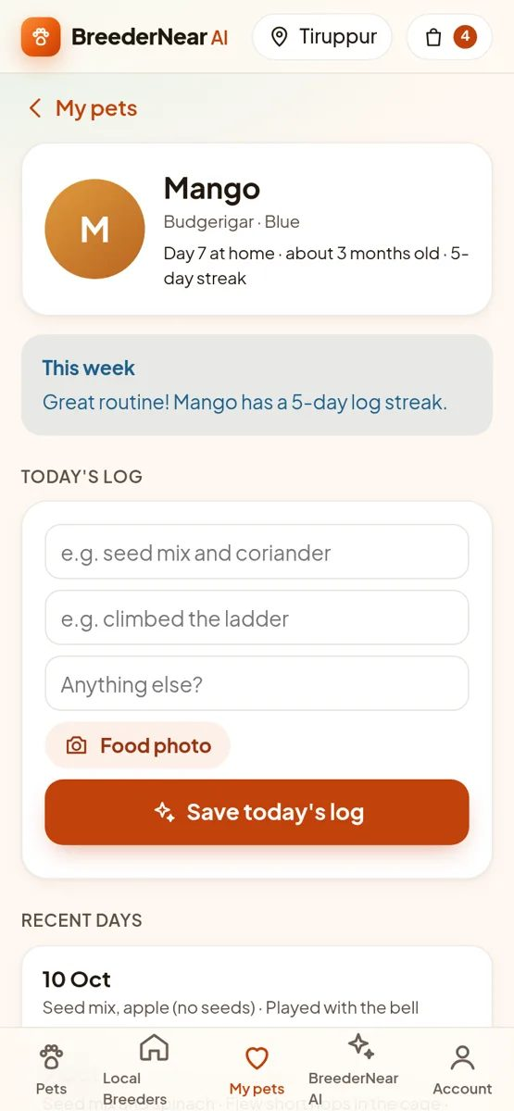
Wireframes/Mock diagrams of the proposed solution (optional)
Sign in or one-tap demo
Pets with match %
Listing + trust checks
Visits, then “I bought it”
My pets companion

Slide 8
Architecture diagram of the proposed solution
Buyers & sellers
phone or laptop
Cloud Run (asia-south1)
Gemini 3.8 Flash
Vertex AI: agents, photos, certificates,
listings, care, scam scan
Gatekeeper · login · rate limits · Gemini retries
only the routes the app uses; roles from the server
FastAPI /api
tap screens
Firestore
accounts, listings, visits, pets,
verification, analytics events
Firebase Hosting
web app on Google’s CDN
Google ADK: 7 agents
Concierge
Listing
Trust
Match
Cloud Storage
private uploads, deleted once read
Firebase Auth
Google sign-in (ID token)
Care
Verify
Companion
callbacks: context · reply guard · tool log
Cloud Logging
one JSON line per tool call
breedernear_core: one tool layer
listings · trust score · verification · match % · visits · care companion
analytics · accounts · safety rules in code · reused-photo hashing
Cloud Build + Artifact Registry
deploy from source; GitHub Actions CI

Slide 9
Technologies to be used in the solution
Google technology | How BreederNear AI uses it
Gemini 3.8 Flash (Vertex AI) | Seven ADK agents; listing extraction from photos + Tamil/English; photo, facility and certificate reading; care plans, daily-log feedback, symptom urgency; message drafts and scam scan. JSON schemas.
Google ADK (Python) | Concierge + listing, trust, match, care, verification and companion agents; tools; callbacks on every agent; streamed replies
Cloud Run | API and agents; login gatekeeper; rate limits; Gemini retries with backoff
Firebase Hosting | The web app on Google’s CDN; calls Cloud Run directly (CORS) so AI replies stream
Firebase Authentication | Continue with Google; the server verifies the Firebase ID token
Firestore | Accounts, listings, enquiries, visits, sales, pets and logs, verification, analytics
Cloud Storage, Cloud Build, Artifact Registry, Cloud Logging | Private uploads; deploy from source; tool-call logs
gemini-3.1-flash-image | Illustrative photos for the fictional sample listings (labelled in the app)
Also used
Python 3.12, FastAPI, Pydantic
imagehash: reused-photo detection
Plain HTML, CSS, JavaScript and SVG charts: no build step
pytest, Playwright + axe-core, GitHub Actions
Firebase CLI (deploy only)

Slide 10
Estimated implementation cost (optional)

Slide 11
Business case, scale and go-to-market
Market: India’s pet care products market is USD 9.2 B in 2026, heading to USD 13.9 B by 2034⁷, with about 39 million pets¹. The animals themselves are still sold with no checks: that is our wedge.
Revenue (planned)
Verified-breeder subscription: badge, dashboard insights, more listings
Featured listings per district
Starter-kit and accessory commerce after every sale (cart already built)
B2B trust-screening API for classifieds and pet shops
Built to scale
Trust costs ≈ ₹1.3 per listing (measured) against pets priced ₹400–₹25,000
Serverless Cloud Run + Firestore: near zero when idle, scales out per request
Districts, species, fair prices and protected lists are data, not code: a new district is a data file
Gemini already reads Tamil, English and mixed messages
Go-to-market
1 · Pilot in Coimbatore and Tiruppur with the founder’s breeder network
2 · Tamil Nadu, district by district; list by sending a WhatsApp message
3 · Other states and languages; the trust API for other marketplaces
Buyers arrive through “Is this post safe?” links shared in the same groups
Growth loop: verified breeders → trusted listings → more buyers → more sales and care data → sharper fair prices and trust scores → more breeders join.
Impact we measure, live in the app: listings checked before going live · protected animals stopped · scam warnings raised · verified breeders. Every warning can be shared back to the group it came from, and protected species come with a way to report them.
Revenue lines and rollout are plans, not results · ¹ Euromonitor 2025 · ⁷ IMARC Group, India Pet Care Products Market (2026) · Cost: docs/submission/05-deck-sources.md

Slide 12
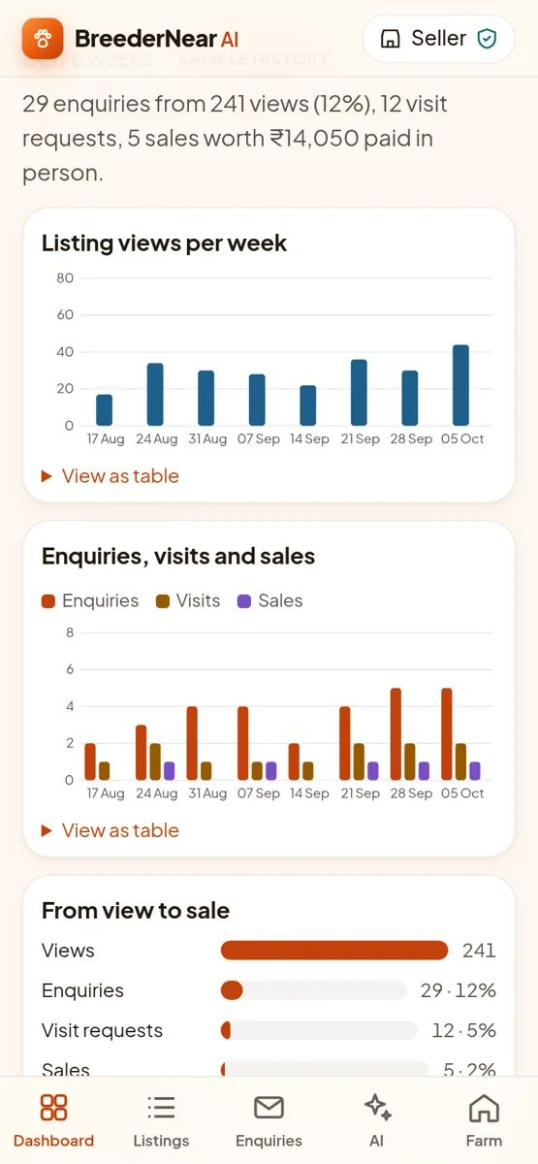
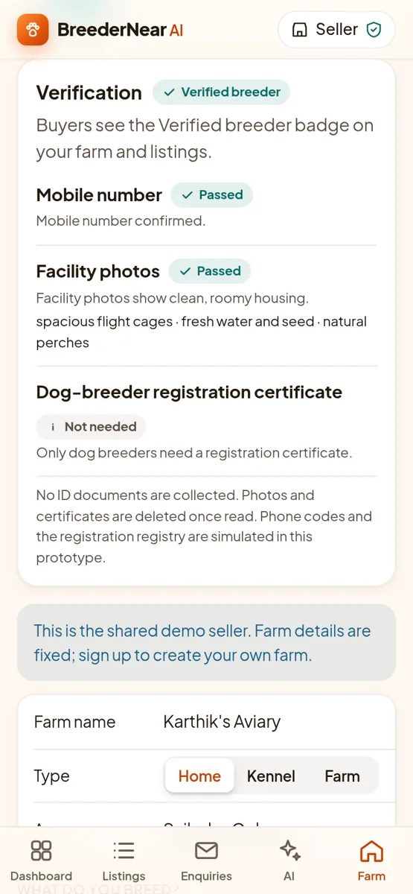
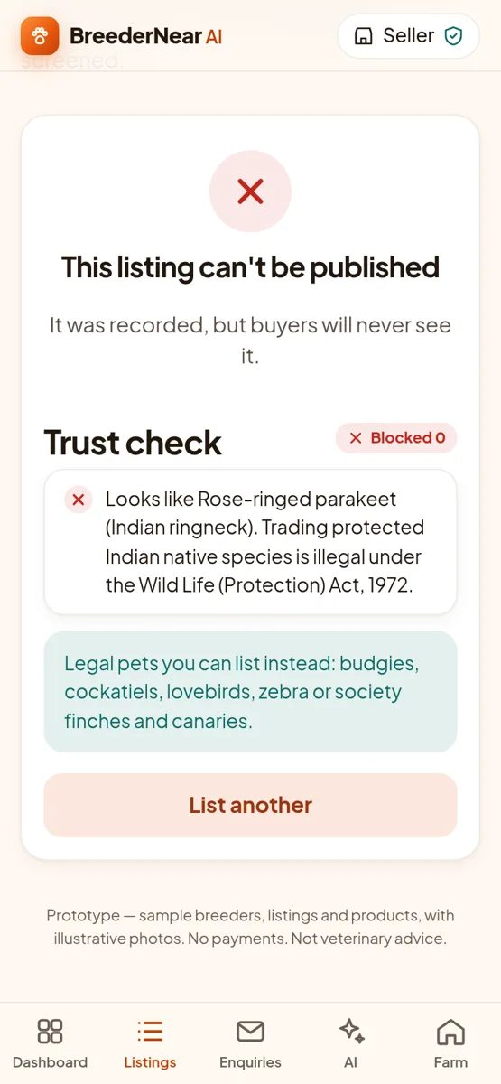
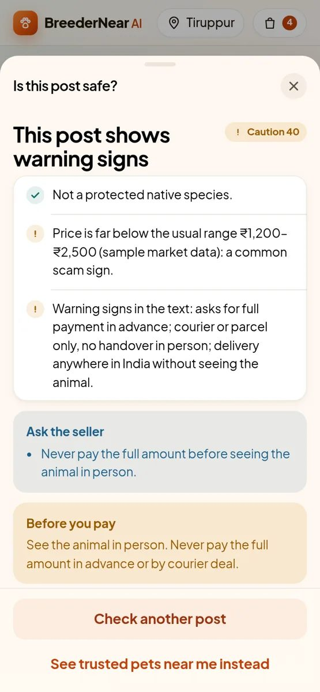
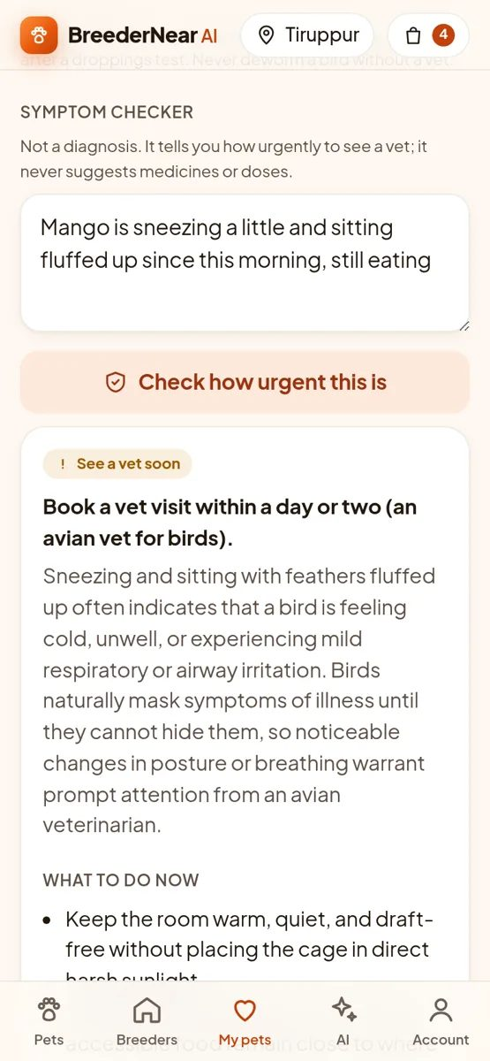
Snapshots of the prototype
Seller analytics
Verified breeder
Protected species: blocked
“Is this post safe?”
Symptom urgency, no doses

Slide 13
Prototype Performance report/Benchmarking
Quality (real Gemini, 10–11 Oct 2026) | Result
Agent evals: 22 cases × 3 runs (listing, Tamil, blocking, scams, reused photos, prompt injection, no medicine advice, roles, verification, visits, care companion) | 66/66 passed
Protected species blocked from the photo alone | 8/8
Ordinary pets wrongly flagged as protected | 0/37
All photo checks: species, dye, blur, no animal, watermark, screenshot | 202/202*
Accessibility: axe-core, WCAG 2.2 AA, light + dark, 320–1280 px, all screens | 0 problems
Unit tests in CI · live smoke test | 335 · 17/17
Speed (live) | Time
List a pet: upload, AI fill, publish with trust check | 17–27 s
Check a pasted post | 5–7 s
Web app load (Firebase CDN) | ≈ 0.7 s
Gemini: read a certificate · scan a message | ≈ 4.5 s · ≈ 2 s
Gemini: symptom urgency · daily-log feedback | ≈ 8 s
How we test
Gemini isn’t deterministic, so each eval runs three times and we report the count. Decisions (trust, verification, match %, urgency floor) are made by tested code.
*Test photos are AI-generated and the screening prompt was tuned on them (first run 196/202), so treat this as an upper bound · Reproduce: scripts/run_evals.sh 3 · scripts/vision_accuracy.py · pytest -m ui tests/ui · evals/RESULTS.md, evals/VISION_RESULTS.md

Slide 14
Additional Details/Future Development (if any)
Roadmap (not in the prototype)
Pilot with real breeders in Coimbatore and Tiruppur, from the founder’s network
Real SMS and email delivery for one-time codes
List by sending a WhatsApp message (WhatsApp Business Platform)
Live State Animal Welfare Board and PARIVESH registry checks; the platform registrations India’s pet-trade rules require
Chat history in Agent Engine sessions, so Cloud Run can scale past one instance
Breeder ratings from buyers’ care-companion outcomes; vet and pet-pharmacy partners; more languages
Responsible by design (already built)
Protected species blocked in code, whatever the model says
No medicine names or doses: checked on every AI reply, even while streaming
Verification without ID documents or selfies; photos deleted once read
Codes shown on screen only open new or demo accounts, never someone else’s
Symptom checker: red flags are always an emergency; never a diagnosis
Synthetic sample data, clearly labelled; simulated registry numbers start with SIM-

Slide 15
Provide links to your:
GitHub Public Repository: https://github.com/sudarsan-22/breedernear-ai
Demo Video Link (3 Minutes): [add the YouTube link on 17 Oct]
Final Product Link: https://breedernear-ai-2026.web.app (API: https://breedernear-655711985039.asia-south1.run.app)
Try it in 2 minutes: demo accounts with preloaded data
Customer: priya.customer@example.com Seller: karthik.seller@example.com Password: demo12345
Or tap “Demo customer · Priya” / “Demo seller · Karthik” on the login screen. The README has a step-by-step walkthrough.

Slide 16


