Slide 1


H1b Application – Related Statistical Analysis
BIG DATA – HADOOP
Sudarsanan m.r.
s170030100604

Slide 2


Apache Hadoop –YARN 2.6.0
(Yet Another Resource Negotiator )
YARN is one of the key features in the second-generation Hadoop 2 version.
Originally described by Apache as a redesigned resource manager.
YARN is now characterized as a large-scale, distributed operating system for big data applications.
YARN includes Resource Manager, Application Master and Node Manager.

Slide 3
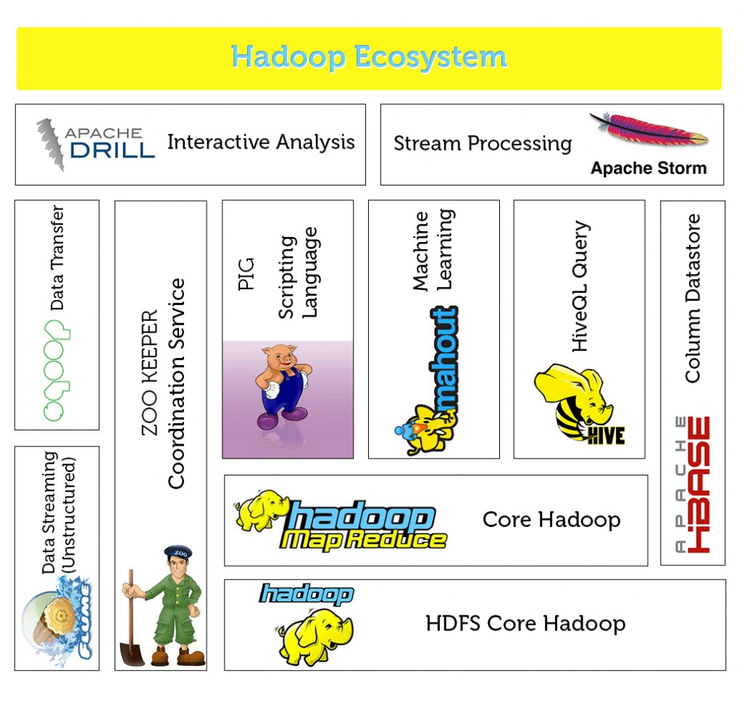
Tools in Hadoop Ecosystem
Apache Hive
Apache Sqoop
Apache Pig
Apache HBASE
Apache Flume

Slide 4

H1b Application –Statistical Analysis
Analysis on H1B is an employment-based, non-immigrant visa category for temporary foreign workers in the United States.
We will be performing analysis on the H1B visa applicants between the years 2011-2015.
It is the purpose of gathering information about the below mentioned fields using Apache Hadoop Tools.
The dataset has nearly 3 million records.
Purpose of this Analysis is to produce the Analytic overview of Applicants applying for visa process.

Slide 5
Input Data set Details
Case status
SOC name
SOC number
Job Title
Employer name
Prevailing Wages
Full time position
Worksite
Year
Latitude
Longitude

Slide 6

HIVE Tool
Data set is loaded into hive table pro under database named Project.
CREATE TABLE h1b_applications(s_no int,case_status string, employer_name string, soc_name string, job_title string, full_time_position string,prevailing_wage int,year string, worksite string,worksite2 string,longitute double, latitude double )
ROW FORMAT SERDE 'org.apache.hadoop.hive.serde2.OpenCSVSerde'
WITH SERDEPROPERTIES (
"separatorChar" = ",",
"quote Char" = "\""
) STORED AS TEXTFILE;

Slide 7
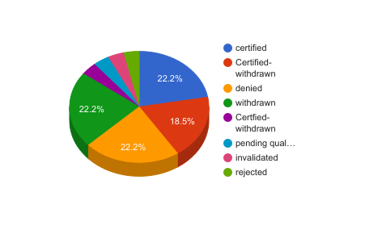
Sample Query in HIVE
Find the percentage and the count of each case status on total applications for each year. Create a graph depicting the pattern of All the cases over the period of time.
Hive> select count(s_no) as count ,(count(s_no)/t.tot)*100 as ctn,year,case_status from pro,(select count(s_no) as tot from pro)t group by case_status,year order by ctn desc;

Slide 8

Pig Tool
Data set is load in a Bag in Pig grunt shell using the following command.
a= load '/home/sudarshan/Downloads/project1/mapreduce' using PigStorage('\t') AS (s_no:int,case_status:chararray,employer_name:chararray,soc_name:chararray,job_title:chararray,full_time_position:chararray,prevailing_wage,year,worksite1:chararray,longitute,lattitute);

Slide 9
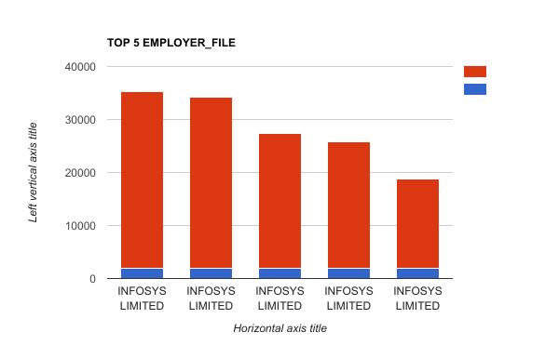
Pig Latin - Script
Sample Question
Which top employers file the most petitions each year?
gp= group a by (year,employer_name);
ct= foreach gp generate group as year, COUNT(a) as headcount;
obc= order ct by $1 desc;
limit2= limit obc 5;

Slide 10
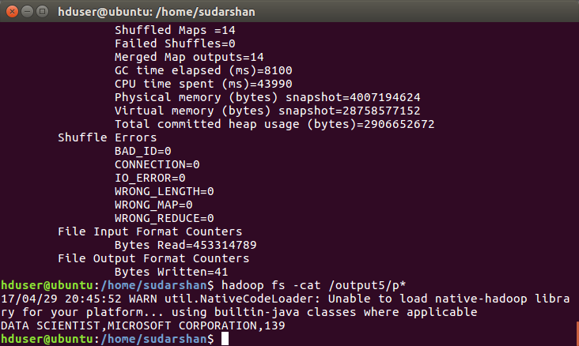
Map - Reduce

Slide 11



Data Export to Relational Database
Job positions which have the highest success rate in petitions has been done in hive tool it is been transfered to mysql database
This can be achieved using Apache Sqoop
Sqoop is used to import and export data from or to Relational Databases

Slide 12
Procedures to Run Sqoop Command
hduser@sudarshan-ubuntu:~$ hadoop fs -put /home/sudarshan/visa.txt /niit
Enter the mysql server: mysql -u root -p
Create a table in Mysql to export data from HDFS:
create table h1b_app(
success_rate FLOAT NOT NULL,
position VARCHAR(40) NOT NULL,
status VARCHAR(40) NOT NULL,
PRIMARY KEY(success_rate));

Slide 13
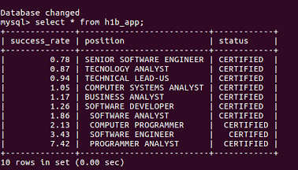
SQOOP QUERY:
sqoop export --connect jdbc:mysql://localhost/app --username root -P --table h1b_app --update-mode allowinsert --update-key success_rate --export-dir /niit/visa.txt --input-fields-terminated-by ',';
OUTPUT -

Slide 14
Analysis of H1- b US - Visa is as follows:
The number of applications submitted for H1-B Visas are increasing rapidly every year. So the government needs to select the top candidates
The top job positions who get certified are Programmer Analyst, Software Engineer and Computer Programmer
The top companies who get certified are Infosys Ltd, TCS Ltd and Wipro Ltd.

Slide 15
SUGGESTIONS FROM THE REPORT :
With Trump's decision on H-1B, Indian IT companies may suffer a major setback as top companies offering H-1B visa were majorly outsourcing employment to India. It will hit hard the entry level techies. So Young People should really work hard for H1-B Visa
There is a setback for Computer Programmers according to the new Policies of H1-B VISA. The competition has increased in Engineering Field.

Slide 16
THANK YOU
THANK YOU

