Slide 1
Deep Learning model for Cancer Detection using CNN and LSTM
Student Name:
Register Number:
College Name:
Department Name:
Email ID:
S.SUDARSAN
813821104102
Saranathan College of Engineering
Computer Science and Engineering
sudarsansathish17@gmail.com

Slide 2
Deep Learning model for Cancer Detection using CNN and LSTM
Description:
1. This project develops a deep learning model for cancer detection. It combines CNNs for image analysis and LSTMs for potentially analyzing medical history data.
2. Targeting doctors and researchers, the goal is to improve accuracy and enable earlier detection, potentially reducing reliance on traditional methods.
3. The unique combination of CNNs and LSTMs allows for a more comprehensive analysis, potentially leading to a more robust cancer detection tool.

Slide 3
AGENDA
Title: “Deep Learning model for Cancer Detection using CNN and LSTM”.
Cancer Detection Using Deep Learning: A Convolutional Neural Network (CNN) and Long Short-Term Memory (LSTM) Approach
Outline:
Problem Statement
Project Overview
Target Audience
Proposed Solution & Value Proposition
Model Uniqueness
Methodology
Results

Slide 4
PROBLEM STATEMENT
Cancer: A Global Challenge - Cancer poses a significant threat to global health, with high rates of occurrence and mortality.
Early Detection Saves Lives - Timely diagnosis is paramount for successful treatment and improving patient survival rates.
Beyond Limitations: Rethinking Diagnosis - Traditional diagnostic methods, while valuable, can be time-consuming, subjective, and susceptible to errors, highlighting the need for innovative solutions.

Slide 5
PROJECT OVERVIEW
This project proposes a novel approach utilizing deep learning.
The model leverages Convolutional Neural Networks (CNNs) - experts in extracting meaningful patterns from medical images like X-rays and mammograms.
Additionally, Long Short-Term Memory (LSTM) networks are incorporated.
These networks excel at handling sequential data, opening the possibility of analyzing a patient's medical history or time-series data, potentially leading to a more comprehensive diagnosis.

Slide 6

END USERS
Empowering Medical Professionals: This project targets radiologists and oncologists, who play a vital role in cancer diagnosis and treatment planning. The model can serve as a valuable tool to enhance their decision-making.
Fostering Collaboration: The project also extends to medical researchers, who can leverage the model for further exploration, and deep learning developers who can contribute to its ongoing improvement.

Slide 7
SOLUTION AND ITS VALUE PROPOSITION
Image Analysis Power: CNNs extract key features from medical images (X-rays, mammograms).
Sequential Data Potential: LSTMs handle medical history data (potentially).
The Benefits:
Improved Accuracy & Early Detection
Faster & Potentially More Cost-Effective Diagnosis
Foundation for Personalized Medicine

Slide 8
UNIQUENESS IN THE SOLUTION
Beyond Images: This project goes beyond analyzing just medical images (X-rays, mammograms).
Unlocking Potential: The model's capability to handle medical history data (potentially time-series data) opens new avenues for analysis.
A Stronger Foundation: This holistic approach has the potential to create a more robust and accurate cancer detection tool.

Slide 9
MODELLING
Harnessing AI for Cancer Detection:
Our model combines CNNs, experts in extracting image features, with LSTMs, adept at handling medical history data (potentially).
Training the System:
We train the model on a vast dataset of labeled medical images and corresponding diagnoses.
Rigorous Evaluation:
A separate testing dataset will be used to assess the model's accuracy in cancer detection.

Slide 10
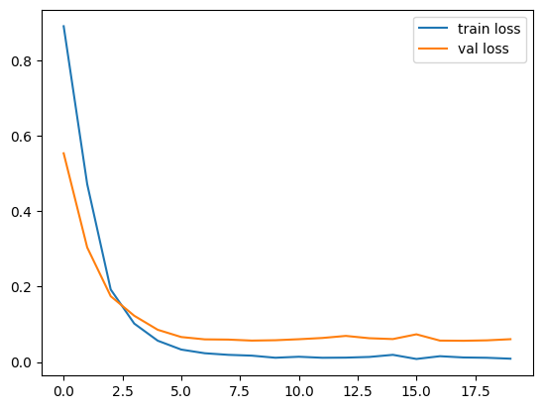
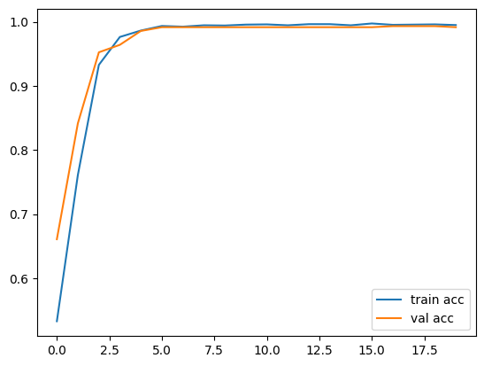
RESULTS
Loss function:
Accuracy function:

Slide 11
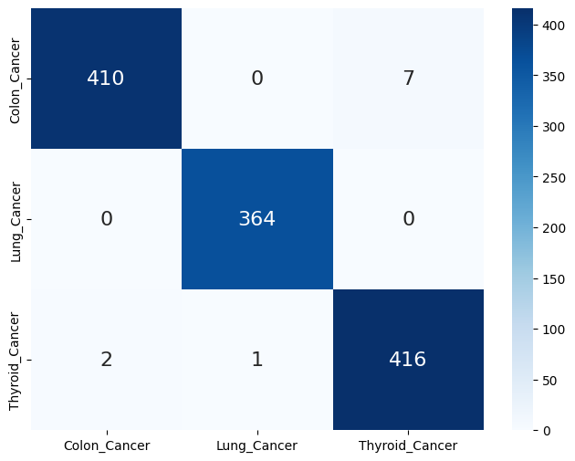
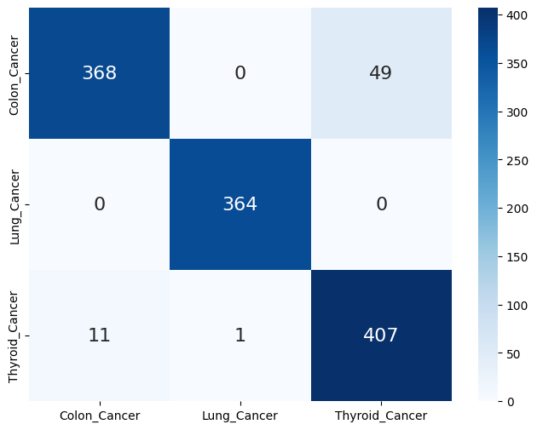
RESULTS
Confusion Matrix:
Github_Link

