Slide 1
Drivers for footfall in restaurants
Pranav, Rukmini, Sudarshan, Yuqin

Slide 2
Business Problem
Identify drivers of footfall for the restaurants in Las Vegas which will help potential new businesses to identify the strategies to be successful. Existing business can use the analysis for improved decision making and ensure that their business stays on top
Why is this problem important?
Yelp as a new source of information is becoming an important determinant of restaurant demand
One-star increase in Yelp rating leads to a 5-9% increase in revenue and this effect is driven by independent restaurants
Source: https://blog.yelp.com/2011/10/harvard-study-yelp-drives-demand-for-independent-restaurants
Notes:
https://blog.yelp.com/2011/10/harvard-study-yelp-drives-demand-for-independent-restaurants

Slide 3
Data Problem
Considering footfall as a metric for success of a business, we need ratings, reviews, attributes of a restaurant etc. which drive the restaurant business, at a business level
An alternate source of data, such as reviews, can be leveraged to understand user sentiments and to look for drivers for their footfall

Slide 4
Dataset
The Yelp’s dataset for businesses and user reviews comprises of 174K businesses and 5.2M reviews collected over a period of 12 years starting from 2006
We focus on restaurant businesses in Las Vegas (for the latest two months) as it has most amount of data in terms of reviews and other business attributes
The data was downloaded from yelp: https://www.kaggle.com/yelp-dataset/yelp-dataset
Business and Review datasets, which were available in json format, were used

Slide 5
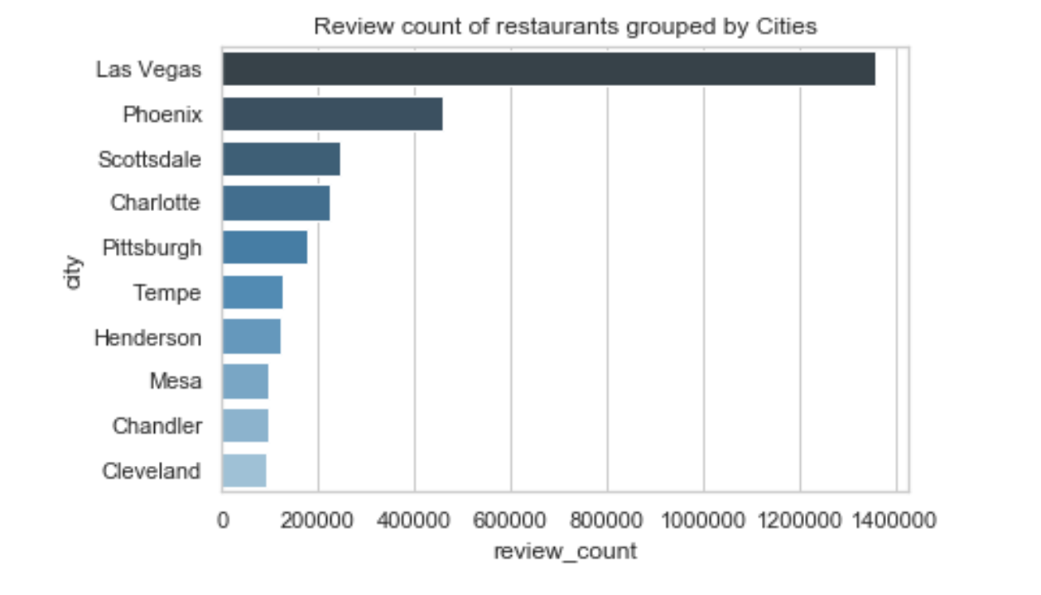
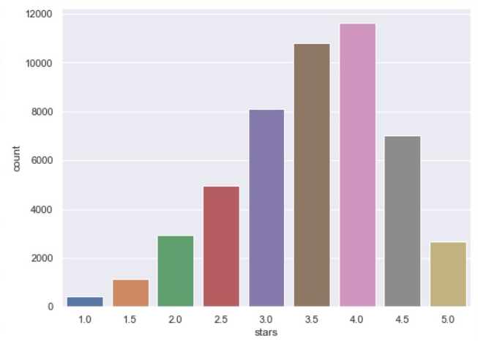
EDA
Distribution of ratings

Slide 6
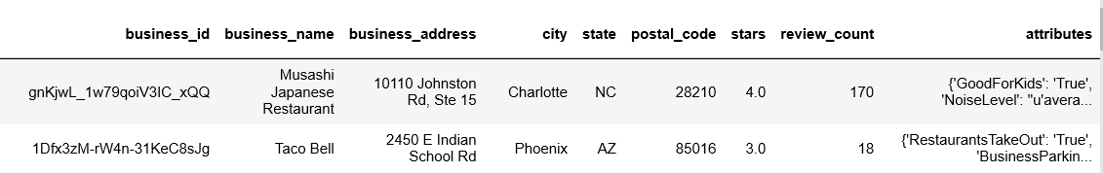
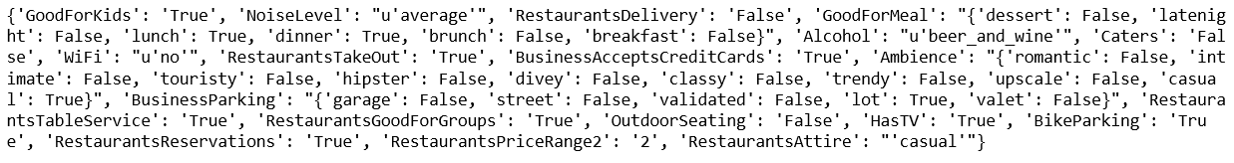
Business File
Data at Business level
Restaurant attributes were in the form of nested dictionaries
The attributes column required to be split into corresponding columns for analysis
attributes

Slide 7
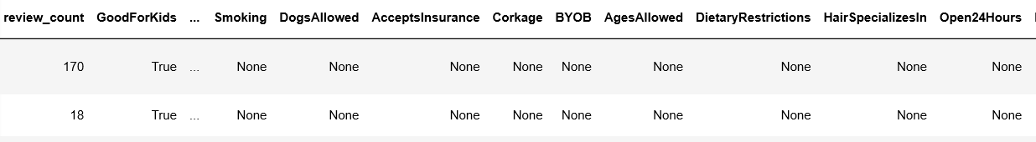
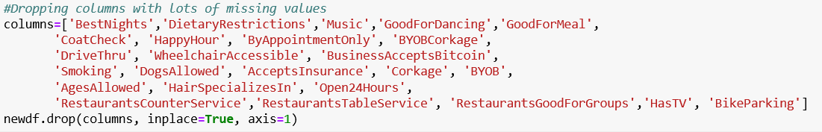
Business file: Cleaning Attributes
Created a function which splits all the key value pairs of the nested dictionary
Columns with a lot of missing attributes were dropped
All the missing and NA values in the columns were replaced by ‘None’ so that all categorical variables only have ‘True’, ‘False’ and ‘None’

Slide 8
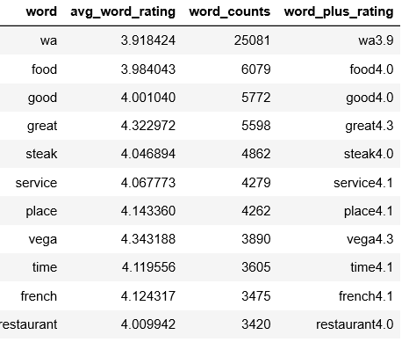
Review File: Unstructured analysis
Analysis of reviews for the business with most number of reviews
Food, Service and Time are few things which are talked about in most of the reviews

Slide 9
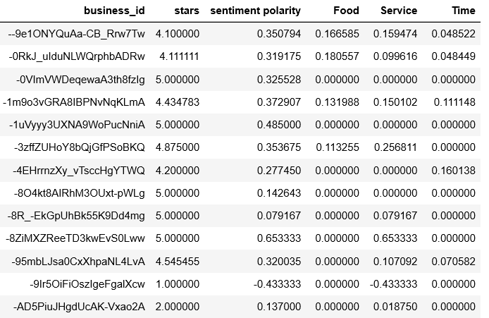
Review File: sentiment analysis
Filtered only for restaurants from Las Vegas and got the reviews for last two months because of computational limitations
Performed tokenization, lemmatization on the review text, and removed stop words
Sentiments only from the reviews where ‘food’, ‘service’ and ‘time’ are talked about were filtered and aggregated at business level

Slide 10
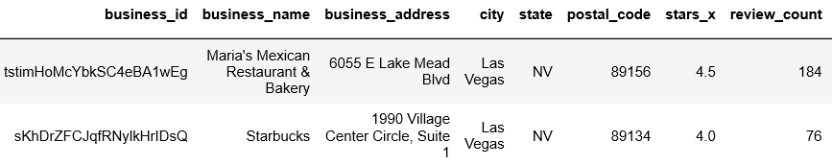
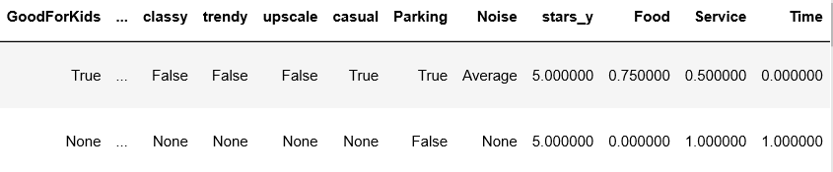
Master file: Merging both datasets
After cleaning the review and business files, they were merged together to get a final file at Business level

Slide 11
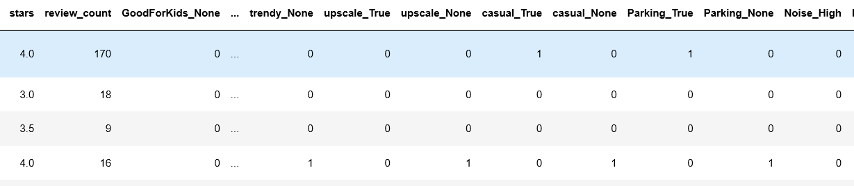
Create dummies
‘None’ was treated as a separate category
Pandas get dummies function was used to create dummies and the first category was dropped for each variable

Slide 12
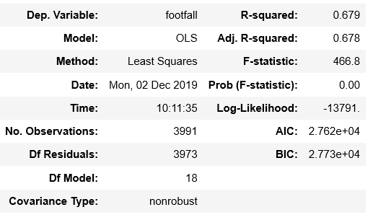
Linear Regression
Multiple linear regression was run with footfalls as target (count of user ID)
r squared: we can explain 68% of the variance in the target variable

Slide 13
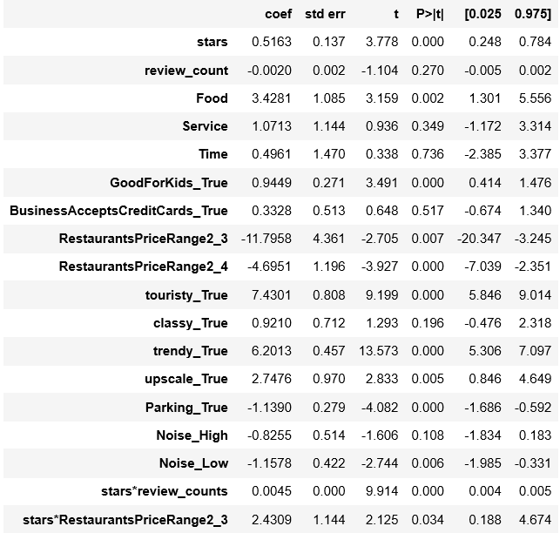
Linear Regression
We notice that user sentiments for Food is significant whereas the sentiments for Service and Time are not
Trendy and Touristy Ambience performs better than other Ambience options
A higher price range restaurants perform well than lower price range restaurants

Slide 14
Linear Regression
We notice that user sentiments for Food is significant whereas the sentiments for Service and Time are not
Trendy and Touristy Ambience performs better than other Ambience options
A higher price range restaurants perform well than lower price range restaurants

Slide 15
Linear Regression
We notice that user sentiments for Food is significant whereas the sentiments for Service and Time are not
Trendy and Touristy Ambience performs better than other Ambience options
A higher price range restaurants perform well than lower price range restaurants
Notes:
For increase in ratings for restaurants with low price range, will not have a significant increase in footfall
Where as
For a restaurant whose price range is average, an increase in rating will have a much higher impact.

Slide 16
Linear Regression: Interaction Terms
Does change in footfall with respect to ratings(stars) depend on the value of Review Count?
Does change in footfall with respect to ratings(stars) depend on the value of Price Range?
Notes:
The effect of review counts on ratings depend positively on footfall. For a given rating, a higher reviewcount will have a positive effect on footfall.

Slide 17
Linear Regression: Interaction Terms
Does change in footfall with respect to ratings(stars) depend on the value of Review Count?
Does change in footfall with respect to ratings(stars) depend on the value of Price Range?
Notes:
For increase in ratings for restaurants with low price range, will not have a significant increase in footfall
Where as
For a restaurant whose price range is average, an increase in rating will have a much higher impact.

Slide 18
Recommendations
The model helps food businesses measure the monetary impact of improvements done to the restaurants.
For instance, if a restaurant makes sure that it gets a perfect positive sentiment score of 1 for food, it would lead to a threefold increase in the restaurant’s footfall
Restaurants should incorporate a trendy or touristy ambience and focus on the quality of food and the service.
Restaurants need not worry if their noise levels are high since lower noise levels have a negative impact on the footfall.

Slide 19
Areas of Improvement
Sentiment Analysis: Our model looks at overall review sentiment and does not account for sentiment of the key words we look for
Data: Lot of attributes have none or null values. Accurate data can help improve the model learn better
The model considers the number of user-ids in the reviews as a metric for footfall which is not an accurate measure. Actual footfall may significantly vary

Slide 20
THANK YOU

Slide 21
references
https://pdfs.semanticscholar.org/7b42/3b983dca05dc7d4bae2259b986516be910a9.pdf
https://github.com/ahegel/yelp-dataset/blob/master/Predicting%20Star%20Ratings.ipynb

