Slide 1

Analyzing Food and Beverage
Industry Survey Data
By Sudarshan
Kamthe

Slide 2







Introduction to Survey Analysis
In this presentation, we will explore from the
. Understanding these
insights is crucial for making informed decisions in the industry. We will cover the , , and
of the data collected.

Slide 3
Problem Statement:
The food and beverage industry faces challenges in understanding the diverse preferences, behaviors, and perceptions of its consumers. Despite ongoing efforts in product development and marketing, there is limited clarity on which factors most influence consumer choices and how brand perception affects buying behavior. Additionally, the industry lacks detailed insights into demographic trends and regional preferences that could drive targeted marketing and product optimization.
To address these challenges, this project aims to analyze survey responses from consumers to:
Identify key consumption patterns and preferences across different demographic groups.
Evaluate brand awareness, perception, and product trial rates to assess their impact on consumer behavior.
Uncover areas for improvement in product offerings and marketing strategies based on consumer feedback.

Slide 4
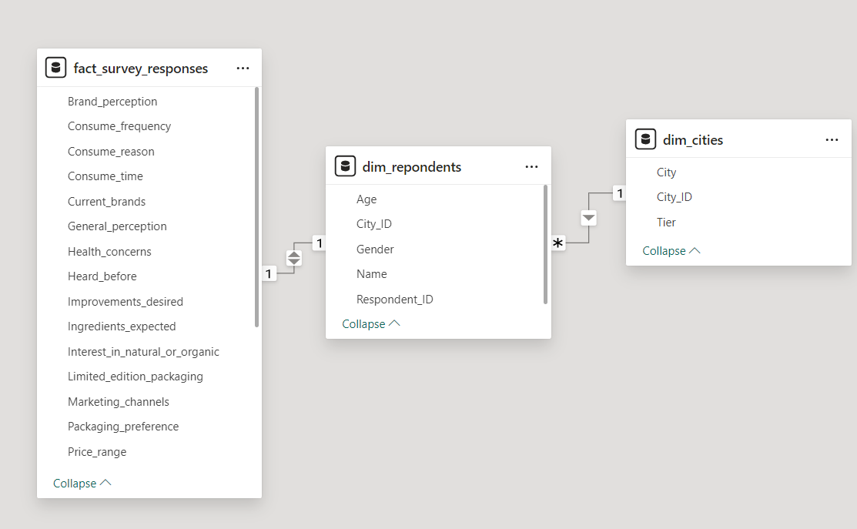
Model View

Slide 5
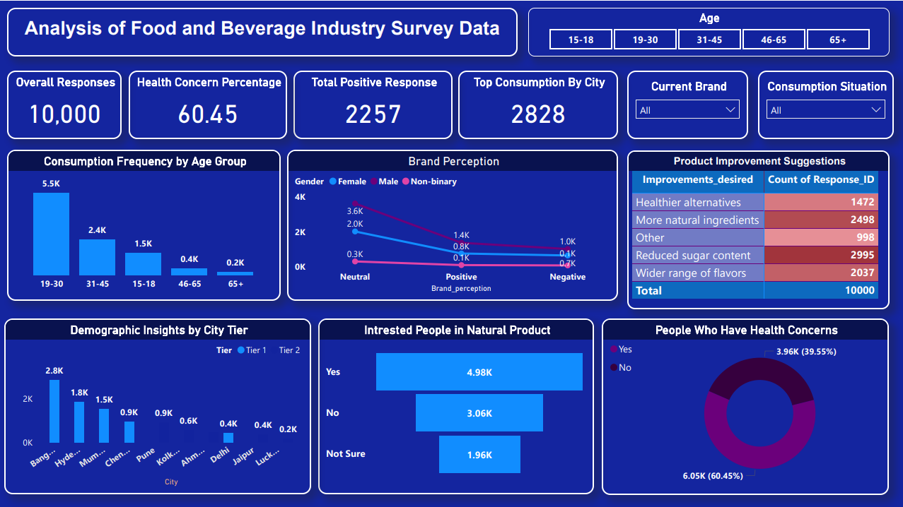

Slide 6
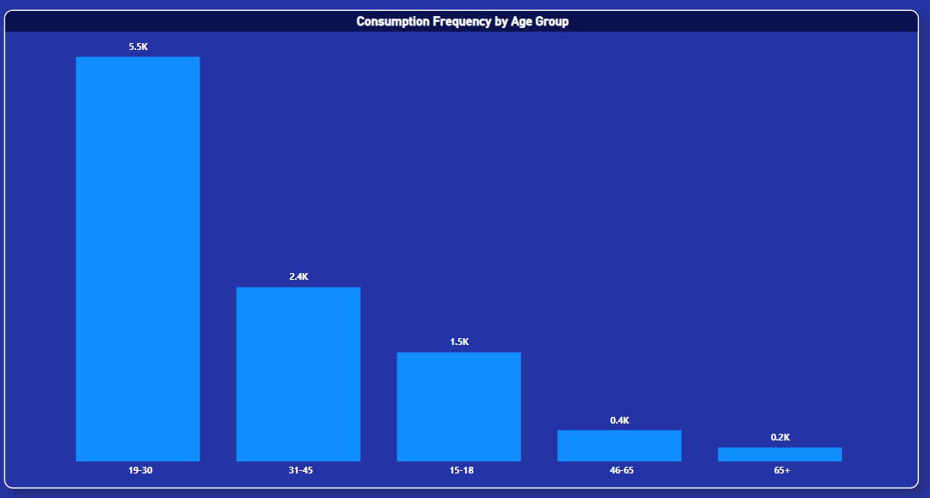

Slide 7
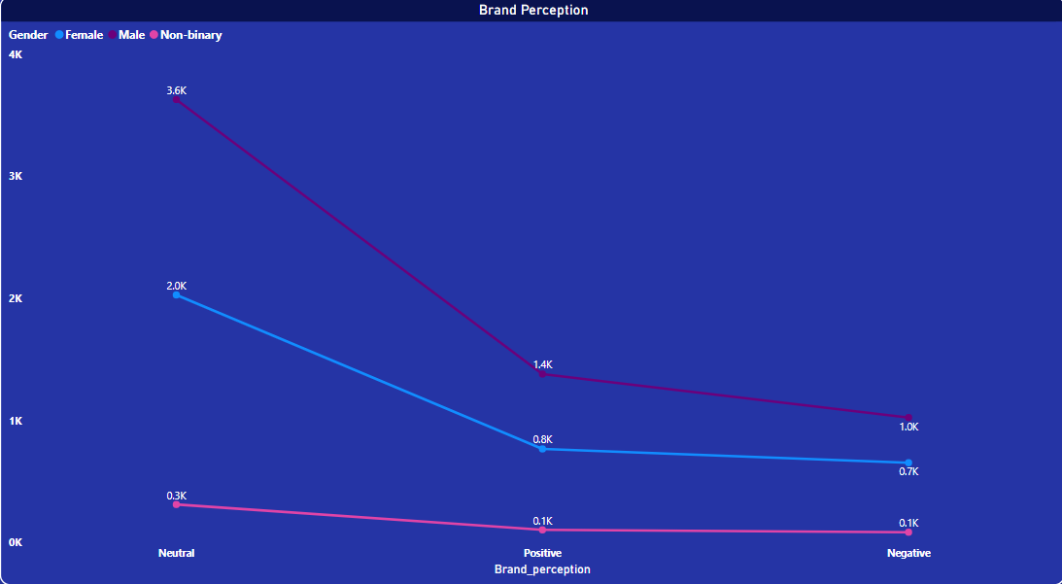

Slide 8
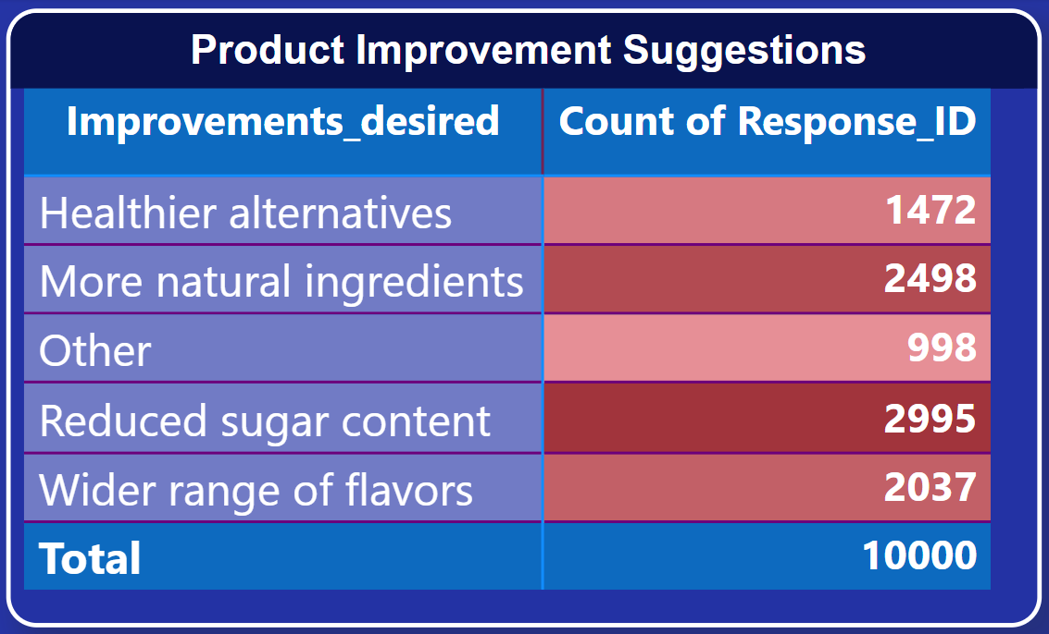

Slide 9
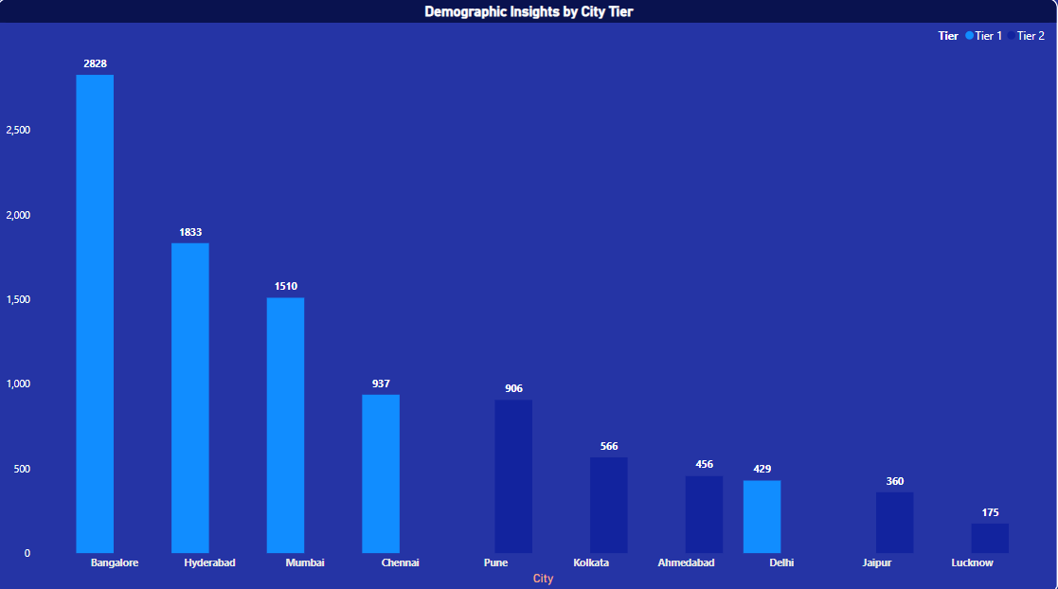

Slide 10
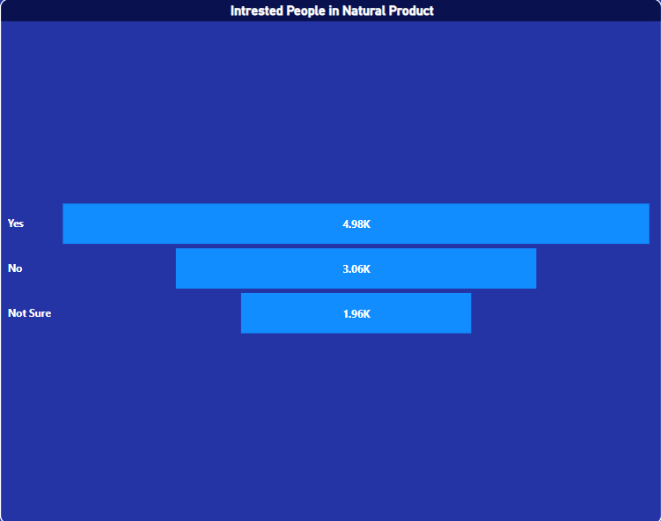

Slide 11
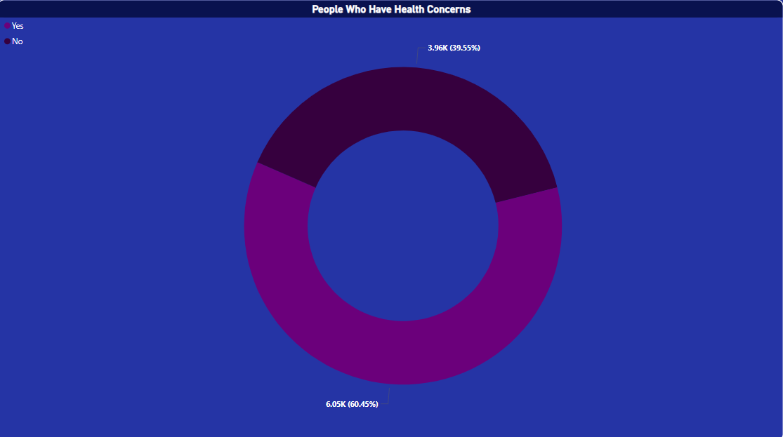

Slide 12
Conclusion
Focus on developing healthier alternatives and products with natural ingredients.
Pay attention to consumer health concerns and address them in product formulations.
Consider expanding product offerings in Tier-2 cities based on consumption patterns.

Slide 13
Thank You!

