Slide 1
Score-Based Generative Models
SMLD and DDPM
Score matching with Langevin dynamics → denoising diffusion probabilistic models
Sudarshan Babu
Slides created using Claude and Manus AI — each slide was prompted by the author.

Slide 2
Overview
1
Score Matching with Langevin Dynamics (SMLD)
Multi-scale scores, the noise-conditional score network, and annealed Langevin sampling.
2
Why Noise Helps
The manifold, scarcity, and mixing problems — and how perturbation fixes each.
3
The Limits of SMLD
Unstable training targets and slow, fragile MCMC sampling — the motivation for DDPM.
4
Denoising Diffusion (DDPM)
An explicit forward Markov chain, ε-prediction, and a learned Gaussian reverse step.
5
The Variational Objective
The ELBO, its KL decomposition, and the tractable reverse posterior.
Appendix — full reverse-process and ELBO derivations.
02 / 62

Slide 3
PART 01
Score Matching with Langevin Dynamics
Multi-scale scores · NCSN training · Annealed Langevin

Slide 4

Recap: What We Are Trying to Do
CENTRAL GOAL
SAMPLING MECHANISM
Generate new samples by learning the gradient of the log data density (the score).
Once learned, we generate samples via Langevin dynamics:
KEY INSIGHT
Score-based modeling replaces intractable density estimation with tractable gradient-field estimation.
04 / 62

Slide 5
THE TROUBLE WITH NAIVE SCORE MATCHING
Why Perturb the Data?
Before adding any noise, plain score matching breaks in three ways:
THE MANIFOLD PROBLEM
THE SCARCITY PROBLEM
THE MIXING PROBLEM
The score ∇ log p is undefined off the data manifold, so Langevin is ill-posed in the empty ambient space.
Low-density regions contain no samples, so the network never learns a valid score there.
Langevin gets trapped in a single mode and cannot move between well-separated modes.
The fix: perturb the data with Gaussian noise — at multiple scales — so the score is defined everywhere and sampling can mix.
We return to each problem in depth in Motivations 1–3.
05 / 62

Slide 6

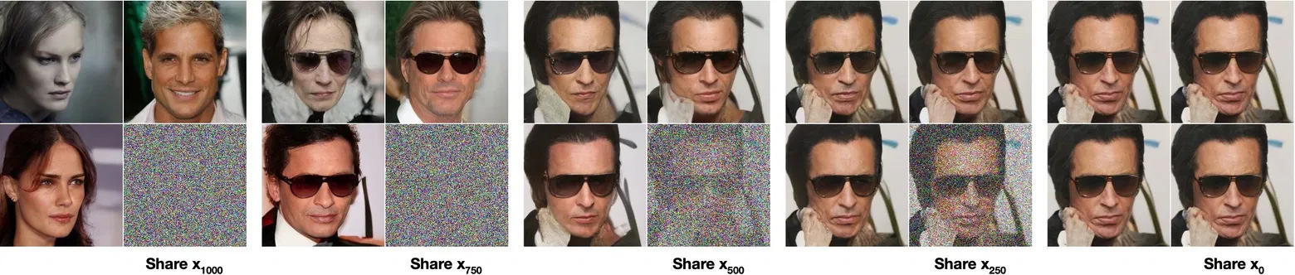
The Noise Model: Perturbing the Data
1. THE PERTURBATION KERNEL
FORWARD NOISING PROCESS
Add isotropic Gaussian noise to clean data x to produce a noisy observation x̃. The level σ controls the degree of corruption.
Two images diffused to shared latents at t ∈ {250, 500, 750, 1000}.
2. THE NOISE SEQUENCE
Reading left-to-right is the forward process (increasing σ); right-to-left is the reverse (denoising). The score network must learn to navigate this entire spectrum.
A geometric sequence of noise levels defines a family of perturbed distributions {pσ}.
[2] Ho, Jain & Abbeel, 2020
06 / 62

Slide 7

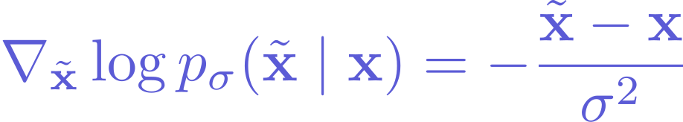
VIEW 1 OF 2 — CONSTRUCTIVE
Constructing Noisy Samples: The Sampling Recipe
Equivalently:
NETWORK INPUT
SCORE TARGET
MULTIPLE LEVELS
x̃ is the noisy sample fed to the score network sθ(x̃, σ).
The true score points back toward the clean data:
We repeat this for each σ in the schedule σ₁ > ⋯ > σ_L, creating a family of perturbed datasets.
07 / 62

Slide 8
VIEW 2 OF 2 — DISTRIBUTIONAL
Noising as Convolution: Fluffing the Manifold
THE PROBLEM WITHOUT NOISE
THE FLUFFING EFFECT
Real data lies on a low-dimensional manifold M ⊂ ℝᴰ. The density is concentrated on M and zero elsewhere, so ∇ log pdata is undefined off the manifold — Langevin dynamics is ill-posed.
Convolving with N(0,σ²I) fattens the manifold into a σ-thick tube. The perturbed density has full support over ℝᴰ, so the score is well-defined everywhere — a valid target.
Larger σ → more fluffing, smoother density • Smaller σ → tighter tube, closer to the true manifold
08 / 62

Slide 9

SCORE MATCHING WITH LANGEVIN DYNAMICS
The SMLD Approach
1. TRAINING (NCSN)
2. SAMPLING (ANNEALED)
Learn a Noise-Conditional Score Network conditioned on the noise level σ:
Run Annealed Langevin Dynamics sequentially.
Start at σ₁ (large noise) and anneal down to σ_L (small noise).
Each level initializes the next.
For a geometric sequence of noise levels:
WHY?
This multi-scale design solves two critical failures of naive score matching.
09 / 62

Slide 10

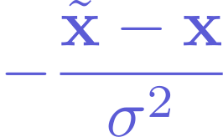
The Unified Solution: Multi-Scale Scores
SINGLE SCALE (NAIVE)
MULTI-SCALE (SMLD)
Fails: undefined on the manifold, and poor mixing in low-density regions.
Succeeds: large σ fills space for mixing; small σ recovers data. Tractable conditional score:
σ₁ > σ₂ > ⋯ > σ_L
Global Exploration → Local Refinement (Smooth → Sharp)
10 / 62

Slide 11
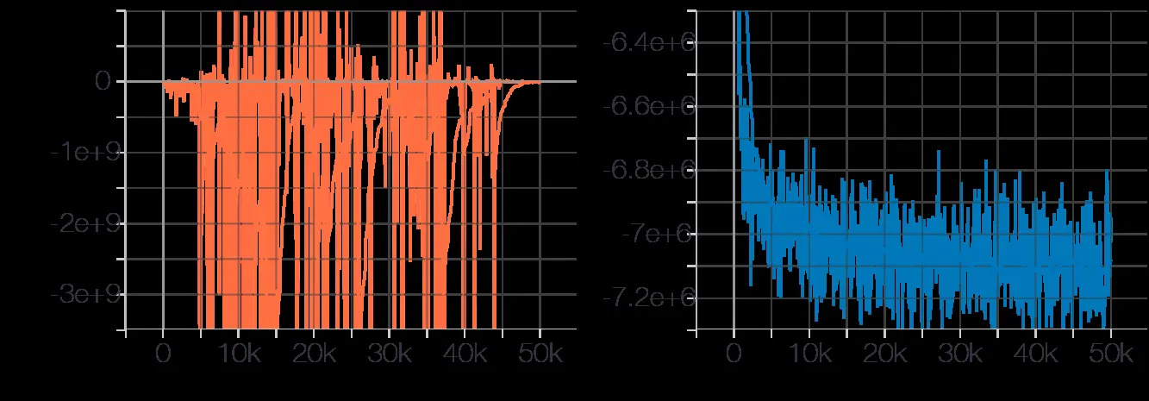
Motivation 1: The Manifold Problem
THE ISSUE
THE SMLD FIX
Real-world data lies on a low-dimensional manifold embedded in high-dimensional space. The density drops to zero outside it, so ∇ log p(x) is undefined in the ambient space.
Perturb with noise: adding Gaussian noise “fluffs” the manifold. The perturbed pσ(x) has full support everywhere, so the score becomes well-defined.
EMPIRICAL EVIDENCE
Fig 1: Without noise, training diverges (left); with noise, it stabilizes (right).
[1] Song & Ermon, 2019
11 / 62

Slide 12
Motivation 2: The Scarcity Problem
LOW-DENSITY REGIONS
Score matching minimizes expected error over the data distribution. In regions where pdata(x) ≈ 0 there are no samples, so the network never learns the score in these empty spaces.
THE SMLD FIX
Large noise levels (σ₁): a large σ convolves the data distribution, spreading probability mass into low-density regions. This provides a valid training signal everywhere, guiding the sampler toward the manifold.
12 / 62

Slide 13
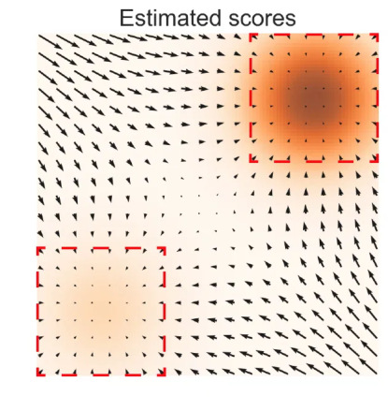
Motivation 3: The Mixing Problem
ISOLATED MODES
Multimodal data has modes separated by vast low-density regions, so standard Langevin gets trapped in a single mode and can’t mix between them.
WHY MIXING MATTERS
Without mixing, a run samples only one mode — so the modes appear in the wrong proportions, not the true distribution.
Fig 2: Estimated score field for a two-mode distribution.
THE SMLD FIX
Annealing (large → small σ): large σ blurs the modes into one connected blob (easy to mix); anneal down to refine.
Intuition: scores are accurate inside each mode but ≈ 0 in the gap — so Langevin can’t cross between modes.
[1] Song & Ermon, 2019
13 / 62

Slide 14
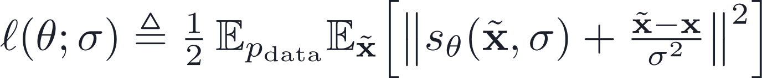
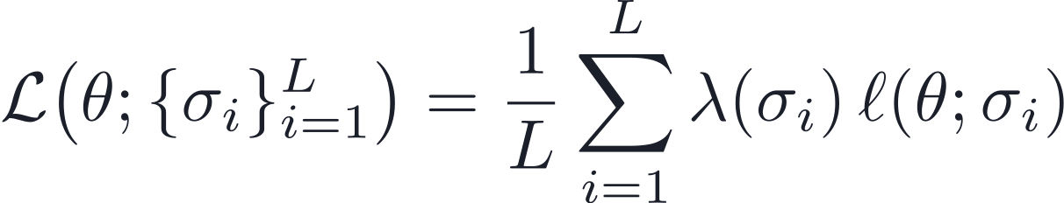
Training the Multi-Scale Score
SINGLE NOISE LEVEL — DENOISING SCORE MATCHING
• Tractable: no adversarial training or sampling loop.
• Scalable: one U-Net learns all noise levels.
• Optimal: minimizer satisfies sθ* ≈ ∇ log pσ.
UNIFIED OBJECTIVE
14 / 62

Slide 15
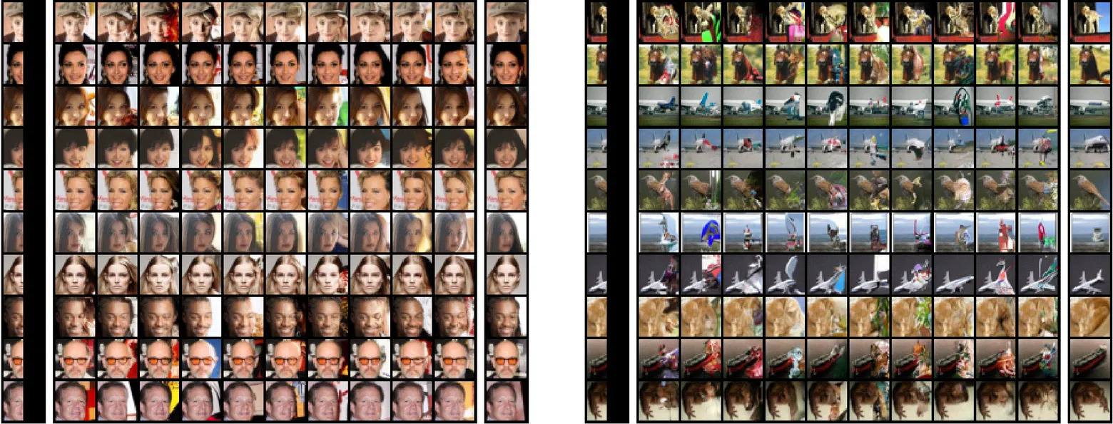
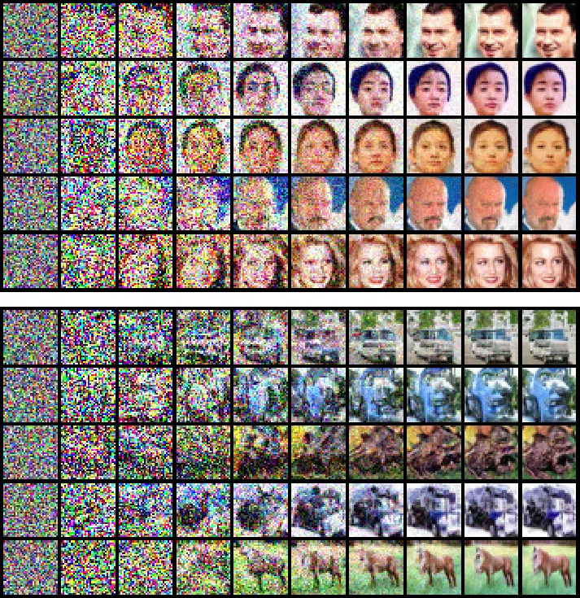
Sampling with Annealed Langevin
ALGORITHM
SAMPLES EVOLVING
Input: {sigma_i}, eps, T
1. init x ~ N(0, I)
2. for i = 1 to L do
a_i <- eps * sigma_i^2 / sigma_L^2 # anneal
for t = 1 to T do
z ~ N(0, I)
x <- x + (a_i/2) s_th(x, sigma_i)
+ sqrt(a_i) z # Langevin
end for
3. end for
Return x
Figs 4–5: noise → structure as σ decreases.
[1] Song & Ermon, 2019
15 / 62

Slide 16




Implementation Detail 1: Loss Weighting
THE PROBLEM
THE SOLUTION
Empirically, the score norm scales inversely with noise:
Choose a weighting function:
Unweighted loss:
Weighted loss:
Small-σ terms explode; gradients are dominated by the finest scale and coarse scales are ignored.
Balanced gradient contributions across all noise levels.
16 / 62

Slide 17
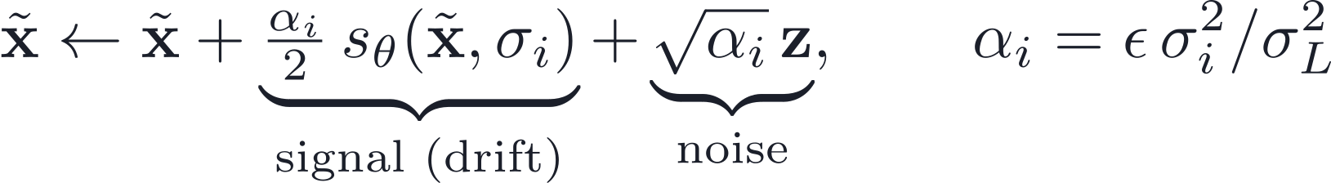

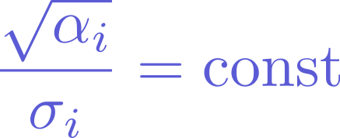

Implementation Detail 2: Step Size
SIGNAL MAGNITUDE
NOISE MAGNITUDE
SIGNAL-TO-NOISE
Setting αᵢ ∝ σᵢ² keeps the SNR constant — ensuring stable mixing dynamics across all noise levels.
17 / 62

Slide 18
Conceptual Flow & Results
THE LOGIC OF SMLD
CIFAR-10 UNCONDITIONAL RESULTS
1
The Goal
Generate samples via Langevin dynamics on learned scores.
Model
IS ↑
FID ↓
PixelCNN
4.60
65.93
2
The Method
Learn a family of scores (NCSN) and anneal noise levels.
WGAN-GP
7.86
36.4
SNGAN
8.22
21.7
3
The Motivation
Solves the manifold problem and the mixing problem.
ProgressiveGAN
8.80
—
4
The Outcome
High-fidelity samples competitive with GANs, no adversarial training.
NCSN (Ours)
8.87 ± 0.12
25.32
Table 1 — CIFAR-10 unconditional results
[1] Song & Ermon, 2019
18 / 62

Slide 19
PART 02
Why SMLD Falls Short
Training instabilities · Fragile MCMC sampling · Motivation for DDPM

Slide 20

SMLD: What We Are Doing
TRAINING OBJECTIVE
ANNEALED LANGEVIN SAMPLING
with corruption
It works in principle. But there are practical issues.
20 / 62

Slide 21
Training Dynamics Issue #1: Scale Mismatch
In SMLD, x = x₀ + σε. As σ grows:
QUANTITY
SCALING WITH σ
IMPACT
Input Norm ‖x‖
↑ Increases (≈ σ)
Network sees huge inputs
Target Norm ‖∇ log p‖
↓ Decreases (≈ 1/σ)
Target signal vanishes
Gradient Magnitude
↓ Decreases
Loss dominated by small σ
THE RESULT — POOR CONDITIONING
Optimization is unbalanced. We are forced to use the heuristic weighting λ(σ) = σ² just to make gradients comparable.
21 / 62

Slide 22
Training Dynamics Issue #2: Activation Regime Drift
THE ROOT CAUSE
INTERNAL SHIFT
Input variance scales with σ². The network sees inputs ranging from “clean” all the way to “massive noise.”
Activations operate at drastically different magnitudes. LayerNorm and residual scaling behave inconsistently across noise levels.
THE CONSEQUENCE
We are effectively training “many differently-scaled networks” with shared parameters — which complicates tuning and slows convergence.
22 / 62

Slide 23
Sampling Issue #1: MCMC Dependence
THE INNER LOOP
WHY IT’S FRAGILE
for i = 1 to L:
for t = 1 to T: # many steps
z ~ N(0, I)
x = x + a*s(x) + sqrt(2a)*z
end
end
• Requires many Langevin steps per level.
• Step size requires careful tuning.
• Approximate score ⇒ biased drift.
• Sampling is expensive and fragile.
Hundreds or thousands of iterations are needed for convergence.
23 / 62

Slide 24

Sampling Issue #2: No Explicit Forward Markov Model
WHAT WE HAVE
WHAT IS MISSING
✗ No explicit joint q(x₀:T).
✗ No closed-form reverse transition.
SMLD defines only a set of marginal distributions — blurred versions of the data.
Reverse dynamics rely purely on MCMC correction (Langevin) — we lack a principled ancestral reverse model like p(xₜ₋₁ | xₜ).
24 / 62

Slide 25
Sampling Issue #3: Hyperparameter Sensitivity
The Noise Ladder
Step Sizes α
Geometric vs arithmetic schedule?
Per-level Langevin step size.
Langevin Steps / Level
Loss Weights λ(σ)
How many T iterations each.
Balancing across noise scales.
Small changes can destabilize training or sampling. Scaling to large, high-resolution models becomes extremely difficult.
25 / 62

Slide 26
Summary of SMLD Issues
TRAINING
SAMPLING
✗ Input scale grows with σ.
✗ Target scale shrinks with σ.
✗ Gradients poorly conditioned.
✗ Heavy manual reweighting required.
✗ MCMC inner loop (slow).
✗ Slow convergence.
✗ Hyperparameter sensitive.
✗ No explicit reverse Gaussian step.
26 / 62

Slide 27
What We Want Instead
✓ Stable input variance across noise levels
✓ Stable target magnitude
✓ Well-conditioned regression problem
✓ Explicit forward Markov chain
✓ Closed-form Gaussian reverse conditionals
✓ Fixed number of sampling steps
This motivates DDPM.
27 / 62

Slide 28
Reminder: What Was Broken in SMLD?
TRAINING
SAMPLING
Annealed Langevin dynamics: many MCMC steps per σ, requiring step-size tuning and sensitive to drift errors.
If σ is large, the input scale explodes; the target sθ ≈ −ε/σ shrinks.
Net effect: poor conditioning, different activation regimes, and the manual weighting λ(σ) = σ².
Net effect: slow convergence, and no explicit reverse conditional to sample from.
28 / 62

Slide 29
PART 03
Denoising Diffusion (DDPM)
VP forward process · ε-prediction · Learned Gaussian reverse · The ELBO

Slide 30
DDPM Design Goal
Instead of “learn a score field and use Langevin to approximate reverse dynamics”…
Define an explicit forward Markov chain with simple Gaussian transitions, derive the exact reverse posterior inside that chain, then learn a reverse model that directly imitates those posteriors.
→ This structural change removes inner-loop MCMC.
30 / 62

Slide 31
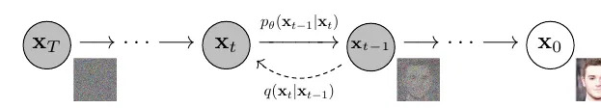
Fix #1: Stabilize Variance — The VP Markov Forward Process
FORWARD STEP
VARIANCE-PRESERVING CONSTRAINT
SMLD: input norm grows as σ — activations drift, gradients shrink.
DDPM: input norm stays O(1) — consistent activations, stable gradients.
The forward process gradually adds noise; the reverse process learns to denoise.
[2] Ho, Jain & Abbeel, 2020
31 / 62

Slide 32
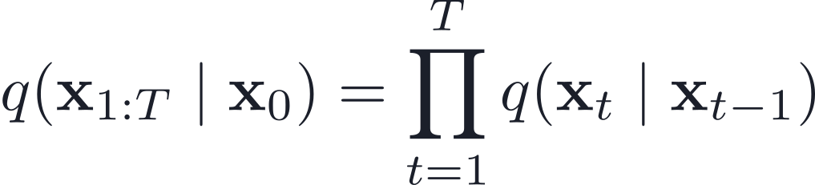

Why Is the Forward Markov Process Essential?
1. TRACTABLE VARIATIONAL DISTRIBUTION
We can efficiently sample and evaluate the forward process because it factorizes:
2. CLOSED-FORM POSTERIOR
The reverse posterior q(xₜ₋₁ | xₜ, x₀) is Gaussian — it is the product of two Gaussians (the forward step and the marginal).
Without the Markov + Gaussian structure, the KL decomposition isn’t computable.
32 / 62

Slide 33
Closed-Form Marginal
Define the cumulative product ᾱₜ = ∏ αₛ. The one-shot marginal is:
You can sample xₜ for any t directly from x₀ — no need to simulate intermediate steps. This enables efficient training.
33 / 62

Slide 34


Fix #2: Predict Noise Instead of Scaled Score
THE SMLD WAY
THE DDPM WAY
Target scale shrinks as σ grows. Gradients vanish at high noise unless manually reweighted.
Target has constant scale (unit variance) for all t. Gradients are uniform — far less reliance on weighting hacks.
34 / 62

Slide 35
Fix #3: Replace MCMC with a Learned Gaussian Reverse Step
LEARNED REVERSE STEP
REVERSE PROCESS
Sampling update (one step):
PROPERTY
SMLD
DDPM
Steps per level
Many (inner loop)
One
Reverse model
MCMC (biased)
Exact Gaussian
Hyperparameters
Step size, T, N
Schedule only
Full reverse-step derivation ↗
[2] Ho, Jain & Abbeel, 2020
35 / 62

Slide 36

The DDPM Generative Model
PRIOR
REVERSE CHAIN
Goal: make pθ(xₜ₋₁ | xₜ) match the true reverse behavior induced by the forward chain.
36 / 62

Slide 37
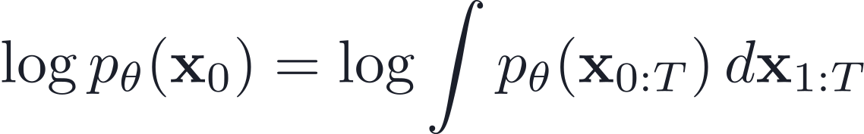
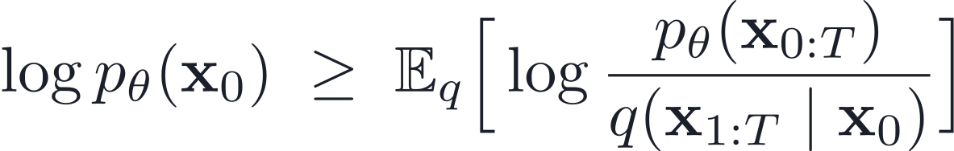
VLB / ELBO: The Probabilistic Objective
We want to maximize the likelihood log pθ(x₀), but marginalizing all latents is intractable:
Introduce the forward chain q(x₁:T|x₀) as a variational distribution to derive the ELBO:
37 / 62

Slide 38
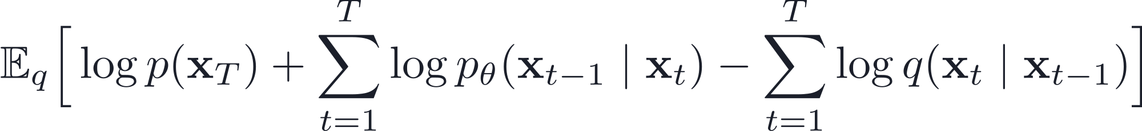
Expand the ELBO
Substituting these into the ELBO yields:
Rearranging gives a sum of KL-divergence terms.
38 / 62

Slide 39
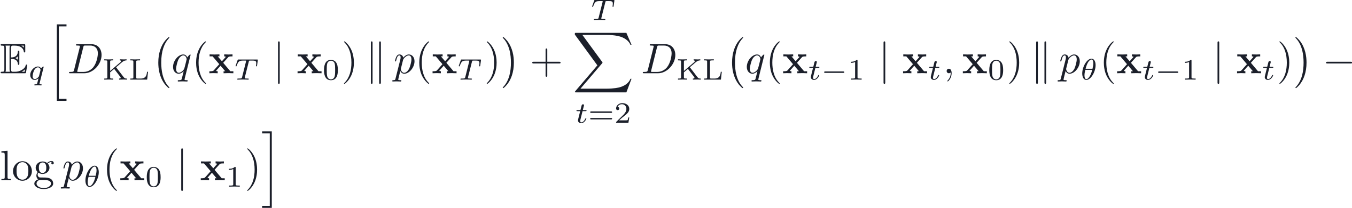
KL Decomposition
So the main learning problem becomes: match pθ(xₜ₋₁|xₜ) to the true posterior q(xₜ₋₁|xₜ,x₀).
Because everything is Gaussian, these KL divergences are tractable.
39 / 62

Slide 40
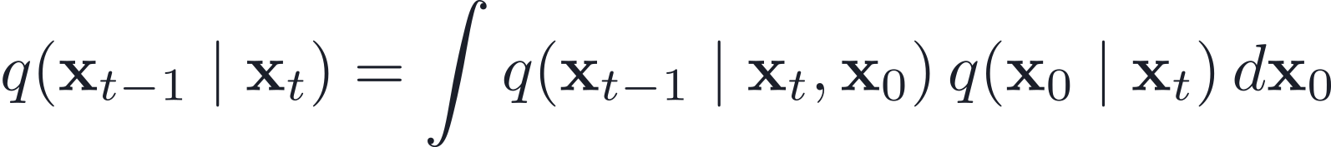
Why We Can’t Use q(xₜ₋₁ | xₜ) Directly
We’d like q(xₜ₋₁ | xₜ), but:
That’s a mixture of Gaussians over x₀, and mixtures are not Gaussian in general ⇒ intractable.
This is the key reason DDPM introduces x₀ in the derivation.
40 / 62

Slide 41
Key Trick: Condition on x₀
Instead, compute the posterior inside the known forward model:
BECAUSE THE FORWARD PROCESS IS LINEAR-GAUSSIAN MARKOV
✓ This posterior will be Gaussian.
✓ It can be derived exactly by multiplying Gaussians.
41 / 62

Slide 42
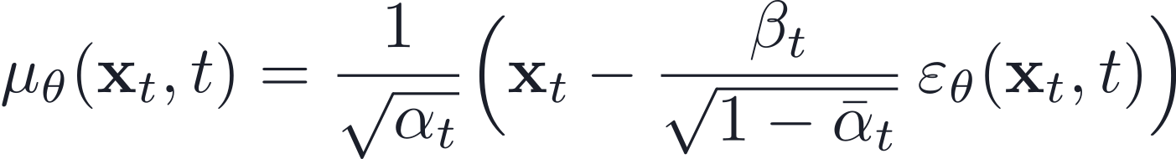
The Practical Reverse Step Mean
After substituting and simplifying, the reverse mean is:
This formula tells us exactly how to denoise xₜ.
Notice the similarity to Langevin dynamics?
42 / 62

Slide 43
The Final Sampling Step
To sample xₜ₋₁ from xₜ:
This is a single Gaussian step. Iterate from T → 0. No MCMC. No inner loops.
43 / 62

Slide 44
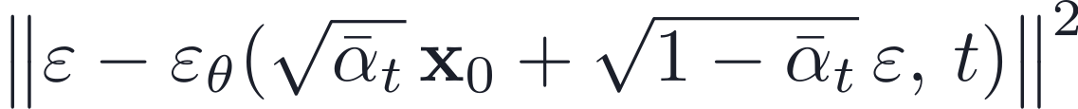
DDPM Algorithm Recap
TRAINING
SAMPLING
1. Sample x₀ ∼ q(x₀), ε ∼ N(0,I), t ∼ Uniform(1,T).
2. Take a gradient step on:
1. Sample x_T ∼ N(0,I).
2. For t = T, …, 1:
3. Return x₀.
44 / 62

Slide 45
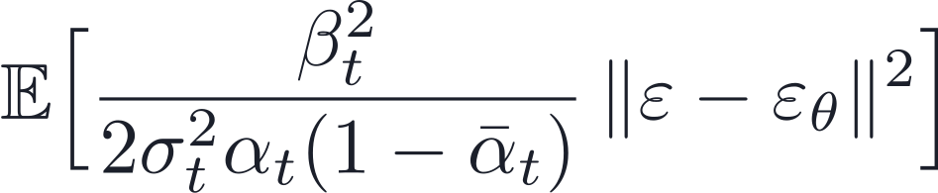
Loss Function Derivation (Simplified)
The KL term becomes a weighted MSE between the true noise and the predicted noise:
DDPM ignores the weighting term for better sample quality:
45 / 62

Slide 46
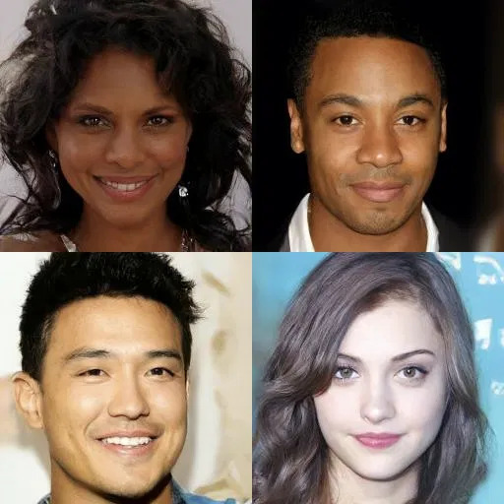
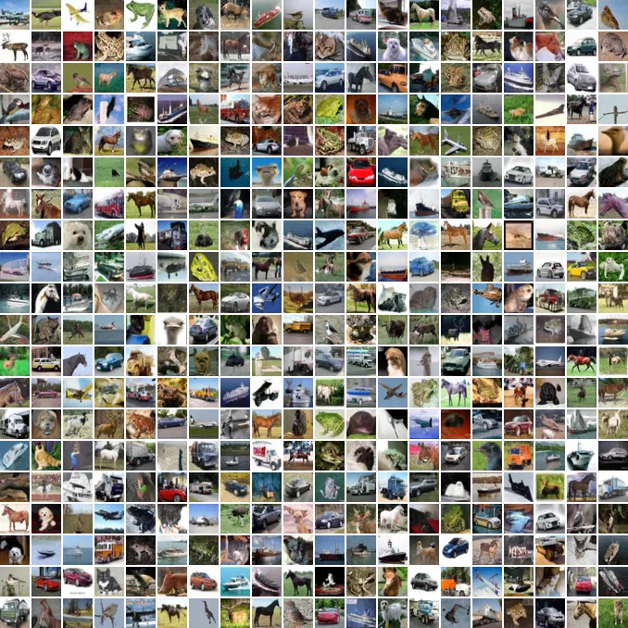
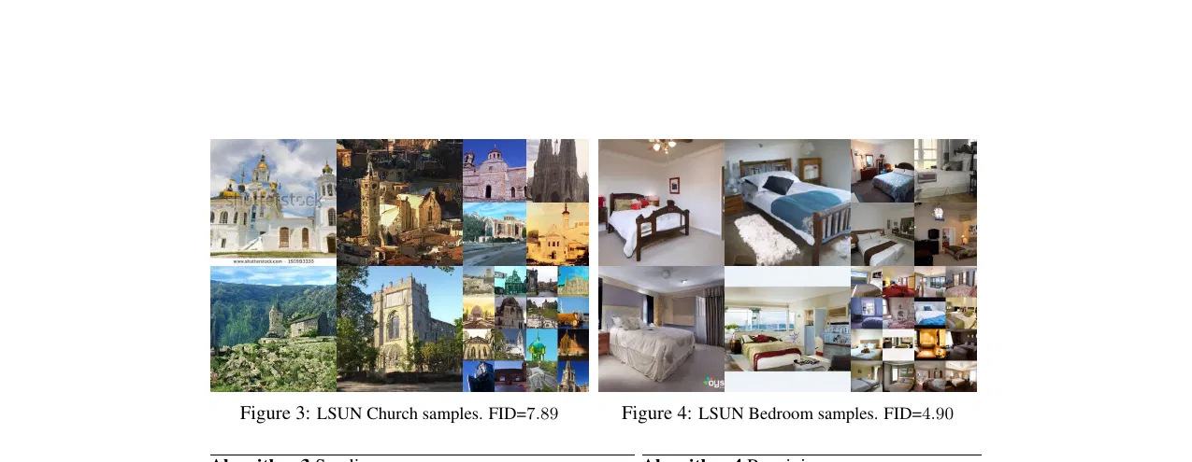
DDPM vs. SMLD: The Final Verdict
SMLD
DDPM
✗ Implicit reverse process (Langevin approximation)
✗ Unstable training targets — scale varies with σ
✗ Slow, fragile MCMC sampling with inner loops
✓ Explicit reverse process (closed-form Gaussian posterior)
✓ Stable training targets — unit-variance noise prediction
✓ Fixed-step ancestral sampling — no inner loops
DDPM GENERATION QUALITY
CelebA-HQ 256×256
CIFAR-10 — FID 3.17 / IS 9.46
LSUN Church 7.89 / Bedroom 4.90
[2] Ho, Jain & Abbeel, 2020
46 / 62

Slide 47
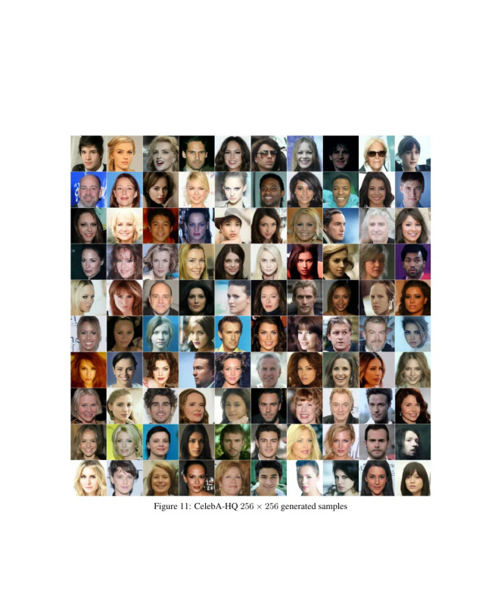
DDPM Generation Quality
CelebA-HQ 256×256
CIFAR-10 — FID 3.17
QUANTITATIVE RESULTS (CIFAR-10 UNCONDITIONAL)
Model
IS ↑
FID ↓
NLL (bits/dim) ↓
PixelCNN
4.60
65.93
3.03
NCSN (Song & Ermon ’19)
8.87 ± 0.12
25.32
—
SNGAN
8.22 ± 0.05
21.7
—
StyleGAN2 + ADA
9.74 ± 0.05
3.26
—
DDPM (Lₛimple) [Ours]
9.46 ± 0.11
3.17
≤ 3.75
[2] Ho, Jain & Abbeel, 2020
47 / 62

Slide 48
APPENDIX
Appendix
The DDPM reverse process, step by step
Bayes & the posterior · Completing the square · Mean & variance · ELBO derivation

Slide 49
Reverse Step — What We Want, and Why It’s Hard
Ideally we’d sample with the true reverse conditional q(xₜ₋₁ | xₜ). But marginally it is a mixture over the unknown x₀:
A mixture of Gaussians is not Gaussian ⇒ intractable. Fix: condition on x₀ for a closed-form posterior, then replace x₀ with a model estimate.
49 / 62

Slide 50
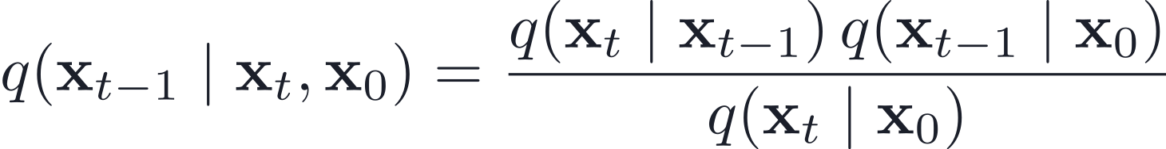
Bayes’ Rule, Exactly
The forward Markov property gives q(xₜ | xₜ₋₁, x₀) = q(xₜ | xₜ₋₁), so:
Still Gaussian: the denominator q(xₜ | x₀) doesn’t depend on xₜ₋₁, so it is only a normalizing constant.
50 / 62

Slide 51
The Two Gaussian Factors
Both factors are Gaussian in the same variable xₜ₋₁:
log-Gaussian is quadratic; the sum of quadratics is quadratic; exp of a quadratic is Gaussian.
51 / 62

Slide 52
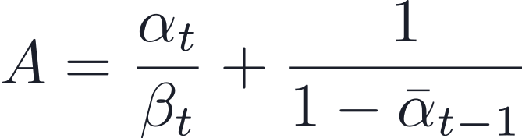
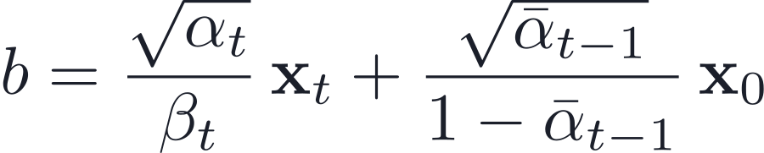
Collect into a Quadratic Form
Adding the exponents and keeping the terms in xₜ₋₁ gives −½(xᵀA x − 2bᵀx + const), with:
The square roots matter: the forward mean is √αₜ xₜ₋₁ and the marginal mean is √ᾱₜ₋₁ x₀.
52 / 62

Slide 53
Complete the Square → Gaussian Posterior
A quadratic −½(xᵀA x − 2bᵀx) is a Gaussian with precision A, covariance A⁻¹, mean A⁻¹b:
A = precision (inverse variance); β̃ₜ = A⁻¹ = variance; √β̃ₜ = the std used for the sampling noise.
53 / 62

Slide 54
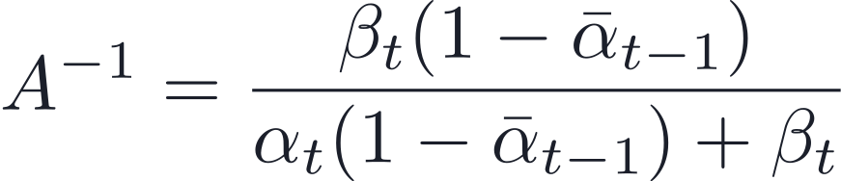
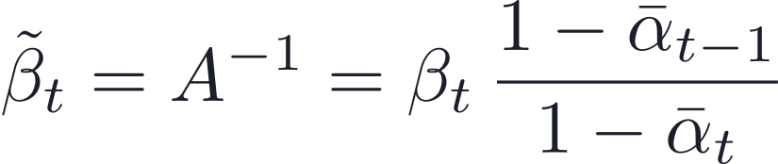
Posterior Variance β̃ₜ
Invert the precision and use βₜ = 1−αₜ, ᾱₜ = αₜ ᾱₜ₋₁ (so the denominator collapses to 1−ᾱₜ):
A fixed constant from the noise schedule — no learnable parameters.
54 / 62

Slide 55
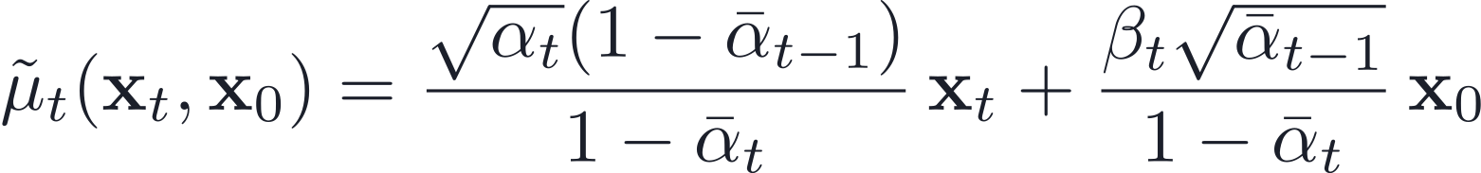
Posterior Mean (given x₀)
Carrying out A⁻¹b and simplifying gives the exact mean inside the forward process:
Exact identity — but it needs x₀, which we don’t have at sampling time.
55 / 62

Slide 56
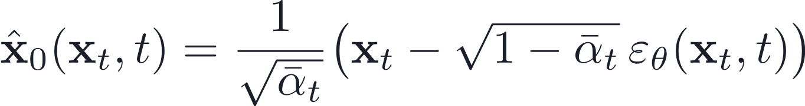
Estimate x₀ via Predicted Noise
Invert the forward marginal xₜ = √ᾱₜ x₀ + √(1−ᾱₜ) ε and use the network’s noise prediction:
Why not just re-noise x̂₀? that samples the prior q(xₜ₋₁|x₀) and ignores the realized xₜ — too much variance. The posterior conditions on xₜ (variance β̃ₜ).
56 / 62

Slide 57
Practical Mean & Ancestral Sampling
Substitute x₀ ≈ x̂₀ into μ̃ₜ to get the noise-prediction mean, then take one Gaussian step:
Set z = 0 for the final step (t = 1 → 0). No inner-loop MCMC.
57 / 62

Slide 58
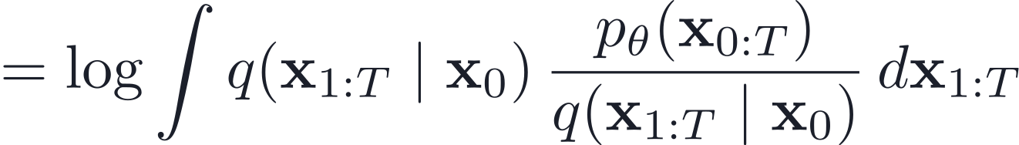
ELBO Derivation: Multiply / Divide Trick
Start with the log-likelihood of the data x₀, then multiply and divide by q(x₁:T|x₀):
58 / 62

Slide 59
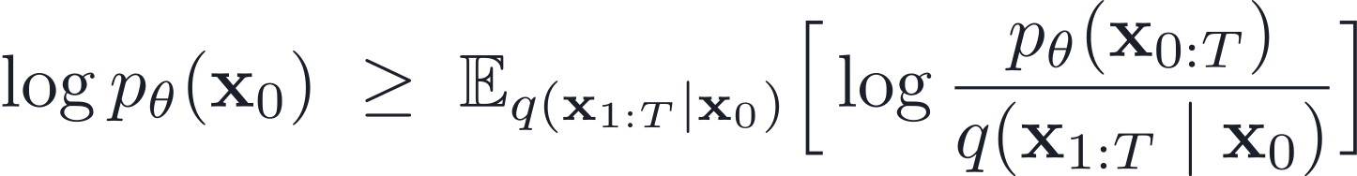
ELBO Derivation: Jensen's Inequality
Applying Jensen's inequality (log 𝔼 ≥ 𝔼 log):
59 / 62

Slide 60
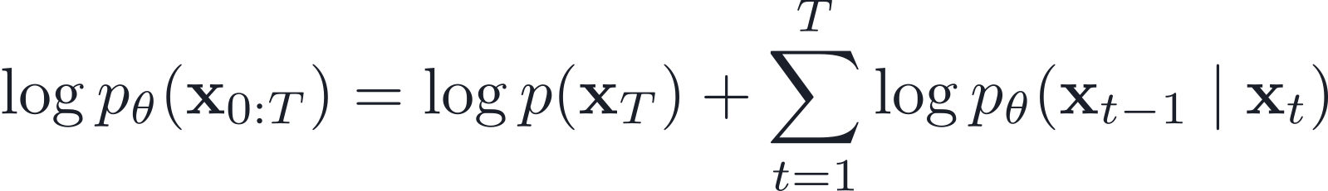
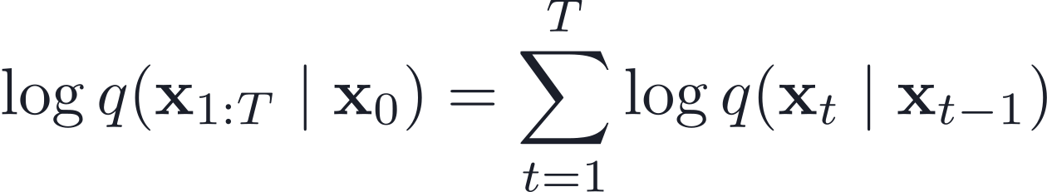
ELBO Derivation: Expanding Terms
Use the Markov property to expand the log-joint and the log-variational posterior:
60 / 62

Slide 61
ELBO Derivation: Final Form
Combining the terms, the ELBO becomes:
We then rearrange this into the sum of KL divergences.
61 / 62

Slide 62
References
[1] Song & Ermon (2019). Generative Modeling by Estimating Gradients of the Data Distribution. NeurIPS.
[2] Ho, Jain & Abbeel (2020). Denoising Diffusion Probabilistic Models. NeurIPS.
[3] Sohl-Dickstein, Weiss, Maheswaranathan & Ganguli (2015). Deep Unsupervised Learning using Nonequilibrium Thermodynamics. ICML.
[4] Welling & Teh (2011). Bayesian Learning via Stochastic Gradient Langevin Dynamics. ICML.
[5] Vincent (2011). A Connection Between Score Matching and Denoising Autoencoders. Neural Computation.
[6] Hyvärinen (2005). Estimation of Non-Normalized Statistical Models by Score Matching. JMLR.
[7] Song, Sohl-Dickstein, Kingma, Kumar, Ermon & Poole (2021). Score-Based Generative Modeling through Stochastic Differential Equations. ICLR.
62 / 62

