Slide 1

GENERATIVE MODELING · FLUX MATCHING
Flux Matching: Learning Beyond the Score
Same stationary distribution, many possible dynamics
Based on Pao-Huang, Qiu & Ermon, “Generative Modeling with Flux Matching,” arXiv:2605.07319 (2026)
Sudarshan Babu
Slides created using Claude and Manus AI — each slide was prompted by the author.

Slide 2
Overview
1
Motivation
Score matching forces one gradient field; the Fokker–Planck view shows why that is restrictive.
2
The Loosening
Stationarity requires only the probability-flux divergence to match — not the field itself.
3
The Extra Field
uθ beyond the score, and the flux residual rθ that measures any stationarity violation.
4
The Objective
Projected Fisher divergence, made tractable as the Flux Matching loss.
5
Implementation
One training iteration: KDE score, a short Langevin probe, Algorithm 1.
6
Applications & Results
Controllability, RNA velocity, image generation, faster sampling, directed structure.
Appendix — full derivation: the Fokker–Planck equation built up from the heat equation.
02 / 34

Slide 3
PART 1
Motivation
The space of vector fields · Why score matching is restrictive · The Fokker–Planck view

Slide 4
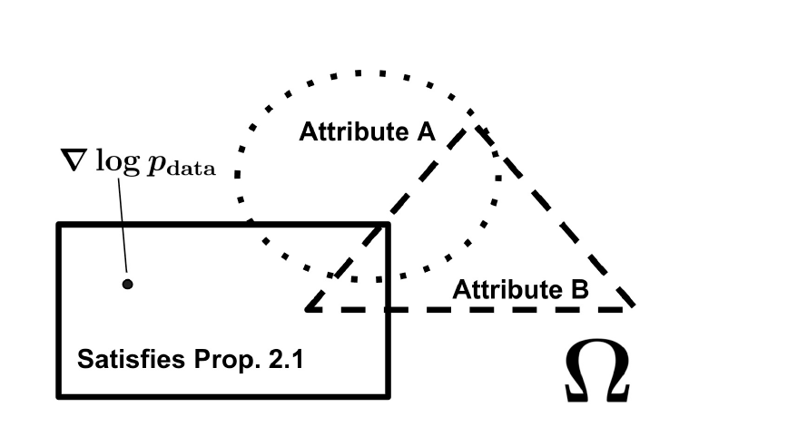
THE BIG PICTURE
The Space of Generative Vector Fields
Ω is the space of vector fields in L²(p_data). Score matching commits to a single point; Flux Matching opens up the whole interior.
FIGURE 1 — ONE DISTRIBUTION, MANY VALID FIELDS
[Figure 1] Pao-Huang, Qiu, Ermon, 2026 — arXiv:2605.07319
04 / 34

Slide 5

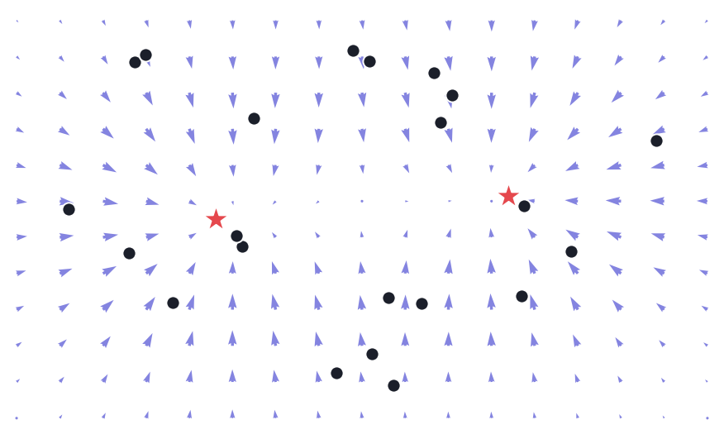

MOTIVATION
Why Score Matching Is Restrictive
SCORE MATCHING LEARNS ONE SPECIFIC FIELD
SUFFICIENT FOR SAMPLING
PARTICLES FOLLOW THE SCORE
Langevin dynamics with this drift converge to pdata as their stationary distribution.
The catch — this forces the learned field to be a gradient (conservative) field — one rigid choice.
05 / 34

Slide 6
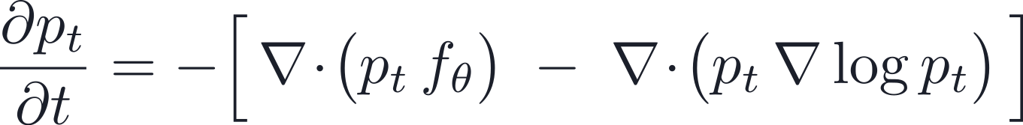
HOW DENSITY EVOLVES
The Fokker–Planck View
Full derivation →
The density evolves by the divergence of two competing probability fluxes.
DRIFT FLUX
DIFFUSION / SCORE FLUX
STATIONARITY
pt fθ carries mass along the vector field.
pt ∇log pt is the smoothing effect of Brownian motion.
When the two fluxes balance, ∂pt/∂t = 0 — no net density change.
[27] Fokker–Planck equation; Prop. 2.1 (paper)
06 / 34

Slide 7
PART 2
The Loosening
Stationarity is weaker · Many fields, one distribution · Directed dynamics

Slide 8

THE KEY LOOSENING
Stationarity Is Weaker Than Score Matching
At stationarity the divergences of the two fluxes balance:
THIS DOES NOT REQUIRE
KEY MESSAGE
Flux Matching matches the divergence of the probability flux — not the vector field itself.
Equality of the fields is not needed.
08 / 34

Slide 9


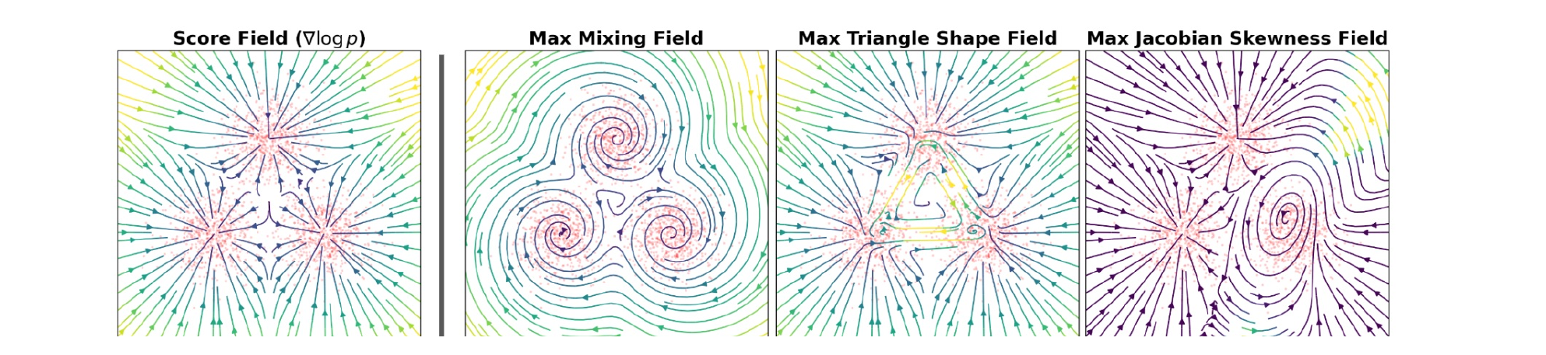
A NULLSPACE OF VALID DRIFTS
Many Fields, Same Distribution
ADD AN EXTRA FIELD
HARMLESS CONDITION
Any v whose weighted divergence vanishes leaves p_data unchanged — v can add circulation, rotation, directed motion, or faster mixing.
FIGURE 2 — MANY VECTOR FIELDS, ONE STATIONARY DISTRIBUTION
[Figure 2] Score field (left) vs. alternative fields with useful properties (right)
09 / 34

Slide 10



A STRUCTURAL LIMIT
Why Score Fields Cannot Express Directed Dynamics
SCORE FIELDS ARE GRADIENTS
THEIR JACOBIAN IS A HESSIAN
Hessians are symmetric — so score fields cannot encode asymmetric directed dependencies or rotational flow.
EXAMPLE — A ROTATIONAL FIELD THAT IS NOT A GRADIENT
Pure circulation: its Jacobian is antisymmetric, so no scalar potential exists.
10 / 34

Slide 11
PART 3
The Extra Field
uθ beyond the score · The flux residual rθ · Why not minimize rθ²

Slide 12

THE EXTRA FIELD
What Flux Matching Wants
DEFINE THE FIELD BEYOND THE SCORE
WHAT UΘ IS — INTUITION
TWO REGIMES
• What is left after subtracting the score ∇log p from the learned field fθ
• The degrees of freedom that score matching throws away
• The part of the dynamics you are free to design
• uθ = 0 → ordinary score-based Langevin dynamics
• uθ ≠ 0 → adds circulation, rotation, or directed flow
• …all while leaving p_data unchanged
Then fθ keeps the same stationary distribution as p_data.
HARMLESS CONDITION
12 / 34

Slide 13
MEASURING THE VIOLATION
The Flux Residual
DEFINITION
EXPAND WITH THE PRODUCT RULE
rθ = 0 — mass only rearranged; density preserved.
READING THE TWO TERMS
• rθ = divergence of the probability flux p·uθ — i.e. the local fractional rate of density change
• ∇·uθ — is the extra field spreading apart or compressing?
• uθᵀ∇log p — does it carry mass up or down the density gradient?
rθ ≠ 0 — probability pile-ups (+) or holes (−).
13 / 34

Slide 14

A TEMPTING DEAD END
Why Not Just Minimize rθ²?
NAIVE LOSS
THE PROBLEM
rθ contains ∇·uθ, so it penalizes derivatives of the network — unstable, derivative-level geometry.
WHY DERIVATIVES ARE DANGEROUS
A tiny function with a huge derivative. Penalizing ∇·uθ makes the loss react to features the data never sees.
[7] derivative-level artifacts in divergence objectives
14 / 34

Slide 15
PART 4
The Objective
Projected Fisher divergence · Residual autocorrelation · The Flux Matching loss

Slide 16
THE RIGHT GEOMETRY
The Projected Fisher Divergence
Keep Fisher-style vector-field geometry, but ignore harmless circulation.
WHAT THE PROJECTION DOES
Πflux fθ = the unique gradient field with the same flux divergence as fθ.
It removes circulation and keeps only the density-changing component — so the objective never penalizes harmless, structure-carrying flow.
[Eq. 4] projected Fisher divergence — intractable directly in high dimension
16 / 34

Slide 17
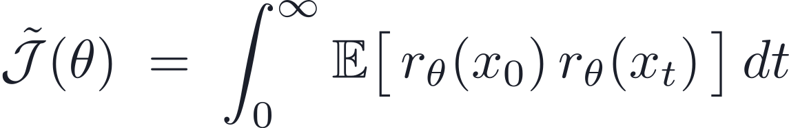
MAKING IT TRACTABLE
Step 1 — Projection → Residual Autocorrelation
MAIN IDENTITY
Important — xt is NOT DDPM noising. It is a training-time probe of stationarity around p_data.
THE PROBE DIFFUSION
Diffusion accumulates the pointwise residual into Fisher-divergence geometry.
[Eq. 5, Step 1] Lemma A.2
17 / 34

Slide 18
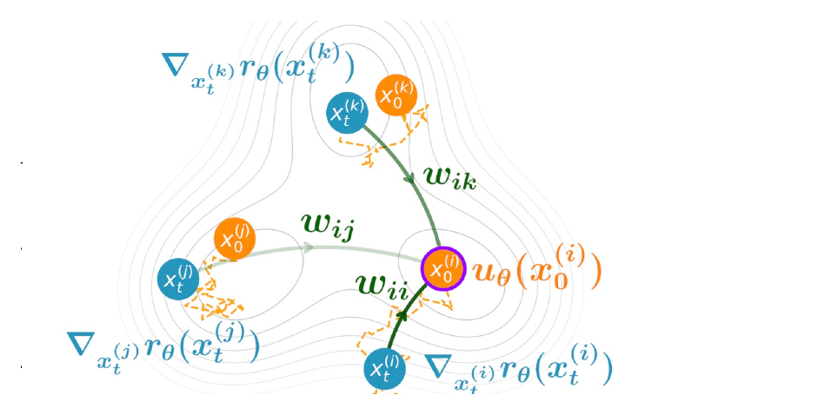
PERSISTENCE OF VIOLATION
Intuition for Step 1
rθ(x₀) rθ(xₜ) measures how long a stationarity violation persists under diffusion.
PERSISTENT
TRANSIENT
NET EFFECT
If the violation survives diffusion, it is structurally important.
If it quickly disappears, it is local and harmless.
Diffusion smooths the derivative-heavy residual into Fisher-like geometry.
FIGURE 3 — GEOMETRIC INTERPRETATION
18 / 34

Slide 19
REMOVING THE DERIVATIVE ON UΘ
Step 2 — Integration by Parts
1
∇rθ(xₜ)
the direction of future flux violation.
2
∂xₜ/∂x₀
how a perturbation at x₀ propagates to xₜ.
3
transpose Jacobian
pulls the future violation back to x₀.
4
dot with uθ(x₀)
asks: does the extra field point toward causing it?
19 / 34

Slide 20
THE TRAINING OBJECTIVE
The Flux Matching Loss
L_FLUX(Θ)
WHAT IT TRAINS
ROLE OF THE STOP-GRADIENT
uθ learns an extra drift that does not create probability accumulation or depletion.
sg(·) freezes the pulled-back violation direction into a fixed regression target during backprop.
Theorem 3.1: ∇θ J̃(θ) = 2 ∇θ L_flux(θ) — same gradients as the projected Fisher divergence.
20 / 34

Slide 21

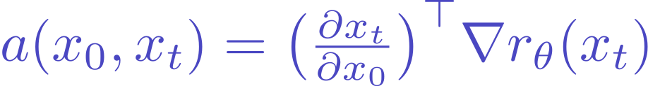
READING THE LOSS
Meaning of the Inner Product
THE PENALIZED QUANTITY
THE PULLED-BACK DIRECTION
“Is my extra field at x₀ aligned with a direction that creates future flux violation?”
Aligned → penalize the field.
Orthogonal → allow it — the flow is harmless.
21 / 34

Slide 22
PART 5
Implementation
Practical estimation · Algorithm 1 · Honest limits

Slide 23
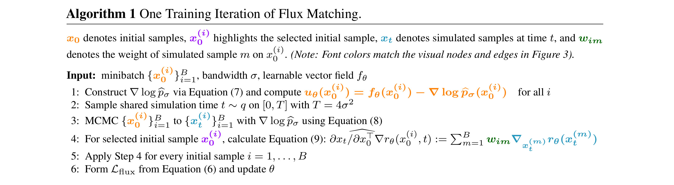
ALGORITHM 1, ONE ITERATION
Practical Estimation
p_data and its score are unknown — approximate ∇log p with a minibatch KDE, then:
1. Sample x₀
›
2. KDE score ∇log p
›
3. Langevin x₀→xₜ
›
4. Compute uθ, rθ
›
5. Apply L_flux
ALGORITHM 1 — ONE TRAINING ITERATION OF FLUX MATCHING
23 / 34

Slide 24
HONEST LIMITS
What Flux Matching Does Not Guarantee
Bare Flux Matching enforces only one thing: the same stationary distribution.
NOT AUTOMATIC
STILL VALID SOLUTIONS
✗ Straight trajectories
✗ Fast sampling
✗ Good tail exploration
✗ Non-score solutions
• The score field itself
• Ugly, curvy density-preserving fields
Underdetermined — correctness alone does not pick a useful field; the dynamics must be chosen.
24 / 34

Slide 25
PART 6
Applications & Results
Controllability · RNA velocity · Generation · Faster sampling · Directed structure

Slide 26
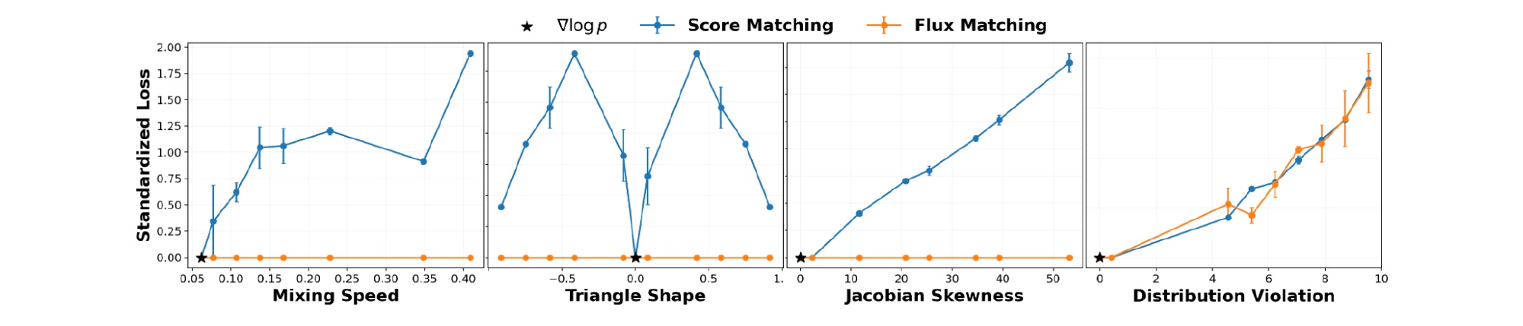
RESULT · SECTION 4.1
Controllable Generative Fields
On a 2D three-component Gaussian mixture, three one-parameter families of distribution-preserving fields (mixing speed, triangle shape, Jacobian skewness) plus a distribution-violating family.
FIGURE 4 — SCORE MATCHING VS. FLUX MATCHING LOSS
KEY RESULT
Score matching’s loss rises with any perturbation; Flux Matching stays exactly zero across all distribution-preserving changes — and only rises under genuine distribution violation.
[Fig. 4 · §4.1] Pao-Huang, Qiu & Ermon, 2026
26 / 34

Slide 27
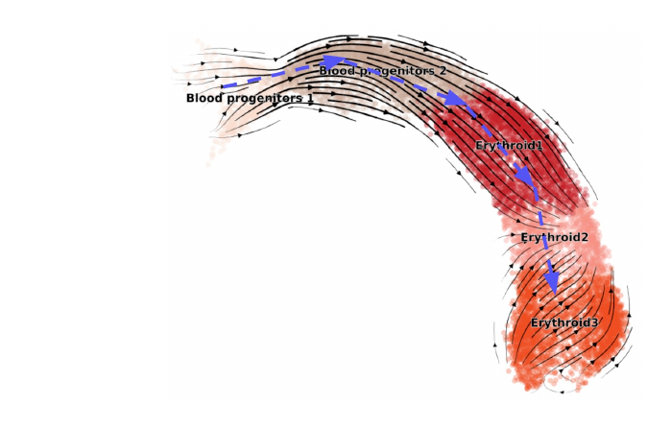
RESULT · SECTION 4.2
Interpretable Fields: RNA Velocity
Keep the biophysical ODE unchanged; replace its bespoke EM fit with gradient descent on L_flux across G = 2000 genes — Flux Matching supplies the training objective.
FIGURE 5 — LEARNED VELOCITY
CROSS-BOUNDARY CORRECTNESS / CONSISTENCY (↑)
Dataset
Flux Matching
scVelo [5]
Pancreas
0.202 / 0.972
0.330 / 0.821
Gastrulation
0.611 / 0.991
−0.639 / 0.877
Dentate Gyrus
0.284 / 0.981
−0.084 / 0.791
Bone Marrow
0.177 / 0.939
−0.789 / 0.857
Hindbrain
0.345 / 0.897
0.332 / 0.874
KEY RESULT
Same model class: Flux Matching improves consistency on all five datasets and CBC on four of five vs. scVelo.
[Fig. 5 · §4.2] RNA-velocity, 5 single-cell datasets
27 / 34

Slide 28
RESULT · SECTION 4.3
Standalone Image Generation
Noise-annealed Flux Matching as a standalone objective on CIFAR-10 and CelebA 64×64, standard UNet; DSM baseline shares architecture and hyperparameters.
GENERATION QUALITY
TRAINING EFFICIENCY
Dataset
Model
FID ↓
IS ↑
NLL ↓
Dataset
Model
Speed it/s ↑
Mem G ↓
CIFAR-10
DSM
4.74
8.52
3.16
CIFAR-10
DSM
11.63
2.79
Flux
9.06
8.54
3.26
Flux
4.01
5.69
CelebA
DSM
2.41
–
2.03
CelebA
DSM
7.20
7.79
Flux
7.07
–
2.17
Flux
1.77
22.67
KEY RESULT
Flux Matching is competitive on IS and NLL; the FID gap reflects DSM’s heavy FID-specific engineering. As a first-pass new objective, it trains ~3–4× slower and uses more memory.
[Table 1 · §4.3] unconditional generation
28 / 34

Slide 29
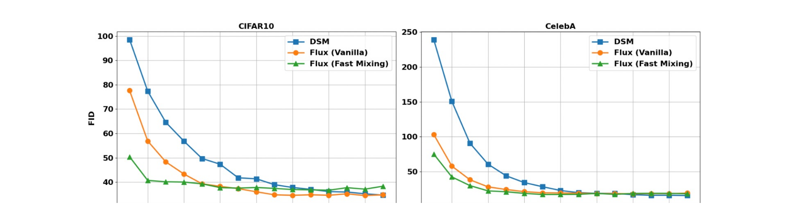
RESULT · SECTION 4.4
Faster Sampling via Fast-Mixing Fields
Add a fast-mixing proxy loss (λ = 0.01): L = L_flux-noise + λ L_mixing, same model as §4.3; evaluate FID on 1K samples vs. number of sampling steps.
FIGURE 6 — FID VS. SAMPLING STEPS
KEY RESULT
Fast-mixing Flux reaches comparable FID with substantially fewer sampling steps on CIFAR-10 — and even vanilla Flux already mixes faster than DSM.
[Fig. 6 · §4.4] accelerated sampling
29 / 34

Slide 30
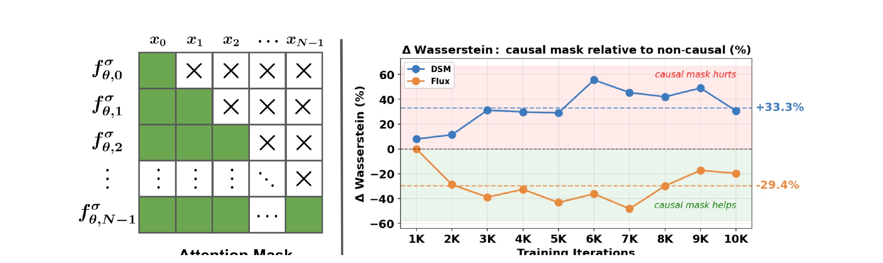
RESULT · SECTION 4.5
Embedding Directed Structure
Two masses coupled by nonlinear springs, sampled as discretized trajectories over N time steps. A causal attention mask makes fθ autoregressive; train DSM and Flux with/without it, score by Wasserstein W₂.
FIGURE 7 — CAUSAL MASK & ΔW₂ (MASK RELATIVE TO NON-CAUSAL)
KEY RESULT
The causal mask helps Flux Matching (−29.4% W₂) but hurts DSM (+33.3%): score fields force a symmetric Jacobian that conflicts with directed temporal dependence.
[Fig. 7 · §4.5] directed dynamics
30 / 34

Slide 31

THREE PARADIGMS
Conceptual Summary
1
Score Matching
“Match the score field.”
2
Flow Matching
“Match a chosen transport path.”
3
Flux Matching
“Match only the probability-flux divergence.”
THE CONDITION THAT DEFINES IT
Flux Matching turns the vector field itself into a design object.
31 / 34

Slide 32
SOURCE
Reference
THIS TALK IS BASED ON
Generative Modeling with Flux Matching
P. Pao-Huang, X. Qiu, S. Ermon
arXiv:2605.07319 (2026)
32 / 34

Slide 33
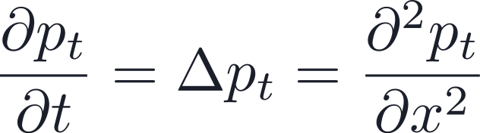

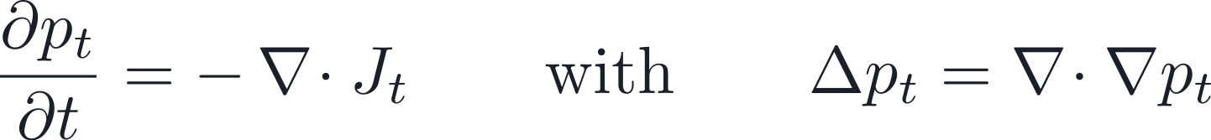
APPENDIX · DERIVATION (1 / 2)
Fokker–Planck from the Heat Equation
↑ Back to FP slide
STEP 1 — PURE DIFFUSION GIVES THE HEAT EQUATION
Brownian motion alone spreads mass from dense regions into neighbouring sparse regions.
STEP 2 — REWRITE THE HEAT EQUATION AS PROBABILITY FLUX
Diffusion moves probability down the density gradient — from dense to sparse.
33 / 34

Slide 34
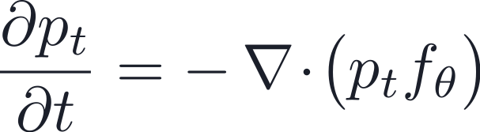


APPENDIX · DERIVATION (2 / 2)
Adding Drift, Then Combining
↑ Back to FP slide
STEP 3 — DETERMINISTIC DRIFT ADDS A CURRENT
STEP 4 — TOTAL FLUX = DRIFT + DIFFUSION
THE FOKKER–PLANCK EQUATION (PAPER FORM)
Matching the score field pointwise is unnecessary — matching the divergence of the two fluxes suffices. This is the foundation of Flux Matching.
34 / 34

