Slide 1

Motivation for Score-Based
Generative Modeling
Diffusion ≈ learning s(x, t) and sampling with it.
Sudarshan Babu
Slides created using Claude and Manus AI — each slide was prompted by the author.

Slide 2
Overview
1
The Generative Landscape
VAE, GAN, and normalizing flows — and the wish list that motivates diffusion.
2
Energy Models & Normalization
Why maximum-likelihood training is intractable: the partition function Z.
3
Score Matching
Learning ∇ₓ log p without Z (Hyvärinen) — and the trace bottleneck.
4
Scalable Estimators
Hutchinson’s trick and sliced score matching make it tractable.
5
Denoising Score Matching
Vincent’s identity, the DSM objective, and multi-scale noise.
6
Modern Diffusion & Sampling
ε-prediction parameterization and Langevin dynamics.
Appendix — full derivations: MLE gradient, Hyvärinen, Vincent, change of variables, Hutchinson.
02 / 43

Slide 3
PART 01
The Generative Landscape
VAE · GAN · Normalizing flows · The wish list

Slide 4
The Generative Modeling Goal
OBJECTIVE
Learn a model of the data distribution from finite samples to generate new, high-quality data.
Density Estimation
Sample Generation
• Estimate the probability density p(x) for any x.
• Useful for anomaly detection, evaluation, and understanding data structure.
• Requires a normalized or at least tractable objective.
• Generate new samples x′ that look like they came from pdata(x).
• Requires efficient sampling mechanisms (e.g., GAN generators, Langevin).
• The core of modern creative AI applications.
04 / 43

Slide 5
VAE: What It Optimizes
Encoder
qφ(z|x)
Latent Space
z
Decoder
pθ(x|z)
→
→
ELBO gap = KL( qφ(z|x) ‖ pθ(z|x) )
The VAE Trade-off: Optimizing a lower bound (ELBO) is stable and gives an explicit objective, but samples are often blurry due to the approximate posterior and reconstruction loss.
[1] Kingma & Welling, 2014
05 / 43

Slide 6
GAN: What It Optimizes
Noise z
Generator
G(z)
Discriminator D
Real Data x
→
→
←
Equilibrium: pg = pdata and D(x) = 1/2
The GAN Trade-off: GANs generate sharp, high-quality samples, but training is unstable (a minimax game), suffers from mode collapse, and gives no explicit likelihood.
[2] Goodfellow et al., 2014
06 / 43

Slide 7
Normalizing Flows: Exact Likelihood
Base Dist.
p(z)
Invertible f
Target Dist.
p(x)
→
→
Change of Variables: the Jacobian determinant accounts for volume distortion under the invertible map.
The Flow Trade-off: Flows enable exact likelihood and efficient sampling, but require invertible architectures with tractable Jacobians — severely limiting expressivity.
See the appendix for the detailed change-of-variables derivation.
[3] Rezende & Mohamed, 2015
07 / 43

Slide 8
The Generative Model Wish List
DESIRED FEATURE
VAE
GAN
FLOW
THE IDEAL MODEL
Sharp Samples
✗ Blurry
✓ Sharp
✓ Sharp
✓ Sharp
Stable Training
✓ Stable
✗ Unstable
✓ Stable
✓ Stable
Explicit Likelihood
∼ Bound
✗ No
✓ Exact
✓ Yes
No Arch. Constraints
✓ Any
✓ Any
✗ Invertible
✓ Any
Computational Feasibility
✓ Tractable
✓ Tractable
✗ Costly
✓ Tractable
Diffusion Models aim to check all of these boxes.
08 / 43

Slide 9
PART 02
Energy Models & Normalization
The partition function Z · The score function

Slide 10
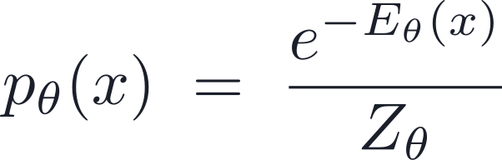
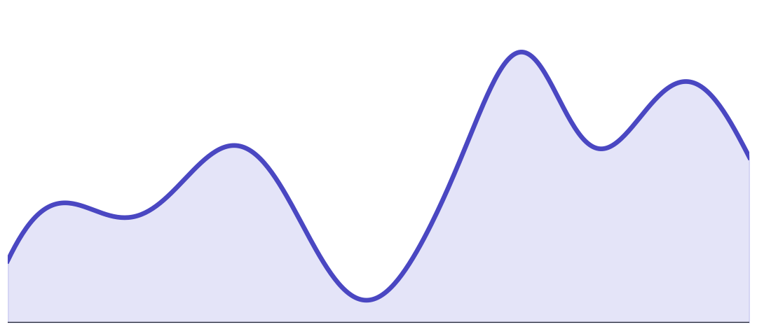
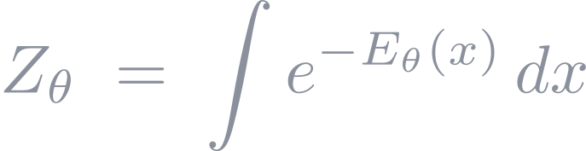
The Normalization Constant Problem
ENERGY LANDSCAPE Eθ(x)
High Energy
(Low Density)
Low Energy
(High Density)
Probability density falls off exponentially as energy rises.
The MLE Gradient Problem
View Derivation ↗
Directly maximizing the log-likelihood log pθ(x) for x ∼ pdata(x) is hard because the gradient of the normalization constant Zθ involves an intractable expectation:
10 / 43

Slide 11


Score Function: The Constant Cancels
THE SCORE FUNCTION
1. Unnormalized model:
2. Gradient w.r.t. x:
3. Result:
Naive Score Matching Loss
The Challenge
We don’t know ∇ₓ log pdata(x) — we only have samples, not the density!
11 / 43

Slide 12
PART 03
Score Matching
Hyvärinen’s objective · The trace bottleneck

Slide 13
ICML 2005: Score Matching
“Estimation of Non-Normalized Statistical Models by Score Matching”
Aapo Hyvärinen (2005)
View Full Derivation ↗
THE TRACTABLE OBJECTIVE
This loss can be computed using only samples from the data distribution and the model’s score function — no normalization constant Zθ or unknown data density pdata is required.
[4] Hyvärinen, 2005
13 / 43

Slide 14
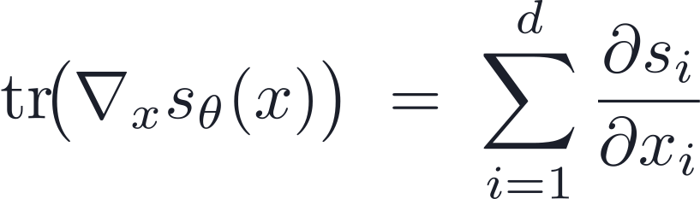
Why Score Matching is Still Hard
THE TRACE BOTTLENECK
The Hyvärinen objective requires computing the divergence (trace of the Jacobian) of the score function:
O(d) Complexity
For high-dimensional data (e.g., 1024×1024 images), computing this trace is prohibitively slow.
We need a way to estimate this trace without computing all d diagonal elements explicitly.
14 / 43

Slide 15
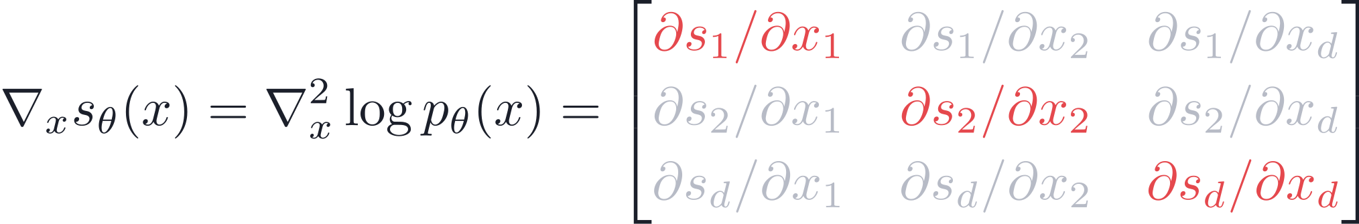
The Trace Bottleneck
THE PROBLEM
THE SCALE
To compute the trace, we need d separate backward passes — one for each input dimension xᵢ.
For 1024×1024 images, d ≈ 10⁶. Computing the exact trace is impossible on modern GPUs.
15 / 43

Slide 16
PART 04
Scalable Estimators
Hutchinson’s trick · VJP / JVP · Sliced score matching

Slide 17
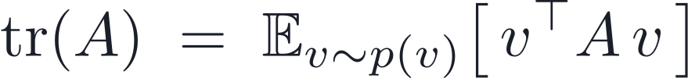
Hutchinson’s Trace Estimator
REQUIREMENT FOR v
Common choices: Rademacher (v ∈ {−1, 1}ᵈ) or Gaussian (v ∼ N(0, I)).
“We replace the sum of d diagonal elements with an expectation over quadratic forms.”
View the Proof ↗
[5] Hutchinson, 1990
17 / 43

Slide 18
The VJP / JVP Trick: No Jacobian Needed
This is a Vector–Jacobian Product (VJP) followed by a dot product.
METHOD
EXACT TRACE
STOCHASTIC ESTIMATOR
Jacobian Matrix
Requires Full Matrix
Never Materialized
Memory Cost
O(d²)
O(d)
Compute Cost
d backward passes
1 backward pass
Modern autodiff libraries (JAX, PyTorch) compute VJPs in a single pass.
18 / 43

Slide 19
Sliced Score Matching
THE “SLICED” IDEA
EFFICIENT COMPUTATION
Instead of matching the full d-dimensional score vector, we match the 1D projection (slice) of the score in random directions v.
Using the Hutchinson trick, this objective needs only first-order gradients (VJPs), making it scalable to massive datasets and high-res images.
“We bypass the second-order pain by projecting it into a scalar problem.”
[6] Song, Garg, Shi & Ermon, 2019
19 / 43

Slide 20
SSM Limitations
We’ve solved the Trace Problem, but at a cost.
HIGH VARIANCE
STABILITY
The double expectation over data and v makes training noisy and slow to converge.
Score matching is still unstable in low-density regions where the model has never seen data.
“Can we make the score a simple supervised target?”
20 / 43

Slide 21
PART 05
Denoising Score Matching
Vincent’s identity · The DSM objective · Multi-scale noise

Slide 22

The Direct Learning Signal
Can we make the score a simple supervised target?
THE BOTTLENECK
THE SOLUTION
We don’t know sdata(x). We only have samples from pdata(x).
We need a way to create a “ground truth” score that we can regress against.
22 / 43

Slide 23
Supervised Denoising
The Denoising Autoencoder (DAE)
Clean Data
x
Noisy Input
x̃
Prediction
fθ(x̃)
→
→
“We know the ground truth x, so we can supervise the reconstruction.”
[7] Vincent, Larochelle, Bengio & Manzagol, 2008
23 / 43

Slide 24
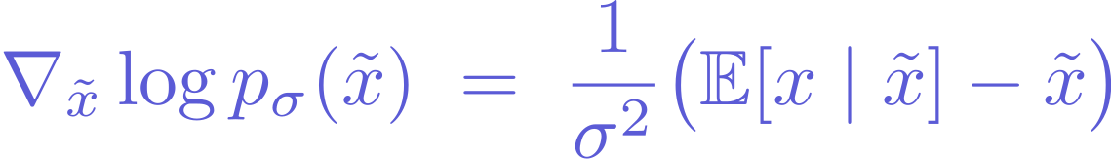
Vincent 2011: Denoiser ⟺ Score
“The score of the smoothed density is exactly proportional to the optimal denoising direction.”
Want to see the full derivation?
View Full Derivation (Appendix) ↗
[8] Vincent, 2011
24 / 43

Slide 25
Modern DSM Training Loss
The Denoising Score Matching Objective
SUPERVISED TARGET
NO TRACE NEEDED
The target ∇x̃ log p(x̃|x) is just the noise direction (x − x̃)/σ².
This is a simple L2 regression. No second-order gradients, no Jacobian trace, no pain.
25 / 43

Slide 26




Multi-Sigma: The Denoising Ladder
Multiple Noise Levels
NOISE
COARSE
FINE
DATA
“We learn to denoise at every scale, from pure noise to fine data details.”
[11] Song & Ermon, 2019
26 / 43

Slide 27
PART 06
Modern Diffusion & Sampling
ε-prediction · The score field · Langevin dynamics

Slide 28
Modern Diffusion Parameterization
ε-Prediction Objective
THE EQUIVALENCE
NUMERICAL STABILITY
Predicting the noise ε is mathematically equivalent to predicting the score or the clean image x.
In practice, predicting the unit-variance noise is more stable than predicting a score that can explode as σ → 0.
[12] Ho, Jain & Abbeel, 2020
28 / 43

Slide 29
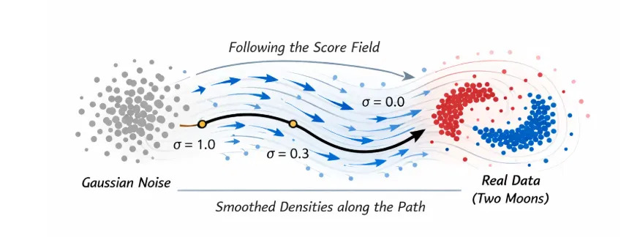
Following the Score Field
“The score field acts as a guide, pushing noisy points from high-entropy regions back toward the Two Moons data distribution.”
29 / 43

Slide 30
Langevin Dynamics: Sampling from the Score
The Langevin Update Rule
GRADIENT ASCENT
NOISE INJECTION
The term ∇ₓ log p(xₜ) pushes the sample toward regions of high probability density.
The term √(2η) εₜ prevents the sampler from getting stuck in local modes, ensuring exploration.
[10] Welling & Teh, 2011
30 / 43

Slide 31






Three Equivalent Parameterizations
APPROACH
SCORE PREDICTION
NOISE PREDICTION
DATA PREDICTION
What we model
Objective
Stability
Can Explode (σ → 0)
Most Stable
Good for Low SNR
“While mathematically equivalent, noise prediction has become the industry standard for stable, high-quality diffusion models.”
31 / 43

Slide 32
APPENDIX
Appendix
Full derivations and supporting proofs
MLE gradient · Hyvärinen score matching · Vincent’s identity · Change of variables · Hutchinson trace

Slide 33
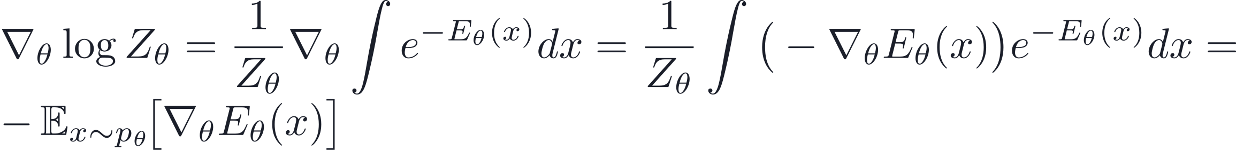
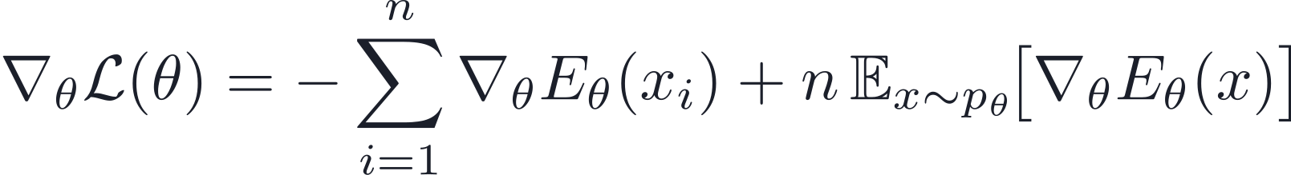
Appendix: MLE Gradient Derivation
GRADIENT OF THE LOG-PARTITION
Positive Phase (Data): push energy DOWN on real data points to increase their probability.
Negative Phase (Model): push energy UP on model samples to decrease their probability.
← Back to Energy Models
33 / 43

Slide 34
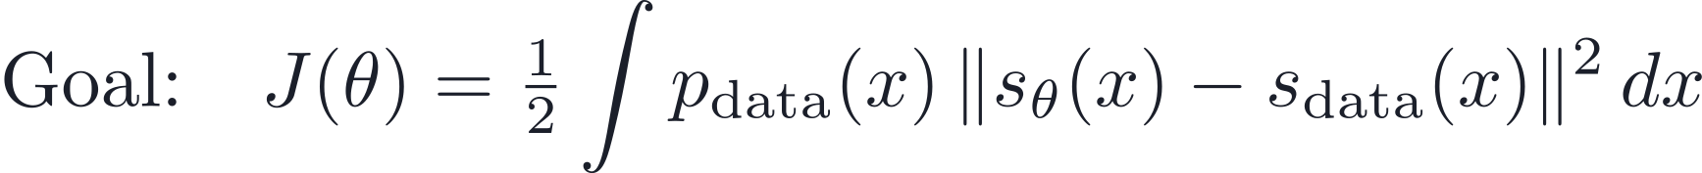
Appendix: Hyvärinen Derivation (Part 1)
STEP 1 — SETUP & GOAL
STEP 2 — EXPAND THE SQUARE
The third term is constant in θ. The second (highlighted) term is the “nasty” one.
← Back to Score Matching
Next: Part 2 →
34 / 43

Slide 35
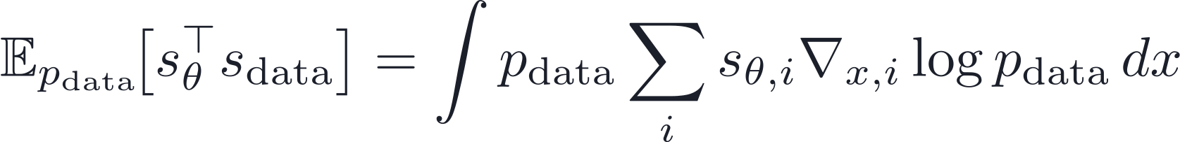
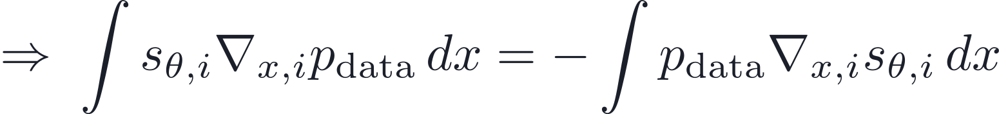
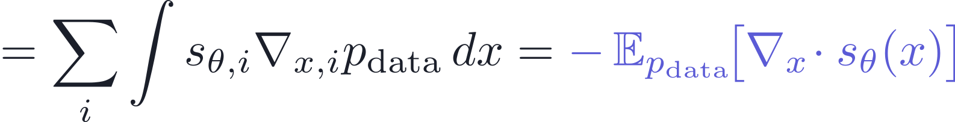
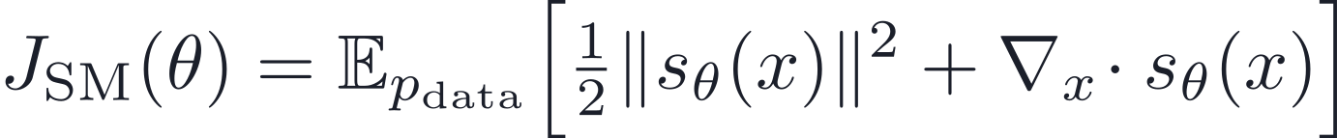
Appendix: Hyvärinen Derivation (Part 2)
STEP 3A — INTEGRATION BY PARTS
STEP 3B — SCORE MATCHING
The boundary term vanishes.
STEP 4 — FINAL OBJECTIVE
← Part 1
Score Matching →
35 / 43

Slide 36
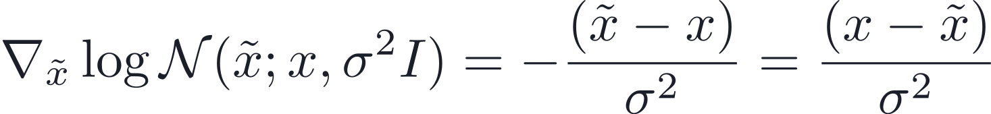
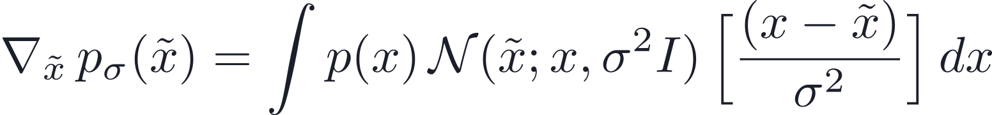
Appendix: Vincent Derivation (Part 1)
STEP 1 — GAUSSIAN SMOOTHING & SCORE
STEP 2 — DIFFERENTIATE THE KERNEL
← Back to Denoising
Next: Part 2 →
36 / 43

Slide 37
Appendix: Vincent Derivation (Part 2)
STEP 3 — CONVERT TO SCORE
STEP 4 — IDENTIFY BAYES’ POSTERIOR
← Back to Part 1
Next: Part 3 →
37 / 43

Slide 38
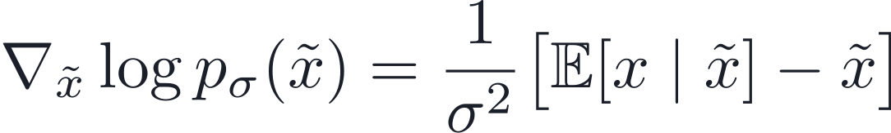
Appendix: Vincent Derivation (Part 3)
STEP 5 — LINEARITY OF EXPECTATION
STEP 6 — THE FINAL IDENTITY
Intuition: the score points from the noisy sample x̃ directly toward the posterior mean of the clean data.
← Back to Part 2
Back to Denoising →
38 / 43

Slide 39
Appendix: Change of Variables (Part 1 — Probability Conservation)
The change-of-variables formula is core to normalizing flows: it describes how densities move under an invertible mapping. We start from the requirement that probability is conserved.
SETUP
PROBABILITY CONSERVATION
Key idea: the probability of a region is identical whether measured in z-space or x-space — the starting point for the derivation.
Next: rewrite these equalities as integrals and apply the multivariate substitution rule to get the explicit formula.
39 / 43

Slide 40
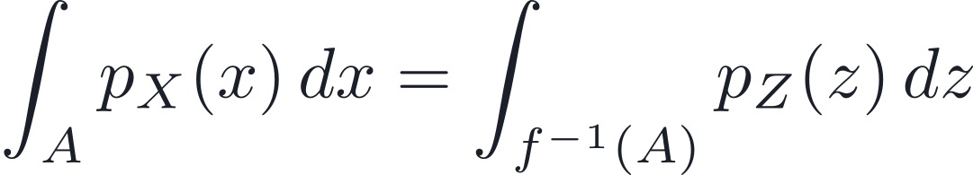
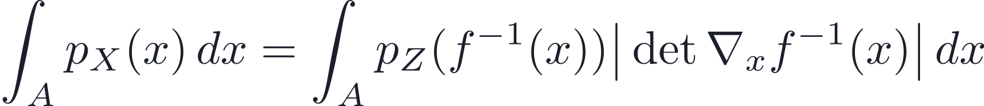
Appendix: Change of Variables (Part 2 — Derivation)
Step 1 — Express as Integrals
Step 2 — Multivariate Substitution
Rewrite conservation using integrals over both domains.
Volume elements transform by the Jacobian determinant.
Step 3 — Match Integrands
Step 4 — Take Logarithms
Holds for all A, so integrands are equal a.e.
The change-of-variables formula for exact log-likelihoods.
Result: this is the exact log-likelihood used to train normalizing flows.
40 / 43

Slide 41
Appendix: Change of Variables (Part 3 — Intuition)
1D INTUITION — STRETCHING & COMPRESSING INTERVALS
Take x = 2z (stretch by 2). If z ∈ [0,1], then x ∈ [0,2]: the interval doubles, so to preserve probability the density must halve:
HIGHER DIMENSIONS: THE JACOBIAN DETERMINANT
Key Insight
The Jacobian determinant accounts for how the transformation changes volume. Without it, probability would not be conserved under the change of variables.
In d dimensions, a linear map x = Az stretches or compresses volumes by |det A|.
41 / 43

Slide 42




Appendix: The Hutchinson Identity (Proof)
PROOF STEPS
( v⊤A v is a scalar )
( cyclic property of trace )
( linearity of expectation )
( since E[vv⊤] = I )
By taking an expectation over random directions v, we recover the full trace of any matrix A.
← Back to Estimator
42 / 43

Slide 43
References
[1] Kingma & Welling (2014). Auto-Encoding Variational Bayes. ICLR.
[2] Goodfellow et al. (2014). Generative Adversarial Nets. NeurIPS.
[3] Rezende & Mohamed (2015). Variational Inference with Normalizing Flows. ICML.
[4] Hyvärinen (2005). Estimation of Non-Normalized Statistical Models by Score Matching. JMLR.
[5] Hutchinson (1990). A Stochastic Estimator of the Trace of the Influence Matrix for Laplacian Smoothing Splines. Commun. Stat. – Simul. Comput..
[6] Song, Garg, Shi & Ermon (2019). Sliced Score Matching: A Scalable Approach to Density and Score Estimation. UAI.
[7] Vincent, Larochelle, Bengio & Manzagol (2008). Extracting and Composing Robust Features with Denoising Autoencoders. ICML.
[8] Vincent (2011). A Connection Between Score Matching and Denoising Autoencoders. Neural Computation.
[9] Sohl-Dickstein, Weiss, Maheswaranathan & Ganguli (2015). Deep Unsupervised Learning using Nonequilibrium Thermodynamics. ICML.
[10] Welling & Teh (2011). Bayesian Learning via Stochastic Gradient Langevin Dynamics. ICML.
[11] Song & Ermon (2019). Generative Modeling by Estimating Gradients of the Data Distribution. NeurIPS.
[12] Ho, Jain & Abbeel (2020). Denoising Diffusion Probabilistic Models. NeurIPS.
[13] Song, Sohl-Dickstein, Kingma, Kumar, Ermon & Poole (2021). Score-Based Generative Modeling through Stochastic Differential Equations. ICLR.
43 / 43

