Slide 1

GENERATIVE MODELING · FLOW MATCHING
Flow Matching & Optimal Transport
From normalizing flows to conditional flow matching
Sudarshan Babu
Slides created using Claude and Manus AI — each slide was prompted by the author.

Slide 2
Overview
01
Normalizing Flows & CNFs
Discrete flows, the Jacobian bottleneck, and continuous-time flows.
02
Flow Matching
The continuity equation and vector-field regression.
03
Conditional Flow Matching
Conditional paths, marginalization, and the CFM theorem.
04
Gaussian Paths & the Closed-Form Field
The canonical affine flow and its exact velocity.
05
Diffusion as a Special Case
Recovering VE / VP and the probability-flow ODE.
06
Optimal Transport Paths
Straight-line transport and more efficient sampling.
07
Results from the Paper
ImageNet & CIFAR-10, sampling efficiency, super-resolution.
02 / 77

Slide 3
PART 01
Normalizing Flows & CNFs
The core problem · Discrete flows · Continuous flows · The training cost

Slide 4
The Core Problem in Generative Modeling
Goal: Learn a model of a complex, high-dimensional data distribution p₁(x) over data x.
The fundamental challenge: real-world data (images, audio, molecules) lives on complex, high-dimensional manifolds that are intractable to model directly.
1
Start from a simple base
A tractable distribution p₀, e.g. a standard Gaussian 𝒩(0, I).
2
Learn a transformation
A map that pushes the base p₀ forward onto the data p₁.
3
Use it both ways
The same transformation gives sampling and density estimation.
Central question: how do we parameterize and learn this transformation efficiently?
04 / 77

Slide 5
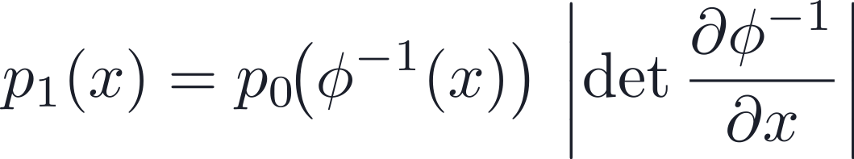

Discrete Normalizing Flows
1
Invert
Compute z = ϕ⁻¹(x) from the data point.
APPROACH
Learn an invertible, differentiable map ϕ so that x = ϕ(z) for base noise z ∼ p₀.
2
Evaluate base density
Compute p₀(z) under the simple prior.
3
Add log-Jacobian
Correct for the volume change of the map.
CHANGE OF VARIABLES
TRAINING OBJECTIVE · MAXIMUM LIKELIHOOD
[4] Rezende & Mohamed, 2015 · [5] Dinh et al., 2017 (RealNVP)
05 / 77

Slide 6
The Bottleneck of Discrete Flows
The Jacobian determinant is the central computational bottleneck.
For a general dense Jacobian, exact computation costs O(d³) — infeasible in high dimensions. Every practical family buys tractability by restricting the architecture.
Method
Trick
Limitation
RealNVP / Glow
Coupling layers
Restricted expressivity
Autoregressive (MAF, IAF)
Triangular Jacobian
Slow sampling or slow training
Residual flows
Trace estimator
Approximate likelihood
Fundamental tension: tractability of the Jacobian requires restricting the architecture, which inherently limits the expressivity of the learned map.
[5] RealNVP · [6] Glow · [7] MAF / IAF
06 / 77

Slide 7
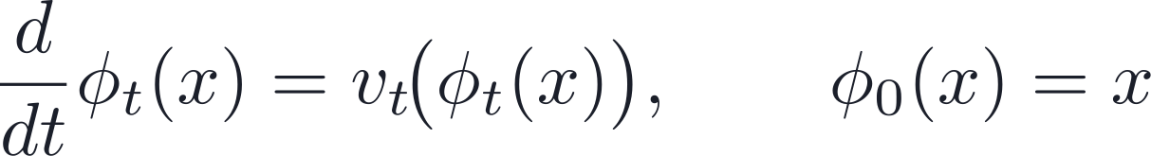
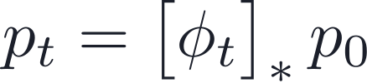
Continuous Normalizing Flows (CNFs)
Key idea: replace the discrete invertible map with a continuous-time dynamical system governed by an ODE.
FLOW ODE
DENSITY TRANSPORT
• ϕₜ is the flow map at time t ∈ [0, 1].
• vₜ(· ; θ) is a learned, time-dependent vector field, parameterized by a neural network.
SAMPLING
Integrate the ODE forward from t = 0 to t = 1, starting from z ∼ p₀.
[2] Chen et al., 2018 — Neural Ordinary Differential Equations
07 / 77

Slide 8
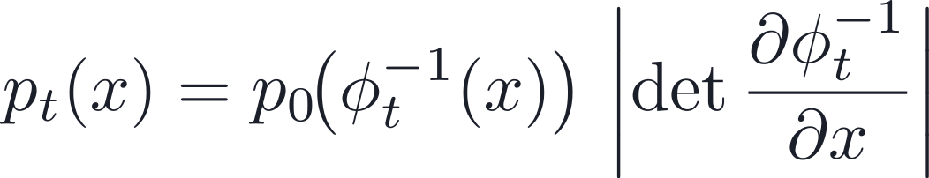
Density Evaluation in CNFs
Change of variables still applies at every time t:
Two compounding difficulties
1. NO CLOSED FORM FOR Φₜ
2. JACOBIAN IS STILL O(D³)
The flow map must be obtained by numerically integrating the ODE, which is costly at test time.
Exact density evaluation still needs the full Jacobian, which scales poorly with dimension.
These issues motivate a smarter way to track how density changes along the flow.
08 / 77

Slide 9
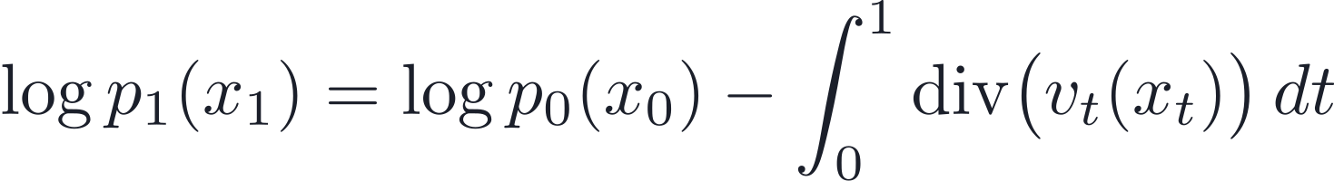
The Instantaneous Change of Variables
Key insight: instead of tracking the global volume change via the determinant, track the instantaneous rate of change via the divergence.
INSTANTANEOUS CHANGE OF VARIABLES (LIOUVILLE)
GLOBAL VS INSTANTANEOUS
• Global: a determinant volume ratio at time t.
• Instantaneous: accumulated local expansion / compression.
where xₜ = ϕₜ(x₀) is the trajectory of x₀ under the flow.
The divergence is the trace of the Jacobian: div(vₜ) = tr(∇ₓ vₜ) costs O(d²) exactly — but, crucially, it is amenable to cheap stochastic estimation.
09 / 77

Slide 10

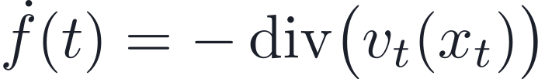
Practical Density Computation in CNFs
AUGMENTED ODE SYSTEM
OUTPUT (INTEGRATE T = 1 → 0)
Jointly integrate the state and the log-density along the trajectory. Boundary: x₀ ∼ p₀, f(1) = 0.
Stochastic trace estimator (Hutchinson): an unbiased estimate of the divergence.
Reduces the per-sample cost of the divergence from O(d²) to O(d).
[2] Chen et al., 2018 (Neural ODEs) · [3] Grathwohl et al., 2018 (FFJORD)
10 / 77

Slide 11
Why CNFs Remain Difficult to Train
Despite their theoretical elegance, Continuous Normalizing Flows face serious practical obstacles in training-time cost.
Issue
Consequence
ODE solve per sample
Many network function evaluations per gradient step
Adjoint method for gradients
Numerically unstable; memory-intensive
Divergence computation
Needs a Jacobian–vector product even with Hutchinson
Sequential time integration
Cannot be parallelized across time steps
Net effect: CNF training is orders of magnitude slower than discrete-flow training on the same architecture, making scaling to high-resolution data challenging.
11 / 77

Slide 12
CNFs — Summary
WHAT CNFS ACHIEVE
THE REMAINING BOTTLENECK
✓ Flexible density modeling with no architectural constraints on the vector field vₜ.
✓ Exact — or stochastically approximate — likelihood evaluation.
✓ Continuous interpolation between the base p₀ and the data p₁.
Component
Cost
Learn
Vector field vₜ(· ; θ) via MLE + adjoint
Flow
Implicit; obtained by ODE integration
Likelihood
Trajectory + divergence integral
Conclusion: CNFs are expressive but expensive — training simulates the ODE, coupling forward and backward passes in a costly, unstable way.
12 / 77

Slide 13
PART 02
Flow Matching
Continuity equation · Vector-field regression · From CNF to FM

Slide 14
The Key Observation Behind Flow Matching
Critical observation: ODE simulation is not needed during training — if we can directly supervise the vector field.
PROPOSED SHIFT IN PERSPECTIVE
PARADIGM SHIFT
1
Define a path
Choose a probability path pₜ interpolating p₀ → p₁ analytically.
Simulation-based MLE
(CNF)
↓
Supervised vector-field regression
(Flow Matching)
2
Derive the target field
Get the vector field uₜ that generates the path via the continuity equation.
3
Regress
Train vₜ(· ; θ) to match uₜ — no ODE solve required.
This reframing converts an expensive, numerically unstable optimization into a stable, scalable supervised learning problem.
14 / 77

Slide 15

Flow Matching — Formulation
GOVERNING EQUATION — CONTINUITY
ADVANTAGES OVER CNF TRAINING
✓ No ODE solve during training.
✓ No adjoint-method gradients.
✓ Numerically stable and highly parallelizable.
✓ Scales to large neural-network architectures.
Any pair (pₜ, uₜ) satisfying this equation defines a valid generative flow from p₀ to p₁.
FLOW MATCHING OBJECTIVE
15 / 77

Slide 16
Comparing the Three Paradigms
A unified view of flow-based generative models.
Method
What is learned
Training cost
Inference cost
Discrete NF
Invertible map ϕ
Jacobian determinant O(d³)
Single forward pass
CNF
Vector field vₜ
ODE solve + divergence integral
ODE integration
Flow Matching
Vector field vₜ
Regression (MSE)
ODE integration
PROGRESSION OF IDEAS
→ Discrete NF — exact, but architecturally constrained.
→ CNF — flexible, but training is simulation-based and costly.
→ Flow Matching — flexible, and training reduces to regression.
In one line: Flow Matching inherits the expressiveness of CNFs while replacing simulation-based training with a simple, stable supervised objective.
16 / 77

Slide 17
Open Questions and Next Steps
TWO OPEN QUESTIONS REMAIN
WHAT WE HAVE ESTABLISHED
1. How do we construct the path pₜ?
We need an analytically tractable interpolation between p₀ and p₁.
✓ Flow Matching frames generative modeling as vector-field regression.
✓ The continuity equation guarantees the learned flow transports p₀ → p₁.
2. How do we derive the field uₜ?
The marginal uₜ is generally intractable — it requires integrating over all data.
NEXT: CONDITIONAL FLOW MATCHING
Construct pₜ and uₜ conditionally on individual data points, then marginalize analytically to recover a tractable training objective.
17 / 77

Slide 18

Conditional Flow Matching: Problem Setup
DATA
where q(x) is the unknown data distribution.
Constraint: we only have sample access — no density evaluation of q.
Goal: learn a generative model of the data distribution q(x).
18 / 77

Slide 19

Probability Paths and the Flow View
DEFINE A PATH
THE FLOW VIEW
Learn a vector field uₜ(x), tied to the path by the continuity equation:
REQUIREMENTS
• p₀ = p, a simple base distribution, e.g. 𝒩(0, I).
• p₁ ≈ q, the target data distribution.
• uₜ transports probability mass through space.
• It defines the evolution of the probability path pₜ.
Interpretation: a continuous transform from noise to data.
19 / 77

Slide 20

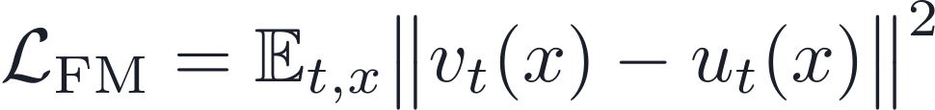
The Flow Matching Objective
LEARN A NEURAL FIELD
LOSS
INTERPRETATION
OPTIMUM BEHAVIOR (IF Vₜ = Uₜ)
A supervised regression problem.
Target: vₜ ≈ uₜ.
✓ The learned flow exactly reproduces the probability path pₜ.
✓ The final distribution matches the data: p₁ ≈ q.
20 / 77

Slide 21
Why This Is Attractive
COMPARED TO CNFS
✓ No likelihood computation.
✓ No ODE solving required during training.
✓ No divergence estimation.
CORE BENEFIT
Reduces generative modeling to a simple regression objective.
21 / 77

Slide 22


The Core Challenge
WHAT WE NEED
THE ISSUES
✗ q(x) is unknown
We only have samples, not the density function.
✗ No closed-form pₜ
Cannot easily compute the marginal probability path.
✗ No direct access to uₜ
The target vector field is intractable to compute globally.
22 / 77

Slide 23
Key Insight: Go Conditional
USE CONDITIONAL OBJECTS
Replace global construction → conditional construction
23 / 77

Slide 24
PART 03
Conditional Flow Matching
Conditional paths · Marginalization · The CFM theorem

Slide 25


Conditional Probability Paths
For each data sample x₁: define a conditional probability path pₜ(x | x₁) — one path per sample.
BOUNDARY CONDITIONS
T = 0 (NOISE)
T = 1 (DATA)
the simple base distribution.
a tight Gaussian around the sample.
Interpretation: noise → a local Gaussian centered at x₁
25 / 77

Slide 26
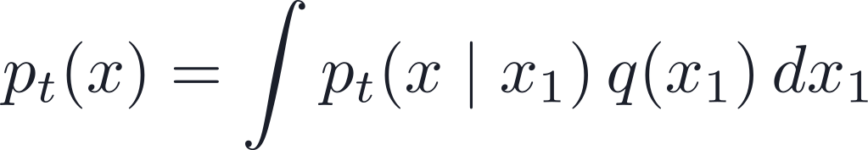

Marginal Path Construction
MARGINAL PATH
AT T = 1
INTERPRETATION
The marginal path is a mixture of the per-sample conditional paths, weighted by the data distribution q.
26 / 77

Slide 27

Conditional Vector Fields
Each conditional path has an associated vector field that generates it:
It satisfies the conditional continuity equation:
27 / 77

Slide 28
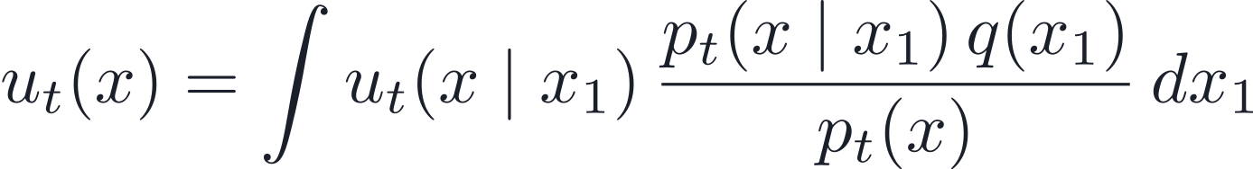
The Marginal Vector Field
DEFINITION — WEIGHTED AGGREGATION OF CONDITIONAL FIELDS
EQUIVALENT FORM
MEANING
• Many x₁ can explain the current state x.
• Each x₁ suggests its own direction uₜ(x | x₁).
• Combine them with posterior weights p(x₁ | x, t).
A posterior-weighted average over candidate data points x₁.
28 / 77

Slide 29
Why This Aggregation Is Non-Trivial
NOT VALID
REQUIREMENT
✗ Uniform averaging of the conditional fields.
✗ Plain (unweighted) simple averaging.
The aggregated field must preserve the probability flow — the flux — of the underlying paths.
29 / 77

Slide 30
Key Result: The Marginal Field Works
THE MARGINAL FIELD SATISFIES THE CONTINUITY EQUATION
CONCLUSION
The posterior-weighted aggregation of the tractable conditional fields generates exactly the marginal path pₜ.
30 / 77

Slide 31
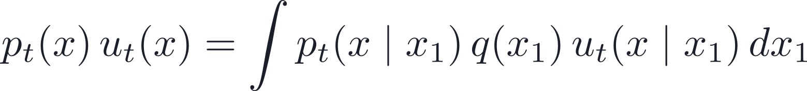
Proof — Setup
STEP 1 · START WITH THE MARGINAL PATH
STEP 2 · DEFINE THE AGGREGATED FLUX
Next: take the divergence of both sides — it moves inside the integral.
31 / 77

Slide 32
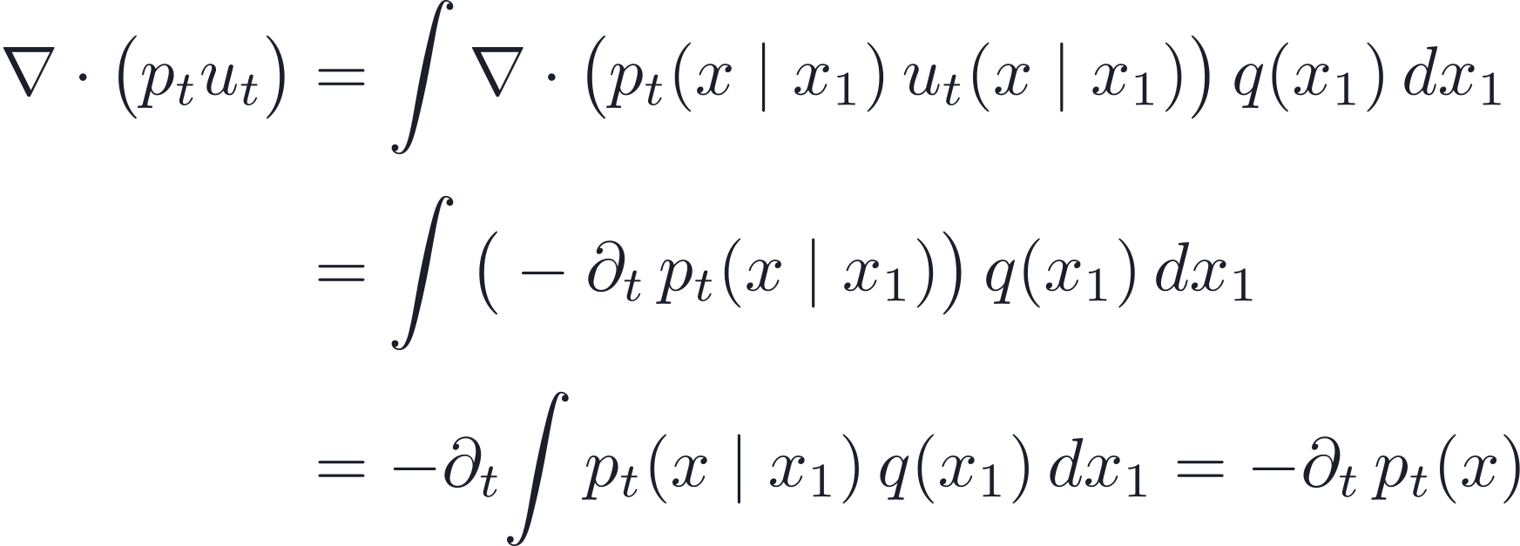
Proof — Taking the Divergence
DERIVATION
RESULT
Rearranging gives the continuity equation ∂ₜpₜ + ∇·(pₜuₜ) = 0.
32 / 77

Slide 33
Why Conditional Flow Matching
INTRACTABLE — THE MARGINAL OBJECTIVE
↓ uₜ(x) is hard to compute
TRACTABLE — THE CONDITIONAL OBJECTIVE
uₜ(x | x₁) is known by design
33 / 77

Slide 34
The Optimal Flow Matching Theorem
Theorem. The two objectives have identical gradients with respect to the parameters θ:
PROOF SKETCH
CONSEQUENCE
• Expand the squared norm in L_CFM.
• Use E[ uₜ(x | x₁) | x ] = uₜ(x) — the posterior weighting appears automatically.
• The target-norm term is independent of θ.
Optimizing the tractable conditional loss exactly optimizes the intractable marginal loss.
34 / 77

Slide 35
PART 04
Gaussian Paths & the Closed-Form Field
Affine flow · Theorem 3 · The CFM objective

Slide 36

Conditional Probability Paths (Gaussian)
A TRACTABLE GAUSSIAN CONDITIONAL PATH
AT T = 0
AT T = 1
begins as the simple base distribution.
a tight Gaussian around the data sample.
Each path transports pure noise toward a local Gaussian centered at the sample x₁.
36 / 77

Slide 37
Non-Uniqueness of Vector Fields
A probability path fixes how density changes — but it does not uniquely determine the velocity field.
SAME PATH
EXTRA COMPONENTS
NEED A CONVENTION
Continuity sees only the divergence of the flux.
Divergence-free flux circulates mass without changing pₜ.
Pick a canonical field that is simple and computable.
Motivation: CFM pairs each Gaussian path with the simplest canonical vector field, not any equivalent field.
37 / 77

Slide 38
Canonical Flow Construction
DEFINE AN AFFINE FLOW
PROPERTY
The flow directly constructs the Gaussian path.
38 / 77

Slide 39
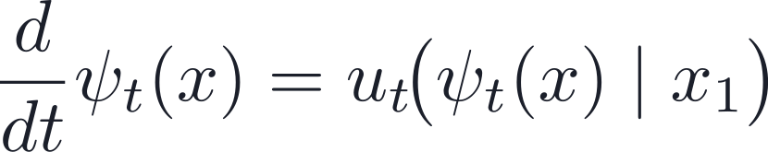
Vector Field from the Flow
The flow induces a vector field through its own time derivative:
GOAL
Find a closed-form expression for the conditional field uₜ(x | x₁).
39 / 77

Slide 40
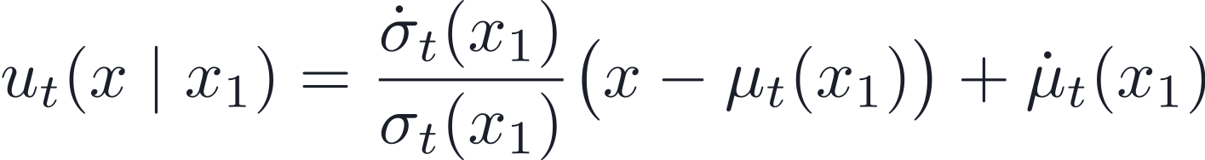
Key Result (Theorem 3)
SCALING TERM
TRANSLATION TERM
The first term expands or contracts points relative to the mean, governed by the rate of change of σₜ.
The second term shifts the whole distribution in space, following the drift of the mean μₜ.
40 / 77

Slide 41

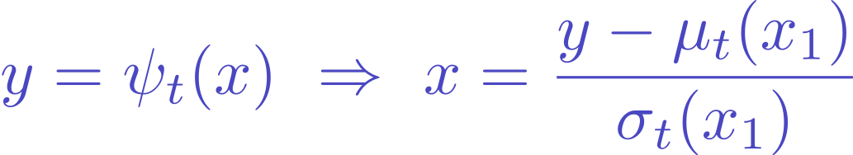
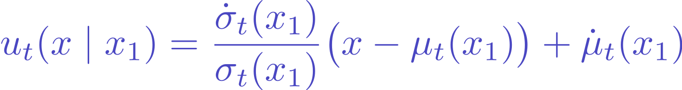
Proof Sketch — Deriving the Field
Differentiate the affine flow, then re-express in terms of the current position.
Since the current position is arbitrary, the identity holds for every x.
41 / 77

Slide 42
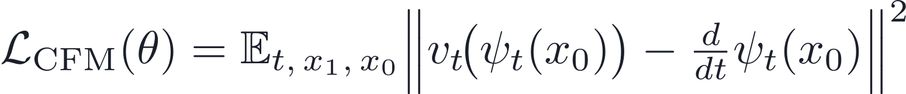
The CFM Objective
KEY IDEA
Train directly on the known velocities of the constructed paths.
42 / 77

Slide 43
The Big Picture
STEP 1
STEP 2
STEP 3
Define conditional Gaussian paths
Derive closed-form vector fields
Train by regression
For each sample x₁, construct a tractable path pₜ(x | x₁) from noise toward the sample.
The conditional velocity uₜ(x | x₁) is exactly computable along the constructed flow.
Fit vₜ(t, x) to the known velocities with the CFM loss — no likelihood integration.
RESULT
Conditional construction turns generative modeling into supervised vector-field learning — a scalable training procedure.
43 / 77

Slide 44
One-Line Takeaway
Gaussian conditional paths give a simple affine flow with an exactly computable velocity field.
SIMPLE PATH
EXACT TARGET
EFFICIENT TRAINING
The conditional transport is affine in the base sample.
The velocity target is available without simulation.
Flow Matching becomes direct vector-field regression.
44 / 77

Slide 45
PART 05
Diffusion as a Special Case
General formulation · VE & VP · Probability-flow ODE

Slide 46
Flow Matching with Diffusion Paths
Flow Matching is a framework for the design of probability paths — and diffusion is one instance.
FLEXIBLE BY DESIGN
Flow Matching allows flexible design of the probability path connecting noise to data.
RECOVERS DIFFUSION
Standard diffusion processes arise as a special case of this design space.
GOES BEYOND DIFFUSION
It also enables non-diffusion paths, such as Optimal Transport.
46 / 77

Slide 47
General Formulation
CONDITIONAL GAUSSIAN PATHS
DESIGN CHOICES
CORE REQUIREMENTS
• Mean schedule μₜ(x₁).
• Standard-deviation schedule σₜ(x₁).
• Both must be smooth functions of t.
• Boundary: t = 0 is noise, t = 1 is data.
⇒ a fully flexible design space
47 / 77

Slide 48
Key Idea: Direct Probability Paths
Flow Matching works directly with probability paths.
No need to derive them from diffusion SDEs.
RECOVER
DESIGN
Reproduce standard diffusion paths exactly.
Build entirely new paths, e.g. Optimal Transport.
48 / 77

Slide 49
Diffusion Paths as a Special Case
Diffusion models define a reverse process:
Noise
→
Data
THESE CORRESPOND TO SPECIFIC CHOICES OF
Result: the conditional paths are exactly Gaussian.
49 / 77

Slide 50
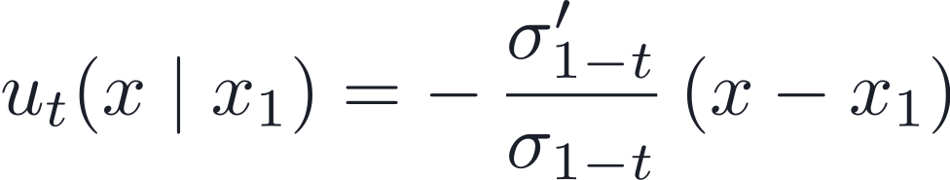
Example: Variance Exploding (VE)
PATH
PARAMETERS
VECTOR FIELD
Points move toward x₁ with a time-dependent scaling.
50 / 77

Slide 51
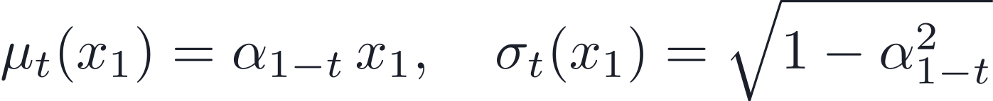
Example: Variance Preserving (VP)
PATH
PARAMETERS
VECTOR FIELD
A more complex form, depending on x, x₁, and time t.
Result: matches standard VP diffusion dynamics.
51 / 77

Slide 52

Same Dynamics as the Probability-Flow ODE
These conditional vector fields
exactly match the probability-flow ODE of diffusion models.
Same dynamics as: score-based diffusion (Song et al., 2021) — the deterministic sampler is one and the same ODE.
[9] Song et al., 2021 — Score-Based Generative Modeling through SDEs
52 / 77

Slide 53
Same Field, Different Training Objective
Flow Matching uses the same vector field as diffusion — but optimizes a different objective.
DIFFUSION MODELS
FLOW MATCHING
Score Matching
Vector-Field Regression
FLOW MATCHING PROVIDES
✓ More stable training.
✓ More robust optimization.
53 / 77

Slide 54
Limitation of Diffusion, Advantage of FM
Theoretical issue: diffusion processes do not reach exact noise in finite time — in practice they must rely on approximations.
THE FLOW MATCHING FRAMEWORK ENABLES
1
Exact path design
Specify the probability path directly, with no SDE approximation.
2
More flexibility
Freely choose mean and variance schedules.
3
Better alternatives
Adopt geometry-driven paths such as Optimal Transport.
54 / 77

Slide 55
PART 06
Optimal Transport Paths
Straight-line transport · OT flow map · Diffusion vs OT

Slide 56


Two Views of the Vector Field
EULERIAN VIEW
LAGRANGIAN VIEW
defined globally at any point x.
velocity along a specific trajectory.
The Key Identity
56 / 77

Slide 57
Why Training Uses the Derivative
WHY — THREE CHEAP STEPS
INSTEAD OF THE GLOBAL FIELD
1
Sample noise
Draw x₀ ∼ 𝒩(0, I).
2
Compute position
Evaluate ψₜ(x₀) along the path.
USE THE TRAJECTORY VELOCITY
3
Differentiate
Read the velocity off directly — no global solve.
57 / 77

Slide 58
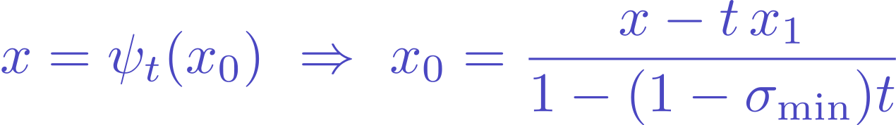
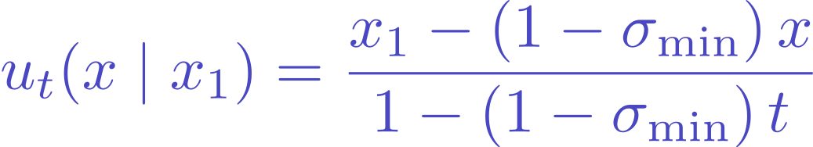
From Flow to Field — the Algebra
Differentiate the OT flow, invert for the base point, and substitute.
Global field and trajectory velocity are two representations of the same object.
58 / 77

Slide 59

Optimal Transport Conditional Paths
Choose linear schedules:
MEAN SCHEDULE
STD-DEV SCHEDULE
⇒ leads to the simple vector field derived previously
59 / 77

Slide 60
The OT Flow Map
THE FLOW MAP
STRAIGHT-LINE INTERPOLATION
CONTROLLED SHRINKAGE
Each point follows a constant-velocity line from noise toward the sample.
The noise component contracts smoothly as t increases toward 1.
60 / 77

Slide 61
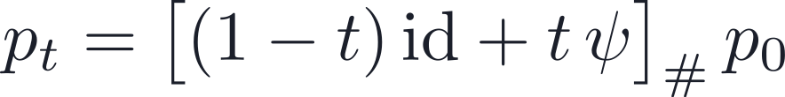
OT Interpretation
This flow is the Optimal Transport displacement map: mass is moved along geodesics in Euclidean space.
KEY PROPERTIES
✓ Particles move in straight lines.
✓ The transport direction is constant along the path.
61 / 77

Slide 62
Key Insight: Simplest Motion
OT paths define the simplest possible motion between distributions.
GEOMETRY
VELOCITY
LEARNING
Samples travel along straight lines, avoiding curved or diffusive trajectories.
The transport direction stays constant along each conditional path.
Flow Matching learns a more direct field from an easier regression target.
62 / 77

Slide 63
Final Training Objective
CFM LOSS FUNCTION
A single MSE regression onto a known, closed-form target velocity.
63 / 77

Slide 64
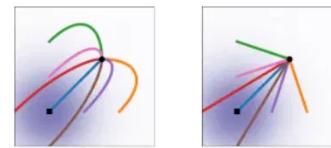
Visual Intuition
COMPARING TRAJECTORIES
→ Left (Diffusion): curved trajectories that bend toward the target.
→ Right (Optimal Transport): straight, direct paths to the target.
64 / 77

Slide 65
Why OT Paths Are Better
Compared to traditional diffusion models:
DIFFUSION PATHS
OPTIMAL TRANSPORT
✗ Curved, complex trajectories.
✗ Can overshoot the target.
✓ Straight-line motion.
✓ No backtracking.
✓ Simpler, stable dynamics.
Diffusion = density-driven flow · OT = geometry-driven transport
65 / 77

Slide 66
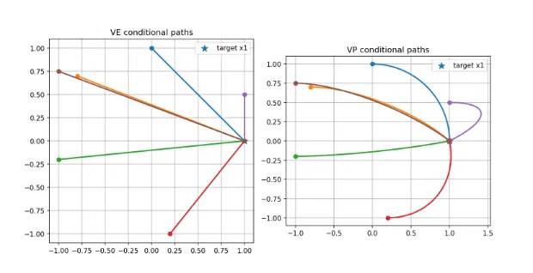
VP Rotation and Conditional Paths
VP FIELD ROTATES OVER TIME
VE VS VP CONDITIONAL PATHS
• The coefficients a(t) and b(t) change over time.
• Early on one term dominates; later the other does.
• The direction rotates ⇒ curved paths.
VE: straight lines to the target. VP: rotation and curvature near it.
66 / 77

Slide 67
Final Takeaway
FLOW MATCHING UNIFIES
+ Diffusion models (VE / VP) — recovered as special cases.
+ General probability paths — including Optimal Transport.
KEY IDEA
Learn vector fields directly from chosen probability paths.
67 / 77

Slide 68
PART 07
Results from the Paper
Lipman et al., 2022 — Flow Matching for Generative Modeling
ImageNet & CIFAR-10 · Sampling efficiency · Super-resolution

Slide 69
Experimental Setup
DATASETS
METRICS
PROTOCOL
• CIFAR-10.
• ImageNet at 32×32, 64×64, and 128×128.
• Unconditional generation (plus a super-resolution study).
• NLL — negative log-likelihood, in bits/dim (↓).
• FID — Fréchet Inception Distance (↓).
• NFE — number of function evaluations (↓).
• One shared U-Net (Dhariwal & Nichol) across all losses.
• dopri5 adaptive solver, tolerance 1e-5.
• FID / NFE averaged over 50k samples.
Ablation: same model, swapping the loss — DDPM · Score Matching · ScoreFlow · FM (diffusion) · FM (OT).
[1] Lipman et al., 2022 — Flow Matching for Generative Modeling
69 / 77

Slide 70
Result: Likelihood, Quality & Sampling Cost
Same architecture, different training losses — lower is better on every metric.
Model
CIFAR-10
ImageNet 32×32
ImageNet 64×64
NLL↓
FID↓
NFE↓
NLL↓
FID↓
NFE↓
NLL↓
FID↓
NFE↓
DDPM
3.12
7.48
274
3.54
6.99
262
3.32
17.36
264
Score Matching
3.16
19.94
242
3.56
5.68
178
3.40
19.74
441
ScoreFlow
3.09
20.78
428
3.55
14.14
195
3.36
24.95
601
FM w/ Diffusion
3.10
8.06
183
3.54
6.37
193
3.33
16.88
187
FM w/ OT
2.99
6.35
142
3.53
5.02
122
3.31
14.45
138
FM with OT wins across the board: best NLL, FID and NFE on CIFAR-10 and ImageNet 32/64 — fewer solver steps for better samples and likelihood.
[1] Lipman et al., 2022 · baselines: [8] DDPM, [9] Score Matching, [10] ScoreFlow
70 / 77

Slide 71
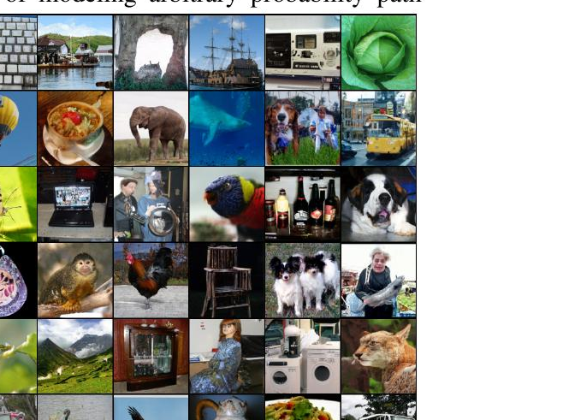
Result: ImageNet 128×128 — Near State of the Art
UNCONDITIONAL SAMPLES
Model
NLL↓
FID↓
Self-cond. GAN
–
41.7
Uncond. BigGAN
–
25.3
PGMGAN
–
21.7
FM w/ OT
2.90
20.9
State-of-the-art FID among comparable methods — and the only one here that also reports a likelihood.
[1] Lipman et al., 2022 · U-Net architecture: Dhariwal & Nichol [11]
71 / 77

Slide 72
Result: Faster, Cheaper Training
IMAGENET 128×128 TRAINING BUDGET
CONVERGENCE
4.36M → 500K
iterations vs Dhariwal & Nichol — about 33% less image throughput, even with a 25% larger model.
• FM-OT lowers FID faster and further than DDPM, SM and ScoreFlow.
• Baselines such as ScoreFlow / VDM report 1.3M–10M iterations.
SAMPLING COST STAYS CONSTANT
With Flow Matching the per-sample NFE is roughly fixed throughout training, whereas for score matching it drifts upward as training proceeds.
[1] Lipman et al., 2022 — Flow Matching for Generative Modeling
72 / 77

Slide 73
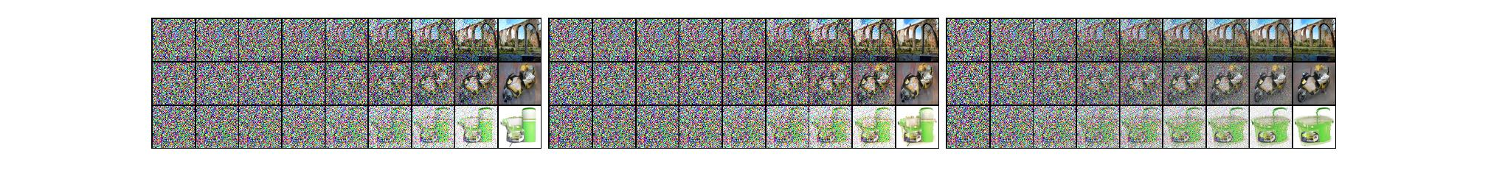
Result: Straighter Sample Paths
SAME INITIAL NOISE, IMAGENET 64×64 · SCORE MATCHING · FM-DIFFUSION · FM-OT
OT reduces noise roughly linearly: the OT-path model starts forming the image early in the trajectory, while diffusion paths keep it buried in noise until the very last steps.
[1] Lipman et al., 2022 — Flow Matching for Generative Modeling
73 / 77

Slide 74
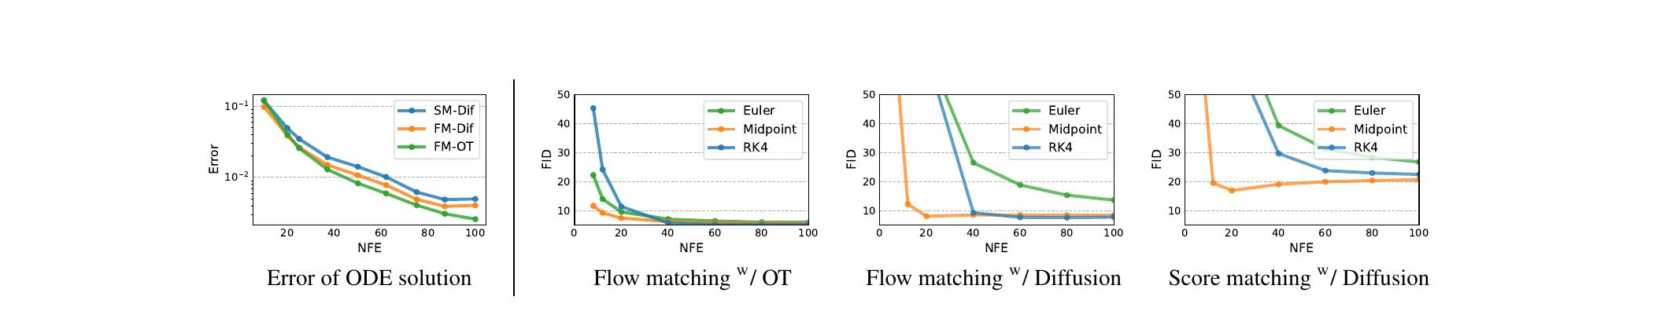
Result: More Efficient Sampling
IMAGENET 32×32 · ERROR AND FID VS NUMBER OF FUNCTION EVALUATIONS
✓ FM-OT reaches the same numerical error using roughly 60% of the NFEs of diffusion models.
✓ It attains good FID even at very low NFE — the best quality-vs-cost trade-off, across every ODE solver.
[1] Lipman et al., 2022 — Flow Matching for Generative Modeling
74 / 77

Slide 75
Result: Conditional Super-Resolution
Upsampling ImageNet images from 64×64 to 256×256 — evaluation protocol of Saharia et al. (2022).
Model
FID↓
IS↑
PSNR↑
SSIM↑
Reference
1.9
240.8
–
–
Regression
15.2
121.1
27.9
0.801
SR3 (Saharia et al.)
5.2
180.1
26.4
0.762
FM w/ OT
3.4
200.8
24.7
0.747
FM-OT improves FID and IS over SR3 with comparable PSNR / SSIM — and FID / IS better reflect perceptual generation quality.
[1] Lipman et al., 2022 · protocol & SR3 baseline: Saharia et al. [12]
75 / 77

Slide 76
Results — Takeaways
WHAT THE EXPERIMENTS SHOW
✓ Best NLL, FID and NFE across CIFAR-10 and ImageNet-32/64 versus diffusion losses on the same model.
✓ Near state-of-the-art FID on ImageNet-128 with substantially less training.
✓ OT paths give straight, constant-speed trajectories → fewer NFEs and faster, more reliable sampling.
✓ The framework extends cleanly to conditional generation (super-resolution).
OT-path Flow Matching: better samples, better likelihood, cheaper sampling — same architecture.
[1] Lipman et al., 2022 — Flow Matching for Generative Modeling
76 / 77

Slide 77
References
[1] Lipman, Chen, Ben-Hamu, Nickel & Le — Flow Matching for Generative Modeling. ICLR 2023.
[2] Chen, Rubanova, Bettencourt & Duvenaud — Neural Ordinary Differential Equations. NeurIPS 2018.
[3] Grathwohl, Chen, Bettencourt, Sutskever & Duvenaud — FFJORD: Scalable Reversible Generative Models. ICLR 2019.
[4] Rezende & Mohamed — Variational Inference with Normalizing Flows. ICML 2015.
[5] Dinh, Sohl-Dickstein & Bengio — Density Estimation using Real NVP. ICLR 2017.
[6] Kingma & Dhariwal — Glow: Generative Flow with Invertible 1×1 Convolutions. NeurIPS 2018.
[7] Papamakarios, Pavlakou & Murray — Masked Autoregressive Flow for Density Estimation. NeurIPS 2017.
[8] Ho, Jain & Abbeel — Denoising Diffusion Probabilistic Models. NeurIPS 2020.
[9] Song, Sohl-Dickstein, Kingma, Kumar, Ermon & Poole — Score-Based Generative Modeling through SDEs. ICLR 2021.
[10] Song, Durkan, Murray & Ermon — Maximum Likelihood Training of Score-Based Diffusion Models. NeurIPS 2021.
[11] Dhariwal & Nichol — Diffusion Models Beat GANs on Image Synthesis. NeurIPS 2021.
[12] Saharia et al. — Image Super-Resolution via Iterative Refinement (SR3). IEEE TPAMI 2022.
77 / 77

