Slide 1


Query-fi
A Transfer Learning Approach to Semantic Parsing SQL Queries
Naman Singhal
Sudarshan Paranjape
Nisharg Gosai
Shreyashri Athani
Notes:
Good afternoon Everyone, Have you ever been tried of writng queries again and again, well! You can just Query-fi,
Where English language meets Structured query language.
Let’s make it more clear, our project is A transfer learning Approach to semantic parsing of SQL queries.
Where we write sequel queries for you!
Let’s start with what is transfer learning,It is the adaptation of pre-trained models' learned features in to new tasks, enhancing accuracy and efficiency in machine learning.

Slide 2


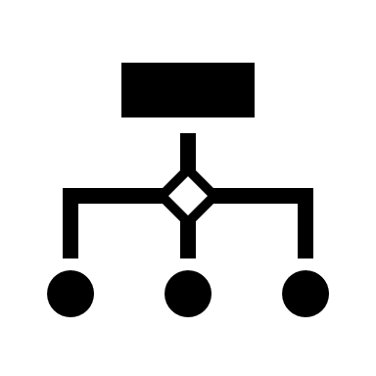





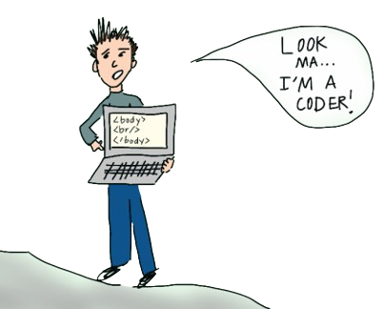




Why?
Because Typing SQL is So Last Century !
Eliminates knowledge Transfer time for large Schemas.
Makes Databases more accessible.
Notes:
Why Query-fi!
Lets imagine there is business analyst who comes from a non technical background is now plotted into a new project where he has to fetch data from complex sequel database.
-> Instead of learning sql from scratch,
-> Spending time in understanding the companies large schema
He can just use Query-Fi, which makes the databases more accessible too.

Slide 3

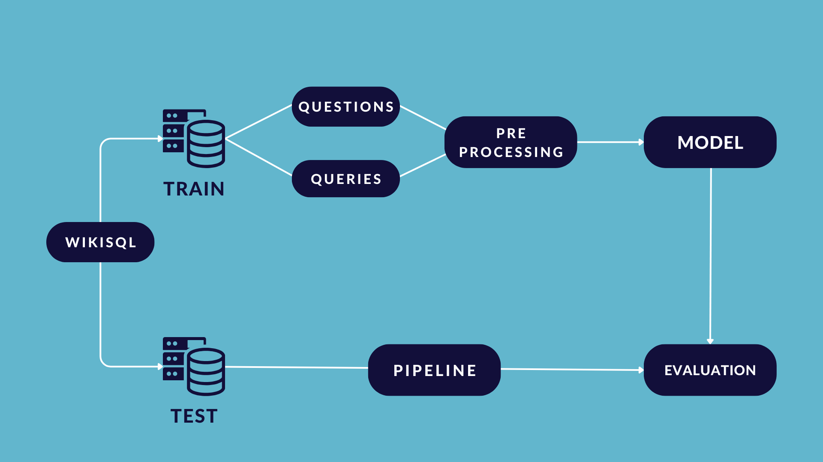
Methodology
Notes:
Nisharg - WikiSQL, Preprocessing

Slide 4
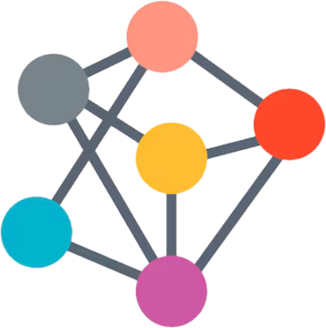


Building the Brain
(Weakly supervised without logical Forms)
NMT
Neural network model used in machine translation Attention based Gated Recurrent Unit (GRU)
Bidirectional & Auto-
Regressive Transformers (BART)
model by Facebook
Utilizes both masked language modeling and denoising autoencoding objectives
Transformer based model by Google
Pretrained on translation of around 50 languages
Notes:
Naman - About these models
Parameters

Slide 5
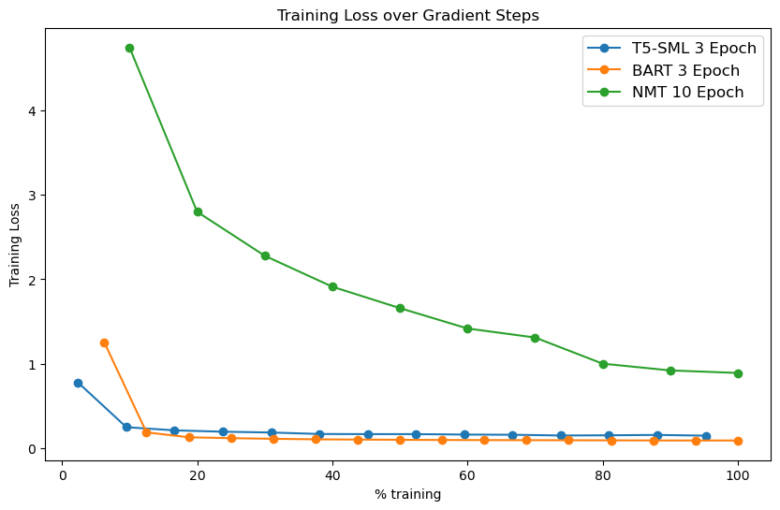
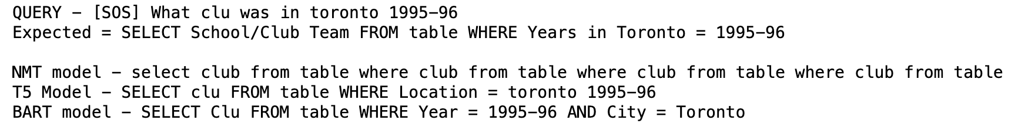
Testing The Model
Notes:
Naman -
T5 starts at a lower loss than BART because T5 is trained on machine translation type data
BART trained on Wikipedia and BooksCorpus datasets
NMT is not pretrained so starts higher.
BART outperforms because it is used to noisy training
Predictions
BART is correctly predicting column names in few places which was very surprising to us as we expected T5 to perform better.
T5 is giving good results
NMT is based on RNN and attention mechanism so it finds it hard to give good SQL

Slide 6

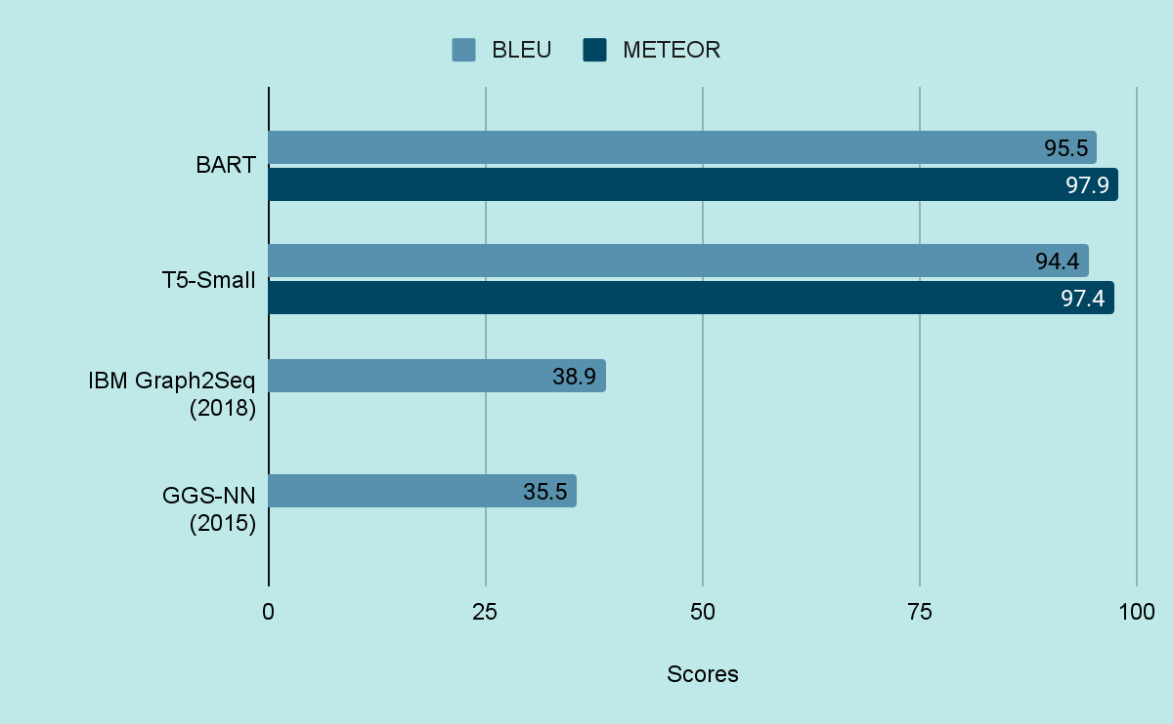
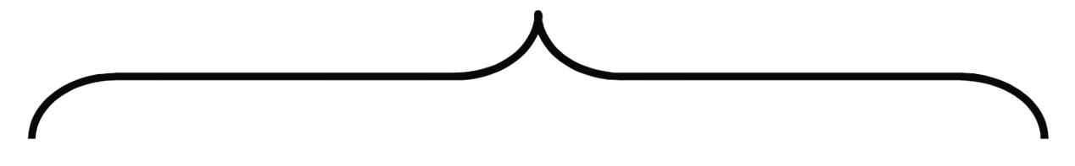
METRICS
Attention Models
Graph Models (Benchmark)
WikiSQL Benchmark (SQL-to-Text) | Papers With Code
Notes:
BLEU = BLEU evaluates translations on the basis of n-gram precision. It compares the n-grams of the predicted text to the n-grams of the target text and counts the number of matches.
METEOR goes beyond simple n-gram matching and includes stemming and synonyms of the other words for evaluation, aiming to capture meaning more effectively.
The Graph2Seq model is a type of neural network architecture designed to handle graph-structured data for sequence generation tasks.
While BLEU remains the de facto standard for quick and rough evaluation, METEOR is often preferred when a more nuanced measure of translation quality is needed. Both have their own set of advantages and are often used complementarily in evaluating machine translation systems.
WE could have used comet as it is relatively new and its not available as a package

Slide 7

Future Scope
Boosting model accuracy and robustness via guided decoding or integrating an SQL-syntax model for query generation.
Support for advanced query generation.
Adaptation to Domain Specific Databases.
Integration with BI tools
Real time and Streaming support
Notes:
Boost accuracy and real time accesible
SELECT->FROM->WHERE
At the moment our database is trained on generic wikisql dataset. Further it can be enhanced taking schema as input an increasing the accuracy

Slide 8
Questions ?

