Slide 1
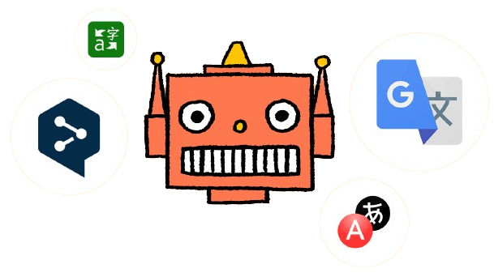
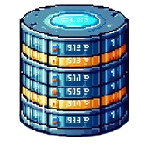
Query-fi
A Transfer Learning Approach to Semantic Parsing SQL Queries
Naman Singhal
Sudarshan Paranjape
Nisharg Gosai
Shreyashri Athani
Notes:
Good afternoon Everyone, welcome to unveiling of Queryfi!
Where English language meets Structured query language. Let’s make it more clear, our project is Querfi, A transfer learning Approach to semantic parsing SQL queries.
Where we write sql queries for you!
Let’s start with what is transfer learning, it is leveraging the strengths of pre-trained ML models and adapt them efficiently for specific tasks, reducing the need for extensive training data and computational resources while improving the model's performance.

Slide 2


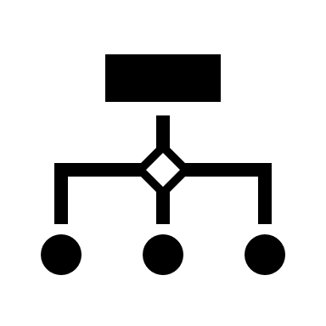





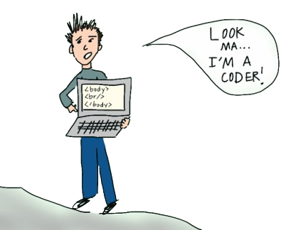




Why?
Because Typing SQL is So Last Century !
Eliminates knowledge Transfer time for large Schemas.
Makes Databases more accessible.
Notes:
Let ‘s meet of diferen

Slide 3

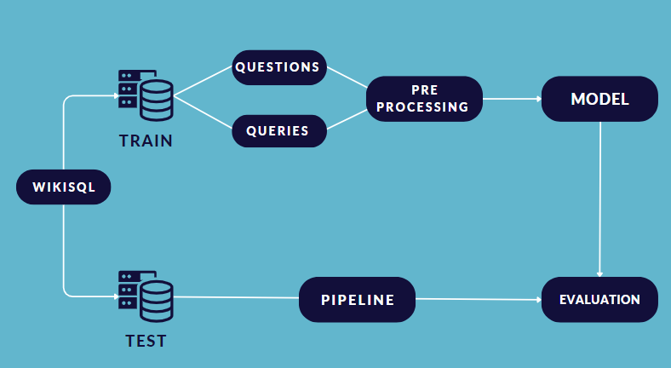
Methodology
Notes:
Nisharg - WikiSQL, Preprocessing

Slide 4
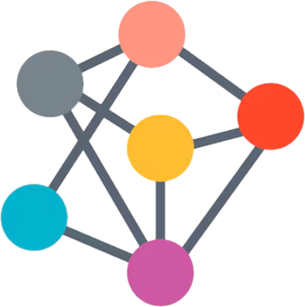


Building the Brain
(Weakly supervised without logical Forms)
NMT
Transformer based model by Google
Pretrained on translation of around 50 languages
Bidirectional & Auto-
Regressive Transformers (BART)
model by Facebook
Utilizes both masked language modeling and denoising autoencoding objectives
Neural network model used in machine translation Attention based Gated Recurrent Unit (GRU)
Notes:
Naman - About these models

Slide 5
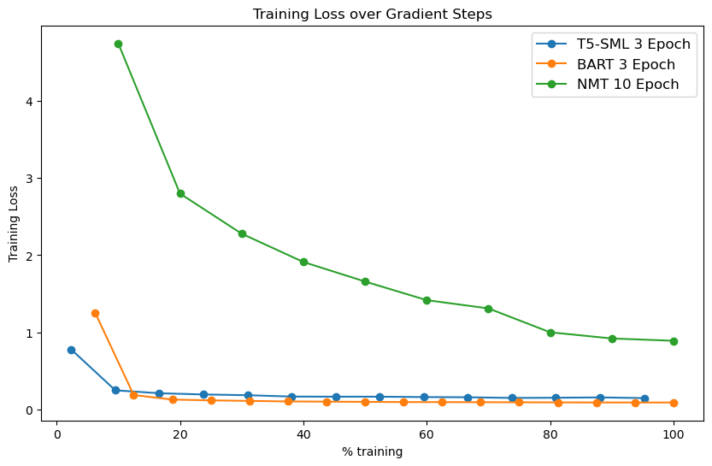
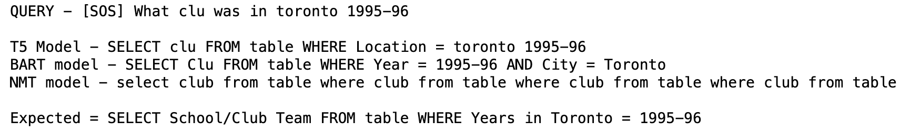
Testing The Model
Notes:
Naman -
T5 starts at a lower loss than BART because T5 is trained on machine translation type data
BART trained on Wikipedia and BooksCorpus datasets
NMT is not pretrained so starts higher.
BART outperforms because it is used to noisy training
Predictions
BART is correctly predicting column names in few places which was very surprising to us as we expected T5 to perform better.
T5 is giving good results
NMT is based on RNN and attention mechanism so it finds it hard to give good SQL

Slide 6

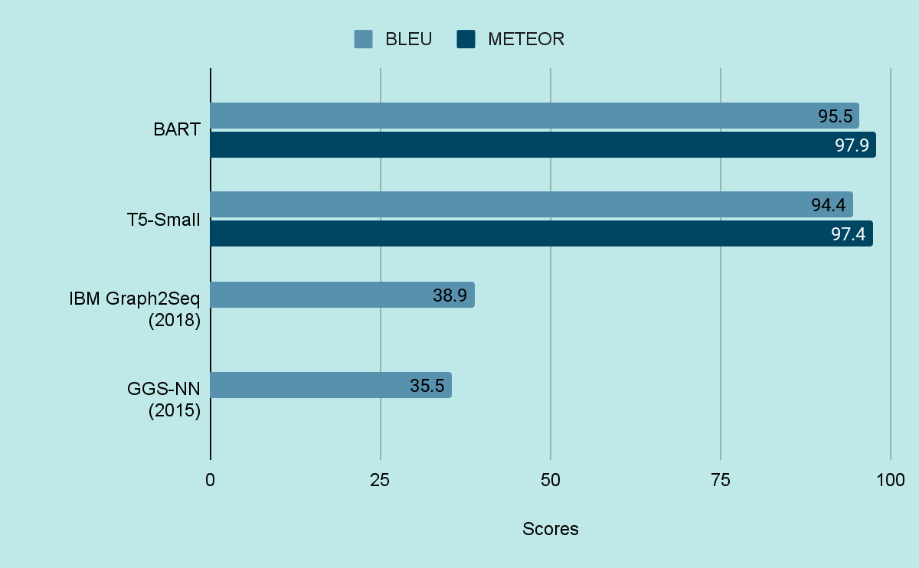
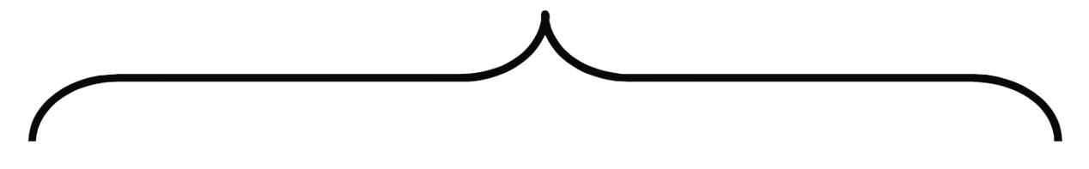
METRICS
Attention Models
Graph Models (Benchmark)
WikiSQL Benchmark (SQL-to-Text) | Papers With Code
Notes:
Sudarshan - BLEU? METEOR? And why meteor, Talk about Graph Models and why no METEOR Score Why not COMET
BLEU = BLEU evaluates translations on the basis of n-gram precision. It compares the n-grams of the machine-translated text to the n-grams of the reference text and counts the number of matches.
METEOR = METEOR goes beyond simple n-gram matching and includes stemming and synonyms for evaluation, aiming to capture meaning more effectively.
While BLEU remains the de facto standard for quick and rough evaluation, METEOR is often preferred when a more nuanced measure of translation quality is needed. Both have their own set of advantages and are often used complementarily in evaluating machine translation systems.
The Graph2Seq model is a type of neural network architecture designed to handle graph-structured data for sequence generation tasks. It is not specific to IBM
WE could have used comet as it is relatively new and its not available as a package

Slide 7

Future Scope
Boosting model accuracy and robustness via guided decoding or integrating an SQL-syntax model for query generation.
Support for advanced query generation.
Adaptation to Domain Specific Databases.
Integration with BI tools
Real time and Streaming support
Notes:
SELECT->FROM->WHERE
At the moment our database is trained on generic wikisql dataset. Further it can be enhanced taking schema as input an increasing the accuracy

Slide 8

THANK YOU
)

