Slide 1


Queryfi
A Transfer Learning Approach to Semantic Parsing SQL Queries
Naman Singhal
Sudarshan
Nisharg Gosai
Shreyashri

Slide 2


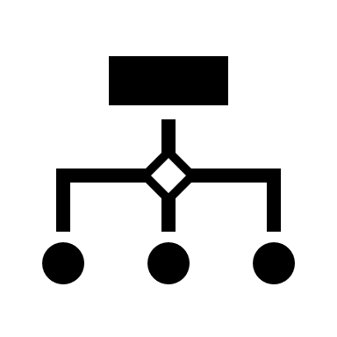





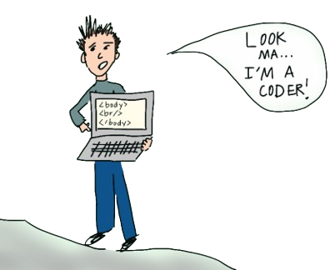




Why is it special?
Because Typing SQL is So Last Century !
Makes Databases more accessible.
Eliminates knowledge Transfer time for Schemas.

Slide 3

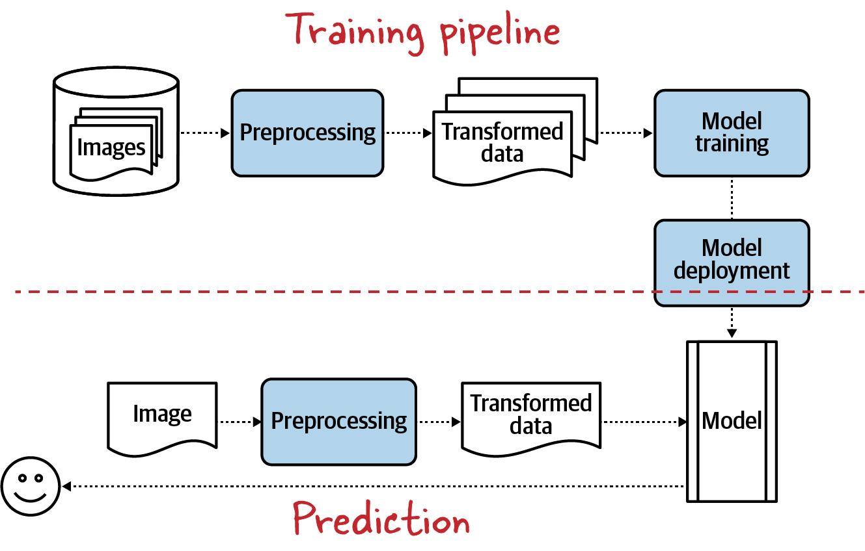
Methodology
T5
Questions
WIKISQL
BART
Queries

Slide 4



Building the Brain
NMT
Bidirectional and Auto-Regressive Transformers (BART) model by Facebook
Utilizes both masked language modeling and denoising autoencoding objectives
Transformer based model by Google
Pretrained on translation of around 50 languages
Neural network models used in machine translation

Slide 5
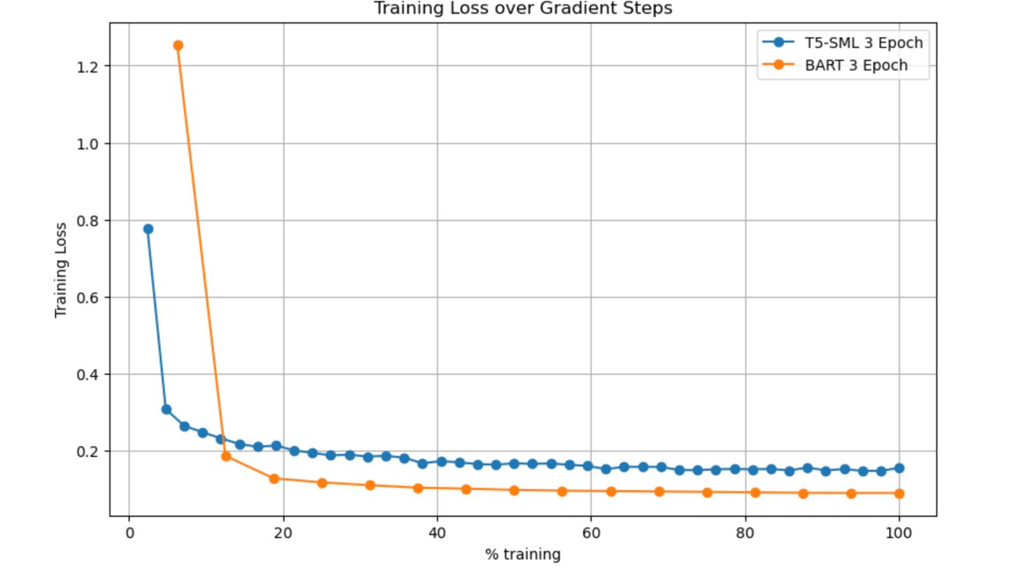
What Happens When We Talk to Databases?

Slide 6
Can It Replace SQL Developers
 | T5-Small | BART | NMT
BLEU | 94.4% | 95.5
METEOR | 97.4%

Slide 7
Reflections/conclusion

