Slide 1
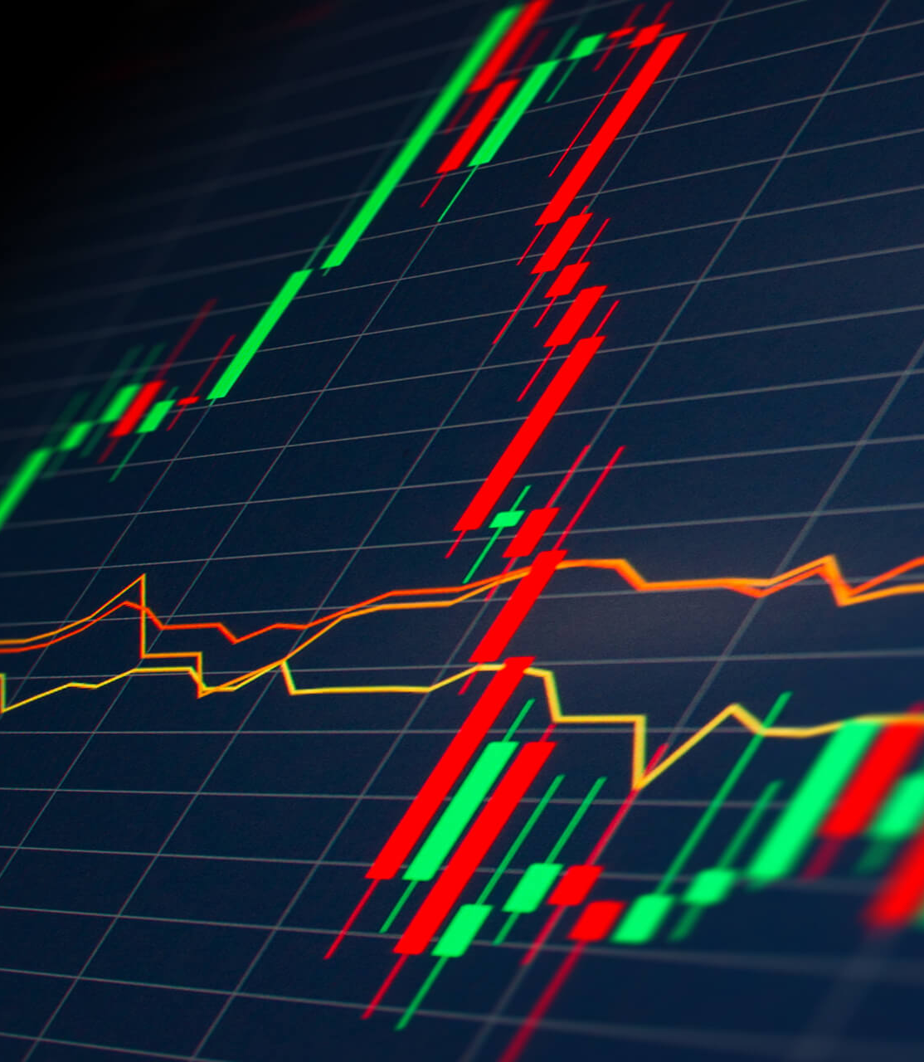


Stock Market Analysis
Presented By :
031- Sanket S. Patil.
036- Rajesh Pant.
050- Sudarshan Satish Jadhav.
052- Sushil Kumar.
Mentored By :
Shivam Pandey

Slide 2
Agenda:
Introduction
Objective
Tools & Technologies
Architecture
KPI’S

Slide 3
Introduction:
Stock market plays a pivotal role in financial aspect of the nation's growth, but stock market is highly volatile and complex in nature.
It is affected by significant political issues, analyst calls, news articles, company's future plans of expansions and growth and many more.
Hence, any investor would be interested in understanding the stock market over time and how the factors mentioned above affect the behaviour of the stock market.

Slide 4

Objective:
The motive of the project is to analyse the historical sector wise data and get key insights through visualizations so that investors can make better decisions while buying stocks.
The project also encompasses historical stocks data fetched through Yahoo Finance API.

Slide 5
Tools & Technologies:
Python (Google Colab)
Py Spark
Power Bi

Slide 6

Historical Data Analysis

Slide 7









Architecture:
Download
BSE Data
Read File
Combine all data
Power BI Data Frame
Analysis

Slide 8
Work Flow:
1. Download the data from Yahoo Finance API.
2. Cleaning and EDA process of data by Python using Google Colab.
3. Merging the cleaned datasets into one dataset.
4. Start py-spark and read the data from local storage and store it in a data frame.
5. Find the KPI using Py-Spark (Spark-SQL)
6. Creation of data-frame.
7. Show graphical representation of data using Power Bi.

Slide 9
Terminology:
1. Market Cap- The total value of all a company's shares of stock.
2. Percentage Change- The price change of a stock over time.
3. Close- The end of a trading session in the financial markets when the markets close for the day.
4. Volume- The total number of shares that have been bought or sold in a specific period of time or during the trading day.
5. Total Revenue- The total amount of income generated by the company.
6. Gross Profit- The profit a company makes after deducting the costs associated with making and selling its products.
7. Net Company- The amount that is left over after you deduct expenses, taxes, and other liabilities.
8. Top Gainers- Higher price at the close of the market rather than its price at the open.
9. Top Losers- High price at the open or at the start of a trading day versus its price at the end of the trading day.
10. High Volume, High Gain- Stocks rising on high volumes
11. High Volume, Top Losers- Big percentage decline for the day on high volumes

Slide 10
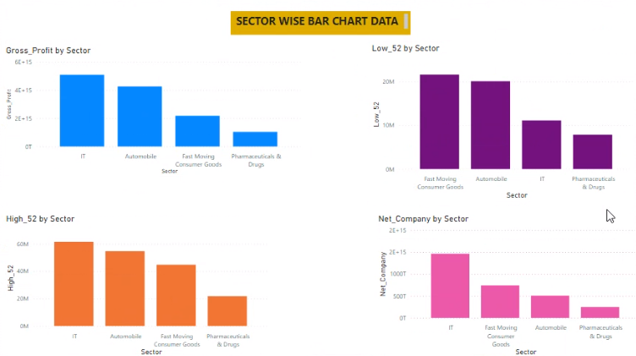
Power Bi Graphical Representation :

Slide 11
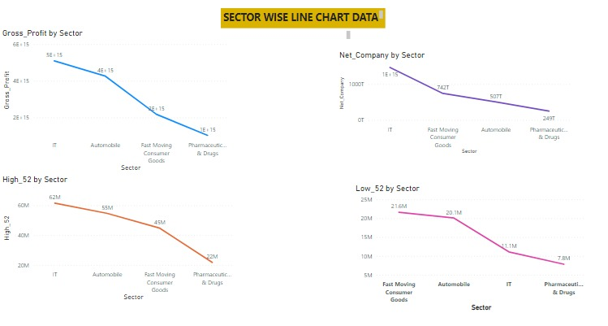
Power Bi Graphical Representation:

Slide 12
Insights:
1. From the year 2012 to 2020 the IT has positioned In the last.
2. From the year 2020 the IT has showed drastic growth and positioned to 2nd.
3. Pharmaceuticals & Drugs has all time growth since 2012.
4. IT has all time market cap.
5. All sectors shown decline in the graph after 2021 due to Russian-Ukraine War.
6. Banking Sector remained all time consistent.
7. Automobile sector remained good till 2019, but then it showed decline in the shares.
8. Fast moving Consumers Goods has steady growth.
9. All sector market cap down after 2021.

Slide 13

Key Performance Indicators:
Above 5% growth company.
Below 5% down company.
5% growth company.
5% down company .
Sector-wise highest growth companies.
Sector-wise lowest growth companies.

Slide 14

Conclusion:
So in this project, we have analysed the data from each sectors and provided this information to the investors who wants to take better decision when buying stocks.

Slide 15

THANK YOU!

