Slide 1
Employee Attrition

Slide 2
What is Attrition:
A reduction in the number ofemployees through retirement,voluntary/involuntary resignation or death is called Attrition
Attrition is also called total turnover or wastage rate

Slide 3
Types of Attrition :
Positive Attrition - where the company inherits new talent when an employee gets promoted or when the company dismisses an employee due to underperformance
Negative Attrition - When a productive employee resigns causing a loss of talent and skills within the company

Slide 4
The reasons Employee Are prone to Leave After Analysing the Data Set:
low salary
less satisfaction level
work accident
less promotion

Slide 5
Why do Employees resign?
General reasons:
Unfair Compensation and Benefits
Inability to cope with the demans of the job
Job becomes boring,routine and monotonous ; lacking challenge
Lack of career growth opportunities
Bad Leadrship and Incompetent Management
Issues with Peers in the Office
contn.......

Slide 6
Health Problems
Change of Career Plans
Lack of Appreciation and Motivation
Salary
Mismatch of job Role and Skills of Employee
Higher studies

Slide 7
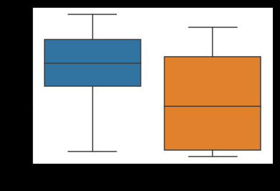
THE FUTURE EMPLOYEE WHO WOULD TEND TO LEAVE THE COMPANY
lower the satisfaction level higher chances employee leaving
lower the salary higher chances employee leaving

Slide 8
Model:
import the libararies
wrangle the dataset as needed to analysis
find the feature importance
using LabelEncoder change object type to int type
split the data set - train data set ,test data set

Slide 9
model:
classification model is used to predict the which employee will leave the company in future
LogisticRegrssion
fit and predict with data
prediction score obtained is 77%
DecisionTree classifier
fit ant predict with data
prediction score obtained is 99%

Slide 10
using these models prediction is done the future employee who would tend to leave the company

