Slide 1

SQL and Relational Databases Introduction to JDBC

Slide 2
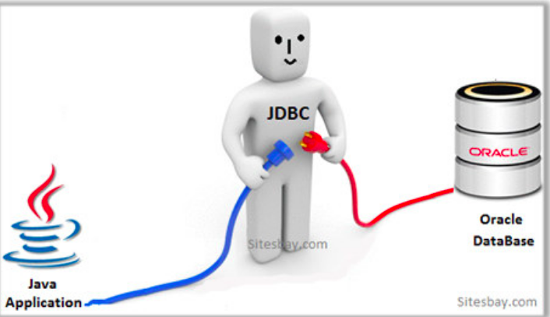
WHAT IS JDBC?
JDBC
JDBC stands for Java Database Connectivity
It is a Java API that can access any kind of tabular data, especially data stored in a relational database
DATABASE
Java Application
Database

Slide 3
WHY WE NEED JDBC?
JDBC establishes a connection between your data and code
The major use cases of JDBC are as follows:
Setting up a connection with the database
Creating a database querying(SQL) statement
Executing a database querying(SQL) statement to fetch the required data
Viewing or manipulating the fetched records

Slide 4
CREATING A JDBC APPLICATION
The following steps are involved while creating a JDBC application
Import the SQL package - java.sql.*
Register the JDBC drivers
Open a connection with the database
Execute the query
Extract the results from the output of the query
Finally close all the database connections

Slide 5
TYPES OF JDBC DRIVERS
JDBC drivers are of four types:
JDBC-ODBC Bridge Drivers
Used only for the development and testing purposes and is suitable for deployment
JDBC Native API
Useful when the type-3 and type-4 drivers are not available for your database
JDBC-Net Pure Java
Useful while accessing multiple types of databases at the same time
100% Pure Java
Used for databases such as - Oracle, MySQL, and IBM .

Slide 6
<Demo JDBC>

Slide 7
SQL VIA JDBC
The following three Interfaces are provided to send the SQL statements over JDBC
Statement
Useful for the static and general-purpose SQL statements.
Prepared Statement
Useful when a SQL statement has to be used multiple times
Callable Statement
Used when you want to access the database stored procedures

Slide 8
<Demo JDBC+SQL>

