Slide 1
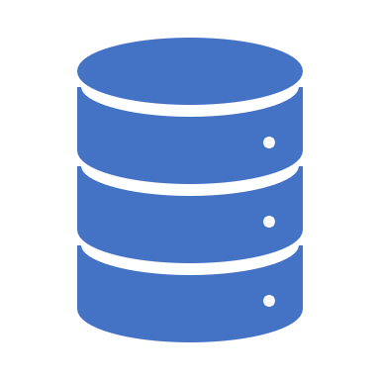
Middleware in ASP.NET Core Web API

Slide 2
What is Middleware in ASP.NET Core Web API:
Middleware is a piece of code that is used in the HTTP Request Pipeline.
An ASP.NET Core Web API Application can have n numbers of middleware.
So, depending upon the requirement, we can configure n numbers of middleware in the application request processing pipeline.

Slide 3
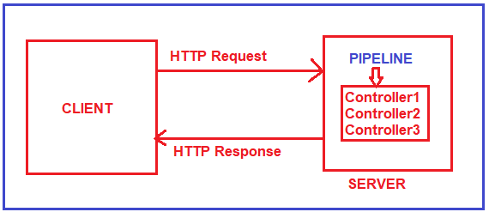
What is HTTP Request Pipeline:
Before understanding ASP.NET Core Middleware components, let us first understand what is HTTP Request Pipeline and how does it work.
So, when the client sends a request to the server, we generally believe that it is the controller action method that is going to serve the request and then we get the response.
But in reality, before hitting the controller action method, the request has to pass through a pipeline. Once the pipeline is completed, then only it navigates the request to the corresponding controller action method

Slide 4
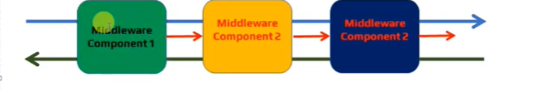
The Request Pipeline in ASP.NET Core Web API Application can have multiple middlewares.
Whenever a request comes from a client to the server, then the request comes to the first middleware which is registered in the request pipeline. The code or logic which is there in Middleware1 will be executed and then if it will call the next method, then the request goes to the next middleware which is registered in the request processing pipeline i.e. Middlware2. The code or logic which is there in Middleware2 will be executed and if it calls the next method, then it navigates to the request to the next middleware i.e. Middleware3.
Let us assume, in Middleware3, we don’t have the next method. So, the code or logic which is there in Middleware3 will be executed and as there is no next method call, so the request will come back to the previous middleware i.e. Middleware2. And if there is some code after the next method in Middleware2, then those codes will be executed and once the code executed the request again comes back to the previous middleware i.e. Middlwware1. Similarly, if there is some code after the next method in Middleware1, then those codes will be executed and once the code gets executed the final response sends to the client who initially made the request.

Slide 5

Middleware Examples
Routing: If we want to implement Routing in our application, then we need to use Routing Middleware in the HTTP Request Processing pipeline.
Authentication: If we want to authenticate the user then we need to use Authentication Middleware.
Authorize: The Authorize Middleware is used to Authorize the users while accessing a specific resource.
Log: If we want to log request and response while processing, then we need this Middleware.
Exception Middleware: we can also use Middleware to handle the exception globally.

Slide 6
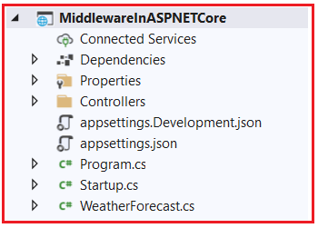
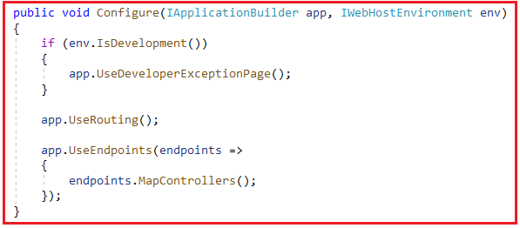
How to Configure Middleware Components in ASP.NET Core application?
After creating Asp.Net Core Web API project this is how our project structure looks like.
In the ASP.NET Core Web API application, the Middleware components are configured within the Configure method of the Startup class. The Startup class is the class that is going to run when the application starts.
we have configured three Middleware components to the HTTP Request Processing Pipeline. They are as follows.
UseDeveloperExceptionPage() Middleware: The UseDeveloperExceptionPage() middleware will come into picture only when the hosting environment is set to “development”.
UseRouting() Middleware: The UseRouting middleware is used to add Endpoint Routing Middleware to the request processing pipeline i.e. it will map the URL (or incoming HTTP Request) to a particular resource.
UseEndpoints() Middleware: In this middleware, the routing decisions are going to be taken using the Map extension method.

Slide 7
Methods in Middleware
Run() Method: The Run() Extension Method is used to complete the Middleware Execution.
Use() Method: The Use() Extension Method is used to insert a new Middleware component to the Request Processing Pipeline.
Next() Method: The Next() Extension Method is used to call the next middleware component in the request processing pipeline.
Map() Method: The Map() Extension Method is used to map the Middleware to a specific URL.

Slide 8
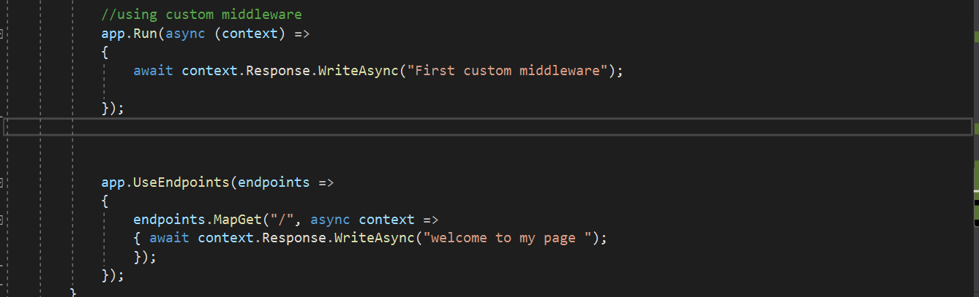
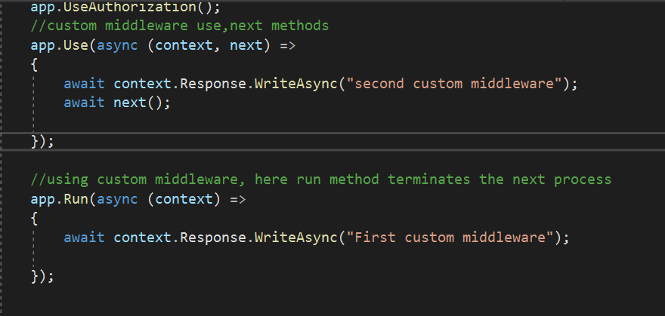
Run Method in ASP.NET Core
The Run method in ASP.NET Core Application is used to complete the Middleware Execution. That means the Run extension method allows us to add the terminating middleware component. Terminating middleware means the middleware which will not call the next middleware components in the request processing pipeline.
Output : First custom middleware
Use() and Next() Extension Methods In ASP.NET Core
The Use Extension Method in ASP.NET Core is used to add a new Middleware component to the Request Processing Pipeline whereas the Next Extension Method in ASP.NET Core is used to call the next middleware component configured in the request processing pipeline.
output: second custom middleware first custom middleware

Slide 9
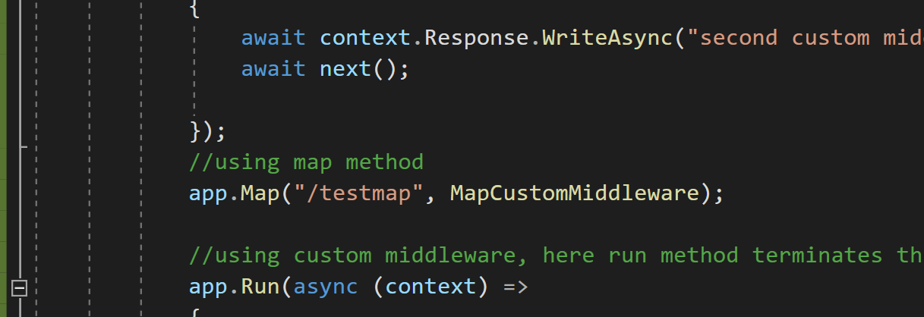
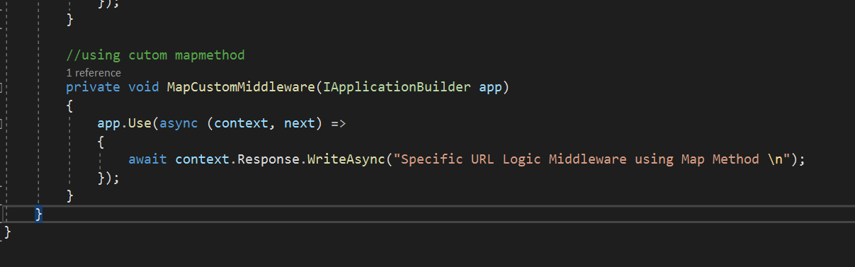
Map Extension Method in ASP.NET Core
If we want to insert some specific middleware logic for some specific URL, then you can do the same using the Map Extension Method in any type of ASP.NET Core Application.
Let us understand the Map Extension Method with Examples. First, add the following method in the Star tup class. This is the custom logic that we want to execute for a specific URL.
Now, we need to register the Middleware component using the Map Extension method
app.Map(“/testmap”, MapCustomMiddleware);
With this when the request comes, if it contains /testmap as part of the URL, then only this Middleware component going to be executed else simply is ignored.

Slide 10
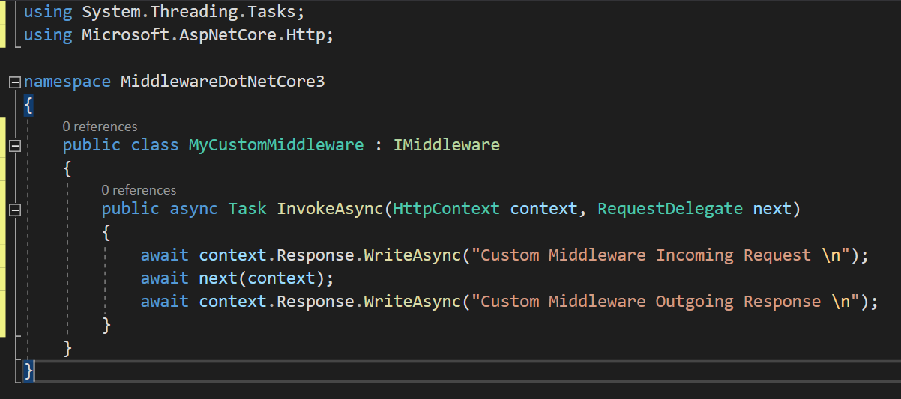
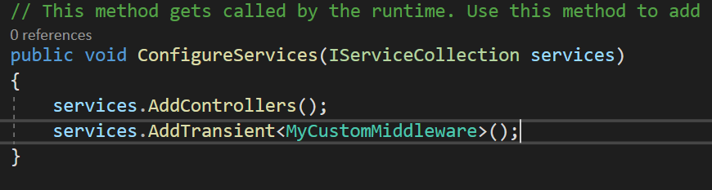
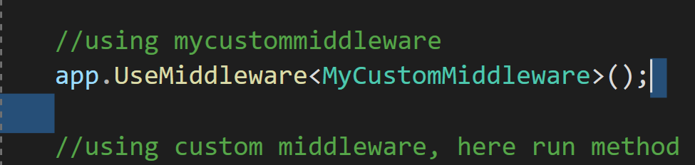
Creating Custom Middleware in ASP.NET Core
let us add a new class file to our project.
In order to make a class a Middleware component, the class needs to be inherited from the IMiddleware interface. Further IMiddleware interface belongs to Microsoft.AspNetCore.Http namespace. And we need to implement the InvokeAsync method. And you need to write your logic within the InvokeAsync method.
Our Custom Middleware component is ready. Now we need to use it in our HTTP Request Processing pipeline. Now it is a two-step process to use this custom middleware component.
Step1: Inject the service to the built-in dependency injection container
we can inject the service using the ConfigureService method of the Startup classas services.AddTransient<MyCustomMiddleware>();.
.Step2: Registering the Custom Middleware in the HTTP Request Processing Pipeline
app.UseMiddleware<MyCustomMiddleware>();
Step3: Run the application

Slide 11
KEY POINTS
The ASP.NET Core Request Processing Pipeline consists of a sequence of middleware components (custom plus built-in) that are going to be called one after the other. If we want to call the next middleware components then we need to use the next method.
Each middleware component in ASP.NET Core Application can perform some operations before and after calling the next component using the next method. The ASP.NET Core middleware component can access both the incoming request and the outgoing response.
The Run method in ASP.NET Core is the terminating Middleware Component which means it is not possible to call the next middleware component.

Slide 12

Thank you

