Slide 1


Conditional Execution
Chapter 3
Python for Informatics: Exploring Information
www.pythonlearn.com
Notes:
Note from Chuck. If you are using these materials, you can remove the UM logo and replace it with your own, but please retain the CC-BY logo on the first page as well as retain the entire last page.

Slide 2
Conditional Steps
x = 5
X < 10 ?
Yes
Program:
x = 5
if x < 10:
print 'Smaller’
if x > 20:
print 'Bigger'
print 'Finis'
No
print 'Smaller'
Output:
Smaller
Finis
X > 20 ?
Yes
No
print 'Bigger'
print 'Finis'

Slide 3
Comparison Operators
Boolean expressions ask a question and produce a Yes or No result which we use to control program flow
Boolean expressions using comparison operators evaluate to - True / False - Yes / No
Comparison operators look at variables but do not change the variables
Python | Meaning
< | Less than
<= | Less than or Equal
== | Equal to
>= | Greater than or Equal
> | Greater than
!= | Not equal
Remember: “=” is used for assignment.
http://en.wikipedia.org/wiki/George_Boole

Slide 4
Comparison Operators
x = 5
if x == 5 :
print 'Equals 5'
if x > 4 :
print 'Greater than 4'
if x >= 5 :
print 'Greater than or Equals 5'
if x < 6 : print 'Less than 6'
if x <= 5 :
print 'Less than or Equals 5'
if x != 6 :
print 'Not equal 6'
Equals 5
Greater than 4
Greater than or Equals 5
Less than 6
Less than or Equals 5
Not equal 6

Slide 5
One-Way Decisions
x = 5
print 'Before 5'
if x == 5 :
print 'Is 5'
print 'Is Still 5'
print 'Third 5'
print 'Afterwards 5’
print 'Before 6’
if x == 6 :
print 'Is 6'
print 'Is Still 6'
print 'Third 6'
print 'Afterwards 6'
Yes
X == 5 ?
Before 5
Is 5
Is Still 5
Third 5
Afterwards 5
Before 6
Afterwards 6
print 'Is 5'
No
print 'Still 5'
print 'Third 5'

Slide 6
Indentation
Increase indent indent after an if statement or for statement (after : )
Maintain indent to indicate the scope of the block (which lines are affected by the if/for)
Reduce indent back to the level of the if statement or for statement to indicate the end of the block
Blank lines are ignored - they do not affect indentation
Comments on a line by themselves are ignored with regard to indentation

Slide 7
Warning: Turn Off Tabs
Most text editors can turn tabs into spaces - make sure to enable this feature
NotePad++: Settings -> Preferences -> Language Menu/Tab Settings
TextWrangler: TextWrangler -> Preferences -> Editor Defaults
Python cares a *lot* about how far a line is indented. If you mix tabs and spaces, you may get “indentation errors” even if everything looks fine
Please do this now while you are thinking about it so we can all stay sane...

Slide 8
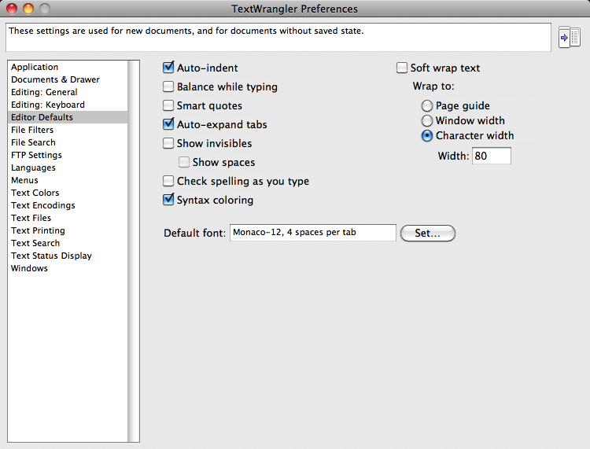

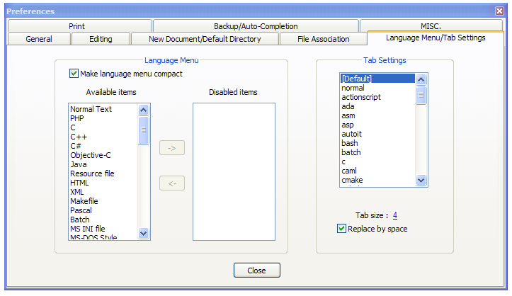
This will save you much unnecessary pain.

Slide 9
increase / maintain after if or for
decrease to indicate end of block
x = 5
if x > 2 :
print 'Bigger than 2'
print 'Still bigger'
print 'Done with 2'
for i in range(5) :
print i
if i > 2 :
print 'Bigger than 2'
print 'Done with i', i
print 'All Done'

Slide 10
Think about begin/end blocks
x = 5
if x > 2 :
print 'Bigger than 2'
print 'Still bigger'
print 'Done with 2'
for i in range(5) :
print i
if i > 2 :
print 'Bigger than 2'
print 'Done with i', i
print 'All Done'

Slide 11
Nested Decisions
x > 1
yes
no
print 'More than one'
x = 42
if x > 1 :
print 'More than one'
if x < 100 :
print 'Less than 100'
print 'All done'
x < 100
yes
no
print 'Less than 100'
print 'All Done'

Slide 12
Two-way Decisions
X = 4
Sometimes we want to do one thing if a logical expression is true and something else if the expression is false
It is like a fork in the road - we must choose one or the other path but not both
no
x > 2
yes
print 'Not bigger'
print 'Bigger'
print 'All Done'

Slide 13
Two-way using else :
x = 4
no
x > 2
yes
x = 4
if x > 2 :
print 'Bigger'
else :
print 'Smaller'
print 'All done'
print 'Smaller'
print 'Bigger'
print 'All Done'

Slide 14
Two-way using else :
x = 4
no
x > 2
yes
x = 4
if x > 2 :
print 'Bigger'
else :
print 'Smaller'
print 'All done'
print 'Smaller'
print 'Bigger'
print 'All Done'

Slide 15
Multi-way
yes
x < 2
print 'small'
if x < 2 :
print 'small'
elif x < 10 :
print 'Medium'
else :
print 'LARGE'
print 'All done'
no
yes
x < 10
print 'Medium'
no
print 'LARGE'
print 'All Done'

Slide 16
Multi-way
x = 0
yes
x < 2
print 'small'
x = 0
if x < 2 :
print 'small'
elif x < 10 :
print 'Medium'
else :
print 'LARGE'
print 'All done'
no
yes
x < 10
print 'Medium'
no
print 'LARGE'
print 'All Done'

Slide 17
Multi-way
x = 5
yes
x < 2
print 'small'
x = 5
if x < 2 :
print 'small'
elif x < 10 :
print 'Medium'
else :
print 'LARGE'
print 'All done'
no
yes
x < 10
print 'Medium'
no
print 'LARGE'
print 'All Done'

Slide 18
Multi-way
x = 20
yes
x < 2
print 'small'
x = 20
if x < 2 :
print 'small'
elif x < 10 :
print 'Medium'
else :
print 'LARGE'
print 'All done'
no
yes
x < 10
print 'Medium'
no
print 'LARGE'
print 'All Done'

Slide 19
Multi-way
if x < 2 :
print 'Small'
elif x < 10 :
print 'Medium'
elif x < 20 :
print 'Big'
elif x < 40 :
print 'Large'
elif x < 100:
print 'Huge'
else :
print 'Ginormous'
# No Else
x = 5
if x < 2 :
print 'Small'
elif x < 10 :
print 'Medium'
print 'All done'

Slide 20
Multi-way Puzzles
Which will never print?
if x < 2 :
print 'Below 2'
elif x < 20 :
print 'Below 20'
elif x < 10 :
print 'Below 10'
else :
print 'Something else'
if x < 2 :
print 'Below 2'
elif x >= 2 :
print 'Two or more'
else :
print 'Something else'

Slide 21
The try / except Structure
You surround a dangerous section of code with try and except
If the code in the try works - the except is skipped
If the code in the try fails - it jumps to the except section

Slide 22
$ cat notry.py
astr = 'Hello Bob'
istr = int(astr)
print 'First', istr
astr = '123'
istr = int(astr)
print 'Second', istr
$ python notry.py
Traceback (most recent call last):
File "notry.py", line 2, in <module> istr = int(astr)ValueError: invalid literal for int() with base 10: 'Hello Bob'
All
Done

Slide 23
$ cat notry.py
astr = 'Hello Bob'
istr = int(astr)
print 'First', istr
astr = '123’
istr = int(astr)
print 'Second', istr
$ python notry.py
Traceback (most recent call last):
File "notry.py", line 2, in <module> istr = int(astr)ValueError: invalid literal for int() with base 10: 'Hello Bob'
The program stops here
All
Done

Slide 24
Generic
Computer
Software
Input
Devices
Central
Processing
Unit
Secondary
Memory
Output
Devices
Main
Memory
Notes:
Who has see a traceback in CTools?

Slide 25
$ cat tryexcept.py
astr = 'Hello Bob'
try:
istr = int(astr)
except:
istr = -1
print 'First', istr
astr = '123'
try:
istr = int(astr)
except:
istr = -1
print 'Second', istr
When the first conversion fails - it just drops into the except: clause and the program continues.
$ python tryexcept.py
First -1
Second 123
When the second conversion succeeds - it just skips the except: clause and the program continues.

Slide 26
try / except
astr = 'Bob'
print 'Hello'
astr = 'Bob'
try:
print 'Hello'
istr = int(astr)
print 'There'
except:
istr = -1
print 'Done', istr
istr = int(astr)
print 'There'
istr = -1
print 'Done', istr
Safety net

Slide 27
Sample try / except
rawstr = raw_input('Enter a number:')
try:
ival = int(rawstr)
except:
ival = -1
if ival > 0 :
print 'Nice work'
else:
print 'Not a number'
$ python trynum.py
Enter a number:42
Nice work
$ python trynum.py
Enter a number:forty-two
Not a number
$

Slide 28
Exercise
Rewrite your pay computation to give the employee 1.5 times the hourly rate for hours worked above 40 hours.
Enter Hours: 45
Enter Rate: 10
Pay: 475.0
475 = 40 * 10 + 5 * 15

Slide 29
Exercise
Rewrite your pay program using try and except so that your program handles non-numeric input gracefully.
Enter Hours: 20
Enter Rate: nine
Error, please enter numeric input
Enter Hours: forty
Error, please enter numeric input

Slide 30
Summary
Comparison operators == <= >= > < ! =
Logical operators: and or not
Indentation
One-way Decisions
Two-way decisions: if: and else:
Nested Decisions
Multi-way decisions using elif
Try / Except to compensate for errors
Short circuit evaluations

Slide 31
Acknowledgements / Contributions
These slides are Copyright 2010- Charles R. Severance (www.dr-chuck.com) of the University of Michigan School of Information and open.umich.edu and made available under a Creative Commons Attribution 4.0 License. Please maintain this last slide in all copies of the document to comply with the attribution requirements of the license. If you make a change, feel free to add your name and organization to the list of contributors on this page as you republish the materials.
Initial Development: Charles Severance, University of Michigan School of Information
… Insert new Contributors and Translators here
...

