Slide 1
Lead-to-Sale Data Platform
on Microsoft Fabric
Gold
Silver
Medallion architecture · Power BI semantic model · AI-assisted lead intelligence
Bronze
Sude Bozkurt · Case study for Veri Yönetimi ve Uygulamaları Uzman Yardımcısı · Borusan Otomotiv İthalat · September 2026
Notes:
Open with the one-sentence summary: three dirty source systems, Bronze→Silver→Gold on Fabric, one star schema read by both Power BI (Direct Lake) and the lead-scoring assistant. Same numbers everywhere.

Slide 2
The business problem
An importer with a dealer network: volume comes from digital channels, conversion comes from people
15,000
leads in 24 months (Sep 2024 – Aug 2026)
18.2%
lead-to-sale conversion
40–80
open leads per advisor, worked in CRM order
Web + social + campaign = 55% of leads, 6.5% conversion. Referral + showroom = 27% of leads, 40% conversion. The high-volume channels need triage — that is where a data product pays off.
Notes:
Numbers come from gold.fact_leads (sanity cell in 03_gold_star_schema). Make the point: ranking open leads is only interesting for the digital channels; referral leads close themselves.

Slide 3
One dataset, two deliverables
A synthetic but realistic lead-to-sale lifecycle that feeds both the Medallion build and the AI product
CUSTOMERS
Why synthetic
Synthetic data avoids exposing real customer information in an interview case while preserving realistic business patterns. A generator with seed 42 gives realistic volumes, Turkish names and cities, 38 BMW / MINI / Land Rover trims, 14 dealers, 56 advisors.
DEALERS
LEADS
15,000
VEHICLES (catalog)
Why deliberately dirty
22 defect types injected on purpose — duplicate customers, five phone formats, orphan keys, 150% discounts, mixed date formats — and their counts written to docs/dq_injections.md as ground truth.
ADVISORS
TEST_DRIVES 5,686
OFFERS 7,114
Why causal structure
Source, dealer, advisor, response time, test drive, discount, price and season all move conversion in the generator. So, the lead-scoring model has meaningful patterns to learn, rather than random noise.
SALES 2,736
INTERACTIONS 67k + notes
Notes:
The ER diagram is the one Sude sketched on day 1. Interactions carry free-text advisor notes in Turkish — that is the raw material for the AI product.

Slide 4
Three source systems, three sets of data challenges
Bronze lands them as-is; every quirk becomes explicit Silver work
CRM export
Web lead forms
Dealer DMS
crm_customers, crm_leads, crm_interactions
Comma CSV, ISO timestamps — except ~1% of rows from an older CRM version in dd/MM/yyyy HH:mm. Mixed status casing. Duplicate rows from a re-export.
web_leads.json
Nested JSON, camelCase keys, +03:00 offsets, UTM fields. Web-sourced leads exist only here —Silver unifies CRM and web leads into one Leads entity.
dms_test_drives, dms_offers, dms_sales
; separator · decimal comma (4,07) · dd.MM.yyyy · Turkish headers (TEKLIF_NO, ISKONTO_ORANI) · E/H booleans · UTF-8 BOM.
Injected defect | Rows | Injected defect | Rows
Duplicate customer records (different id) | 180 | Leads pointing at the duplicate id | 224
Phone numbers in non-standard formats | 742 | Orphan / malformed dealer id | 120
City spelling variants (Istanbul/ISTANBUL/…) | 352 | Missing vehicle id | 225
Missing / invalid e-mail | 124 / 62 | Status casing variants | 750
Impossible discount % (150, −5, 99) | 42 | Sale dated before its lead | 13
Missing final price | 70 | Satisfaction score out of 1–5 | 23
Interaction with orphan lead id | 203 | Mixed timestamp formats (CRM) | 99 + 676
Full list of 22 defect types with counts: docs/dq_injections.md
Notes:
Say explicitly: in a real project there is no ground truth — that is why every repair is logged to dq_results. Here the synthetic ground truth let me validate the checks, not just write them.

Slide 5
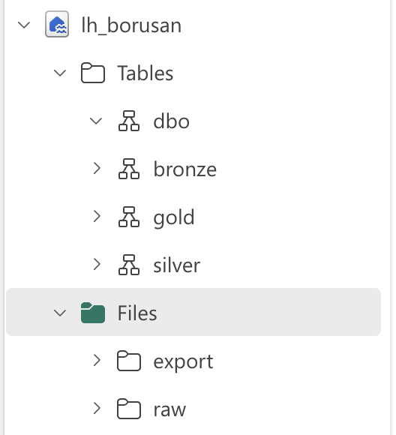
Architecture
One schema-enabled lakehouse, three schemas, one pipeline, one semantic model, one AI consumer
Semantic model (Direct Lake)
→ Power BI report, 4 pages
Sources
CRM · Web · DMS · Master
Bronze
raw as-is + lineage
Silver
clean · conform · validate
Gold
star schema
Lead Intelligence Assistant
scoring model + Streamlit
Data Factory pipeline pl_lead_to_sale_daily: notebook 01 → 02 → 03, on-failure alert, daily 06:00.
Trainer runs separately (next step: add as a 4th pipeline step)
Lakehouse lh_borusan with schemas bronze / silver / gold — one storage, clear boundaries, no cross-workspace plumbing for the case scope
Notebooks run unchanged in Fabric (Delta) and on a laptop (parquet) — the environment is detected, not configured
Semantic model in Direct Lake: no scheduled data import; the report reads the Gold Delta tables directly.
The AI product reads Gold only — report and assistant look at the same numbers
Notes:
Decision to defend: one lakehouse with schemas instead of three lakehouses or a Warehouse. Answer: simplest thing that keeps the boundaries explicit; Warehouse is a next step for T-SQL-heavy consumers.

Slide 6
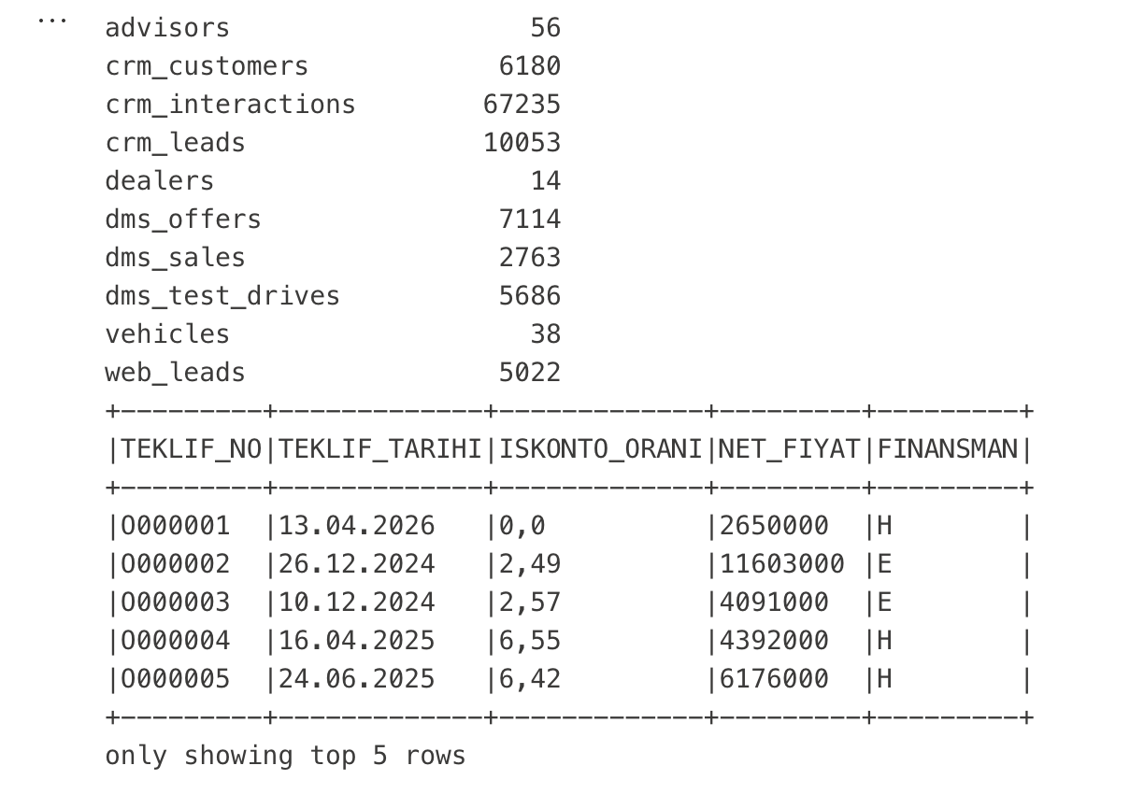
Bronze — land it exactly as received
The audit trail: if a Silver number is ever wrong, Bronze shows what the source actually sent
1
Everything read as string
No type casting, no decimal-comma fix, no date parsing. A parse failure in Bronze would silently become null; in Silver it becomes a counted DQ issue.
2
Three lineage columns on every table
_source_system · _source_file · _ingest_ts. Full-extract overwrite today; daily files would switch to append partitioned by ingest date.
3
Nested JSON kept nested
web_leads.json is exploded to one row per lead but the struct stays intact. Flattening is a Silver decision. 10 Bronze tables, ~100k rows, one notebook.

Slide 7
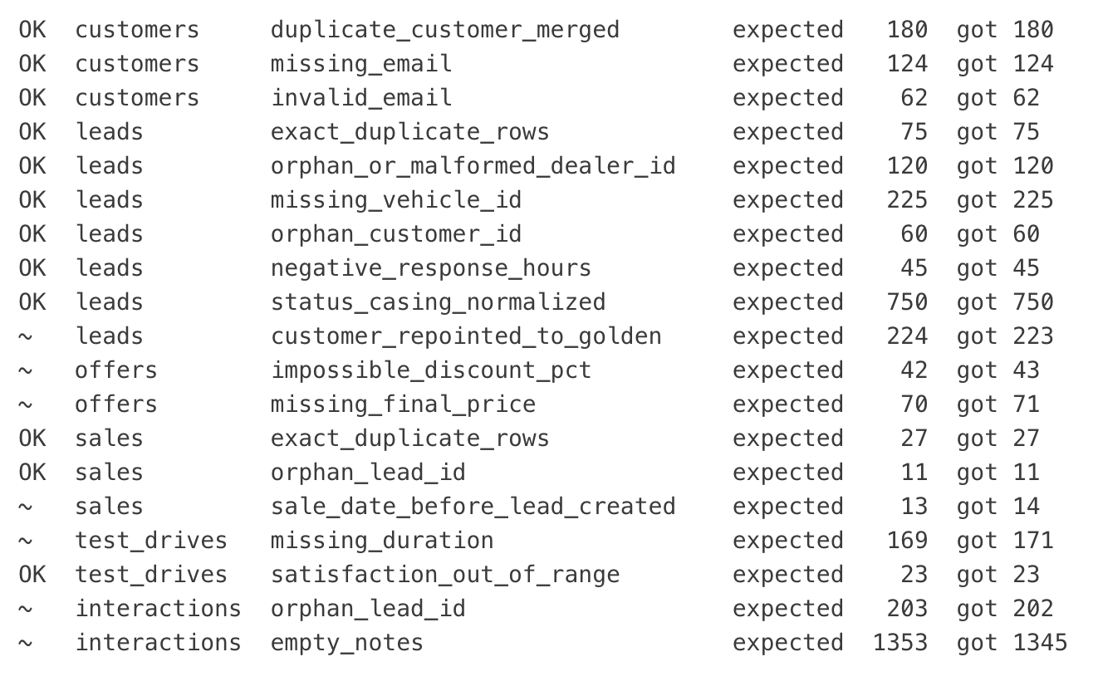
Silver — clean, conform, validate
Every data-quality decision is explicit, logged, and — here — verified against ground truth
Never drop a row
Never null silently
except exact duplicates. Problem rows keep a dq_flags entry; Gold decides.
every nulled or imputed value is a row in silver.dq_results with severity and action.
One entity, one schema
Golden record
CRM leads ∪ web leads → silver.leads; DMS Turkish headers → English names.
same normalised phone ⇒ same person; earliest record wins; customer_xref re-points leads and sales.
25
180
12 / 18
DQ checks logged
duplicate customers merged
checks matching ground truth exactly; rest within ±8
Sude Bozkurt · Borusan Otomotiv case study · 7
Notes:
Why impute the missing net price instead of leaving null? A revenue KPI with silent gaps is worse than a documented estimate; the imputed rows carry the flag final_price_imputed. Mention try_to_timestamp with 7 patterns and the CORRECTED parser policy if asked about the date handling.

Slide 8
Gold — a star schema Power BI reads as-is
fact_leads is one row per lead with the whole funnel pre-joined; every dimension has an UNK member
dim_dealer
dim_date
dim_vehicle
fact_leads
Additional facts: fact_test_drives · fact_offers · fact_sales · fact_interactions
Natural keys; surrogate keys + SCD2 are the next step when dealers get renamed
UNK rows: a lead with a broken dealer id shows under 'Unknown dealer' instead of vanishing in a join
Revenue 13.1 bn TRY (illustrative prices) — the report cards must reproduce these totals exactly
dim_customer
dim_lead_source
dim_advisor
Also in Gold: lead_notes (text for the AI product, hidden from BI) and dq_results (for the DQ monitor page).

Slide 9
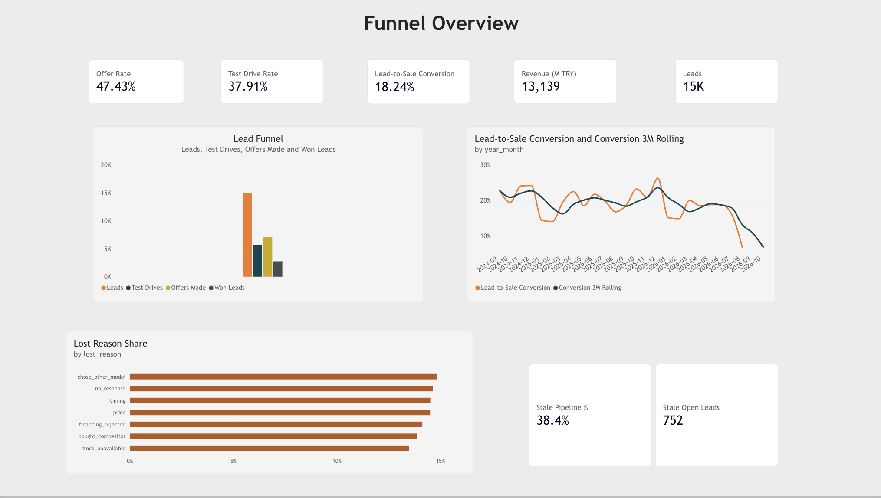
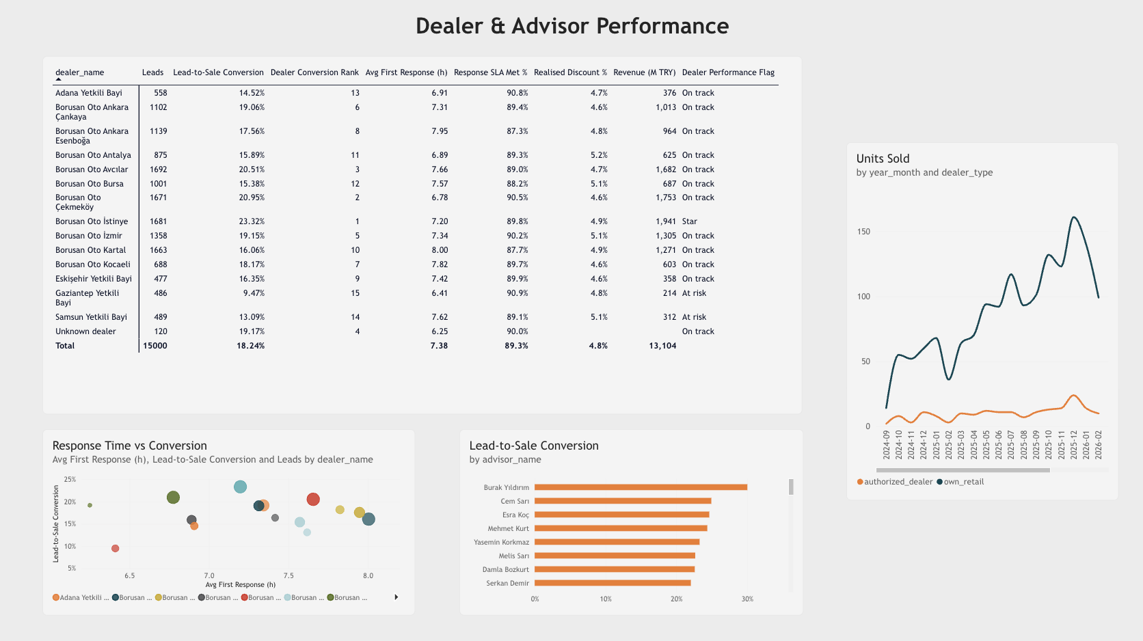
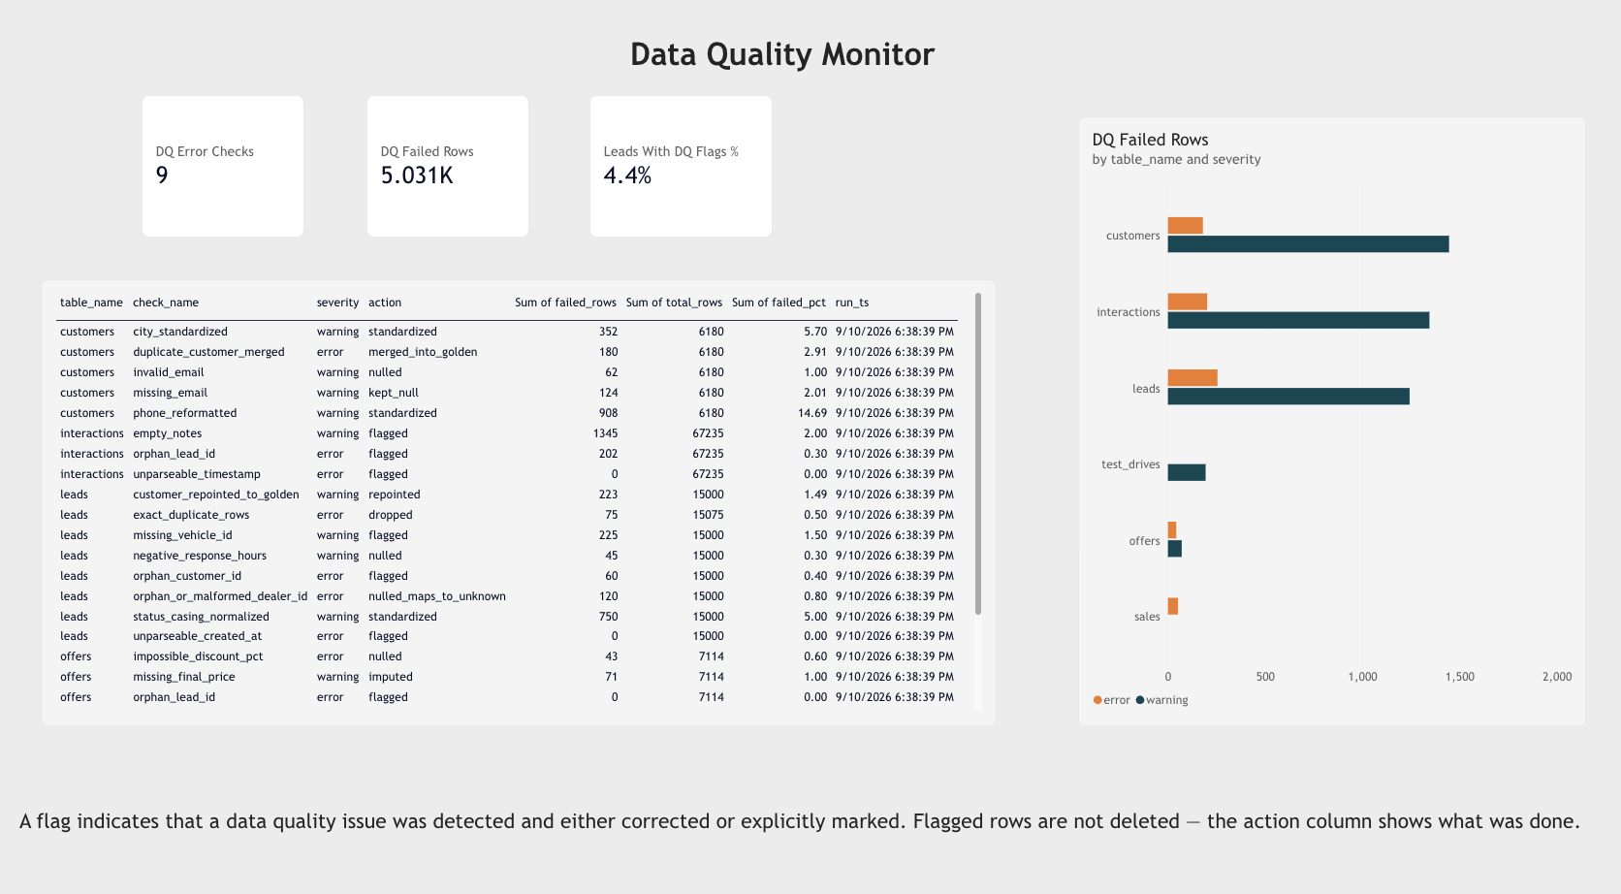
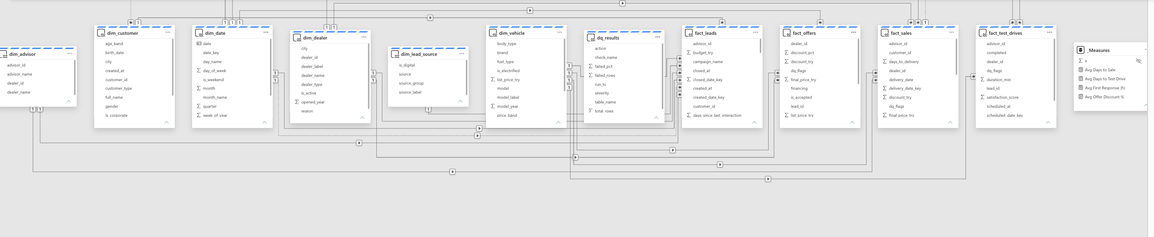
Semantic model and report
Direct Lake on Gold · single-direction star · 41 measures in a dedicated _Measures table · 4 report pages
Modelling choices
dim_date marked as date table (time intelligence). Single-direction relationships from dimensions to facts; no bi-directional filters. Text columns (notes) excluded from the model. Inactive relationship on closed_date_key for 'closed in month' views via USERELATIONSHIP.
Two conversion measures
Lead-to-Sale Conversion = Won / all leads (as of today, open leads in the denominator).
Conversion Rate (Closed) = Won / (Won + Lost) — fairer for recent months.
Plus Conversion 3M Rolling, Response SLA Met %, Stale Pipeline %, Realised Discount %, Dealer Performance Flag.
Notes:
If asked about row-level security: a DealerManager role on dim_dealer[dealer_id] with a user→dealer mapping table — not built in two days, but it is the answer to 'veri erişimi, yetkilendirme'.

Slide 10
Live demo
1
Lakehouse
bronze / silver / gold schemas · raw vs cleaned data
2
Pipeline
last run in Monitor, three notebook steps chained
3
Report
Funnel overview → filter to web leads → Dealer page → DQ monitor
4
Assistant
ranked open leads → one lead → reasons → next best action + draft message
Fallback order if something breaks: screenshots in this deck → local run (run_local.py + Streamlit)

Slide 11
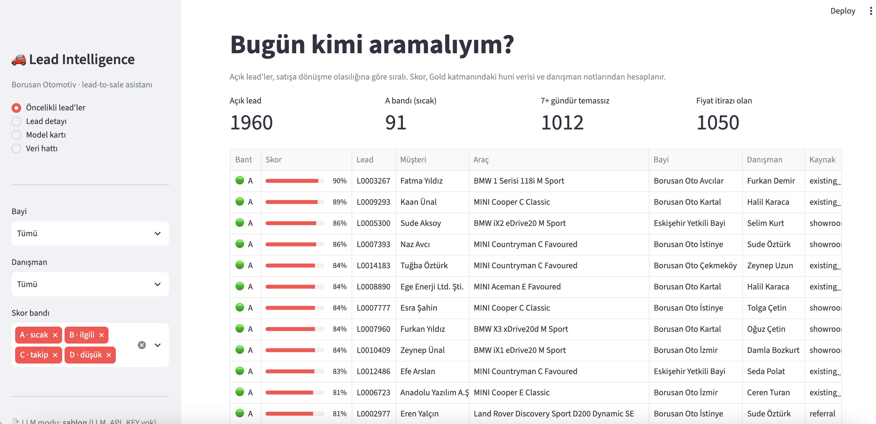
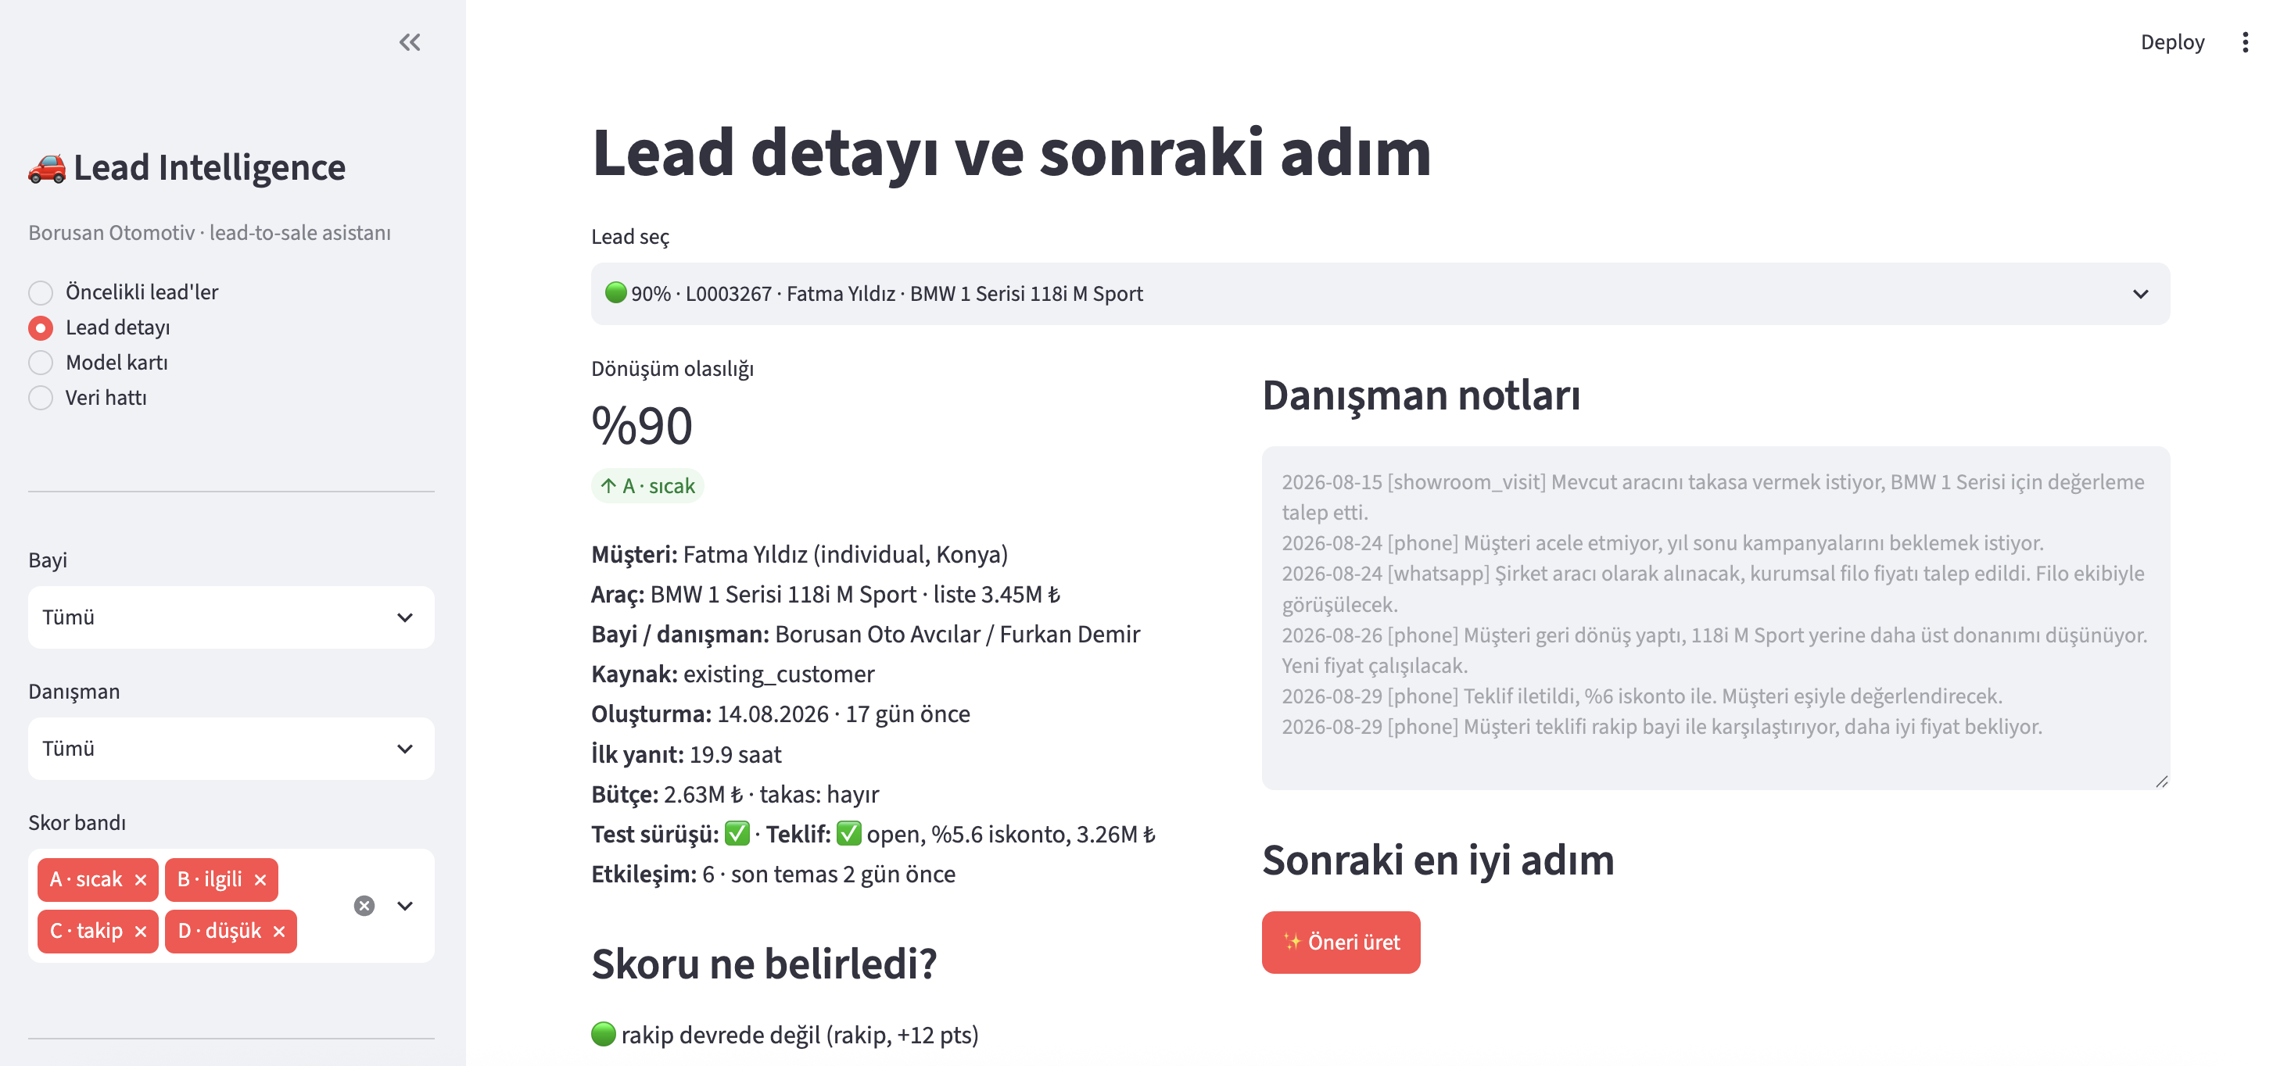
AI product — Lead Intelligence Assistant
Which of my 60 open leads should I call first, why, and what should I say?
What it does
Rules at scale, LLM last mile
Scores every open lead with a conversion probability, shows the three factors behind the score, drafts the next action and a WhatsApp message to the customer. Filters by dealer and advisor.
Advisor notes are converted into structured signals such as price objection, went quiet and buying intent using keyword rules across all leads. For an individual lead, an optional LLM can generate a summary or message on demand. Without an API key, the app uses a template fallback, so the demo does not depend on an external service.
Why it belongs on this platform
  The assistant consumes only curated Gold data — gold.fact_leads, fact_interactions, fact_offers and fact_test_drives. Lead scores are written back to gold.lead_scores, keeping the model output in the same data layer and making it available for future inclusion in the Power BI semantic model. Model training currently runs separately from the Bronze → Silver → Gold pipeline; the next step is to add the trainer as a fourth orchestration step. This makes the AI product a direct consumer of the Medallion platform rather than a disconnected demo.
Notes:
If asked 'why not just use Fabric Copilot': Copilot answers questions about data; this ranks work for a specific role and closes the loop with an action. Different job.

Slide 12
The model — and how I avoided fooling myself
Point-in-time snapshots, outcome notes removed, temporal validation
A closed lead's final state is not a training example — 'has offer = won' is the answer written on the exam
Each closed lead contributes two snapshots from random moments in its life; every feature is computed from events before that moment
The interaction that records the outcome ('Sözleşme imzalandı') is removed entirely(target leakage)
Train on leads created before 2026-03-01, test on later ones — the way the model is actually used
0.82
0.84
3.7×
AUC, all test snapshots
AUC before the offer stage
lift in top 10% pre-offer
Gradient boosted trees (scikit-learn), 42 features. Pre-offer is the slice that matters: after an offer everyone knows the lead is warm.
Notes:
Limits to state yourself: synthetic notes are cleaner than real ones; dealer/advisor effects make cross-dealer ranking unfair (fine within a dealer); explanations are single-feature ablation, SHAP is the upgrade; no drift monitoring yet.

Slide 13
What I would do next
Deliberately out of scope for two days, documented as next steps in the repo
1
Incremental loads
2
History
3
Access
Bronze append by ingest date, Silver MERGE upserts, pipeline parameter run_date
Surrogate keys and SCD2 on dim_dealer / dim_advisor
Row-level security per dealer; workspace roles on OneLake; PII stays in Silver
4
Monitoring
5
Model
6
Product
DQ trend from dq_results, fail the pipeline on error-severity thresholds, monthly model AUC to a metrics table
SHAP explanations, monthly retraining as a pipeline step, LLM signal extraction at scale if note quality is low
A Fabric-native page on gold.lead_scores next to the report; write-back of advisor feedback

Slide 14
Thank you
Repo: notebooks (.py + .ipynb), DAX, report spec, generator, AI product, docs
sude.bozkurt@ozu.edu.tr · linkedin.com/in/sudebzkurt
Sude Bozkurt · Borusan Otomotiv case study · 14

Slide 15
Backup — how I used AI assistance
The brief invited an AI-assisted approach; this is what that looked like in practice
I decided
The assistant helped with
I verified
The dataset shape and the business scenario
One lakehouse with schemas, no Warehouse
Silver rules (flag, never drop)
Star-schema grain and UNK members
Snapshot-based training to avoid leakage
What to leave out for two days
Writing and refactoring notebook cells
DAX drafts and Streamlit boilerplate
Turkish keyword lists for note signals
Explanations in every markdown cell
CLAUDE.md / AGENTS.md so a teammate can continue with the same context
Every notebook run end to end, locally and in Fabric
DQ counts against generator ground truth
Funnel totals: Gold cell = report cards
Model metrics on a temporal split, calibration by decile
App smoke test on all four pages
Every notebook cell carries a 'why' paragraph so I can defend it line by line; the repo's CLAUDE.md lists what was decided, what was delegated, and what was verified.
Sude Bozkurt · Borusan Otomotiv case study · 15

Slide 16
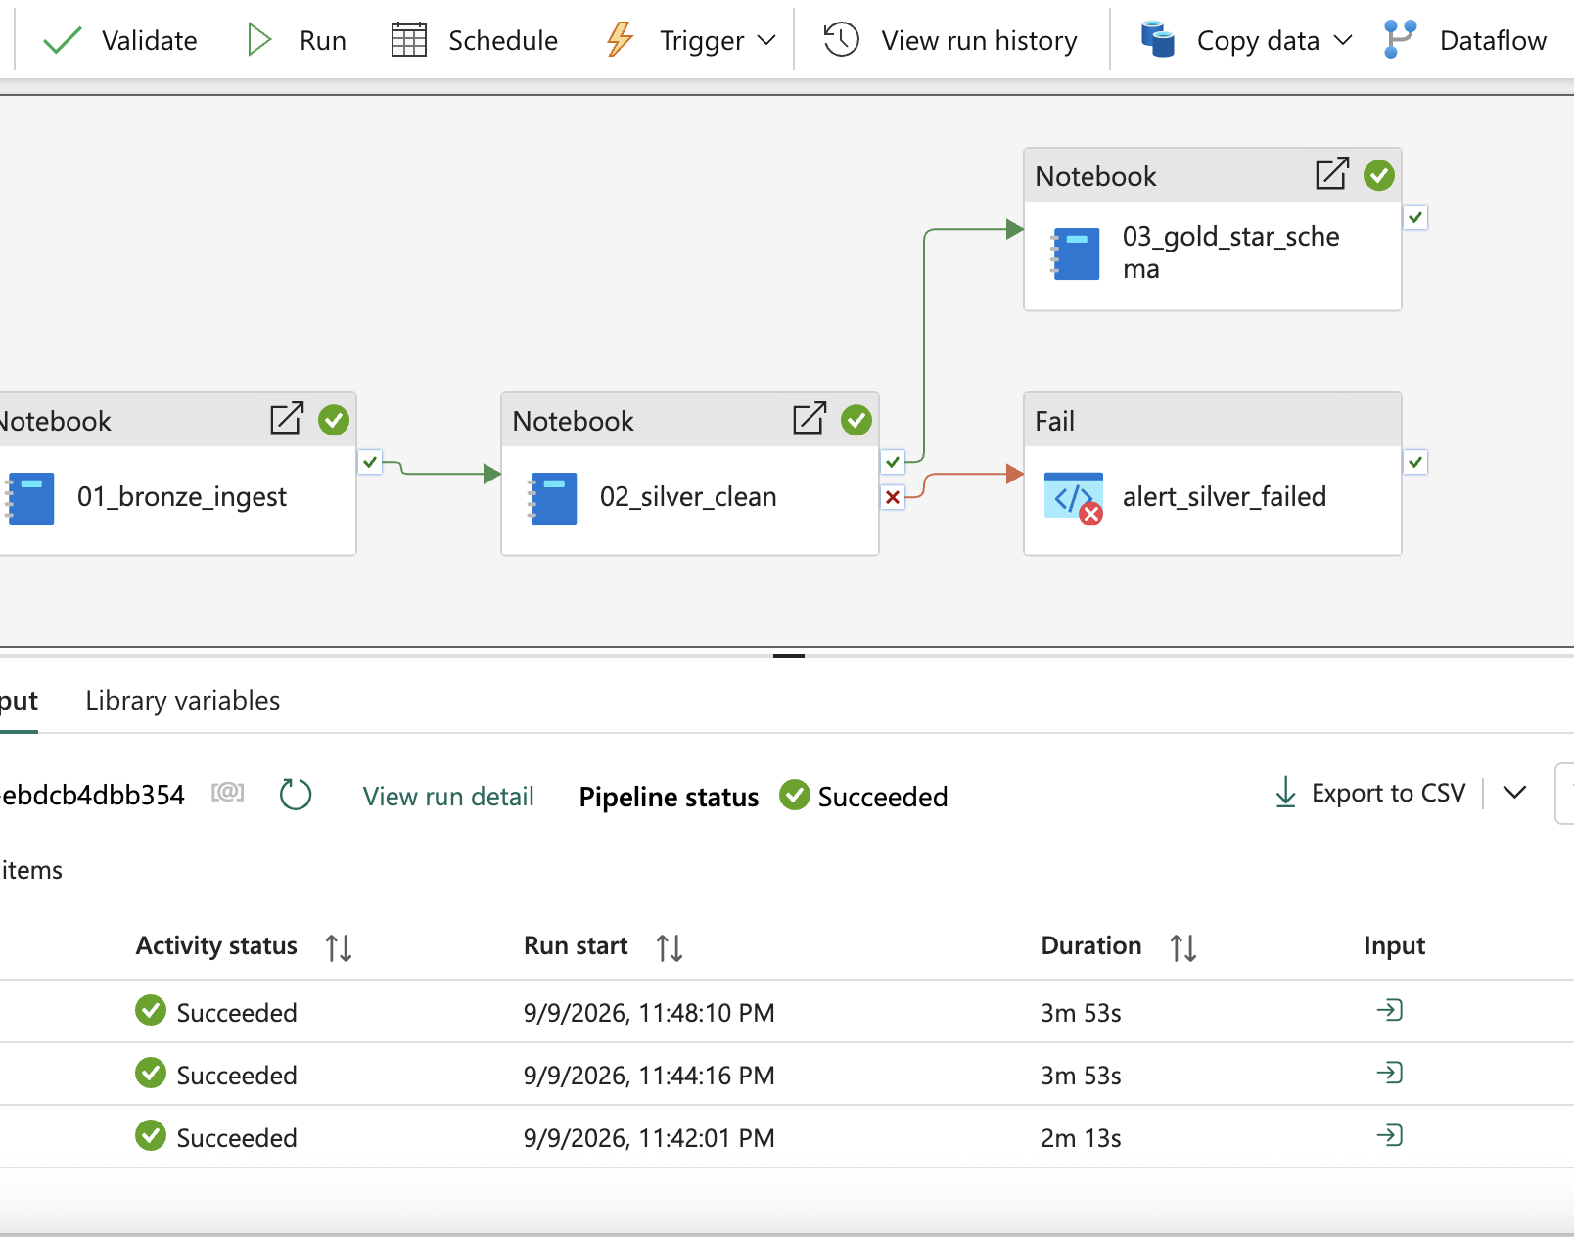
Backup — pipeline run and orchestration
pl_lead_to_sale_daily in Data Factory
SCREENSHOT PLACEHOLDER
Monitor view of a successful run with per-activity durations
save as report/screenshots/16b_pipeline_monitor.png
Sude Bozkurt · Borusan Otomotiv case study · 16

