Slide 2
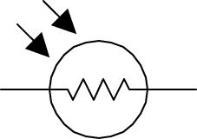
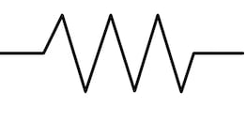
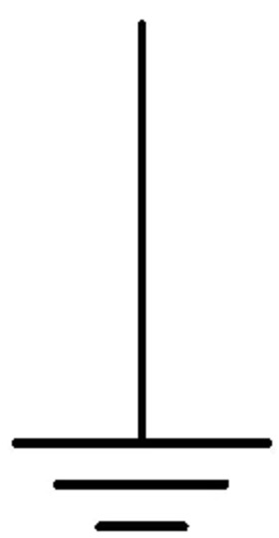
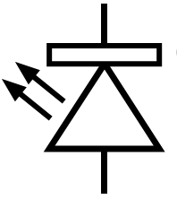
LDR
Resistor 10 k Ohm
Analog A0
Ground
3.3 V power
LED
Resistor 330 Ohm
GPIO 1

