Slide 1
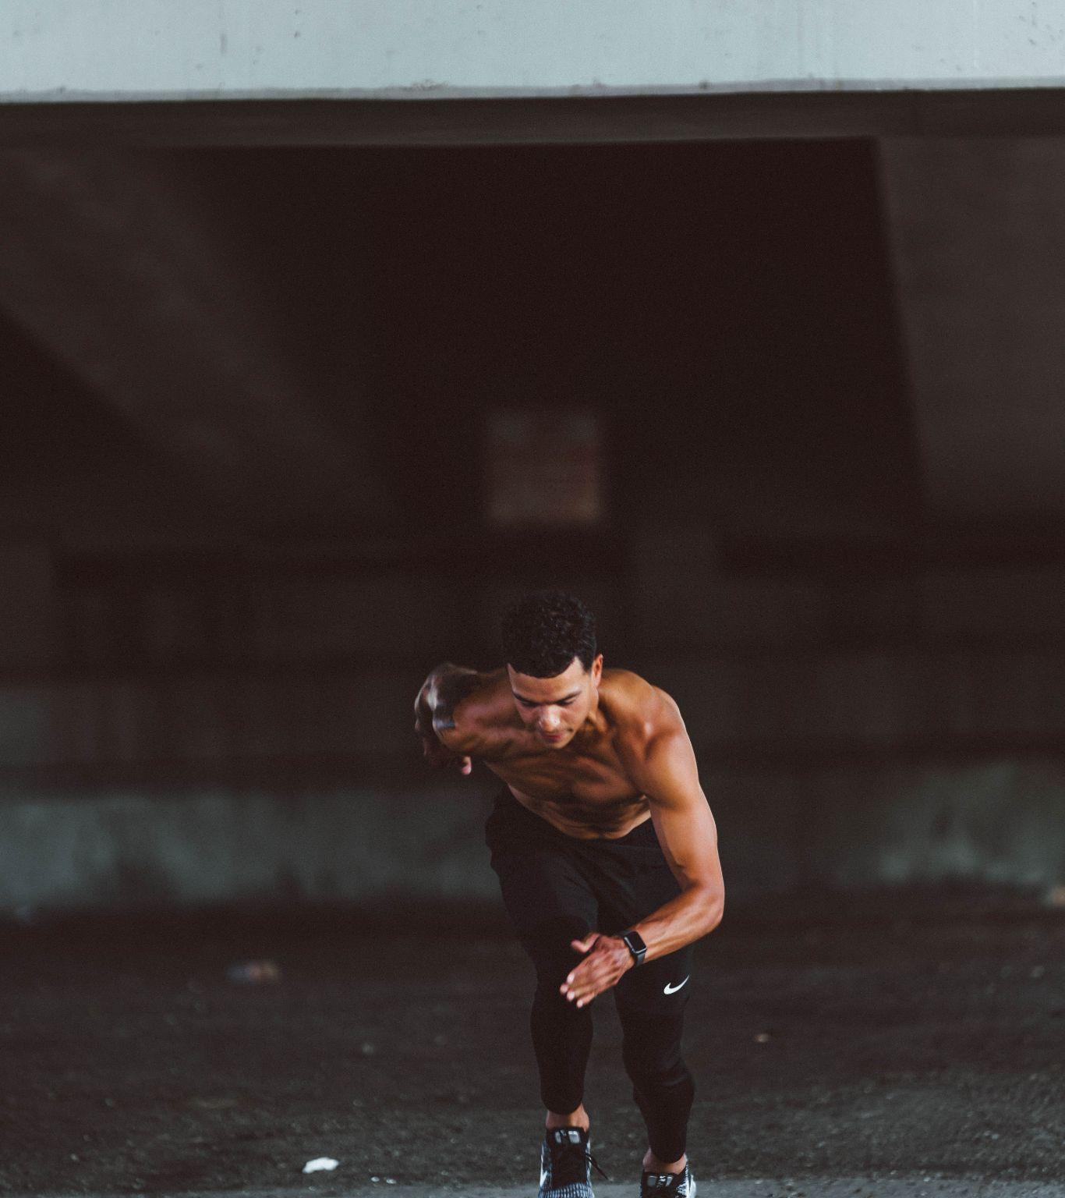
F I T - A I
Nithin Shet N (4NM19CS120)
Parthasarathy H M (4NM19CS128)
Rahul N Adhikari (4NM19CS146)
Sanath Poojary (4NM19CS168)

Slide 2
Contents of the presentation:
Introduction
Problem Statement
Objectives
Methodology
Literature Survey
What is mediapipe?
Creating the gui using tkinter
Conclusion and Future Work

Slide 3
Introduction:
FIT-AI is a fitness tracker app that uses pose detection model to keep track of exercises .It uses the Mediapipe model .
The main goal is to provide users with a easy to use interface that will make their fitness life easier and also motivate them to achieve their fitness goals faster..

Slide 4
Problem Statement:
It is our ultimate goal to enable a healthy lifestyle to prevent obesity and obesity-related illnesses.It is important to keep track of exercises to reach fitness goals efficiently as planned.
A fitness tracker app is a the perfect solution for this as it can offer users a convenient and user-friendly way to track their physical activity .

Slide 5
Objectives:
The main objectives of the project are:
To track exercise reps and positions
To count the number of repetitions done
To develop a Desktop App

Slide 6
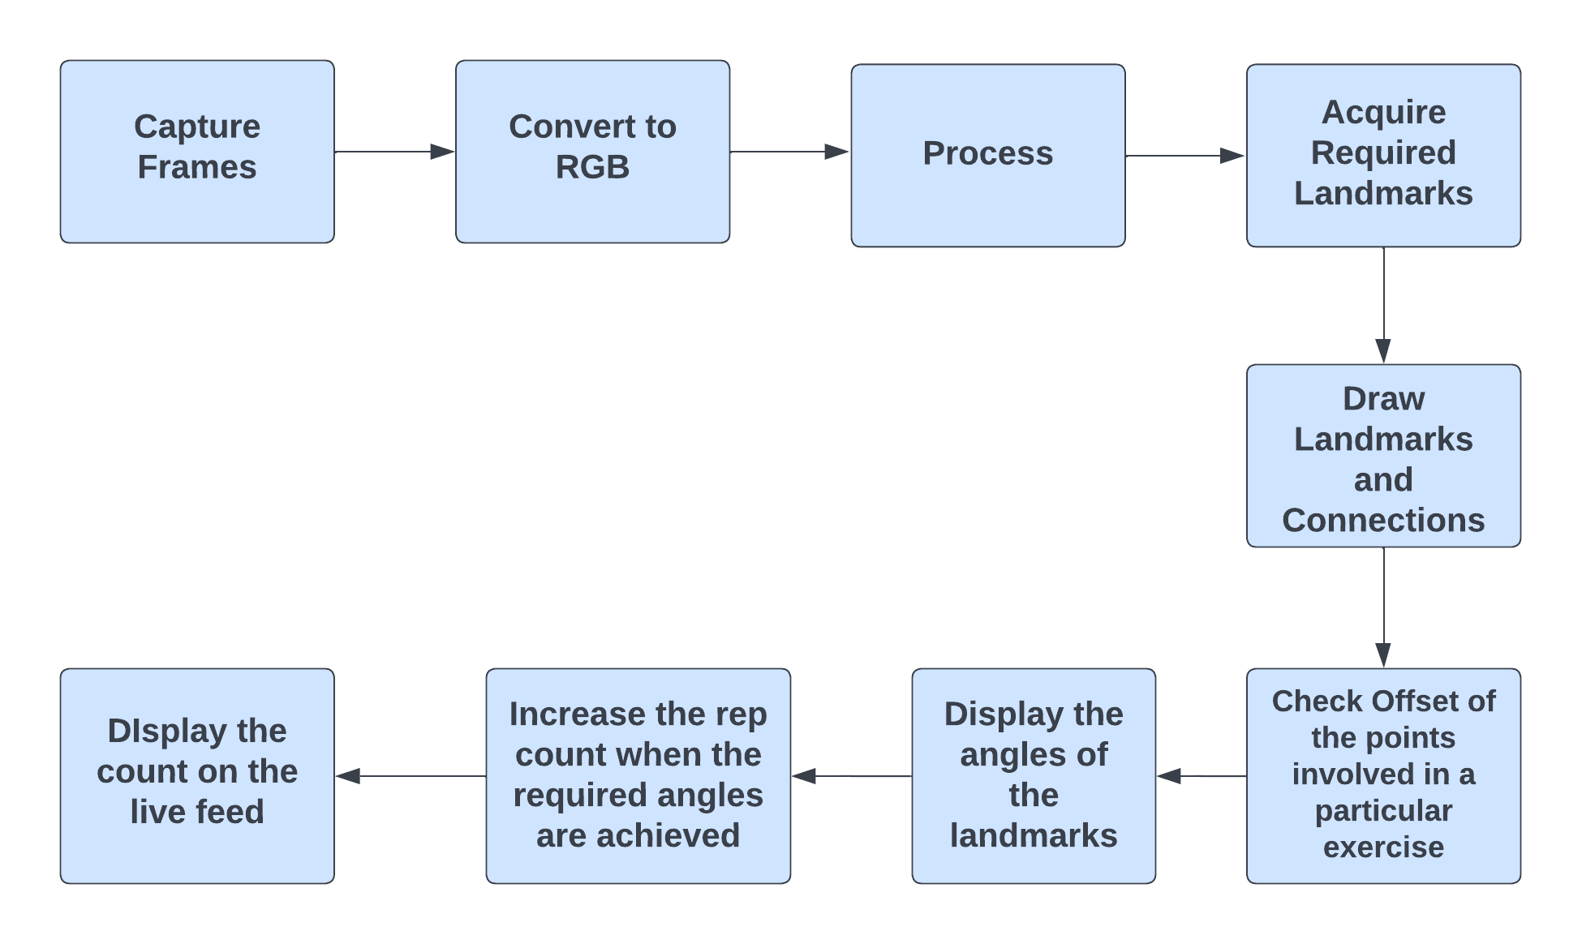
Methodology:

Slide 7
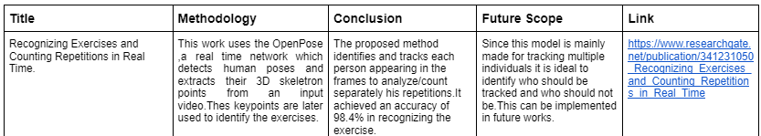
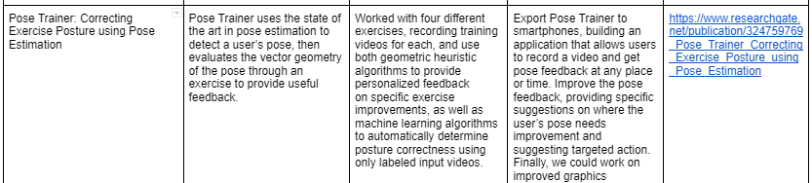
Literature Survey:

Slide 8
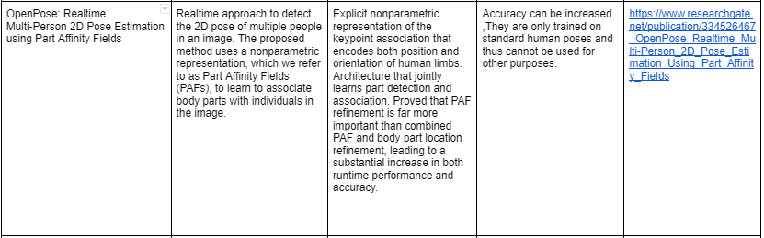
Literature Survey:

Slide 9
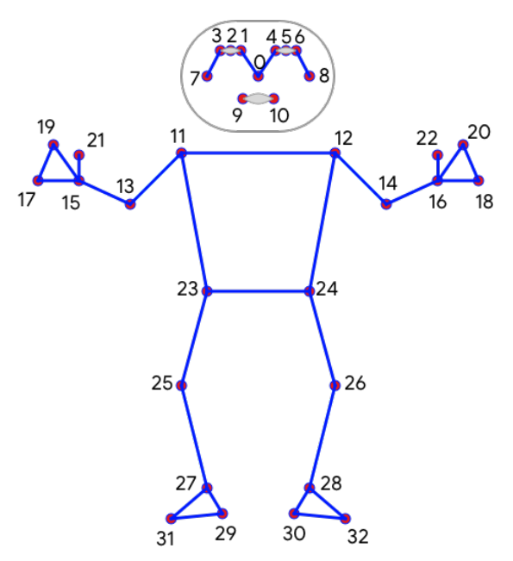
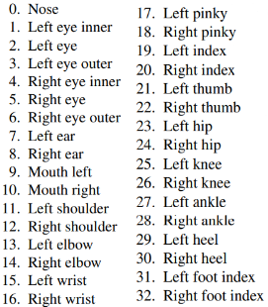
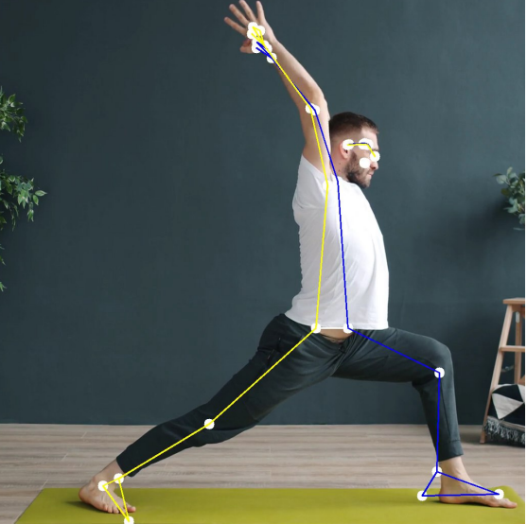
What is Mediapipe ?
MediaPipe Pose is a ML solution for high-fidelity body pose tracking, inferring 33 3D landmarks and background segmentation mask on the whole body from RGB video frames utilizing theBlazePose research .
This is trained on a dataset of 85K images with single or multiple persons doing different exercises.
There are two models with different capacities :
Blazepose Full(6.9 MFlop,3.5M Params)
Blazepose Lite(2.7 MFlop,1.3M Params)
Key Points detected
=>

Slide 10
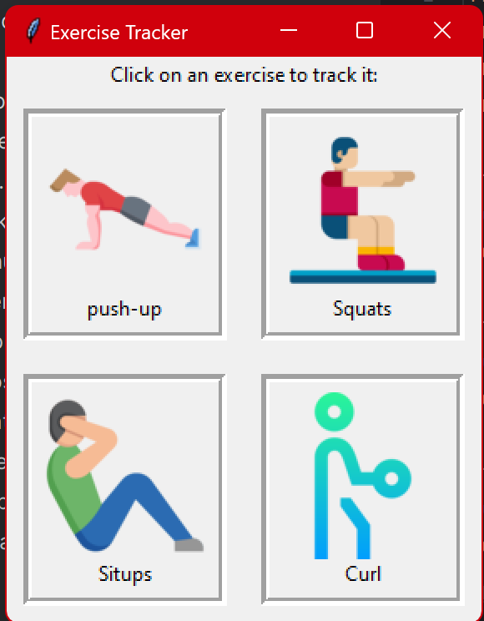
Creating the gui using Tkinter
Tkinter is the standard GUI library for Python. Python when combined with Tkinter provides a fast and easy way to create GUI applications.
Tkinter provides a powerful object-oriented interface to the Tk GUI toolkit.
We created a dock window in tkinter to access the different exercise trackers.
We have used pyttsx 3 library for the text-to-speech function.

Slide 11
Conclusion and Future Work:
This model is successful in detecting the landmarks and counting the number of repetitions.This can run smoothly and there is low latency in processing the frames.
In the future the number of exercises to be tracked can be increased and also the accuracy can be increased .

Slide 12
ThankYou…

