Slide 1
Performance analysis of the community reconstruction technique using a homogeneous collaboration multiplex.
Team: 5
SUDEEPKUMAR SHETTY
DHANYASHREE YELAHANKA SRINIVASA
Email id:
sudeepkumar.shetty@mavs.uta.edu
dhanyashree.yelahankasriniv@mavs.uta.edu

Slide 2
References, if any
Abhishek Santra ,Sanjukta Bhowmick: Holistic Analysis of Multi- Source, Multi-Feature Data:Modeling and Computation Challenges
Abhishek Santra ,Sanjukta Bhowmick ,Sharma chakravarthy:Efficient Community Re-creation in Multilayer Networks Using Boolean Operations

Slide 3
Acknowledgments, if any
We would like to thank the professor for motivating us to take up this project
We would like to thank our TA for all his support and guidance .

Slide 4
PROJECT DELIVERABLES
Introduction:
Finding communities and patterns in multiplexes has several uses in different domains.
In this project we find communities in the multiplex and try to analyse them and find interesting patterns.

Slide 5
Data sets used
Dblp dataset
We chose this dataset because it is a metadata of about 1.8 million publications that covers all disciplines of computer science hence giving us an opportunity to observe a large amount of communities

Slide 6
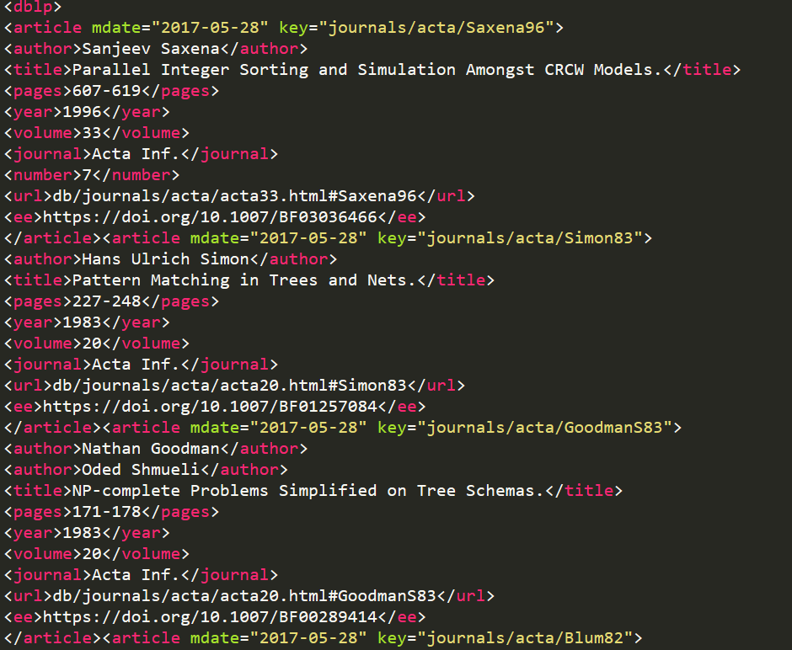
Data

Slide 7
Details of your Approach
We first pre-processed the dataset and removed all the unwanted data and reduced the size of the dataset considerably
We then built a multiplex with 5 layers
We chose 5 journals to be the different layers

Slide 8
Layers
We have created homogenous multiplexes.
We have picked 5 different journals as our layers.
The journals we choose as our layers:
ACM Transactions on Computer Systems - 5.045
Future Generation Comp. Syst. - 3.977
IEEE Transactions on Computers -2.916
IEEE Computer - 6783 -impact factor - 1.755
International Journal of Computer Vision - 8.222

Slide 9
The authors who have published in any of these journals are the nodes
The nodes remain the same for all the layers
We came up with 5 questions for analysing the multiplex.
We then ran the community detection algorithm over the multiplex and are now analysing the results.

Slide 10
images for Layers

Slide 11
Details of the Analysis
We came up with 5 questions to analyse the multiplex based on the communities.
We first wanted to see if there is any relationship between the impact factor and the number of communities in the individual layers.

Slide 12
Details of the Analysis
Fig 2: a bar graph indicating the number of communities in each layer

Slide 13
Details of the Analysis
Fig 3: the impact factor of all the journals.

Slide 14
Details of the Analysis
We can observe from fig 2 and fig 3 that the journal with the highest impact factor is the IJCV journal with an impact factor of 8.22
but we can also observe that the ATCS journal with an impact factor of 5.045 has the most number of communities.

Slide 15
Details of the Analysis
We came up with 5 questions to analyse the multiplex based on the communities.
We first wanted to see if there is any relationship between the impact factor and the number of communities in the individual layers.

Slide 16
Details of the Analysis
2. We were curious to know if a group of authors working together in a particular domain also worked together in a different domain.
Fig 4: collaborations across domains

Slide 17
Details of the Analysis
3. We then wanted to know if a group of authors publishing in high impact factor journals also collaborate with each other in low impact factor journals.
Fig 5: the series one indicates the number of communities and series 2 indicates the size of the largest community.

Slide 18
Details of the Analysis
From this graph we can infer that some authors collaborating with each other in an high impact factor journal also collaborate with each other in low impact factor journals.
4. We then wanted to find the best communities in each journal.we considered a community to be the best community if it had the highest score. We computed the score by taking the product of the community density and the number of vertices.

Slide 19
Details of the Analysis
Journal | #of vertices | Community density | score
FGCS | 1480 | 0.00711 | 10.522
ATCS | 31 | .76 | 23.66
IEEEC | 41 | .496 | 20.34
IJVC | 134 | .077 | 10.33
 | 48 | .278 | 13.36

Slide 20
Details
Have you finished the project?
yes
Did you encounter any problems
Few problems we encountered are as follows:
The size of the data
Version miss match errors

Slide 21
Conclusions
What you think you learned from this effort
How to create a multiplex
How to analyze the efficiency of different algorithms
Do you think there is a paper from this project?
No
If not, Can you extend this to make a decent conference paper?
No

Slide 22

Thank You !!!

