Slide 1

ANNAMACHARYA INSTITUTE OF TECHNOLOGY AND SCIENCES::TIRUPATHI (AUTONOMOUS) DEPARTMENT OF ARTIFICIAL INTELLIGENCE (AIDS & AIML) A.Y.: 2024-2025 THIRD REVIEW [Academic year: 2024-25 * Batch: 2021-25]
Under the Guidance of Head of the Department
Ms V S Gayathri , M.Tech Dr. C.Siva Balaji Yadav, M.Tech., Ph.D
Assistant Professor, Professor,
Department of AI Department of AI
AITS, Tirupati. AITS, Tirupati.

Slide 2
PROJECT TITLE
Machine Learning-Based Classification of Sleep Patterns and Disorders
AIDS-2-Batch Number: 01
21AK1A3063 M.RAMANA KUMAR REDDY
21AK1A3054 P.PAVAN KUMAR REDDY
21AK1A3060 B.PUNEETH
21AK1A3093 K.VENKATA SUDEEP

Slide 3
ABSTRACT
Sleep disorders significantly impact physical and mental health, necessitating accurate and accessible diagnostic methods. Traditional diagnostic techniques like Polysomnography (PSG) are often inconvenient, expensive, and limited in availability. This project aims to leverage machine learning algorithms to classify sleep disorders using health and lifestyle data from the Kaggle Sleep Health and Lifestyle Dataset. The existing system employs algorithms such as K-Nearest Neighbors (KNN), Support Vector Machine (SVM), Decision Tree, Random Forest, and Artificial Neural Network (ANN), which have several limitations including computational expense and sensitivity to hyperparameters. To address these issues, the proposed system implements ensemble learning techniques, specifically Stacking Classifier and Voting Classifier, to enhance accuracy, robustness, and interpretability. By combining the strengths of multiple models, the project seeks to provide a more efficient, cost-effective, and accessible solution for diagnosing sleep disorders, ultimately improving patient outcomes and quality of life.

Slide 4
DOMAIN INTRODUCTION
Machine learning helps uncover sleep patterns, making sleep disorder diagnosis easier and more accurate.
Sleep disorders have a significant impact on millions of people worldwide, affecting their physical and mental health.
Traditional diagnostic methods for sleep disorders, such as Polysomnography, have limitations, including inaccessibility and high cost.
This project proposes the use of machine learning algorithms to classify sleep disorders using health and lifestyle data.
Traditional machine learning algorithms, such as KNN and SVM, have limitations, including computational expense and risk of overfitting..
Ensemble learning techniques, such as Stacking Classifier and Voting Classifier, can be used to enhance the performance and robustness of sleep disorder classification models.
Keywords:Sleep Disorders, Machine Learning, Stacking Classifier, Voting Classifier, Sleep Apnea, Insomnia.

Slide 5
RELATED WORKS (EXISTING)
Sl. | Title of the Paper | Problem Statement | Method / Algorithm Used | Year | Author Name
1. | Ensemble SVM Method for Automatic Sleep Stage Classification, | This paper discusses the use of ensemble support vector machine (SVM) methods for automatic sleep stage classification. The authors address the challenges of accurately classifying sleep stages and demonstrate the effectiveness of ensemble methods in improving classification accuracy | Support Vector Machine(SVM) | 2018 | E. Alickovic & A. Subasi
2. | Deep Learning for Classification of Sleep Stages | This study focuses on the application of deep learning techniques for the classification of sleep stages using EEG data. The authors emphasize the potential of deep learning models to handle complex and high-dimensional sleep data, achieving high classification accuracy. | Convolutional Neural Networks(CNN) & Recurrent Neural Networks(RNN) | 2019 | C. Tran, Y. Wijesuriya, R. Thuraisingham, A. Craig, & H. Nguyen

Slide 6
RELATED WORKS (EXISTING) Continue…
Sl. | Title of the Paper | Problem Statement | Method/ Algorithm Used | Year | Author Name
3. | Sleep Apnea Detection Based on Time and Frequency Domain Analysis of ECG and SpO2 Signals | The authors propose a method for detecting sleep apnea using time and frequency domain analysis of ECG and SpO2 signals. By applying machine learning algorithms to these physiological signals, they achieve high accuracy in identifying sleep apnea events. | Time-Domain Analysis & Frequency Domain Analysis | 2020 | M. J. Sun, Z. F. Wu, & X. B. Lu
4. | Sleep Disorder Classification Using EEG Signal Analysis and Machine Learning | The authors present a comprehensive approach to sleep disorder classification using EEG signal analysis and machine learning techniques. By extracting relevant features from EEG signals and applying classifiers such as SVM and deep neural networks, they achieve high classification accuracy | EEG signal analysis & Machine Learning Algorithms | 2021 | A. K. Vuppalapati, V. Guddeti, & P. Prasad
5. | Classification of Sleep Disorders Using Machine Learning Algorithms . | This study explores various machine learning algorithms for the classification of sleep disorders based on polysomnography (PSG) data. | Machine Learning Algorithms | 2023 | T. Radha, V. S. Kumar, & S. Pradeep

Slide 7
PROPOSED SYSTEM
The proposed system implements ensemble learning techniques to improve the classification of sleep disorders.
The Stacking Classifier involves training multiple base models and then using another model to combine their predictions.
The Voting Classifier combines the predictions of multiple models through majority voting or averaging.
Improved Performance and Robustness: Ensemble learning techniques combine the strengths of multiple base models to enhance overall performance and robustness.
The Voting Classifier provides a more stable and accurate classification outcome by combining the predictions of multiple models

Slide 8
MINIMUM SYSTEM REQUIREMENTS
Software Requirements:
Application platform : Python 3.10.8
Operating System : Windows 8/10/11
IDE : VSCode
Server side Script : HTML, CSS, Bootstrap & JS
Hardware Requirements:
RAM : 8GB (min)
Processor : I5/Intel Processor
Hard Disk : 128 GB

Slide 9
ANALYSIS AND DESIGN

Slide 10
Analysis
System and User Modules
Data Collection Module:
Sleep Data Acquisition: Collect sleep data from wearable devices and medical records.
Data Annotation: Label sleep data with disorder classifications.
Preprocessing Module:
Noise Removal: Filter out unwanted noise from sleep signals.
Feature Extraction: Identify key sleep features like breathing patterns and movement.
Model Training Module:
Algorithm Selection: Use machine learning models like SVM, CNN, or LSTM for classification.
Hyperparameter Optimization: Adjust model settings to improve accuracy.

Slide 11
Real-Time Image Capture Module:
Wearable Device Integration: Connect with smartwatches or sleep trackers for live data collection.
Sleep Stage Detection: Identify sleep stages such as light sleep, deep sleep, and REM.
Output Visualization Module:
User Dashboard: Display sleep reports and detected disorders in a simple interface.
Graphical Insights: Show sleep trends using charts and graphs.
User Engagement Module:
Personalized Recommendations: Suggest lifestyle changes based on detected sleep issues.
Alerts & Notifications: Notify users of potential sleep disorders.
Customization and Preferences Module:
Sleep Goal Settings: Let users set and track personal sleep goals.
Integration with Health Apps: Sync with platforms like Google Fit or Apple Health.

Slide 12
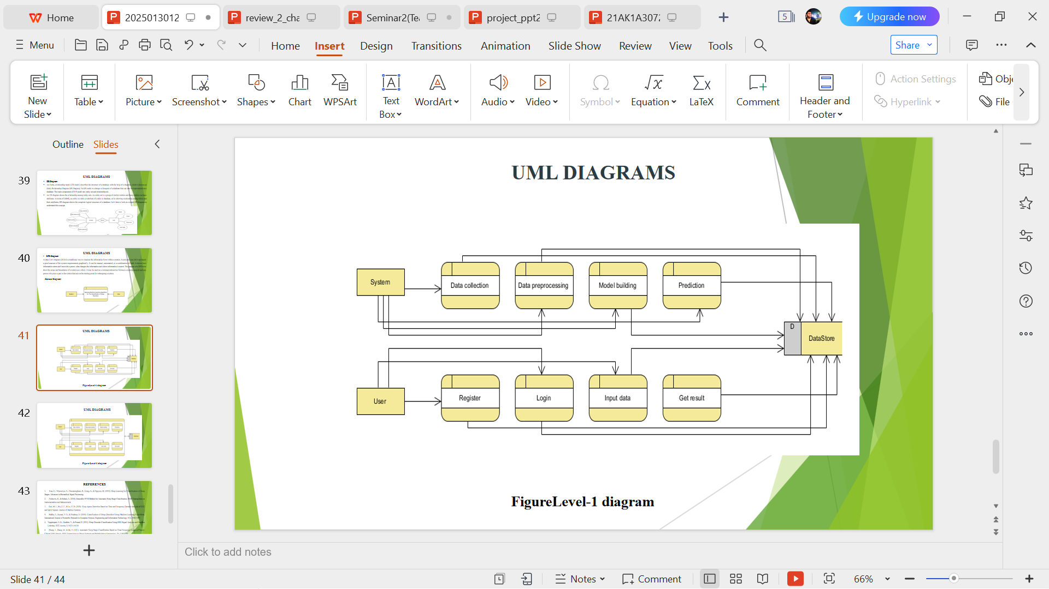
DESIGN
Data Flow Diagram

Slide 13
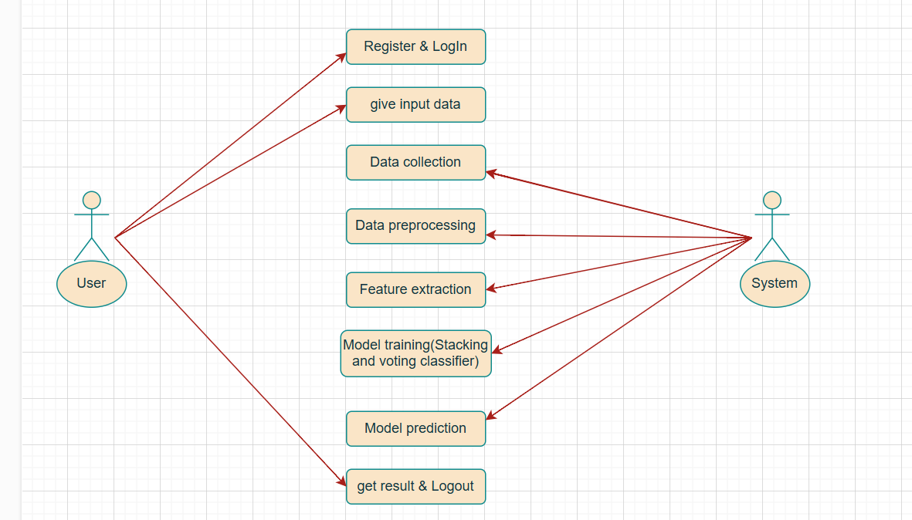
UML DIAGRAMS
USE CASE DIAGRAM

Slide 14
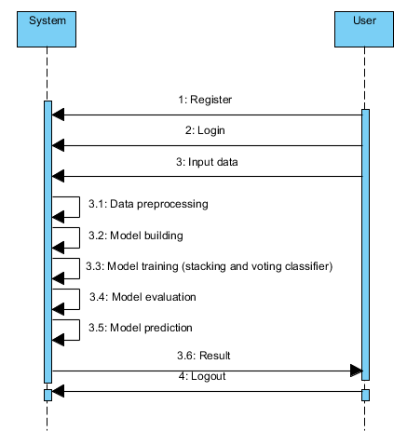
SEQUENCE DIAGRAM

Slide 15
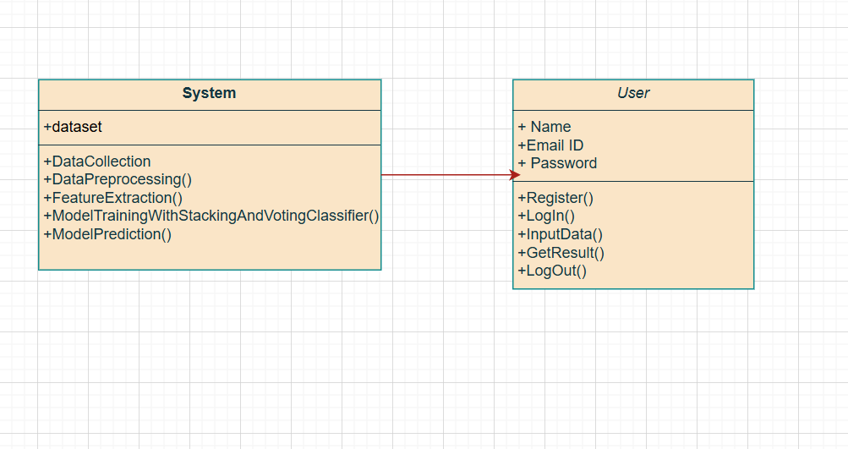
CLASS DIAGRAM

Slide 16
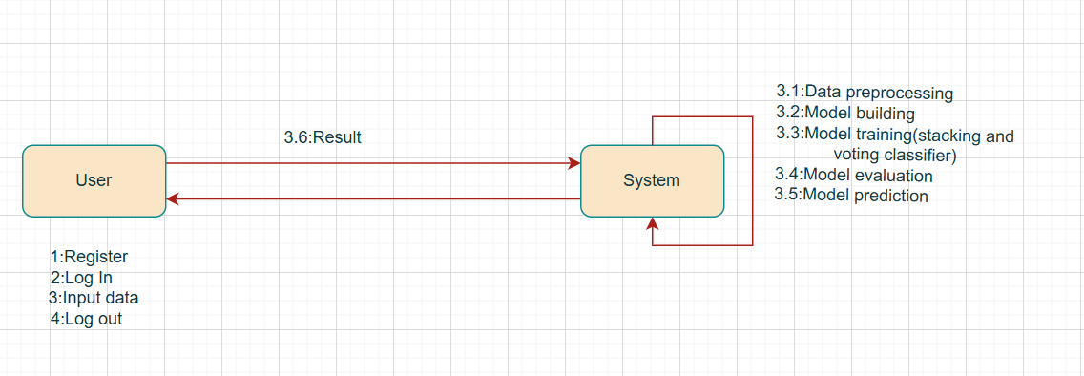
COLLABORATION DIAGRAM

Slide 17
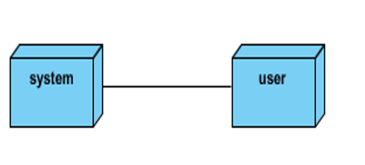
DEPLOYMENT DIAGRAM

Slide 18
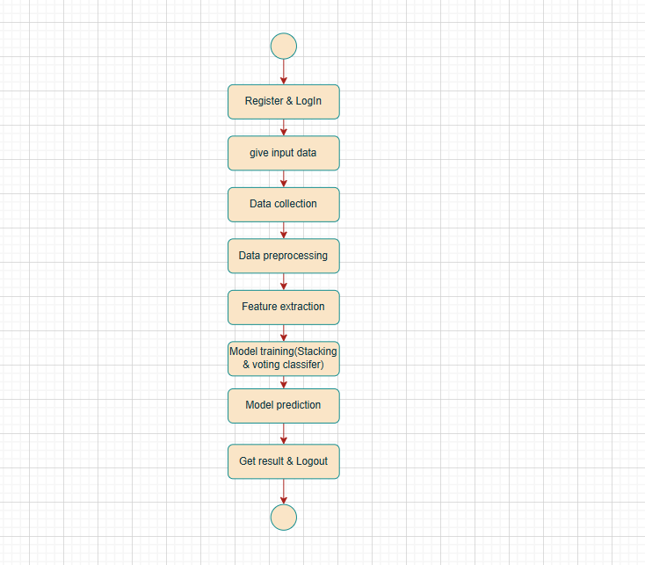
ACTIVITY DIAGRAM

Slide 19
SEMINAR – 2
(IMPLEMENTATION, TESTING & RESULTS)

Slide 20
IMPLEMENTATION

Slide 21
from flask import Flask, url_for, redirect, render_template, request, session
import mysql.connector, os, re
import pandas as pd
import numpy as np
from sklearn.model_selection import train_test_split
from sklearn.preprocessing import StandardScaler,LabelEncoder
from sklearn.metrics import accuracy_score, classification_report
from xgboost import XGBClassifier
from sklearn.ensemble import AdaBoostClassifier
from sklearn.linear_model import LogisticRegression
from sklearn.ensemble import StackingClassifier
from sklearn.metrics import accuracy_score, classification_report
from sklearn.ensemble import VotingClassifier
from sklearn.preprocessing import LabelEncoder
import joblib
from imblearn.over_sampling import SMOTE
import pickle
import numpy as np
import pandas as pd
from sklearn.preprocessing import StandardScaler

Slide 22
@app.route('/prediction', methods=["GET", "POST"])
def prediction():
result = None
if request.method == "POST":
Gender = int(request.form['Gender'])
Age = int(request.form['Age'])
Occupation = int(request.form['Occupation'])
Sleep_Duration = float(request.form['Sleep_Duration'])
Quality_of_Sleep = int(request.form['Quality_of_Sleep'])
Physical_Activity_Level = int(request.form['Physical_Activity_Level'])
Stress_Level = int(request.form['Stress_Level'])
BMI_Category = request.form['BMI_Category']
systolic = int(request.form['systolic'])
diastolic = int(request.form['diastolic'])
Heart_Rate = int(request.form['Heart_Rate'])
Daily_Steps = int(request.form['Daily_Steps'])
# Predict using the stacking classifier model
prediction = stacking_classifier.predict(input_k_best)
# Map prediction to class labels
class_labels = {0: 'No sleeping disorder', 1: 'Sleeping disorder'}
result = class_labels[prediction[0]]

Slide 23
TESTING

Slide 24
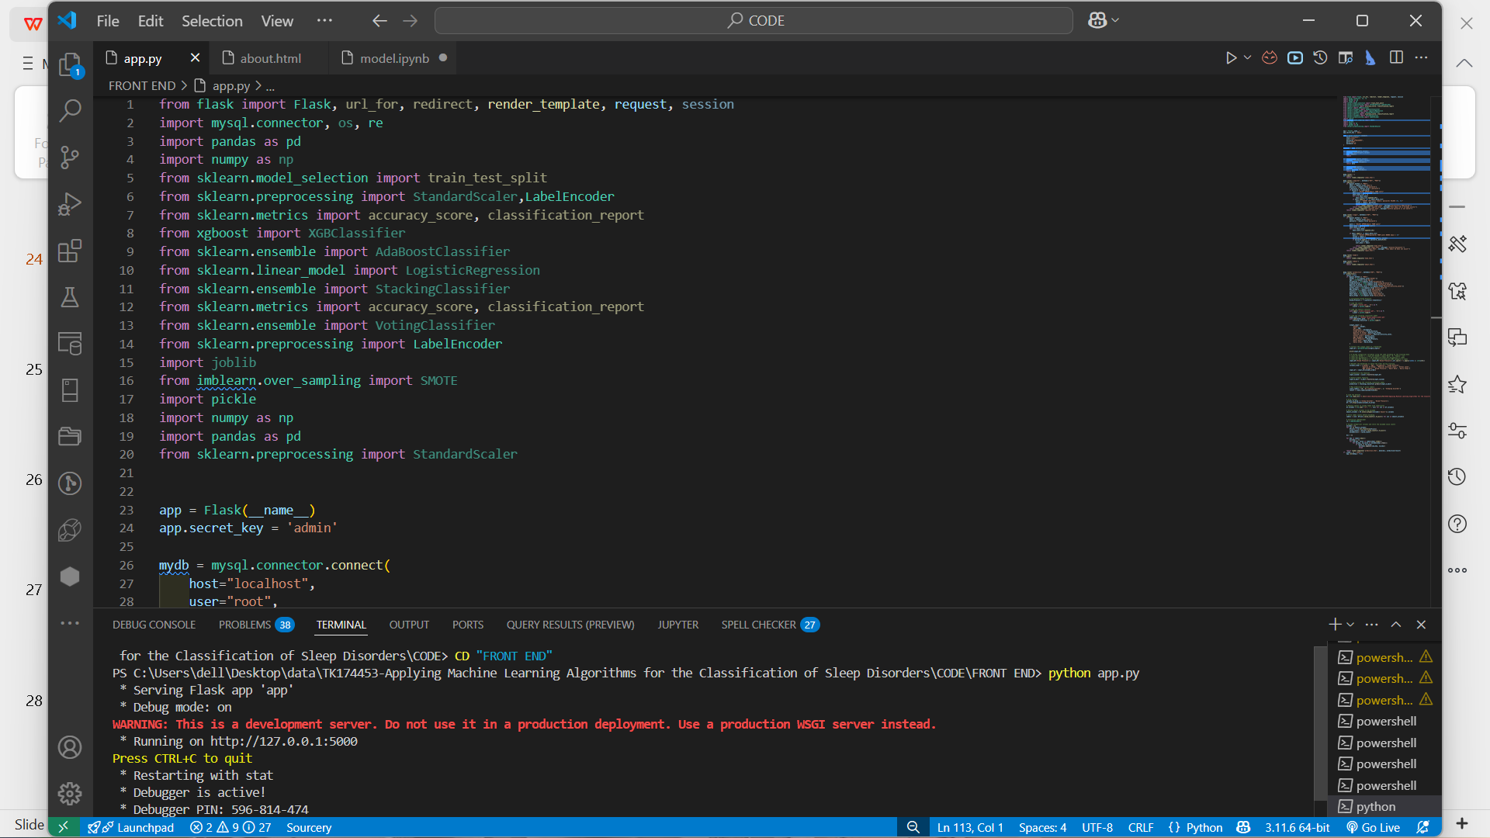
To perform testing open VS Code and select the folder where you have saved the files. Open terminal and type “python -m notebook” to navigate into the browser.

Slide 25
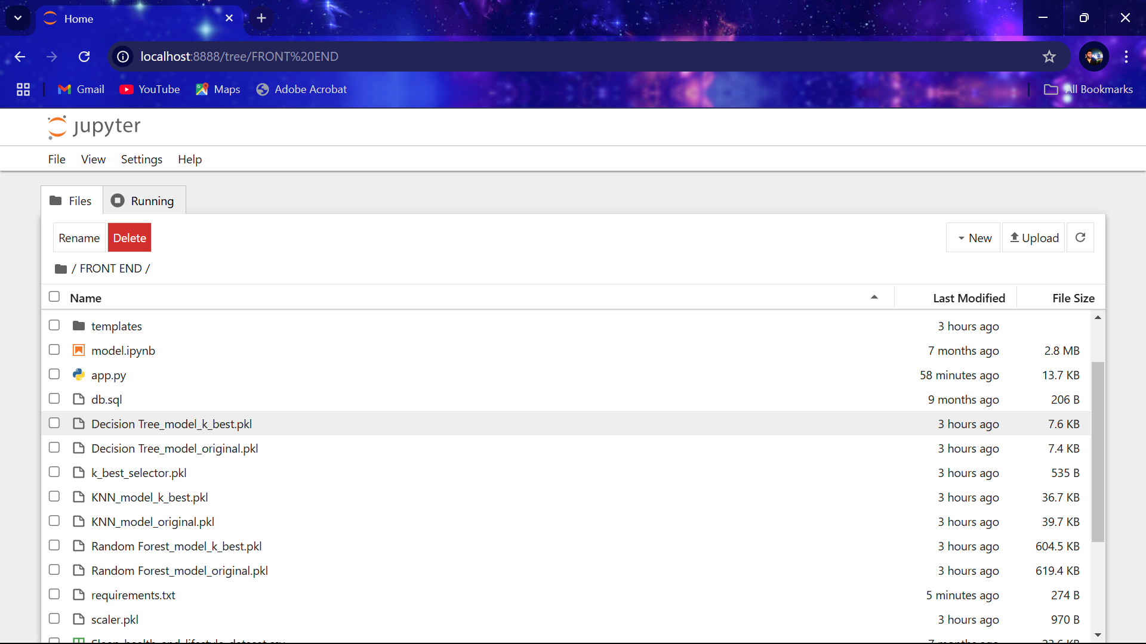
After navigated into the browser select the “.ipynb” file and next select the cell which you have to test. Click on run button to get Accuracy scores of each algorithm.

Slide 26
Next select the cell which you have to test and click on run button to get Accuracy scores of each algorithm.
Testing the data set using the following algorithms:
S. No | Name Of The Algorithm | Accuracy Score(%)
1 | KNN | 92.31
2 | SVM | 91.05
3 | DECISION TREE | 90.91
4 | RANDOM FOREST | 89.31
5 | ANN | 87.30
6 | STACKING CLASSIFIER | 94.32
7 | VOTING CLASSIFIER | 94.28

Slide 27
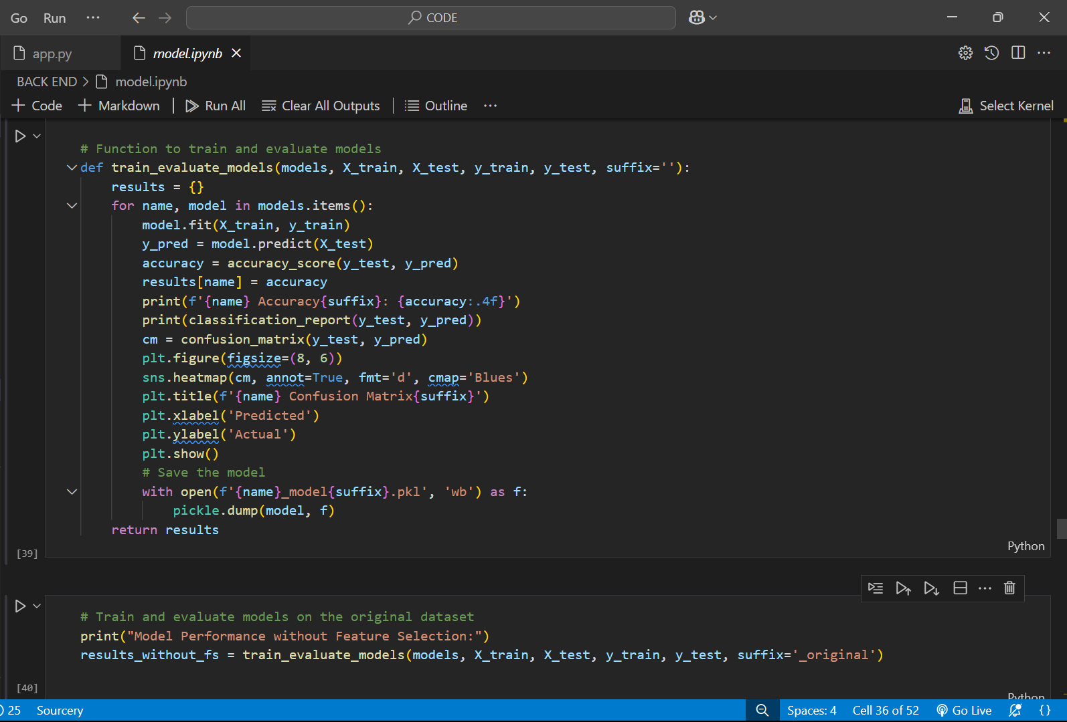
Accuracy Score of Algorithms:

Slide 28
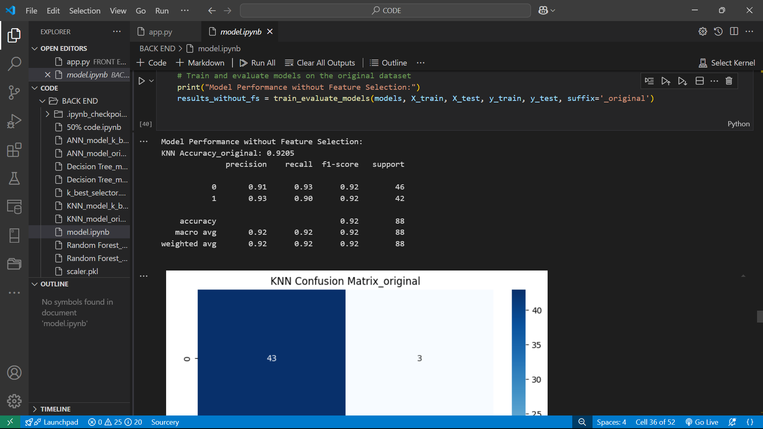
Accuracy Score of KNN Algorithm:

Slide 29
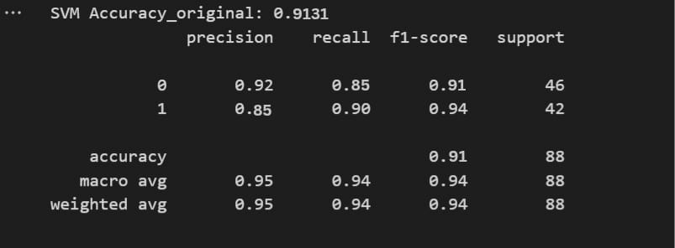
Accuracy Score of SVM Algorithm:

Slide 30
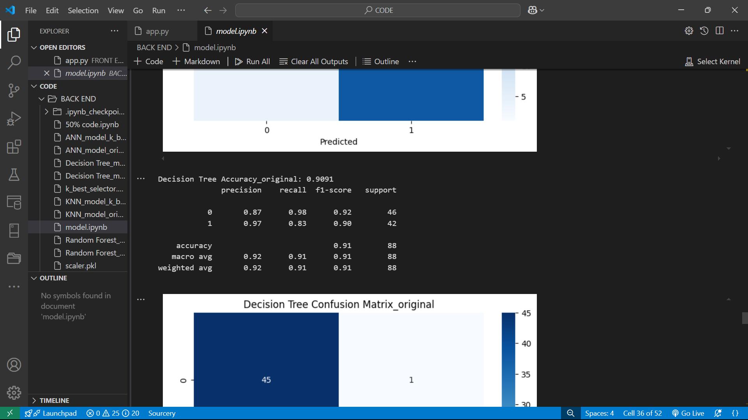
Accuracy Score of Decision Tree Algorithm:

Slide 31
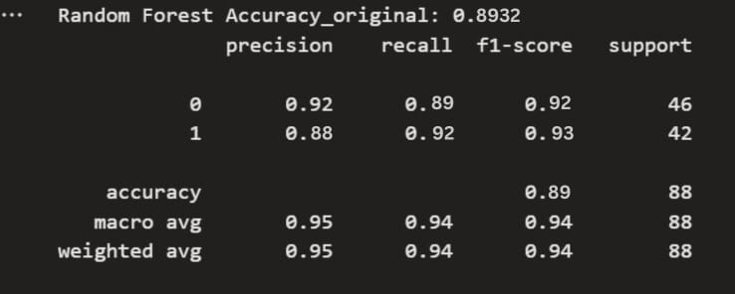
Accuracy Score of Random Forest Algorithm:

Slide 32
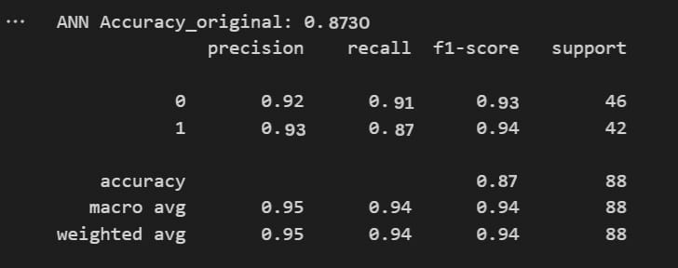
Accuracy Score of ANN Algorithm:

Slide 33
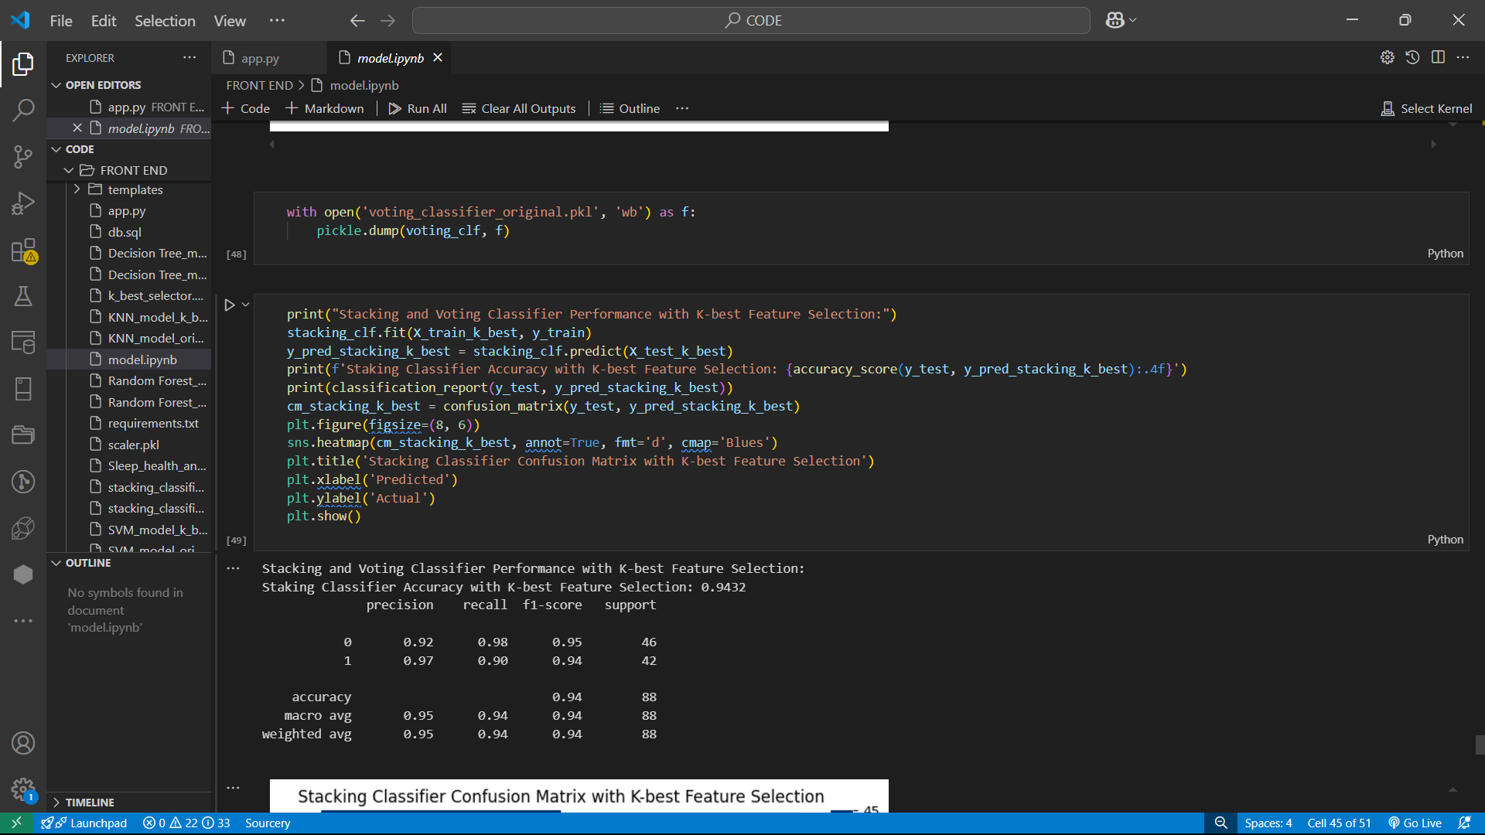
Accuracy Score of Stacking Classifier Algorithm:

Slide 34
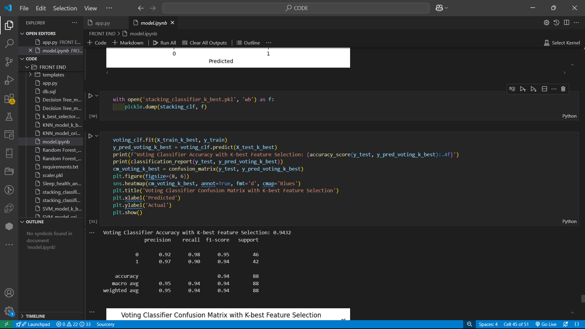
Accuracy Score of voting Classifier Algorithm:

Slide 35
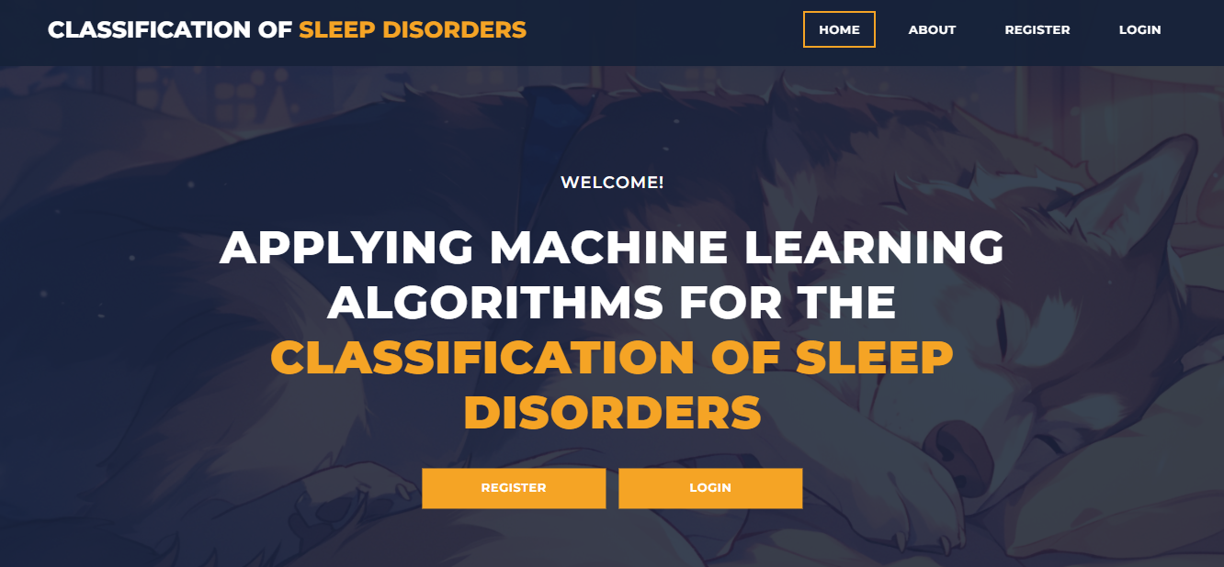
HomePage: The HomePage serves as the landing page of your application. It provides an overview of the project's features, objectives, and benefits. Users can navigate to other sections of the application from this page

Slide 36
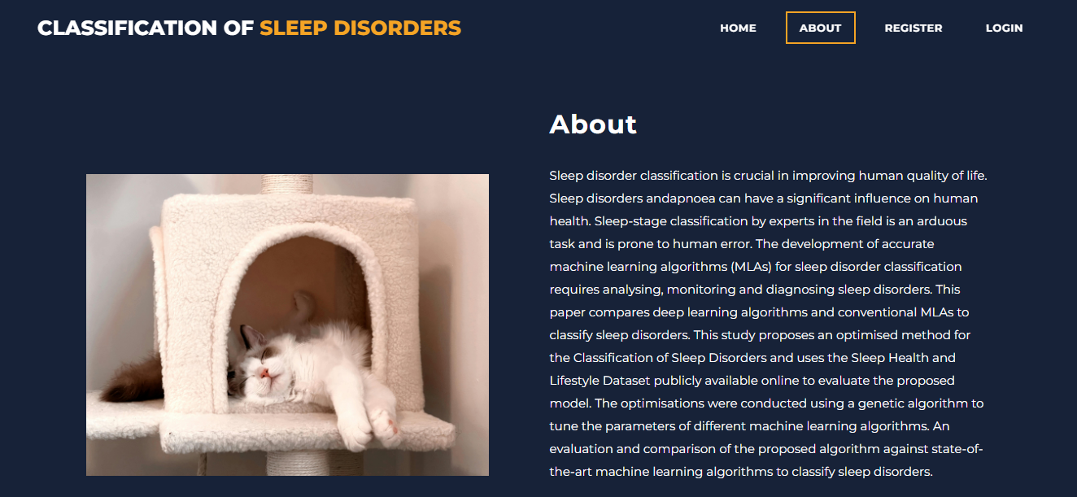
AboutPage: The AboutPage offers detailed information about the project, including its purpose, goals, and the technology used. It provides background information on the problem being addressed and the methods employed.

Slide 37
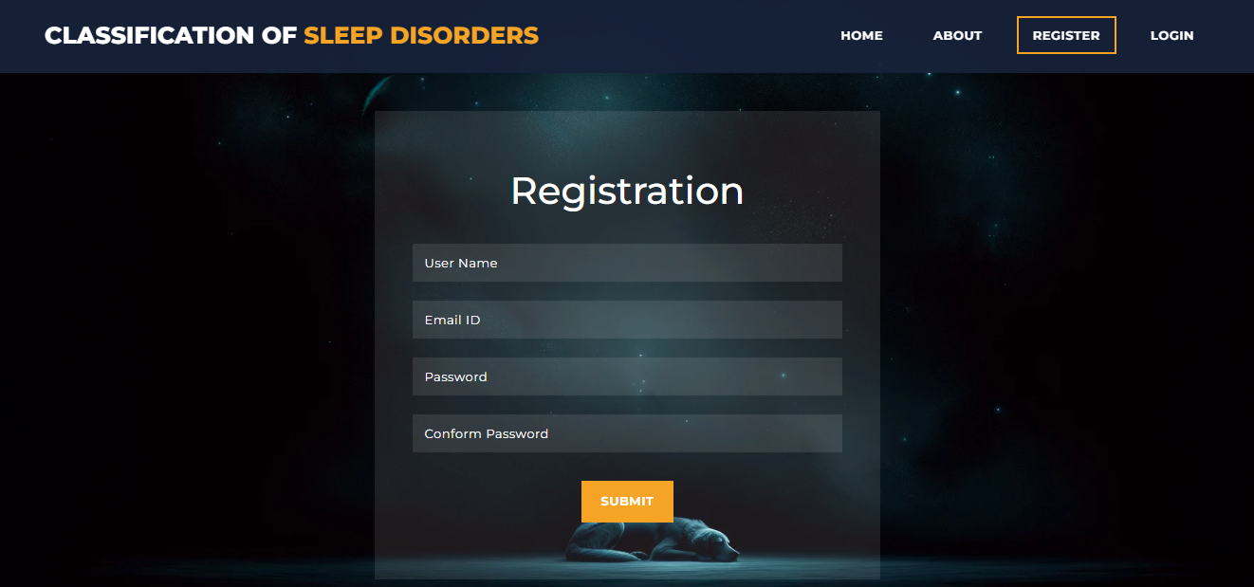
Registration Page: The Registration Page allows new users to create an account with the application. It typically includes fields for entering personal information such as name, email, password, and possibly other details like phone number or address. Users need to fill out this form to gain access to the application's features.

Slide 38
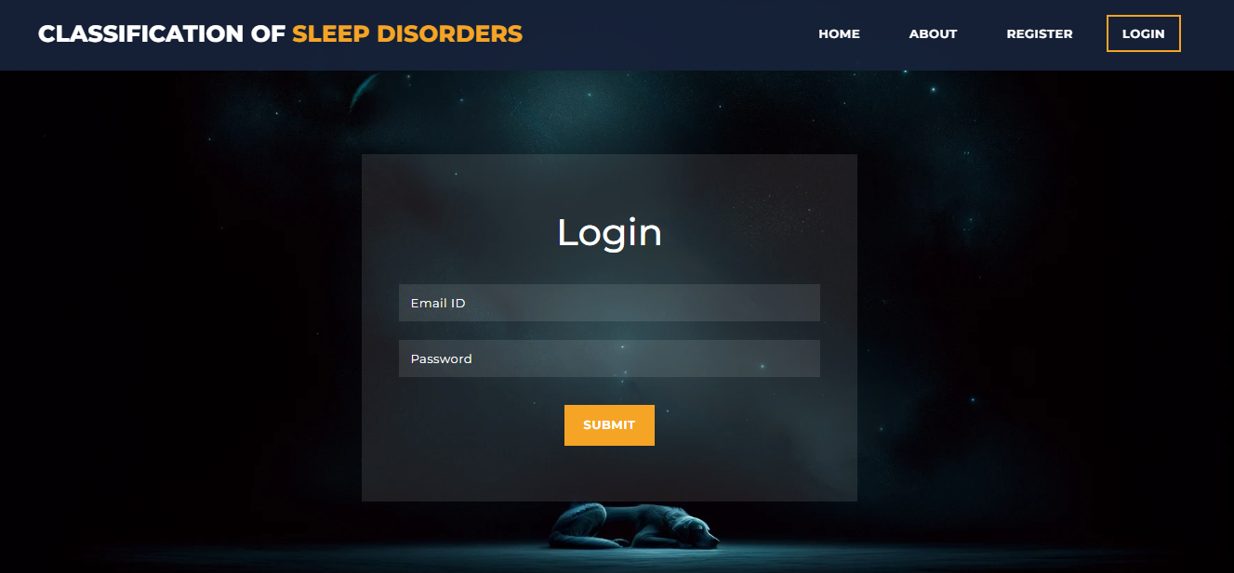
Login Page : The Login Page enables users to access their existing accounts by entering their credentials. It usually includes fields for entering a username/email and password.

Slide 39
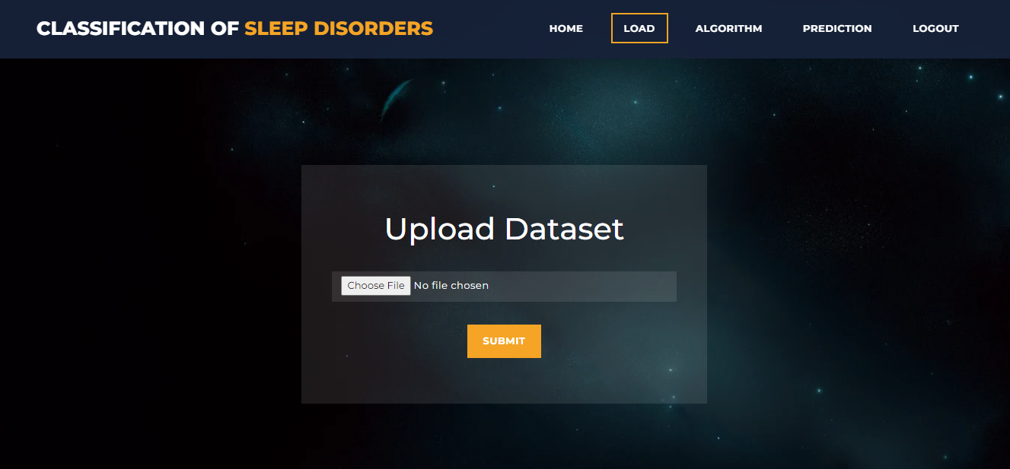
Upload Dataset: Here user can upload the data

Slide 40
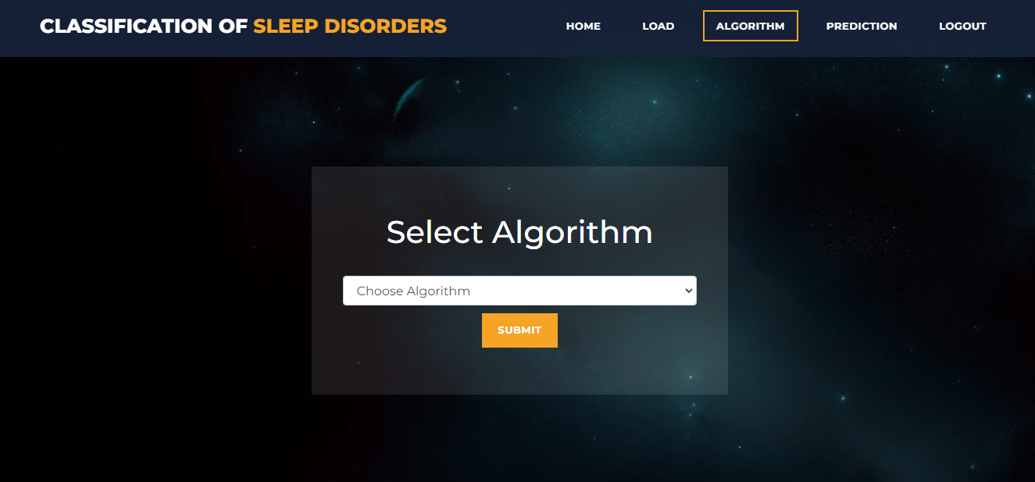
Algorithms:User can selects the algorithms

Slide 41
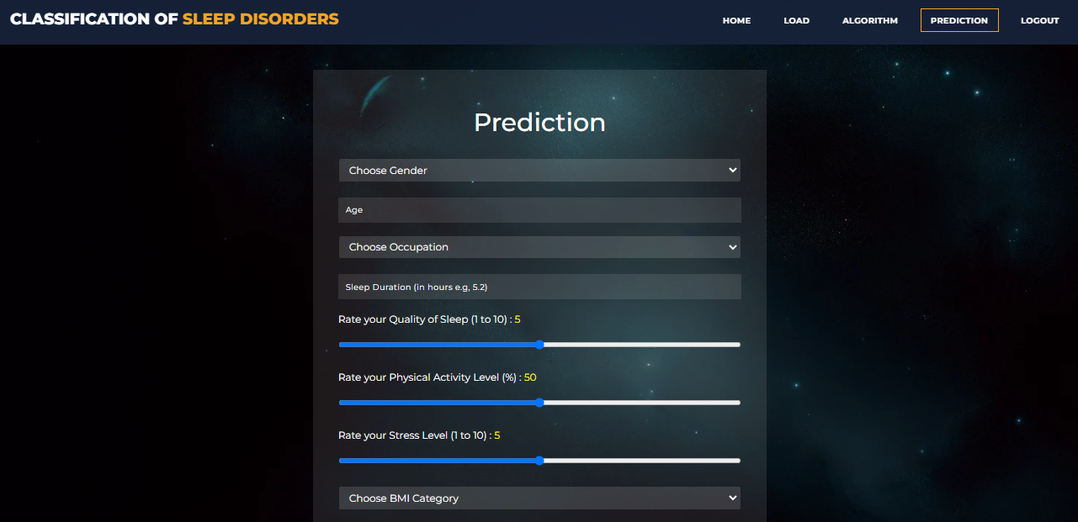
Prediction Page: : The Prediction Page allows users to input data and receive predictions based on the trained machine learning models. This page typically includes a form or interface for uploading or entering data

Slide 42
Conclusion
In this project, an optimized sleep disorder classification model was developed by leveraging machine learning algorithms (MLAs) with stacking and voting classifiers. The proposed approach utilized a combination of MLAs to explore optimal hyperparameter values and achieve improved results. Our study analyzed the performance of various MLAs on a real-world sleep disorder dataset and demonstrated their ability to learn from high-dimensional sleep data without relying on expert-defined features. The proposed optimized model achieved a high accuracy of [insert accuracy percentage], with precision, recall, and F1-score values of [insert respective percentages]. Despite limitations in data quantity, this study addressed challenges in implementing MLAs for sleep disorder classification. Future work will focus on exploring unsupervised learning techniques, assessing new models, and comparing their performance against existing state-of-the-art models to further improve sleep disorder classification accuracy.

Slide 43
REFERENCES
1. ALICKOVIC, E & SUBASI, A. (2018): Ensemble SVM Method for Automatic Sleep Stage Classification. IEEE Transactions on Instrumentation and Measurement.
2. TRAN, C., WIJESYRIYA, Y., THURAISINGHAM, R., CRAIG, A., & NGUYEN, H. (2019): Deep Learning for Classification of Sleep Stages. Advances in Biomedical Signal Processing.
3. SUN, M. J., WU, Z. F., & LU, X. B. (2020): Sleep Apnea Detection Based on Time and Frequency Domain Analysis of ECG and SpO2 Signals. Journal of Medical Systems.
4. VUPPALAPATHI, A. K., GUDDETI, V., & PRASAD, P. (2021: Sleep Disorder Classification Using EEG Signal Analysis and Machine Learning. IEEE Access, 9, 54321-54330.
5. RADHA, T., KUMAR, V. S., & PRADEEP, S. (2023): Classification of Sleep Disorders Using Machine Learning Algorithms. International Journal of Scientific Research in Computer Science, Engineering and Information Technology, 4(3), 2456-3307.

Slide 44
Any Questions?

Slide 45
Thanking You

