Slide 1



Dashboard
View in Power BI
Last data refresh:
7/12/2026 8:34:11 AM UTC
Downloaded at:
7/12/2026 8:40:51 AM UTC

Slide 2
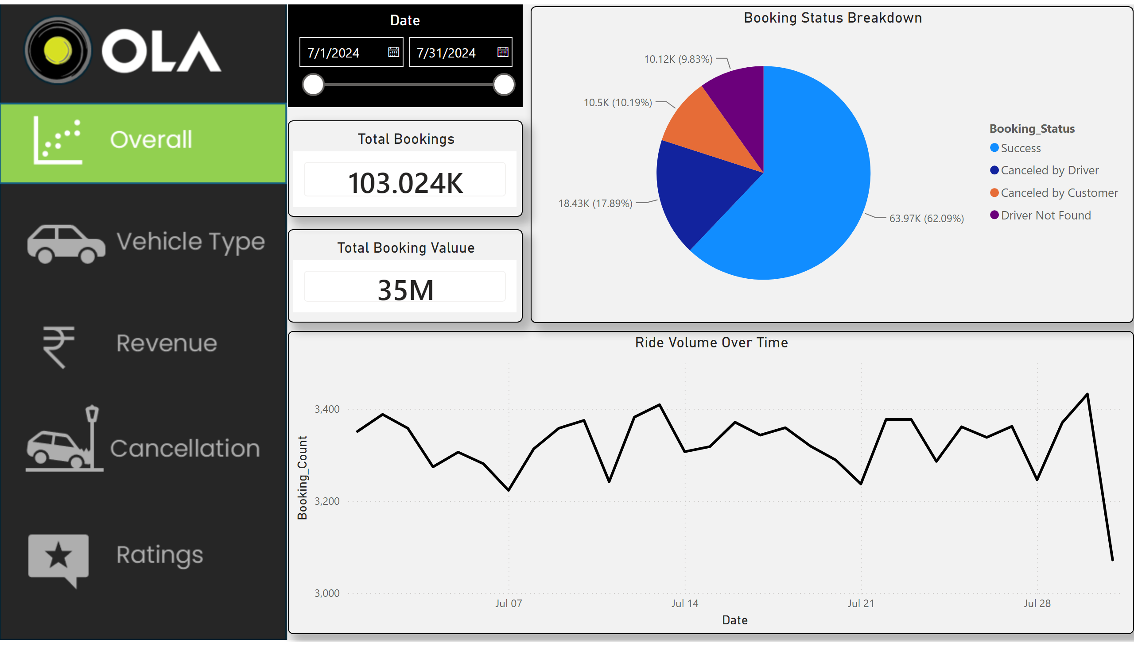
Overall
Notes:
actionButton
No alt text provided
actionButton
No alt text provided
actionButton
No alt text provided
actionButton
No alt text provided
Ride Volume Over Time
No alt text provided
Booking Status Breakdown
No alt text provided
Date
No alt text provided
Total Bookings
No alt text provided
Total Booking Valuue
No alt text provided

Slide 3
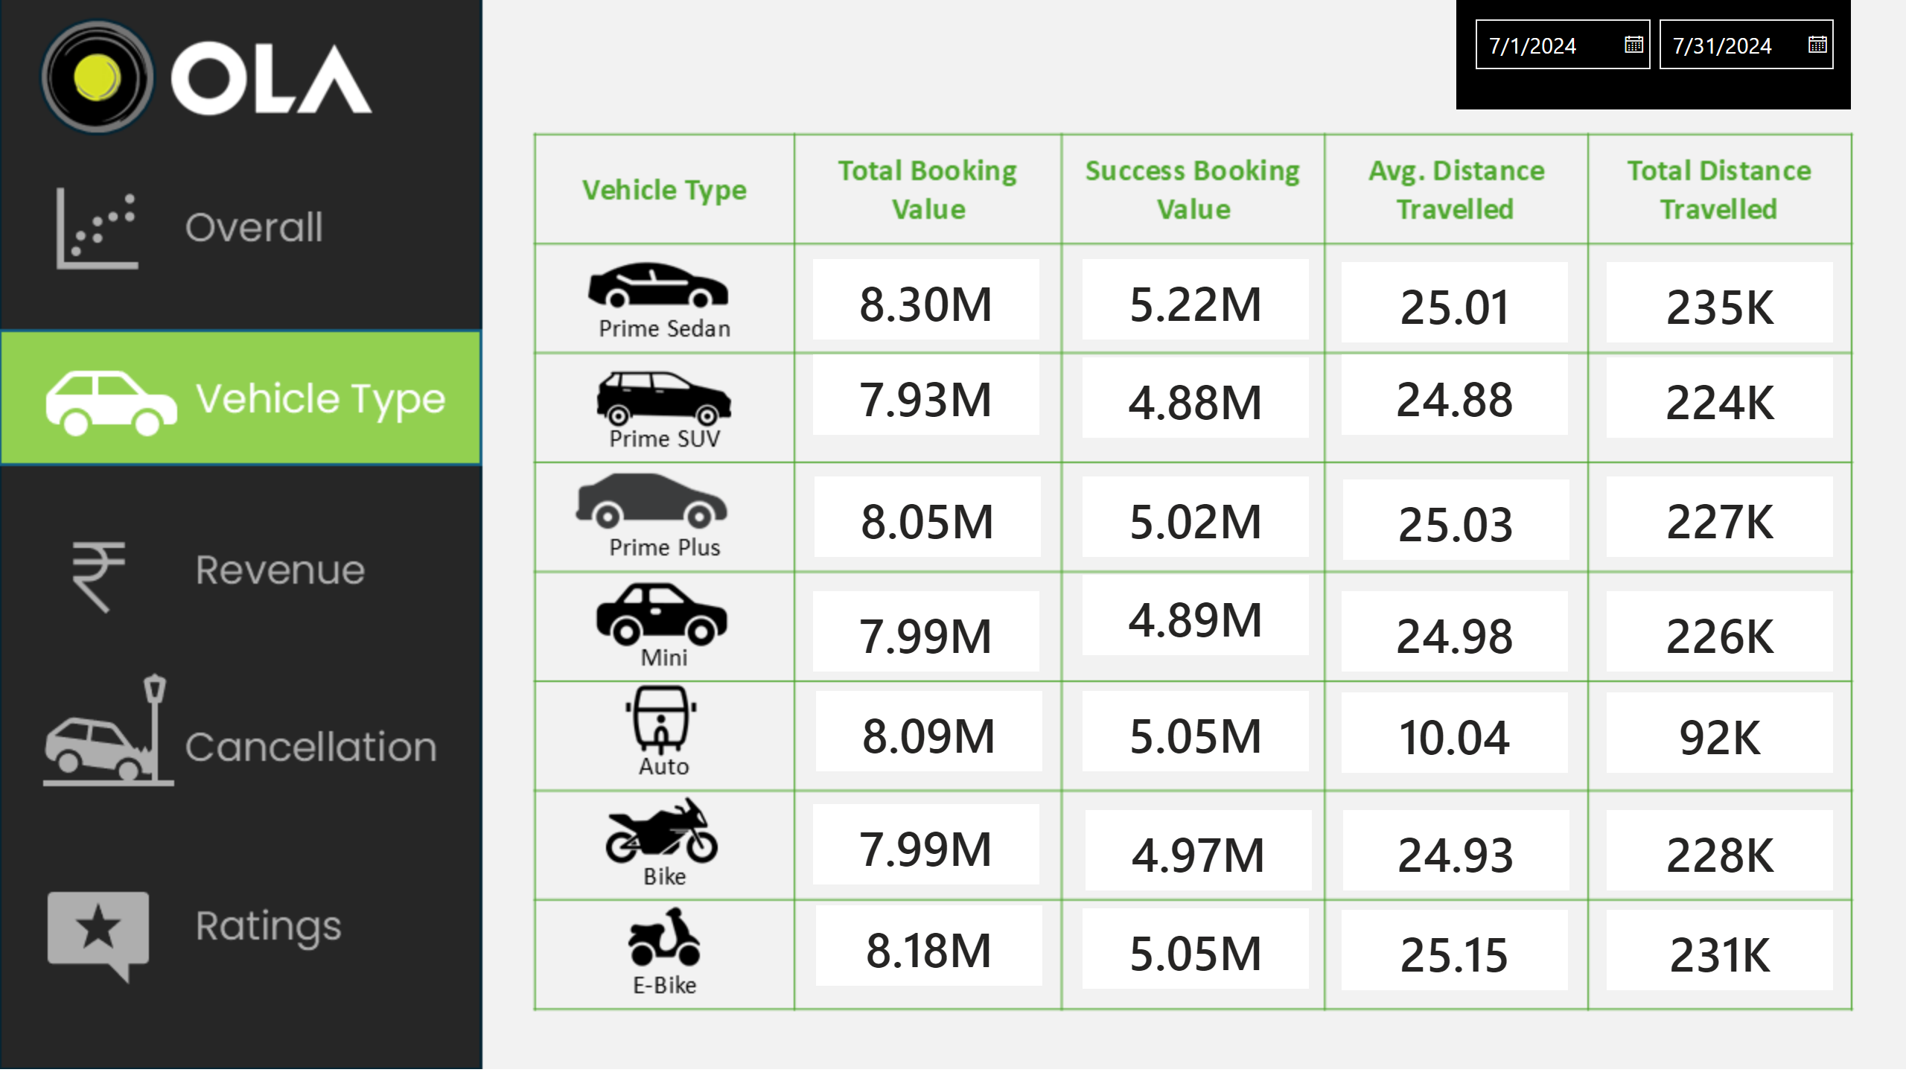
Vehicle Type
Notes:
actionButton
No alt text provided
actionButton
No alt text provided
actionButton
No alt text provided
actionButton
No alt text provided
cardVisual
No alt text provided
cardVisual
No alt text provided
cardVisual
No alt text provided
cardVisual
No alt text provided
cardVisual
No alt text provided
cardVisual
No alt text provided
cardVisual
No alt text provided
cardVisual
No alt text provided
cardVisual
No alt text provided
cardVisual
No alt text provided
cardVisual
No alt text provided
cardVisual
No alt text provided
cardVisual
No alt text provided
cardVisual
No alt text provided
cardVisual
No alt text provided
cardVisual
No alt text provided
cardVisual
No alt text provided
cardVisual
No alt text provided
cardVisual
No alt text provided
cardVisual
No alt text provided
cardVisual
No alt text provided
cardVisual
No alt text provided
cardVisual
No alt text provided
cardVisual
No alt text provided
cardVisual
No alt text provided
cardVisual
No alt text provided
cardVisual
No alt text provided
cardVisual
No alt text provided
Date
No alt text provided

Slide 4
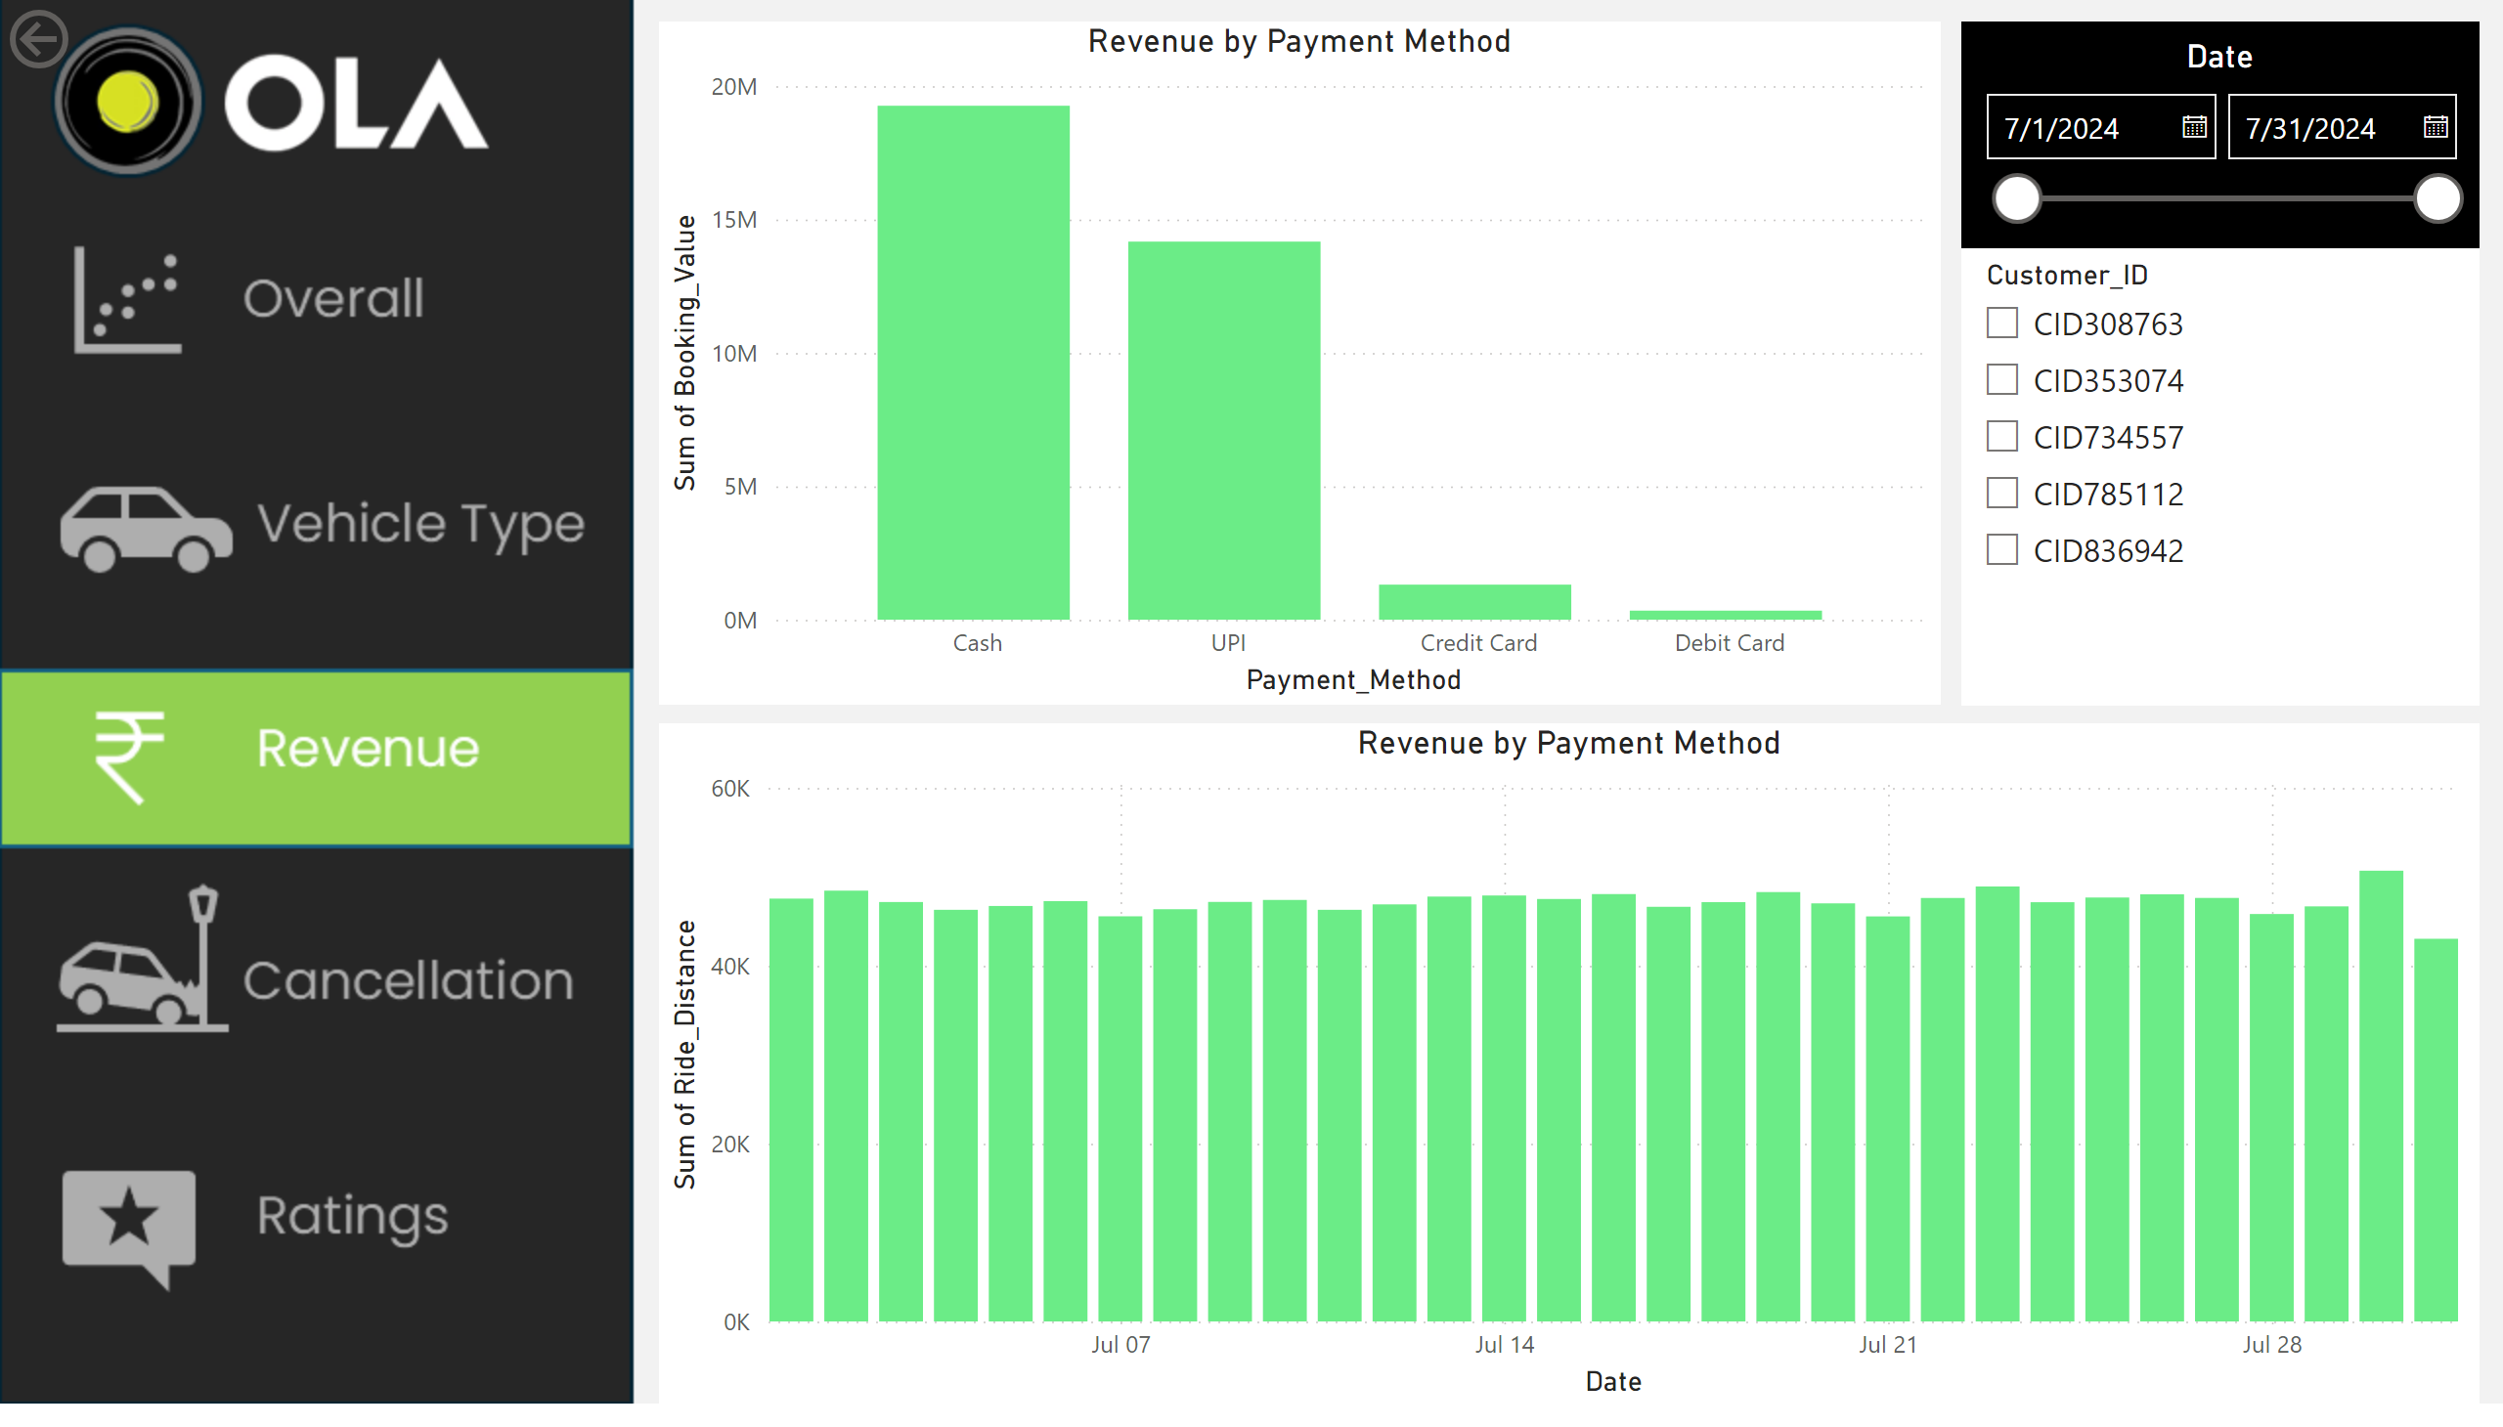
Revenue
Notes:
actionButton
No alt text provided
actionButton
No alt text provided
actionButton
No alt text provided
actionButton
No alt text provided
Revenue by Payment Method
No alt text provided
Revenue by Payment Method
No alt text provided
Date
No alt text provided
slicer
No alt text provided
actionButton
No alt text provided

Slide 5
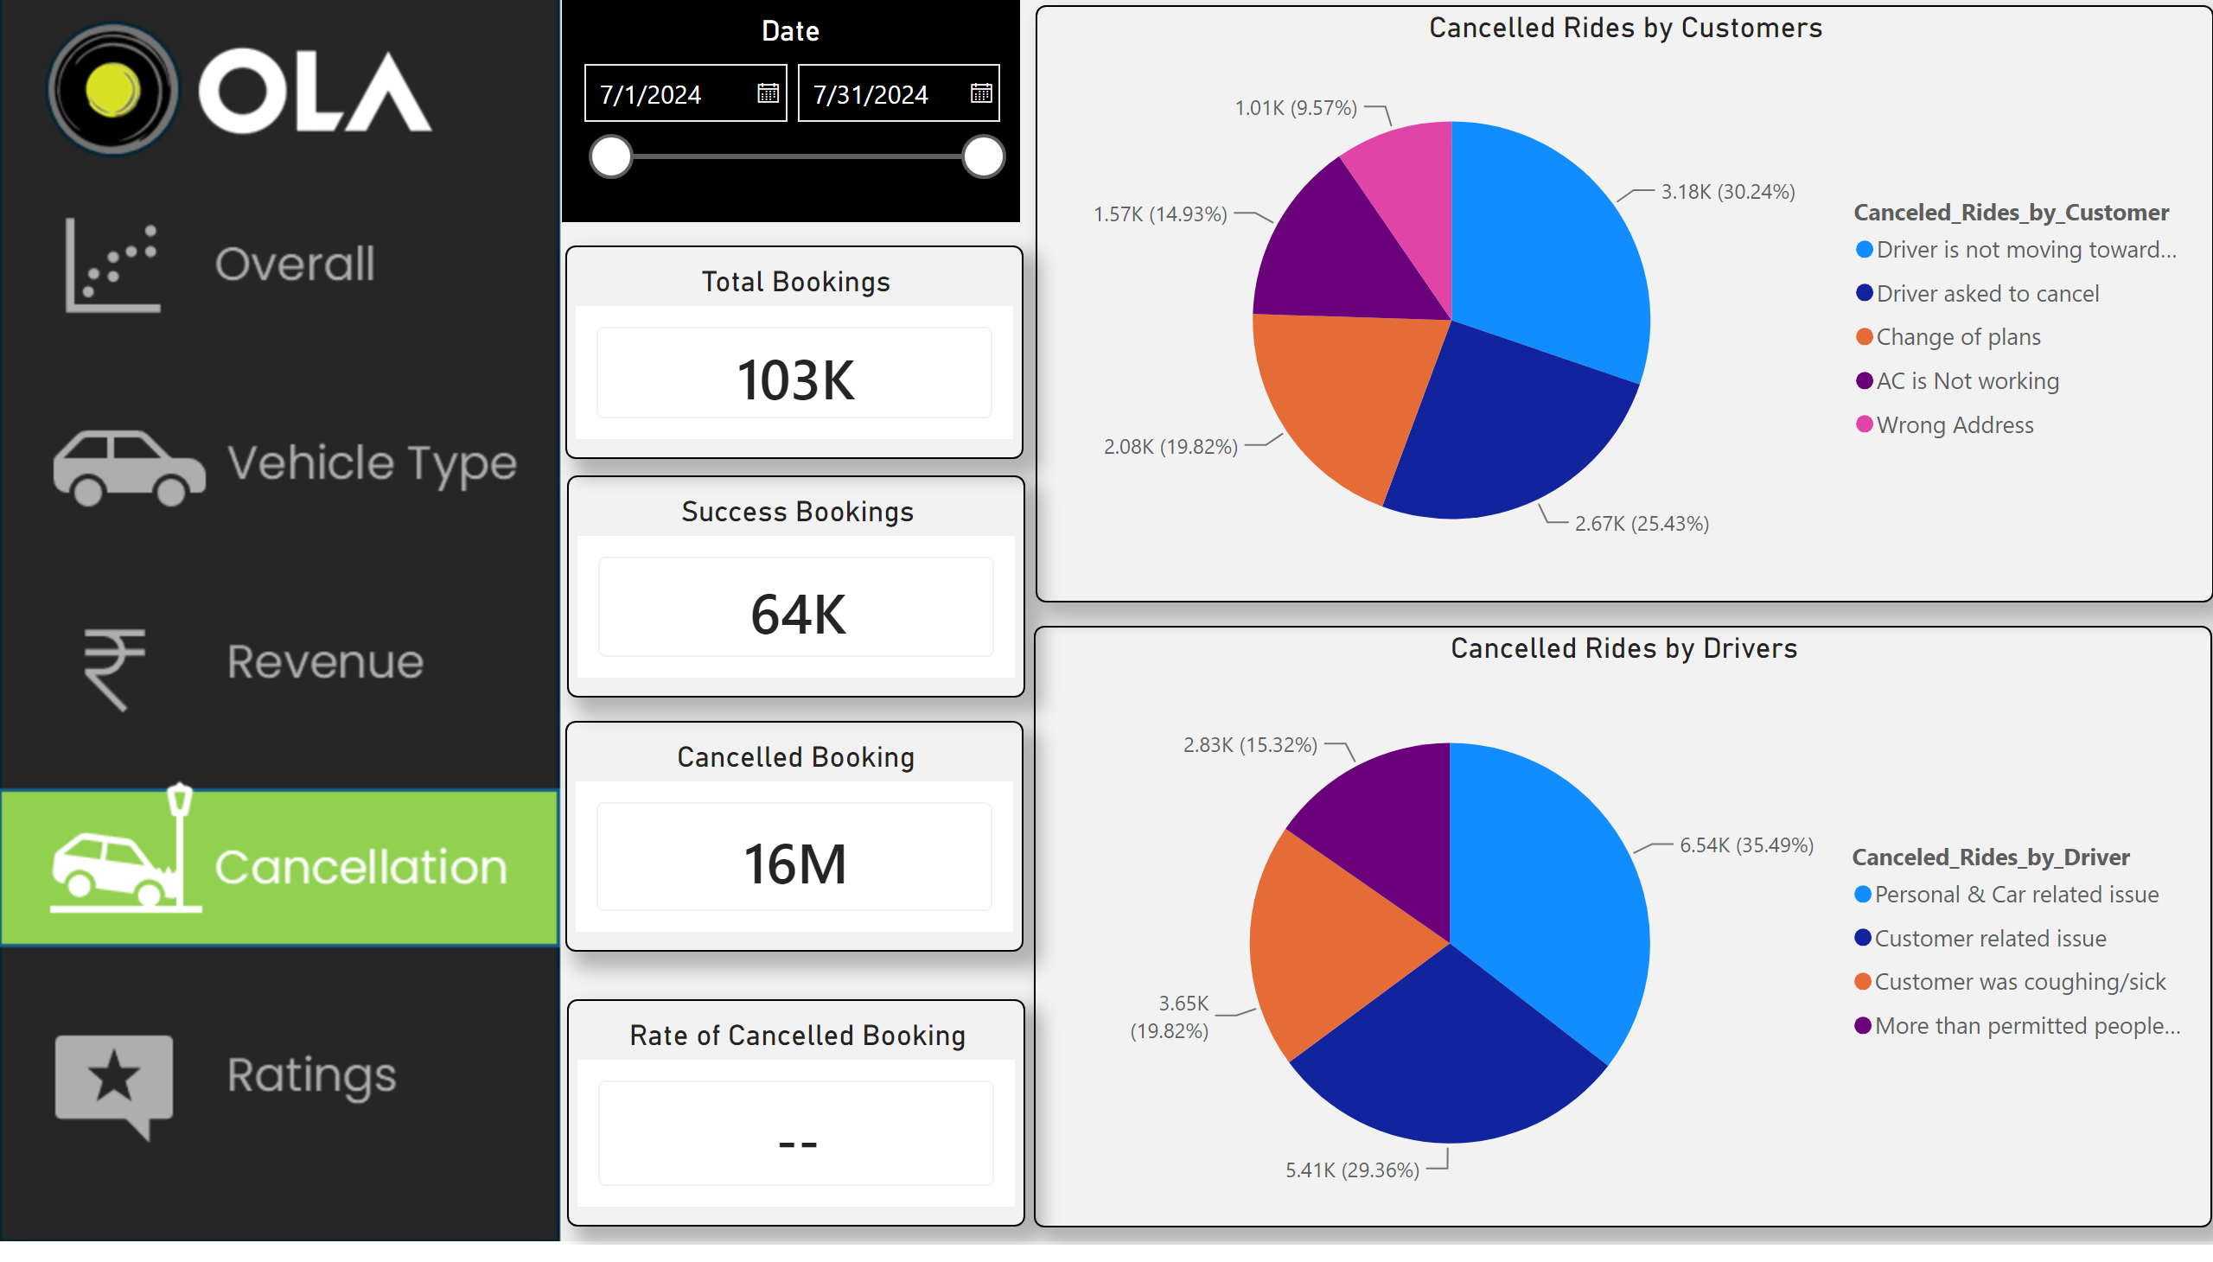
Cancellation
Notes:
actionButton
No alt text provided
actionButton
No alt text provided
actionButton
No alt text provided
actionButton
No alt text provided
Cancelled Rides by Customers
No alt text provided
Cancelled Rides by Drivers
No alt text provided
Date
No alt text provided
Total Bookings
No alt text provided
Cancelled Booking
No alt text provided
Success Bookings
No alt text provided
Rate of Cancelled Booking
No alt text provided

Slide 6
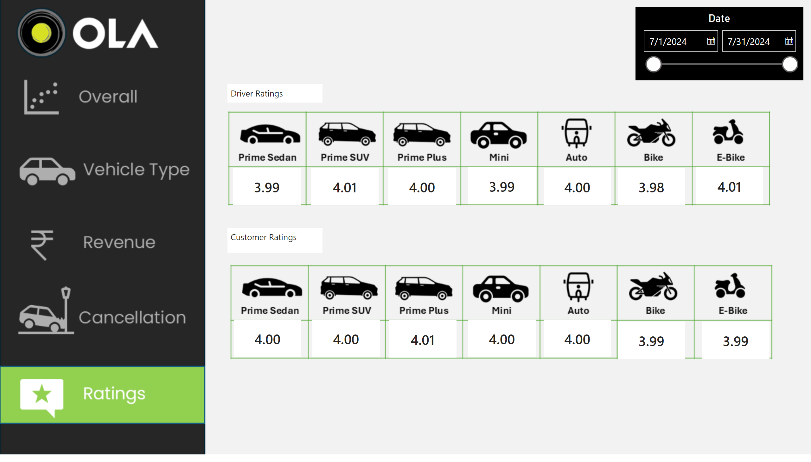
Ratings
Notes:
actionButton
No alt text provided
actionButton
No alt text provided
actionButton
No alt text provided
actionButton
No alt text provided
cardVisual
No alt text provided
cardVisual
No alt text provided
cardVisual
No alt text provided
cardVisual
No alt text provided
cardVisual
No alt text provided
cardVisual
No alt text provided
cardVisual
No alt text provided
textbox
No alt text provided
textbox
No alt text provided
cardVisual
No alt text provided
cardVisual
No alt text provided
cardVisual
No alt text provided
cardVisual
No alt text provided
cardVisual
No alt text provided
cardVisual
No alt text provided
cardVisual
No alt text provided
Date
No alt text provided

