Slide 1
Technology Solutions Analyst Intern Role.
Performance-based screening
Submitted by :
Sudeep Ravindra Bedmutha
Graduate Student in Data Analytics
Major in Applied Machine Intelligence.

Slide 2
Overview of the Article
Clinical Decision Making and Pattern Recognition in Health Care
Focus on Clinical Decision-Making:
Explores how healthcare professionals use data and insights to make informed decisions.
Emphasizes the role of pattern recognition in identifying trends in patient data to aid decision-making.
Key Technologies Discussed:
Chain Reasoning: Step-by-step decision-making, linking symptoms and test results logically to improve care.
Agentic Generative AI: AI that autonomously creates personalized treatment plans based on patient data.
Classification and Prediction: Organizes patient data into categories and predicts outcomes such as disease progression or treatment responses.
Inference and Clustering: Helps healthcare providers draw conclusions from data and group similar data points to enhance diagnoses.
Time-Series Anomaly Detection: Monitors patient data (e.g., heart rate, blood pressure) over time to detect irregular patterns that may indicate health issues.

Slide 3
Overview of the Article
Opportunities in Healthcare:
Technologies improve accuracy and efficiency in healthcare.
Personalized treatment plans are tailored to individual patient needs.
Early detection of issues reduces healthcare costs by preventing expensive interventions.
Threats and Ethical Concerns:
Over-reliance on AI may lead to mistakes in decision-making.
Biases in AI systems could result in unfair treatment for certain patient groups.
Strategic Recommendations for Cotiviti:
Invest in AI tools that assist healthcare providers in making better, more informed decisions.
Partner with hospitals and tech companies to create specialized solutions for healthcare challenges.

Slide 4
Demonstrator Prototype Predicting Hospital Length of Stay Using Machine Learning
Problem Statement:
Hospitals face challenges in efficiently allocating resources due to unpredictable patient stays.
Predicting the length of stay (LOS) can help optimize hospital operations.
Goal:
Build a predictive model to estimate hospital length of stay based on patient data.

Slide 5
Data Overview
Data Source:
Patient demographics, medical history, treatment details.
Key Features:
Age, gender, diagnosis, comorbidities, treatment received, admission type.
Target Variable:
Length of Stay (LOS) in days.

Slide 6
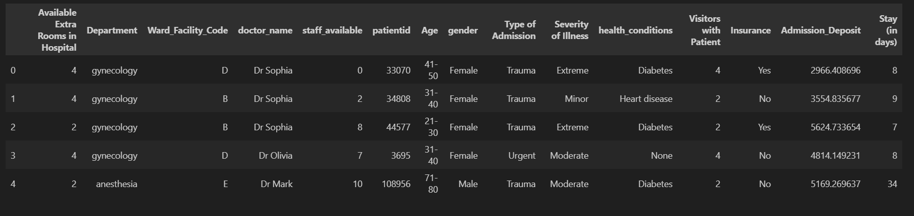
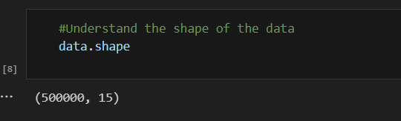
Data Overview

Slide 7
Data Preprocessing
Steps Taken:
Handling missing data, encoding categorical variables, scaling numerical features.
Feature Engineering:
New features based on medical history or treatment patterns.

Slide 8
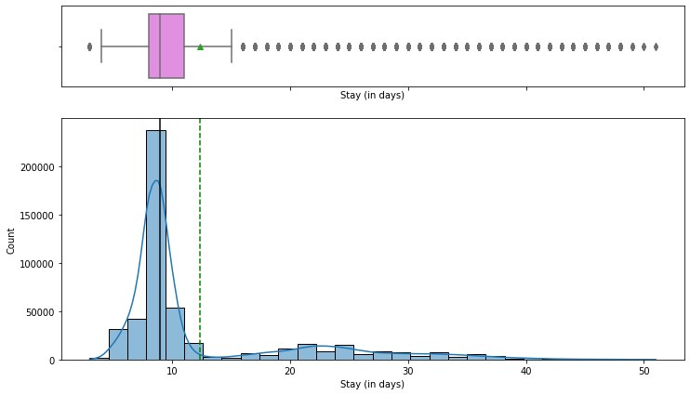
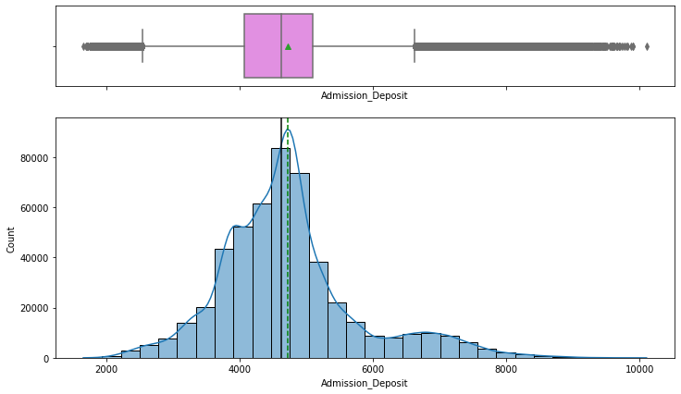
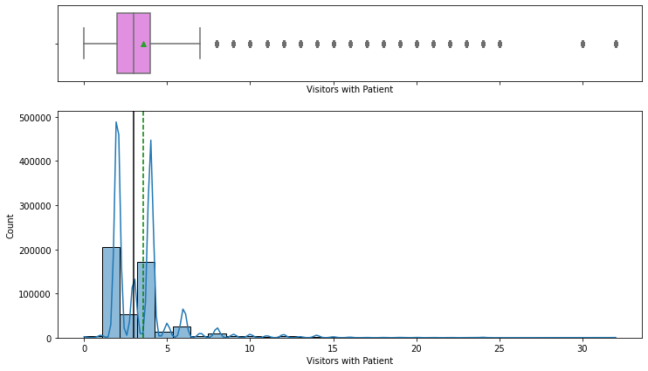
Length of Stay
Admission Deposit
Visitors with Patient.

Slide 9
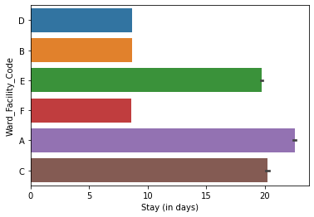
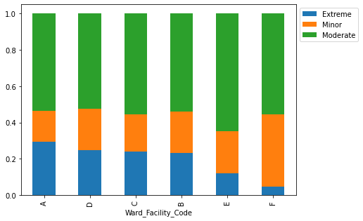
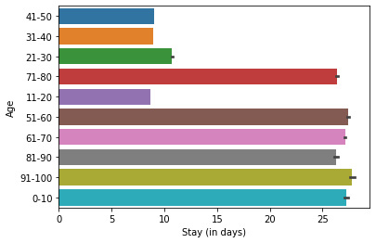
Distribution of LOS from various Wards
Distribution of Serios Patients wrt to wards
Distribution of LOS across various ages

Slide 10
Model Selection
Models Tested:
Linear Regression, Random Forest, Gradient Boosting.
Evaluation Metrics:
Mean Absolute Error (MAE), Root Mean Squared Error (RMSE), R-squared.

Slide 11
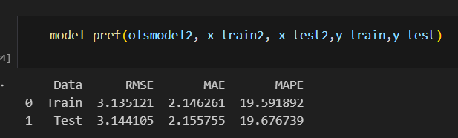
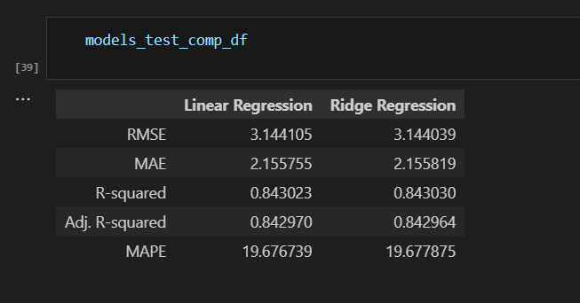
Checking Performance of Model wrt to train and test dataset
RMSE, MAE, and MAPE of train and test data are not very different, indicating that the model is not overfitting and has generalized well
Comparison of all the models

Slide 12
REFERENCE
Amisha, Malik, P., Pathania, M., & Rathaur, V. K. (2019). Overview of artificial intelligence in medicine. Journal of Family Medicine and Primary Care, 8(7), 2328-2331. https://doi.org/10.4103/jfmpc.jfmpc_440_19
Esteva, A., Chou, K., Yeung, S., Naik, N., Madani, A., Mottaghi, A.& Dean, J. (2021). Deep learning-enabled medical computer vision. NPJ Digital Medicine, 4(1), 1-9. https://doi.org/10.1038/s41746-020-00376-2
Yu, K. H., Beam, A. L., & Kohane, I. S. (2018). Artificial intelligence in healthcare. Nature Biomedical Engineering, 2(10), 719-731. https://doi.org/10.1038/s41551-018-0305-z

