Slide 1
Store Item Sales Demand Forecast
Machine Learning Project
By - Sudeep Raj

Slide 2
1. Problem Statement
2. EDA
3. Model Training and forecasting
4. Conclusion
AGENDA

Slide 3
Problem Statement
Build a model to forecast the sales in store.
The data is classified in date/time and the store, item and sales.

Slide 4
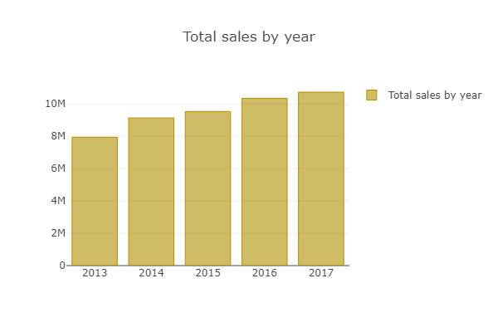
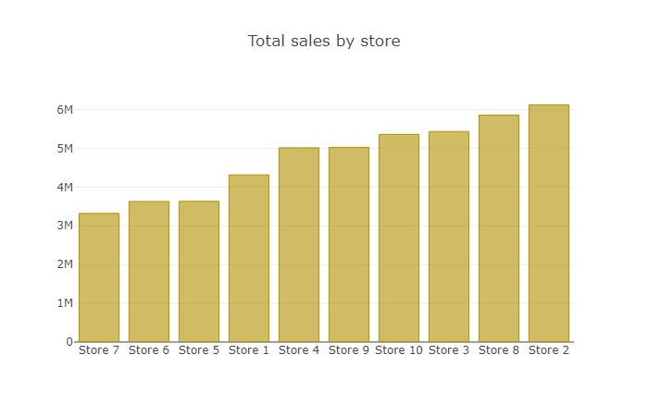
EDA
Total sales by Year
Total sales by Store

Slide 5
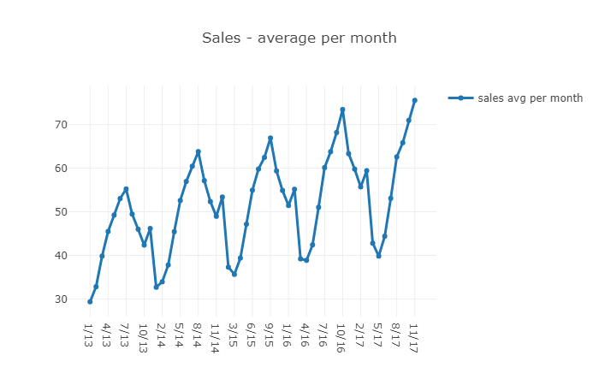
Time series model

Slide 6
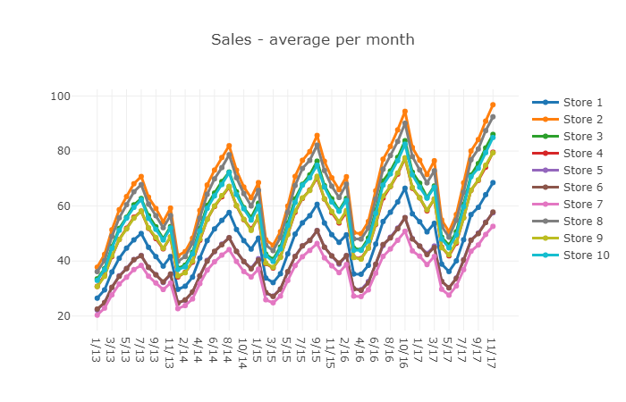
Thank you!!!

Slide 7
Model Training and forecasting
Stationarity Check
Decomposition
Data Transformation to achieve Stationarity
Plotting ACF & PACF
Building ARIMA Model

Slide 8
Conclusion
We have used Sales 1 : Items 1 data for forecasting.
Used ARIMA model to predict best p, q, d values ie, ARIMA(6, 0, 1) AIC=601.196
With the help of ACF and PACF plotting monitored in Autocorrelation graph and Partial Autocorrelation graph at every 7 point we can see recurring pattern.

Slide 9
Thank you!!!

