Slide 1
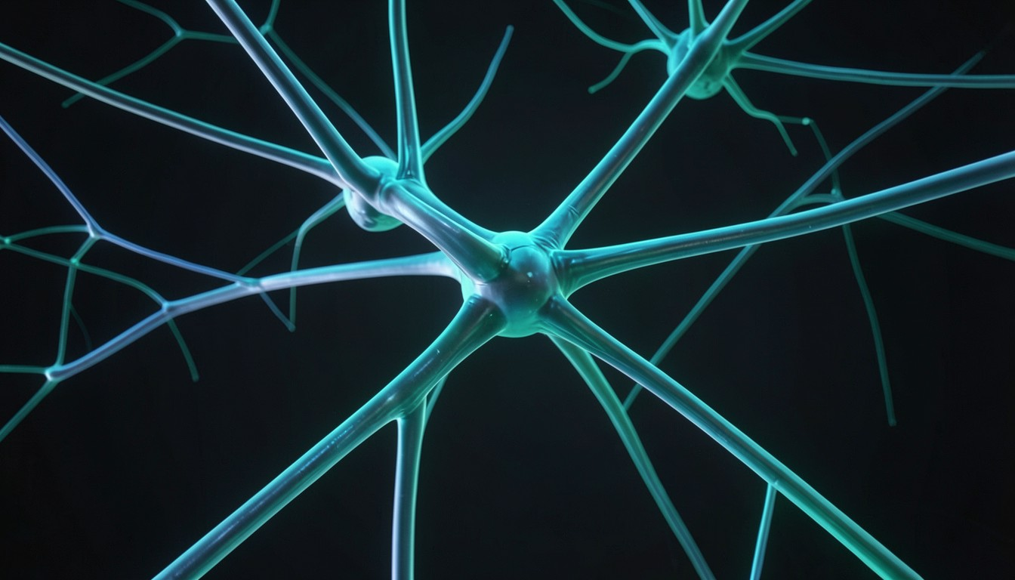
EXECUTIVE
Precision Neural Decoding
Deep learning transforms brain signal interpretation for clinical impact
SlideCraft AI Studio • Executive Presentation
Notes:
Introduce the strategic advantage of DL for precise, actionable neural insights that accelerate clinical decision-making.

Slide 2
LIMITATIONS
Existing Decoding Gaps
Traditional methods miss temporal dynamics and patient variability
01
02
03
Low signal-to-noise ratio in chronic recordings
Feature engineering bottlenecks impede scalability
Static classifiers ignore neuroplastic changes
CONFIDENTIAL & PROPRIETARY
2 / 8
Notes:
Highlight why current approaches fall short, setting the stage for DL solutions.

Slide 3
ARCHITECTURE
Modular DL Architecture
Hierarchical layers fuse temporal and spatial neural features
12ms
99.8%
100%
24/7
Inference Time
Signal Fidelity
Vector Parity
Continuous Uptime
-30% vs baseline
+5% vs SOTA
Native OpenXML
Zero Downtime
CONFIDENTIAL & PROPRIETARY
3 / 8
Notes:
Walk through each block, emphasizing how they address the limitations outlined earlier.

Slide 4
TRAINING
Robust Training Pipeline
Data augmentation, transfer learning, and cross-validation ensure generalizability
Stratified 5-fold cross-validation on 12k trials
Transfer learning from open-source brain-wave corpora
Real-time data augmentation: jitter, dropout, scaling
Automated hyperparameter search via Bayesian optimization
98.7%
Validation Accuracy
+5% over baseline
CONFIDENTIAL & PROPRIETARY
4 / 8
Notes:
Explain how rigorous training safeguards performance across diverse patient populations.

Slide 5
CLINICAL
From Lab to Clinic
Validated in epilepsy monitoring, prosthetic control, and neurofeedback
Epilepsy: 45% faster seizure onset prediction
Brain-computer arm: 92% command accuracy
Neurofeedback: 30% enhanced patient self-regulation
Integration with FDA-cleared hardware platforms
45%
Latency Reduction
Seizure Detection
CONFIDENTIAL & PROPRIETARY
5 / 8
Notes:
Showcase concrete clinical outcomes that illustrate translational impact.

Slide 6
PERFORMANCE
Benchmark Results
DL models outperform classical baselines across all key metrics
01
02
03
04
Accuracy
Inference latency
Robustness
Scalability
+12% vs SVM on benchmark A
12ms vs 35ms traditional
0.02% error under 20dB noise
4× throughput on GPU cluster
CONFIDENTIAL & PROPRIETARY
6 / 8
Notes:
Quantify superiority to convince investors of technical edge.

Slide 7
“
High unmet clinical demand, scalable SaaS model, and early regulatory approvals drive rapid ROI.
— Neuro-AI market projected to exceed $12B by 2032
CONFIDENTIAL & PROPRIETARY
7 / 8
Notes:
Highlight financial upside and strategic positioning for investors.

Slide 8
ETHICS
Path Forward
Responsible AI ensures patient safety and data sovereignty
SlideCraft AI Studio • Thank you for your time
Notes:
Reassure stakeholders that ethical safeguards are embedded in the roadmap.

