Slide 1
AI Driven Public Health Chatbot for Disease Awareness
CSE7302- University Project
Review-5
Batch Number: CSE_159
Roll Number | Student Name
20221CSE0591 20221CSE0625 20221CSE0622 | K SUDEEP TEJASWINI VIJAYKUMAR BONGALE SUVIDHA SHARANAPPA IBERI
Under the Supervision of,
Ms. Sreelatha P.K
Assistant Professor
School of Computer Science and Engineering
Presidency University
Name of the Program: B.TECH
Name of the HoD: Dr. Blessed Prince
Name of the Program Project Coordinator: Mr. Muthuraju V
Name of the School Project Coordinators: Dr. Sampath A K , Dr. Geetha A

Slide 2
Problem Statement Number: SIH25049
Organization: Government of Odisha
Category (Hardware / Software / Both) : Software
Problem Description: Public health awareness is essential for preventing diseases, but many people lack access to accurate and reliable medical information. Existing online sources often provide incomplete or misleading content, leading to confusion and poor health decisions. Healthcare professionals are also overburdened and cannot address general disease-related queries at all times. This creates a gap between medical knowledge and its accessibility to the public. An AI-driven public health chatbot can provide instant, reliable, and awareness-level information on diseases. Such a system helps improve health literacy, reduce misinformation, and support public health education.

Slide 3
Problem Statement: Lack of accessible and reliable public health information leads to misinformation and poor awareness about common diseases. An AI-driven public health chatbot can provide accurate, real-time disease awareness and preventive guidance to the public.
Objectives:
To develop an AI-based chatbot for public health disease awareness
To provide reliable information on symptoms, causes, and prevention of diseases
To improve public accessibility to healthcare knowledge
To reduce misinformation related to diseases
To support multilingual interaction for wider reach

Slide 4
ANALYSIS OF PROBLEM STATEMENT
Lack of instant access to verified medical information
Overburdened healthcare professionals
Spread of misinformation on social media
Language barriers in accessing health information
Proposed Solution:
An AI chatbot that interacts with users, understands health-related queries, and provides accurate awareness-level responses.
Technology Stack Components:
Frontend: HTML, CSS, JavaScript
Backend: Python (Flask / FastAPI)
AI/NLP: Machine Learning, NLP (NLTK / SpaCy / Transformers)
Database: MySQL / MongoDB
Deployment: Cloud / Local Server

Slide 5
INNOVATION / NOVEL CONTRIBUTIONS
1. AI-Based Conversational Disease Awareness System
Provides intelligent, awareness-level information about diseases using AI and NLP to understand user queries and deliver accurate responses.
2. Real-Time Interactive Responses
Enables instant interaction with users by processing queries in real time, ensuring quick and reliable disease-related guidance.
3. User-Friendly Interface for Non-Technical Users
Designed with a simple and intuitive interface that allows people of all age groups and technical backgrounds to access health information easily.
4. Scalable Architecture for Future Healthcare Integrations
Built with a modular and scalable design to support future enhancements such as hospital systems, APIs, and advanced AI models.
5. Multilingual Support (Future Enhancement)
Supports multiple regional and global languages to improve accessibility and reach a wider population across diverse linguistic backgrounds.

Slide 6
Literature Review & Project Overview
Literature Review: Recent studies show that AI-based healthcare chatbots using Natural Language Processing (NLP) improve public access to disease-related information and reduce misinformation. Existing systems mainly provide static or limited responses and lack contextual understanding. Research highlights the effectiveness of conversational AI in improving health literacy and user engagement.
Project Overview: This project proposes an AI-driven public health chatbot that interacts with users in natural language to provide reliable disease awareness, symptoms, causes, and preventive measures. The system leverages NLP and machine learning to deliver accurate, real-time responses through a user-friendly interface.

Slide 7
Github Link
The GitHub link provided should have public access permission.
Github Link

Slide 8
Analysis of Problem Statement (contd...)
Software and Hardware Requirements:
Software Requirements:
Operating System: Windows / Linux
Programming Language: Python
Framework: Flask
Libraries: NLP, Machine Learning libraries (SpaCy)
Tools: VS Code, Git, Web Browser
Hardware Requirements:
Processor: Intel i5 or higher
RAM: Minimum 8 GB
Storage: Minimum 20 GB free disk space
Internet Connectivity

Slide 9
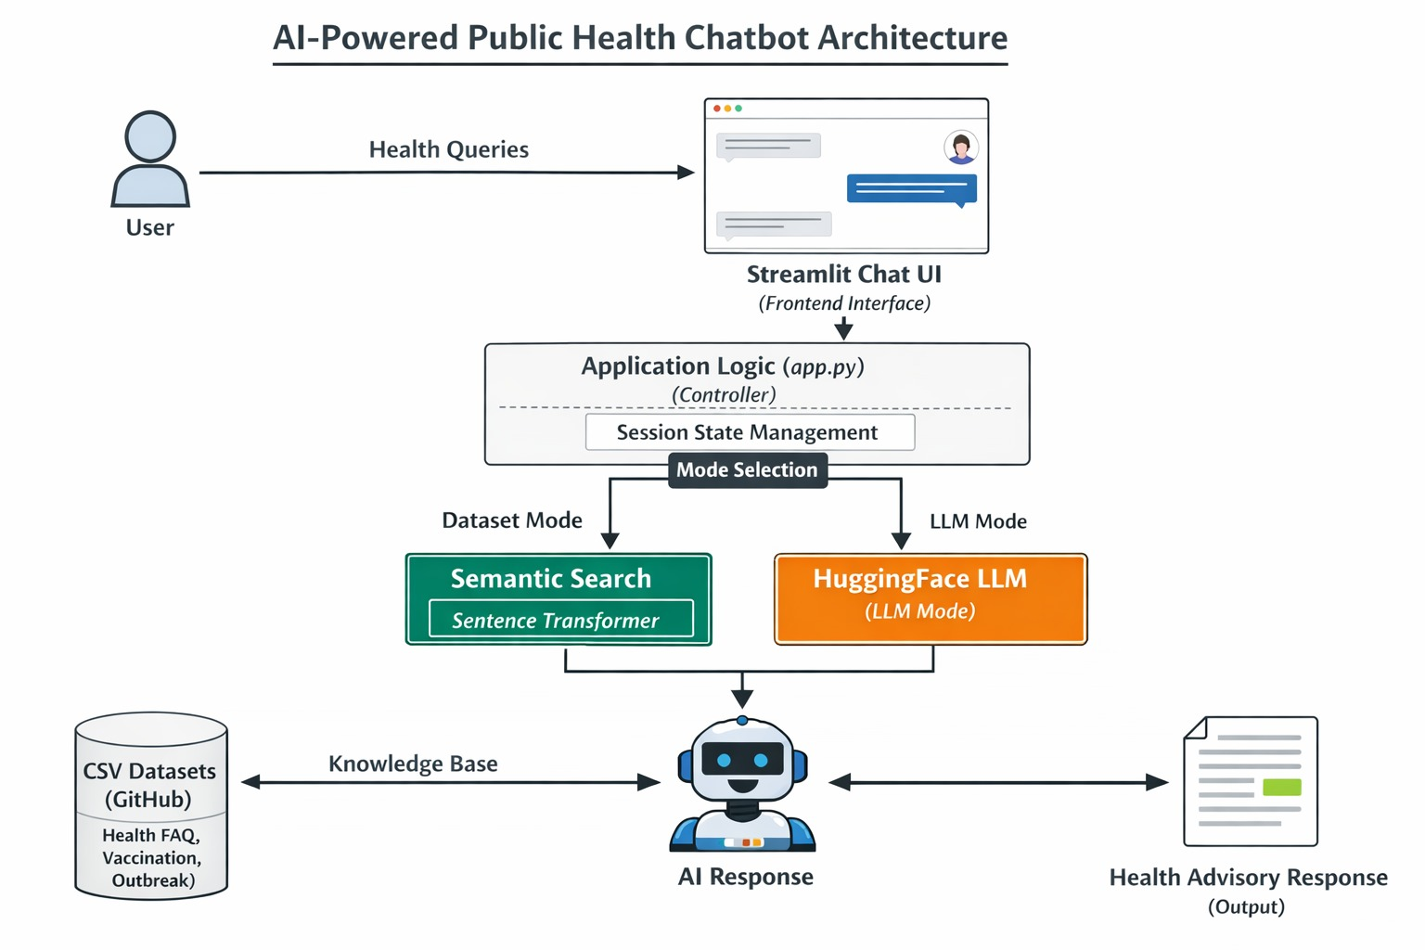
Architectural Diagram

Slide 10
Timeline of the Project (Gantt Chart)
Stage | Phase | Task
Review 1 | Problem Identification & Literature Survey | Identify public health issues and study existing AI healthcare chatbots
Review 2 | System Design & Requirement Analysis | Define system architecture, data flow, and software requirements
Review 3 | Chatbot Development & NLP Implementation | Develop chatbot logic, train NLP model, and implement response handling
Review 4 | Integration, Testing & Validation | Integrate frontend and backend, test chatbot accuracy and performance
Review 5 | Evaluation, Documentation & Final Submission | Evaluate system results, prepare project report, and final presentation

Slide 11
References (IEEE Paper format)
[1] A. Zagade, V. Killedar, O. Mane, G. Nitalikar, and S. Bhosale, “AI-based medical chatbot for disease prediction,” International Journal for Multidisciplinary Research (IJFMR), vol. 6, no. 3, pp. 1–9, 2024. LINK
[2] I. Parashar and P. Bisht, “AI chatbot for medical consultation and health awareness,” International Journal of Research Publication and Reviews (IJRPR), vol. 6, no. 5, pp. 3046–3051, 2025. LINK
[3] S. K. Ojha, A. Kumar, T. Bhole, and S. Naaz, “AI-based chatbot for healthcare,” International Journal of Engineering Research & Technology (IJERT), vol. 14, no. 12, pp. 1–6, 2025. LINK
[4] P. J. Rani, S. Priya, and K. V. Rao, “Artificial intelligence-based healthcare monitoring system,” Bioinformation, vol. 21, no. 8, pp. 827–833, 2021. LINK

Slide 12


