Slide 1

DEPARTMENT OF INFORMATION SCIENCE & ENGINEERING
Saved Wi-Fi Details Sniffer
Presentation by,
NAME: Sudeep Kudari
USN: 1NH19IS165
Under the Guidance of ,
Guide Name: Mrs.Mounica B
Designation: Senior Asst.prof

Slide 2
Agenda
Introduction
Problem Definition
Objectives
Proposed system
  Methodology
Expected Outcome
Conclusion
Mini Project – 19ISE49

Slide 3
Introduction
A pleasant python application where the saved Wi-Fi details(SSID and Security Key) from the system can be sniped out.
In windows 10, Wi-Fi SSID and passkey are saved in the system directories.
This application works with windows PowerShell command netsh.
Using netsh commands the saved list of Wi-Fi passwords can be drawn out.
Mini Project – 19ISE49

Slide 4
Problem Definition
To develop a system which can be used to get forgotten Wi-Fi details i.e., Wi-Fi SSID and passkey.
Mini Project – 19ISE49

Slide 5
Objectives
The main objective of the proposed system is to visualize the working of Windows PowerShell commands and to find the Wi-Fi details
Mini Project – 19ISE49

Slide 6
Proposed System-Methodology
Firstly, using subprocess module we will pass the netsh command.i.e,
netsh wlan show profiles.
This command gives the list of saved passwords.
Then we will save all the SSIDs and security key into a empty list.
Creating mail msg with the extracted details using email.message module.
Then to send the mail will use smtp server,using smtp will login and send mail to user given mail address.
Sent!!!!
Mini Project - 19ISE49

Slide 7
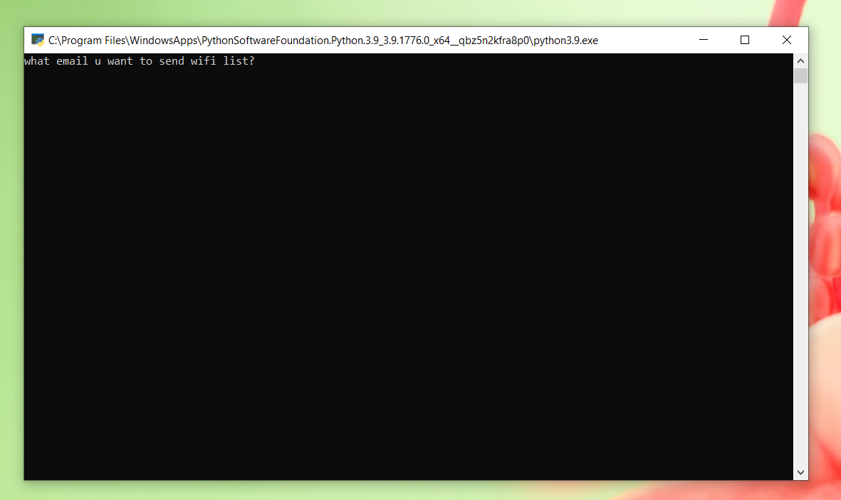
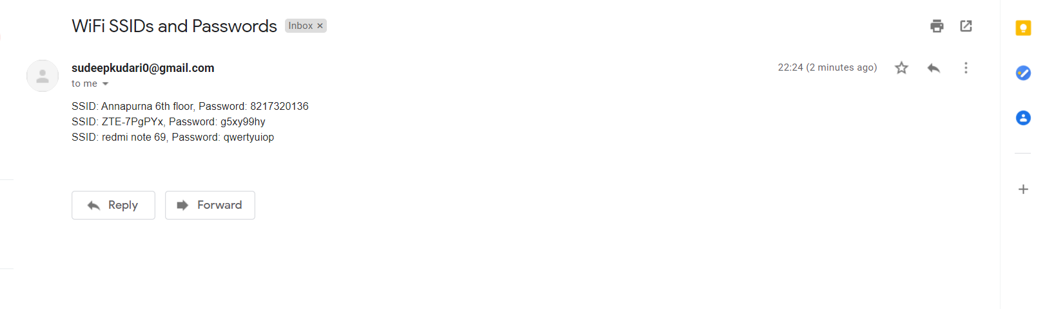
Outcome
Output window asking for mail id to which Wi-Fi details is to be sent.
The mail which is received.
Mini Project - 19ISE49

Slide 8
Conclusion
This python code requires some modules which has to be imported to run this code.
As of now this code works only in windows os, which can run netsh commands.
As of now this code works only in windows os, which can run netsh commands.
This application can also be used to snipe the Wi-Fi password from strangers laptops.
Mini Project - 19ISE49

Slide 9
References
Reference 1 – Python Crash Course by Eric Matthes.
Reference 2 - Python Cookbook: Recipes for Mastering Python 3 by Brian K. Jones and David M. Beazley
Mini Project - 19ISE49

Slide 10
Thank You
Mini Project – 19ISE49

